Slide 1
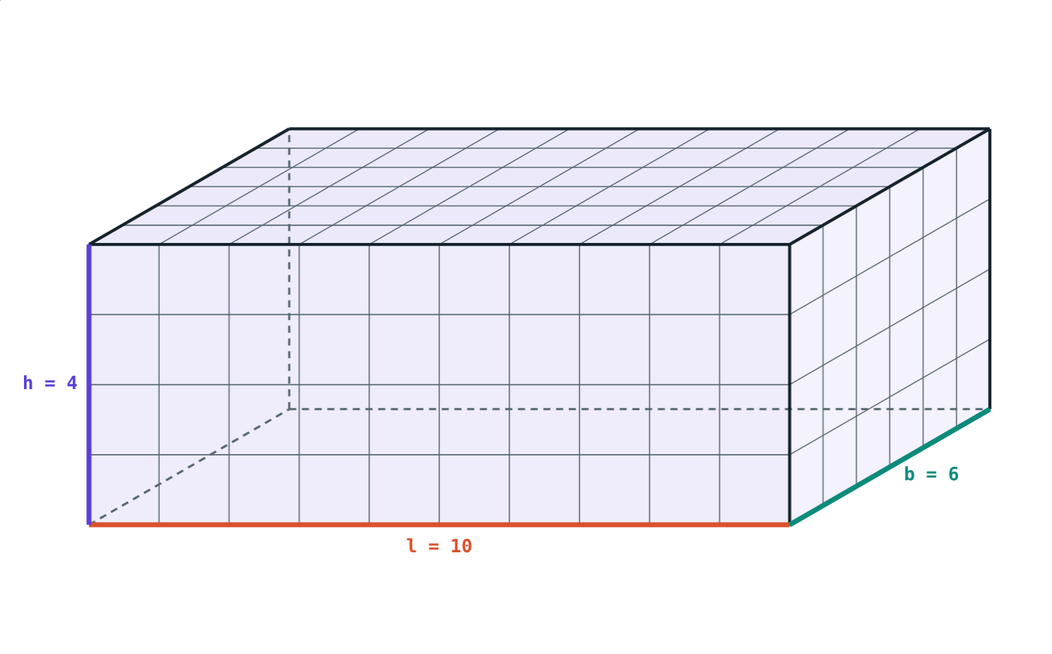
Cuboids, Cubes and Cylinders
STD 9 MATHEMATICS PART II · CH. 9 SURFACE AREA AND VOLUME
Lesson 1 · Visual Science & Maths
Notes:
Goal: students can find the lateral surface area, total surface area and volume of a cuboid, a cube and a right circular cylinder, and know which units to use.

Slide 2
Card and space
A shoebox needs card to cover it and holds shoes inside. Those are two different questions.
How much card covers it? How much does it hold?
10 cm × 6 cm × 4 cm: 240 one-centimetre cubes
Notes:
Surface area answers the first question (cm²), volume the second (cm³). Bring a real box if possible.

Slide 3
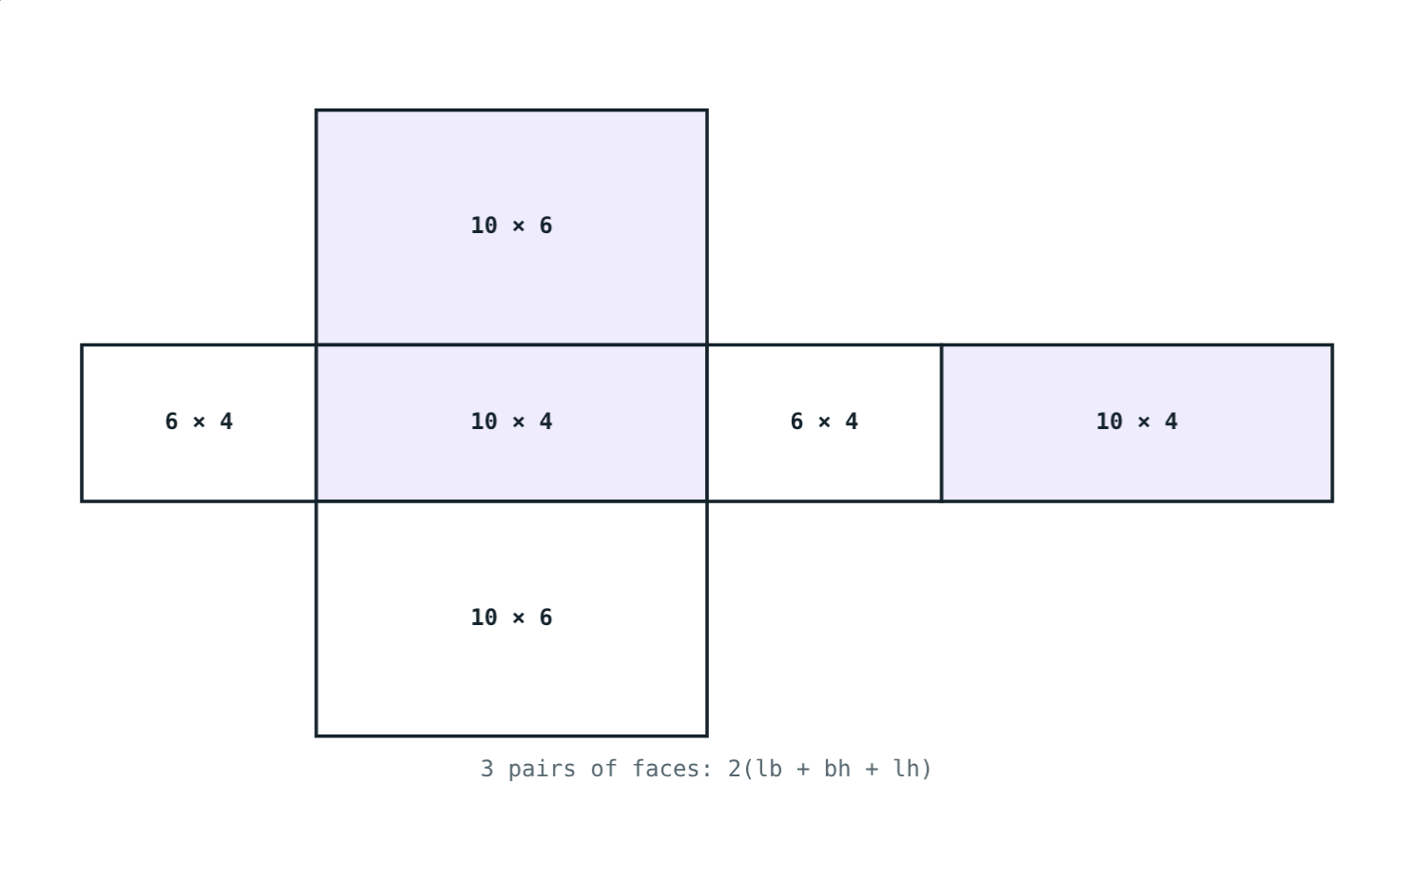
Cuboid
V = l × b × h
4 vertical faces: 2(l + b) × h
Total surface area: 2(lb + bh + lh)
6 faces in 3 equal pairs
The net of a 10 × 6 × 4 cuboid
Notes:
The net shows why the total surface has a factor 2: opposite faces are equal. For 10 × 6 × 4: lateral 128 cm², total 248 cm², volume 240 cm³.

Slide 4
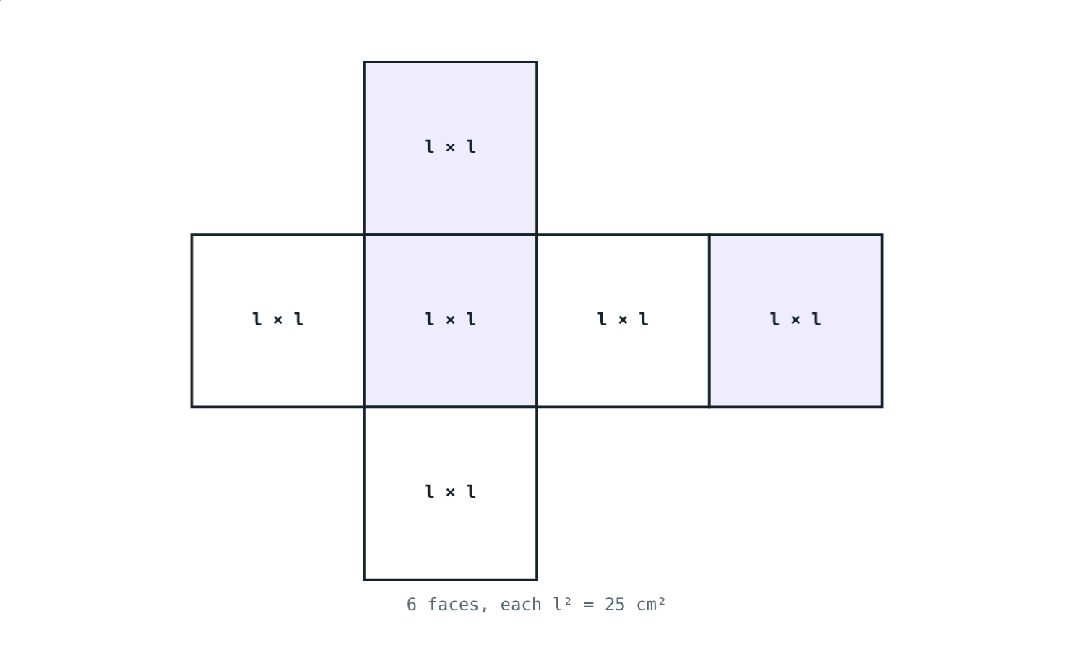
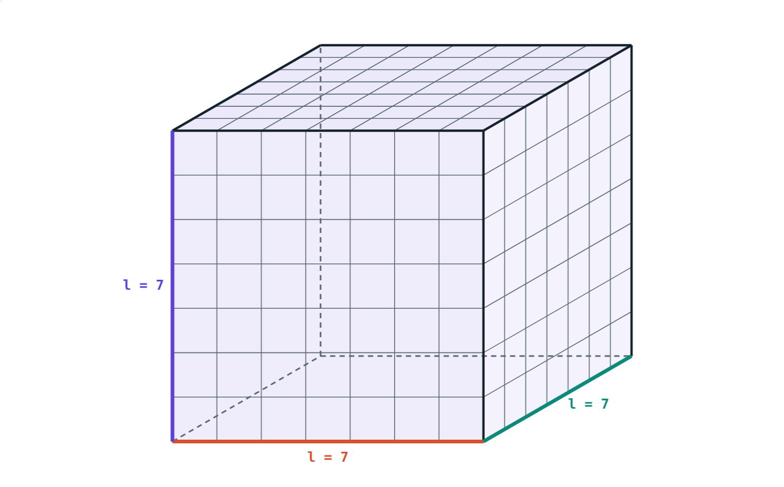
Cube: a cuboid with equal sides
6 squares of 25 cm²: total surface area 6l² = 150 cm².
Side 7 cm: 6l² = 294 cm², volume l³ = 343 cm³.
Notes:
Lateral surface area of a cube is 4l² (four side faces only).

Slide 5
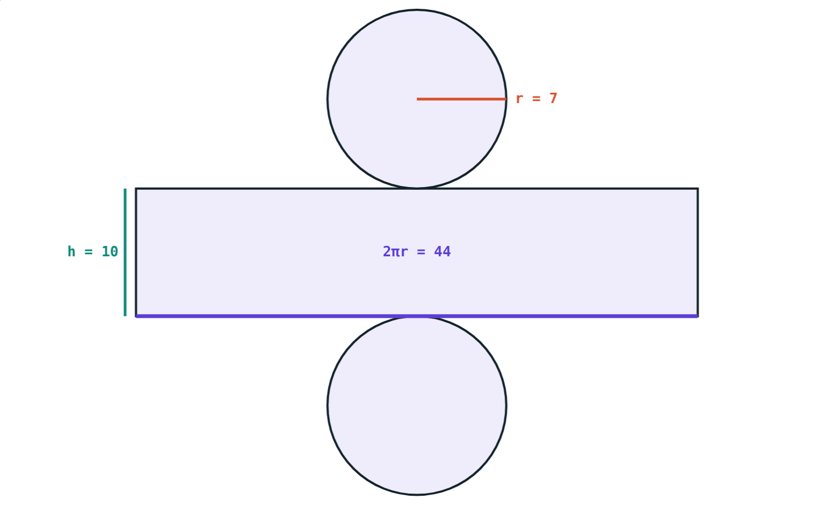
Unroll a cylinder
Cut the curved surface straight down
It opens into a rectangle
Length 2πr, breadth h
So curved surface area = 2πrh
r = 7 cm, h = 10 cm: rectangle 44 cm × 10 cm
Notes:
A paper label from a tin shows this nicely. 2πr = 2 × 22/7 × 7 = 44 cm.

Slide 6
Cylinder formulae
Measure | Formula | r = 7, h = 10 (π = 22/7)
Curved surface area | 2πrh | 440 cm²
Total surface area | 2πr(r + h) | 748 cm²
Volume | πr²h | 1540 cm³
Circumference of base | 2πr | 44 cm
Notes:
Volume of any prism-like solid is area of base × height; for a cylinder the base is a circle πr².

Slide 7
Worked examples
A gift box
Back to the side
Cuboid 12 cm × 8 cm × 5 cm. Find the vertical faces, total surface area and volume.
A cube has total surface area 294 cm². Find its side and volume.
2(20) × 5 = 200 cm²
2(96 + 40 + 60) = 392 cm²
12 × 8 × 5 = 480 cm³
6l² = 294, l² = 49, l = 7 cm
V = 7³ = 343 cm³
Notes:
In the second example, students often stop at l² = 49; remind them to take the square root.

Slide 8
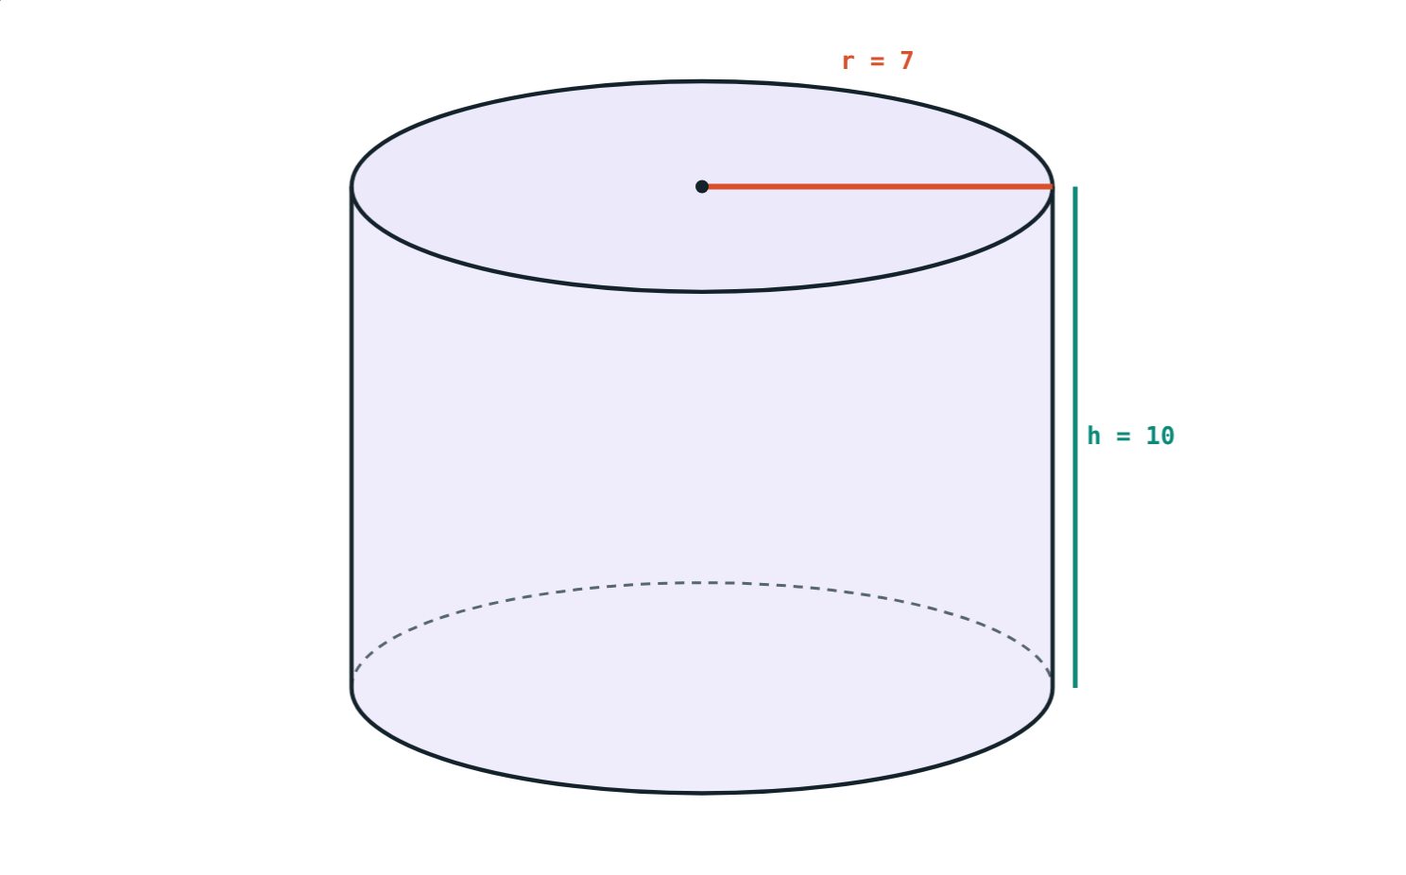
Worked example: a water tank
A cylindrical tank has radius 7 m and height 10 m. Find its curved surface area, total surface area and volume.
2 × 22/7 × 7 × 10 = 440 m²
2 × 22/7 × 7 × 17 = 748 m²
22/7 × 49 × 10 = 1540 m³
r = 7 m, h = 10 m, π = 22/7
Notes:
Choose π = 22/7 when r is a multiple of 7: the 7s cancel and the answer is exact.

Slide 9
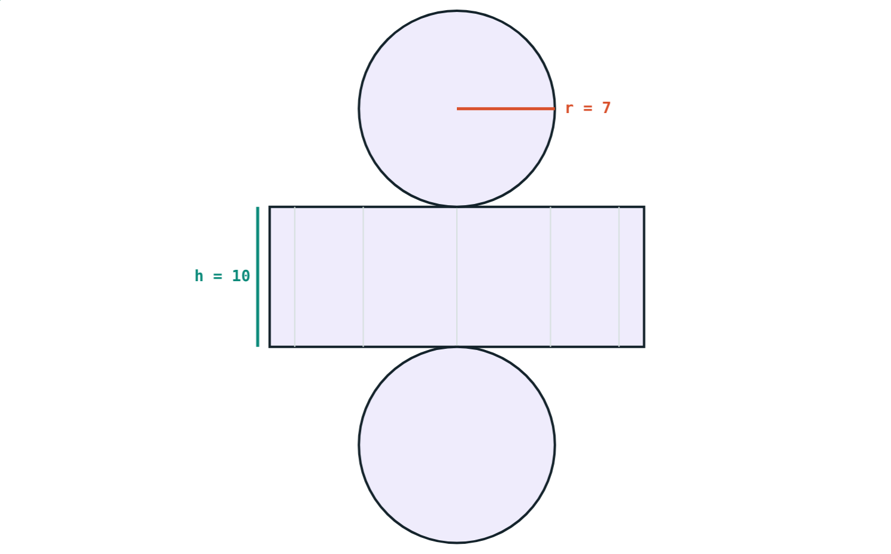
Using π = 3.14
Cylinder with r = 5 cm, h = 12 cm:
376.8 cm²
curved surface 2πrh
942 cm³
volume πr²h
Total surface area 2πr(r + h) = 2 × 3.14 × 5 × 17 = 533.8 cm².
Unrolling the curved surface
Notes:
The textbook gives the value of π in each problem: 22/7 or 3.14. Always use the one given.

Slide 10

Common mistakes
cm² for volume
Total for lateral
Area is in cm²; volume is in cm³.
Four vertical faces: 2(l + b)h only.
Diameter as radius
Forgetting the ends
14 cm across means r = 7 cm.
Closed cylinder: 2πr(r + h), not just 2πrh.
Notes:
Ask students to find one of these mistakes in a classmate's work.

Slide 11
Quick check
1
The side of a cube is 4 cm. Find its total surface area.
2
Find the volume of a cuboid 5 cm × 4 cm × 3 cm.
3
A cylinder has r = 7 cm and h = 5 cm. Find its curved surface area (π = 22/7).
4
What shape does the curved surface of a cylinder make when it is unrolled?
Notes:
Answers: 1) 6 × 16 = 96 cm². 2) 60 cm³. 3) 2 × 22/7 × 7 × 5 = 220 cm². 4) A rectangle, 2πr long and h wide.

Slide 12
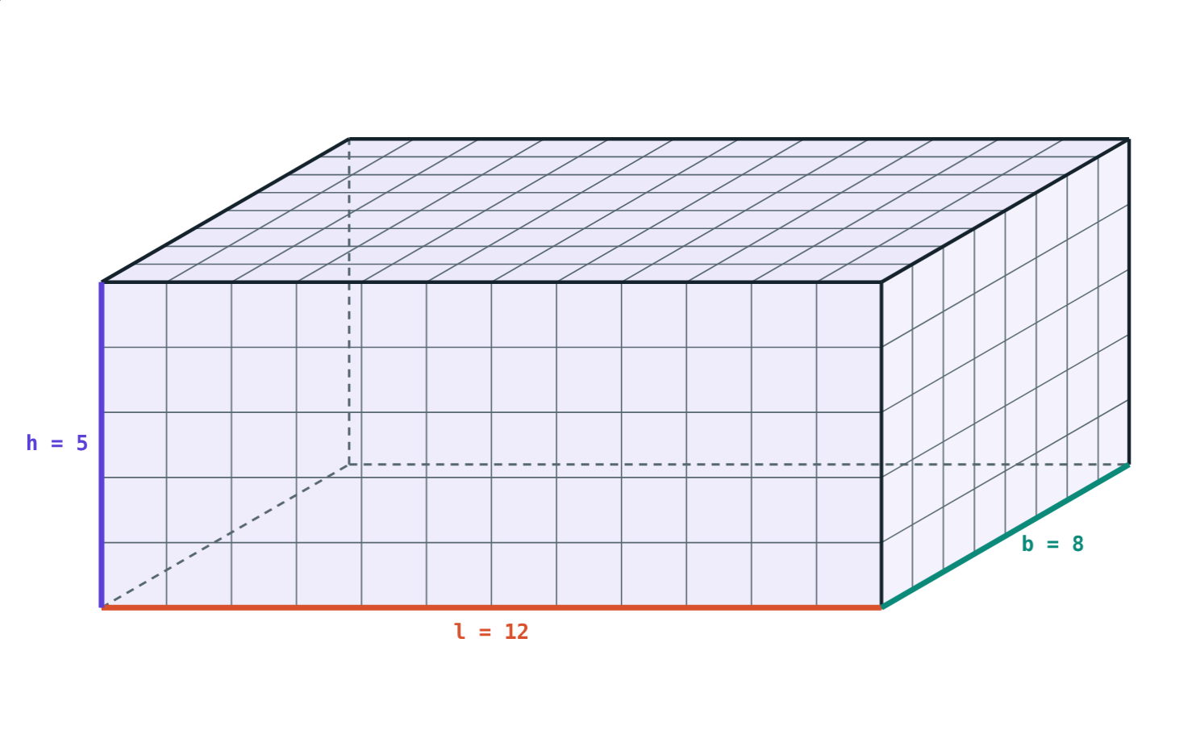
Fold and fill the solids yourself
Open the Cuboids, Cubes and Cylinders lesson on the Visual Science & Maths website. Show the 1 cm cubes and unroll the cylinder.
Next lesson: Cones
Notes:
Homework: measure a box and a tin at home; find the surface area and volume of each.

