Slide 1
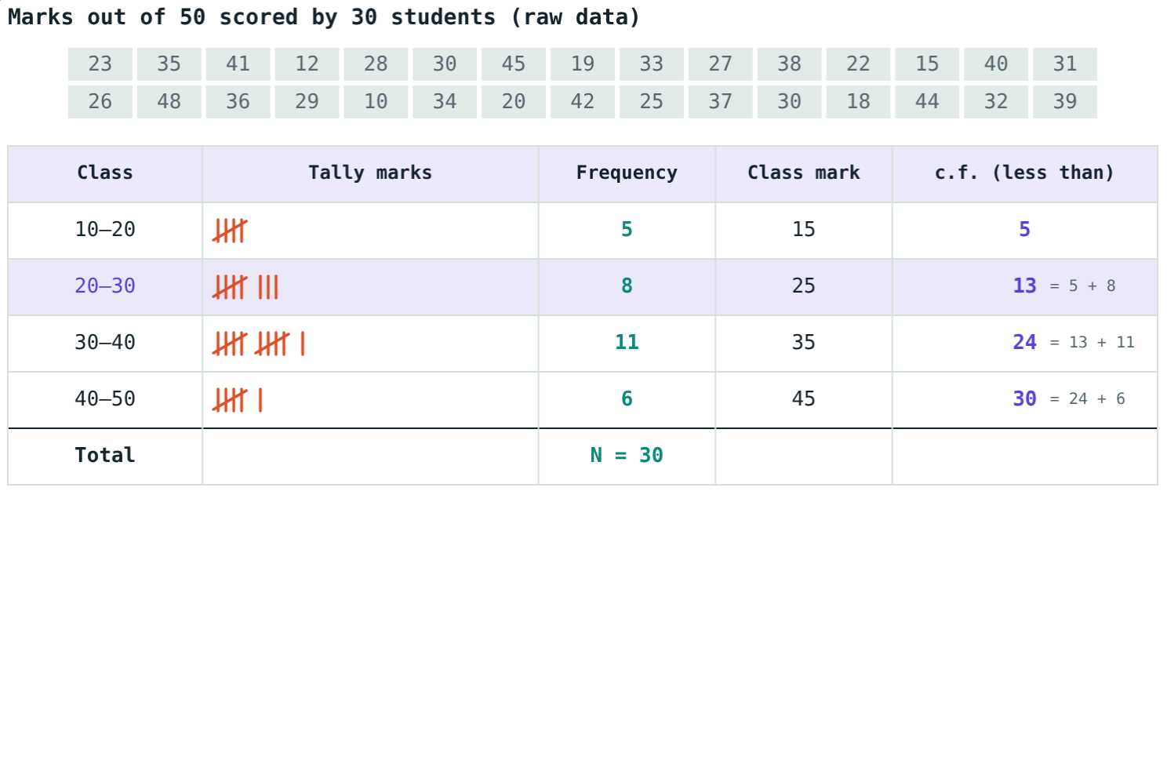
Frequency Tables
STD 9 MATHEMATICS PART I · CH. 7 STATISTICS
Lesson 2 · Visual Science & Maths
Notes:
Goal: students can make ungrouped and grouped frequency tables with tally marks, find class marks, handle inclusive and exclusive classes, and find less-than and more-than cumulative frequencies.

Slide 2
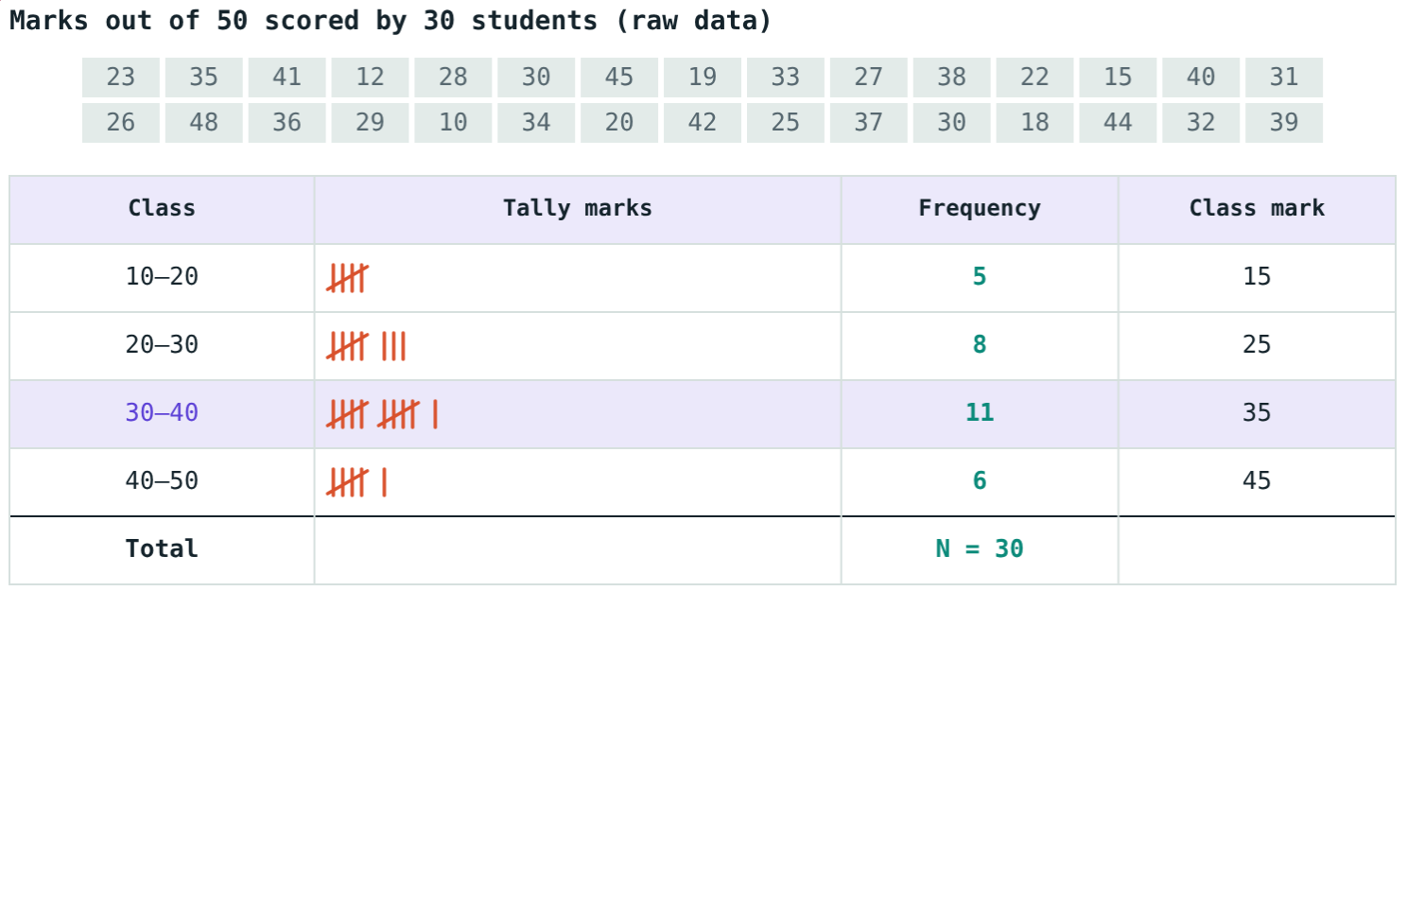
Thirty marks in a row
23, 35, 41, 12, 28, 30, 45, 19, 33, 27, … Thirty test marks out of 50.
How many students scored less than 30?
Sorted: 5 + 8 = 13
Notes:
Let students try to answer from the raw list first; then show the table.

Slide 3
Kinds of data
1°
2°
Raw
Primary data
Secondary data
Raw data
Collected by the investigator directly.
Taken from records collected by others.
Data as collected, not yet arranged.
Notes:
Example: asking classmates = primary; a census report = secondary.

Slide 4
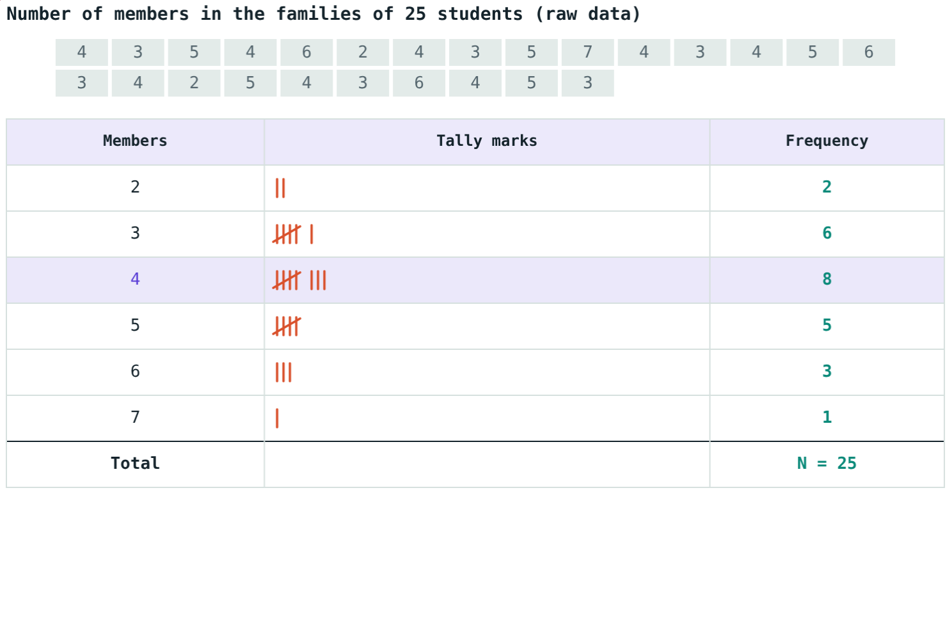
Tally marks and frequency
Frequency: how often a value occurs
Tally: four strokes, the fifth across them
Ungrouped table: one row per value
Frequencies add up to N
Family sizes of 25 students
Notes:
8 families have 4 members; 2 + 6 + 8 + 5 + 3 + 1 = 25.

Slide 5
Classes
Class mark = (lower + upper) ÷ 2
20–30: lower limit 20, upper limit 30
Class width = 30 − 20 = 10
Exclusive 20–30: 30 not included
Inclusive 20–29: both limits included
Width 10, exclusive classes
Notes:
Inclusive to continuous: subtract 0.5 from lower limits, add 0.5 to upper limits.

Slide 6
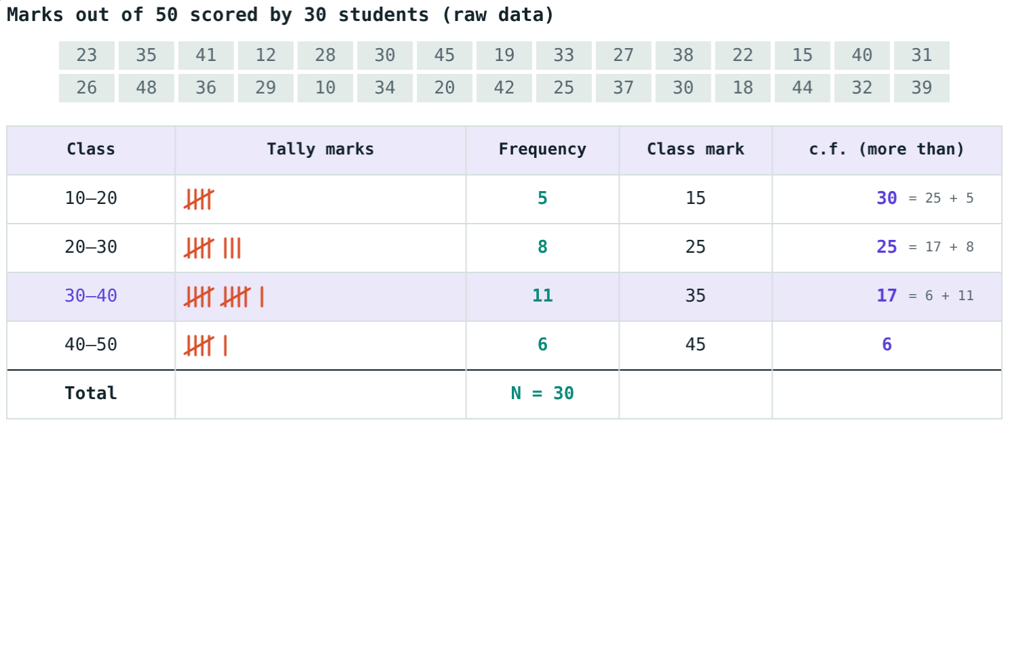
Cumulative frequency
Add downwards: 5, 13, 24, 30. Last = N.
Add upwards: 30, 25, 17, 6. First = N.
Notes:
Less than counts values below the upper limit; more than counts values at or above the lower limit.

Slide 7
Worked examples
Ungrouped
Grouped
Family sizes of 25 students, values 2 to 7.
30 marks in classes 10–20, …, 40–50.
f: 2, 6, 8, 5, 3, 1
Total 25 = N; most common: 4 members
f: 5, 8, 11, 6 (total 30)
Class marks: 15, 25, 35, 45
Notes:
A mark of 20 goes into 20–30, a mark of 30 into 30–40.

Slide 8
Worked example: cumulative frequency
From the marks table, how many scored less than 30, and how many 30 or more?
Less than c.f. of 20–30: 13
More than c.f. of 30–40: 17
Check: 13 + 17 = 30 ✓
More-than c.f. column
Notes:
These two numbers always add up to N.

Slide 9
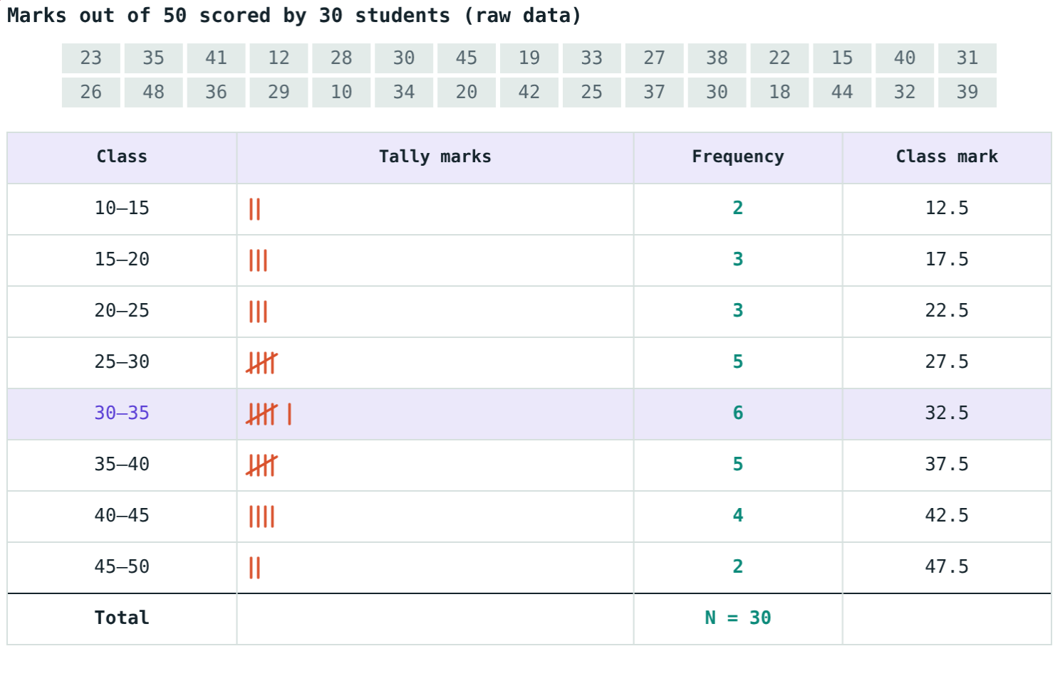
Narrower classes
With class width 5 there are 8 classes:
30–35
fullest class, f = 6
32.5
its class mark
Narrower classes show more detail but give a longer table.
Same marks, width 5
Notes:
Frequencies with width 5: 2, 3, 3, 5, 6, 5, 4, 2.

Slide 10

Common mistakes
Boundary counted twice
Class mark = width
In exclusive classes 20 is only in 20–30.
It is (lower + upper) ÷ 2.
Total not N
More-than added down
Add the frequency column every time.
Start from the last class.
Notes:
Ask a student to sort the data aloud while the class tallies.

Slide 11
Quick check
1
What is the class mark of 40–50?
2
Classes 10–20, 20–30, 30–40: where does 30 go?
3
Frequencies 4, 7, 9, 5: less-than c.f. of the third class?
4
Asking classmates how they travel: primary or secondary data?
Notes:
Answers: 1) 45. 2) 30–40. 3) 20. 4) Primary data.

Slide 12
Sort the data yourself
Open the Frequency Tables lesson on the Visual Science & Maths website. Watch each value find its row and the cumulative frequency build up.
Next lesson: Mean, median and mode
Notes:
Homework: collect the heights of 20 classmates and make a grouped frequency table.

