Slide 1
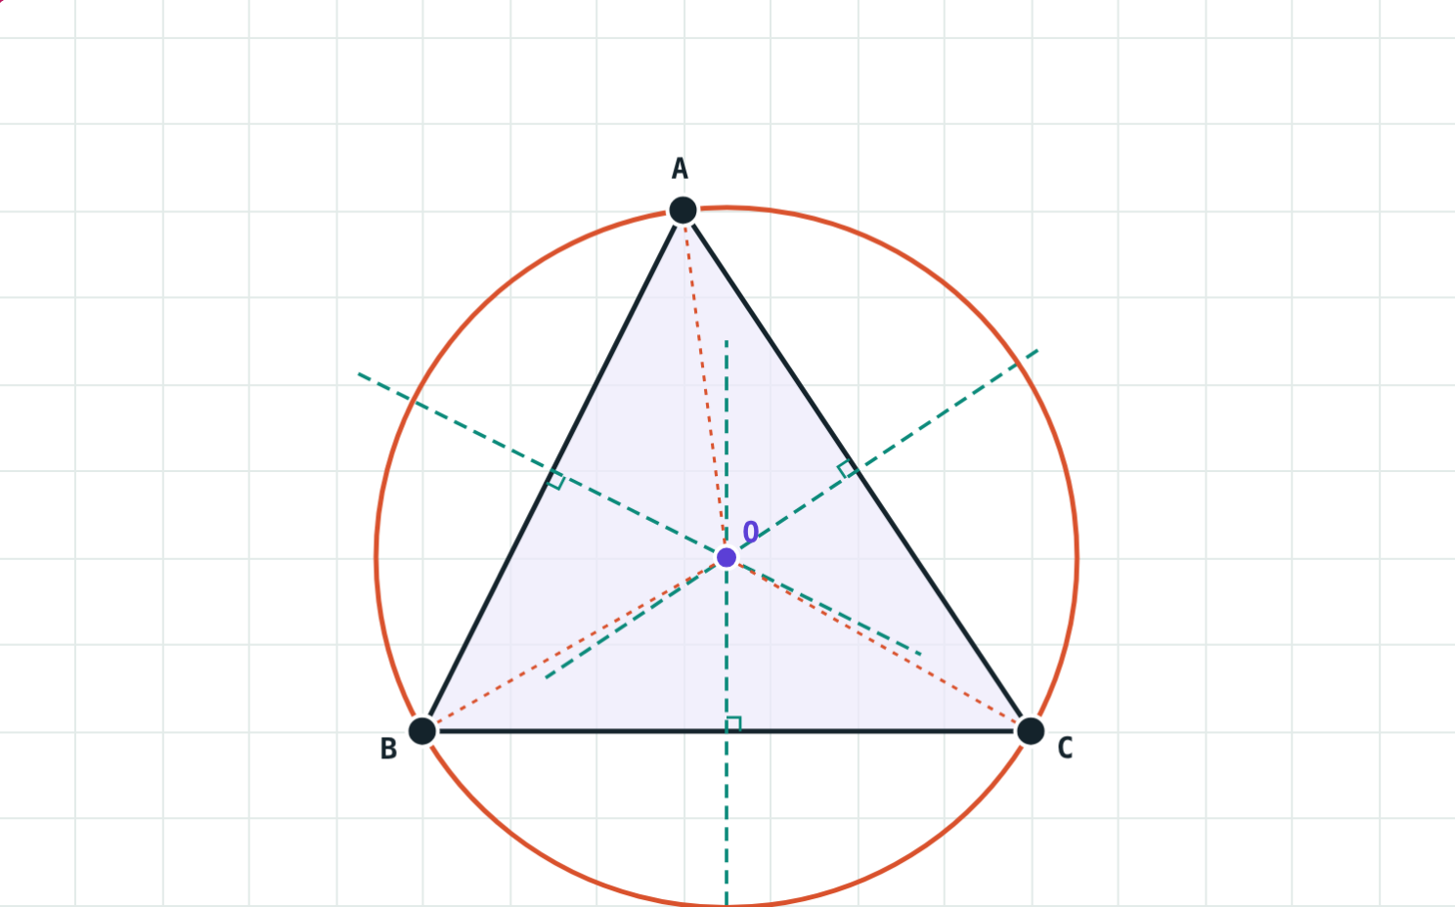
Incircle and Circumcircle
STD 9 MATHEMATICS PART II · CH. 6 CIRCLE
Lesson 2 · Visual Science & Maths
Notes:
Goal: students can construct the circumcircle and the incircle of a triangle and say where the circumcentre lies.

Slide 2
One well, three villages
Three villages A, B and C want one well that is the same distance from all three.
Where should they dig?
O is equally far from A, B and C
Notes:
Students usually suggest the middle; the answer is the circumcentre, which is not always inside.

Slide 3
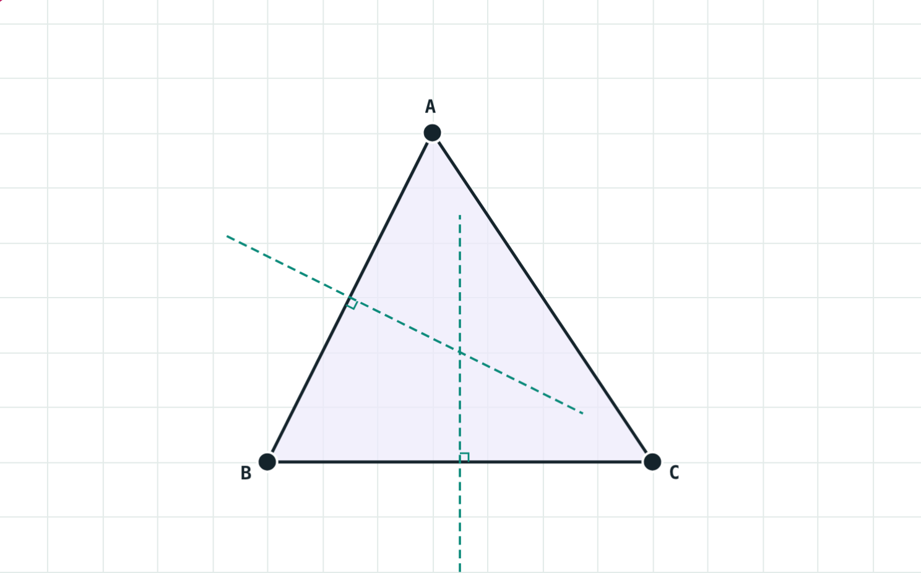
The circumcircle
OA = OB = OC
Passes through all three vertices
Centre O: where the perpendicular bisectors of the sides meet
Two bisectors are enough; the third passes through O too
Radius OA is the circumradius
Perpendicular bisectors of AB and BC
Notes:
Every point on the perpendicular bisector of AB is equidistant from A and B.

Slide 4
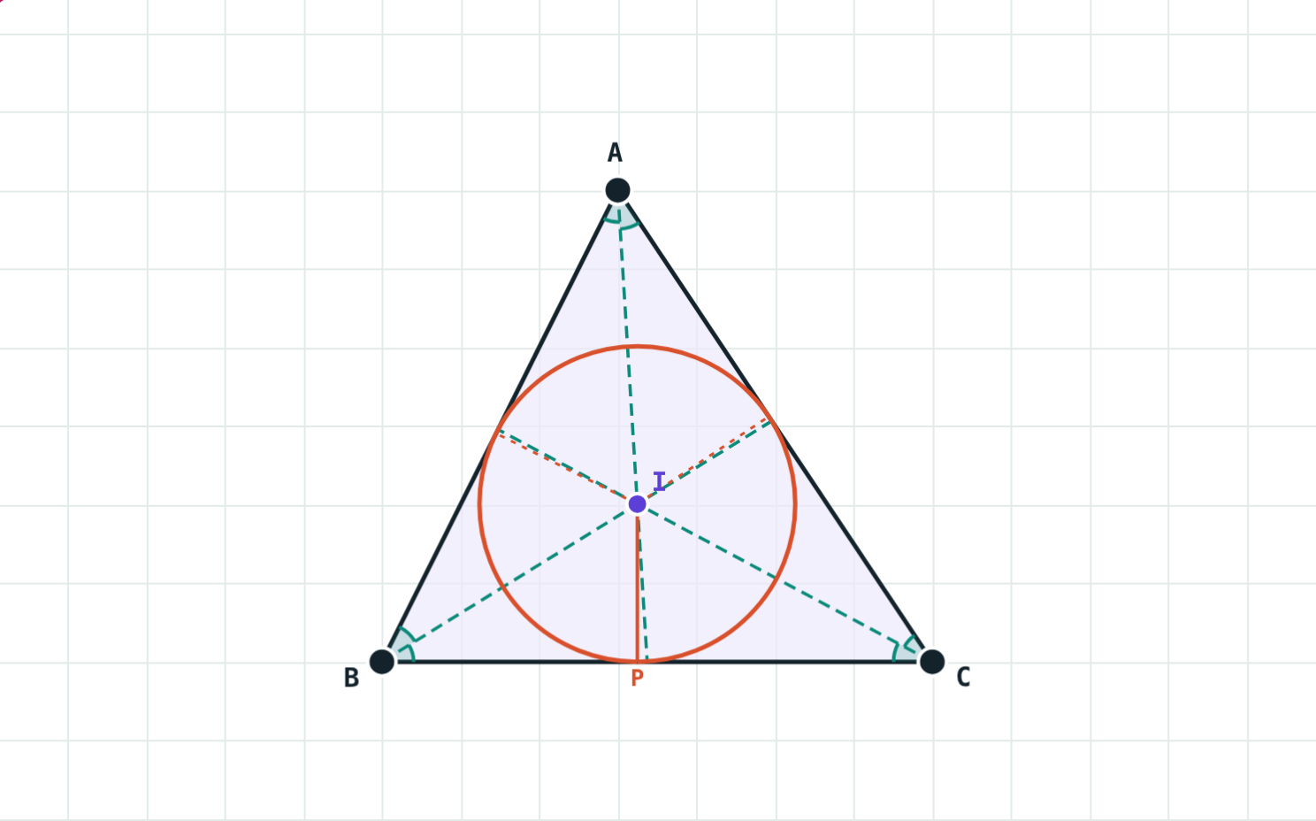
The incircle
I is equidistant from the sides
Touches all three sides from inside
Centre I: where the angle bisectors meet
Radius is the perpendicular IP to a side
The incentre is always inside
Incircle of the same triangle
Notes:
A common slip is to use IA as the radius. The radius is IP, with IP ⊥ BC.

Slide 5
Where is the circumcentre?
Triangle | Circumcentre | Example angles
Acute-angled | inside the triangle | 50°, 60°, 70°
Right-angled | midpoint of the hypotenuse | 30°, 60°, 90°
Obtuse-angled | outside the triangle | 20°, 35°, 125°
Notes:
The incentre is inside for every triangle; only the circumcentre moves out.

Slide 6
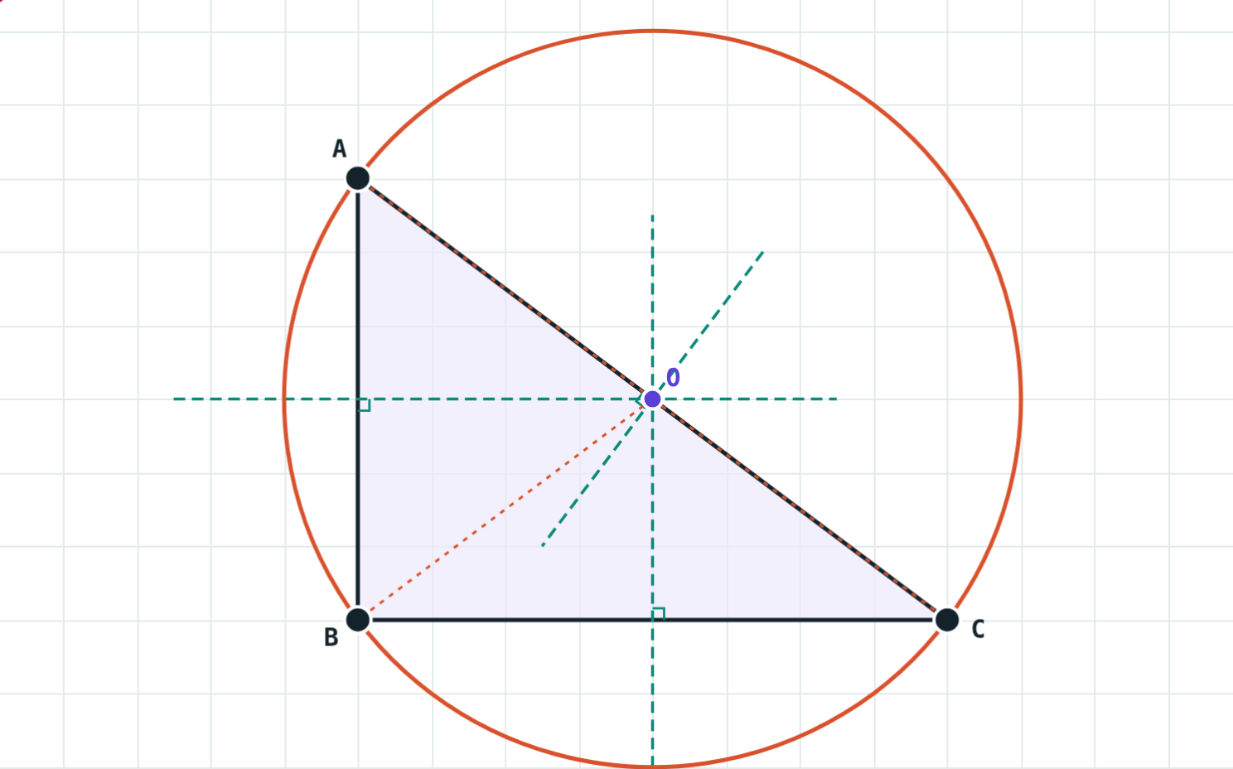
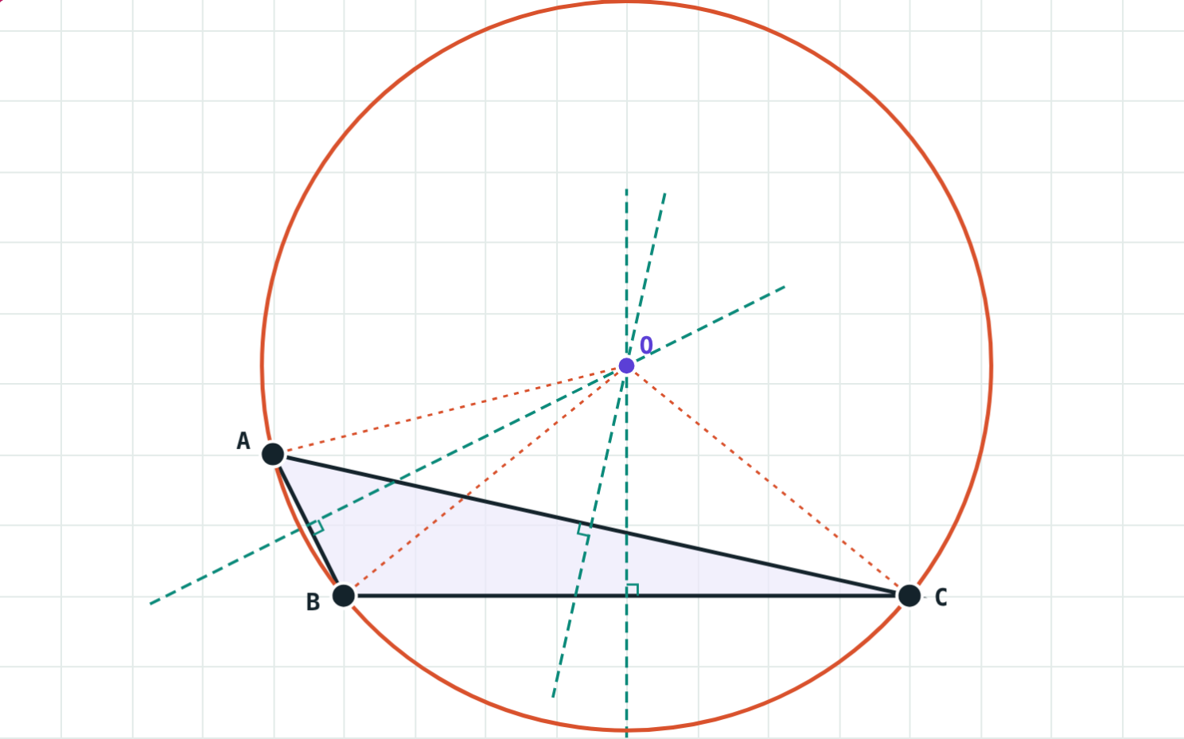
Right and obtuse
Sides 6, 8, 10 cm: O is the midpoint of AC; radius 5 cm.
∠B ≈ 116.6°: O lies outside the triangle.
Notes:
In a right triangle the circumradius is half the hypotenuse, the same fact as the median on the hypotenuse in Chapter 3.

Slide 7
Worked examples
A right triangle
Inside or outside?
∠B = 90°, AB = 6 cm, BC = 8 cm. Find the circumcentre and circumradius.
Angles (a) 50°, 60°, 70°; (b) 30°, 60°, 90°; (c) 20°, 35°, 125°.
AC = √(36 + 64) = 10 cm
O = midpoint of AC
Circumradius = 5 cm
(a) inside
(b) midpoint of the hypotenuse
(c) outside
Notes:
Only the largest angle matters: below 90°, equal to 90°, or above 90°.

Slide 8
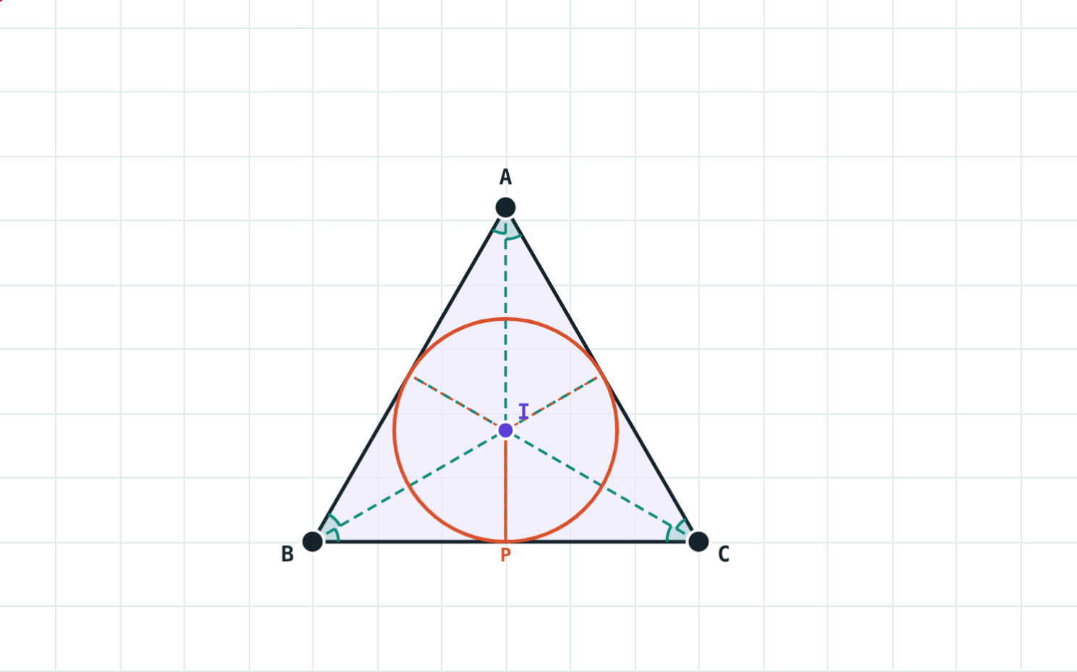
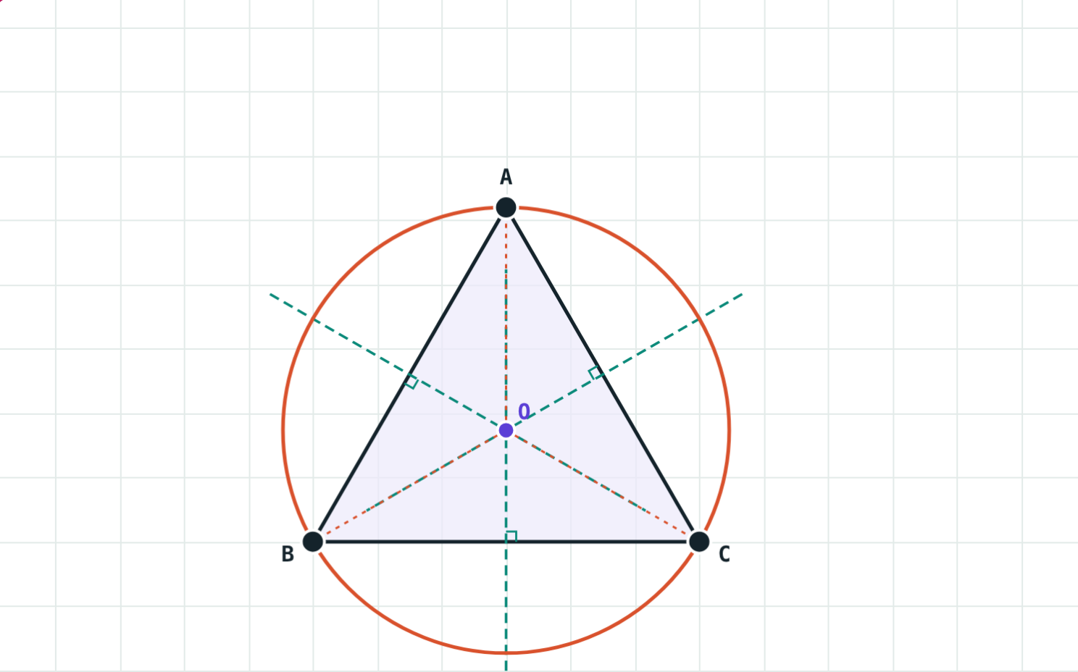
An equilateral triangle, side 6 cm
Inradius ≈ 1.73 cm (√3 cm).
Circumradius ≈ 3.46 cm (2√3 cm): twice the inradius.
Here each angle bisector is also a perpendicular bisector, so I and O are the same point.
Notes:
Students can measure both radii in their own constructions and compare: the ratio is 2 : 1.

Slide 9
Construct it
1
2
3
4
Draw
Bisect
Mark
Circle
Draw the triangle with the given measures.
Perpendicular bisectors of two sides, or bisectors of two angles.
Mark the meeting point O (or I). For I, draw IP ⊥ BC.
Radius OA for the circumcircle, IP for the incircle.
Notes:
Do one of each with compass and ruler; keep the construction arcs.

Slide 10

Common mistakes
Mixing up the bisectors
Wrong incircle radius
Circumcircle: sides. Incircle: angles.
Use IP ⊥ side, not IA.
“Always inside”
Drawing all three
The circumcentre is outside an obtuse triangle.
Two bisectors fix the centre; the third is a check.
Notes:
Ask students to explain why two bisectors are enough.

Slide 11
Quick check
1
Which lines meet at the circumcentre?
2
A right triangle has hypotenuse 13 cm. Find its circumradius.
3
The incentre is equidistant from the three vertices or the three sides?
4
Angles 25°, 40°, 115°: where is the circumcentre?
Notes:
Answers: 1) The perpendicular bisectors of the sides. 2) 6.5 cm. 3) The three sides. 4) Outside the triangle (it is obtuse-angled).

Slide 12
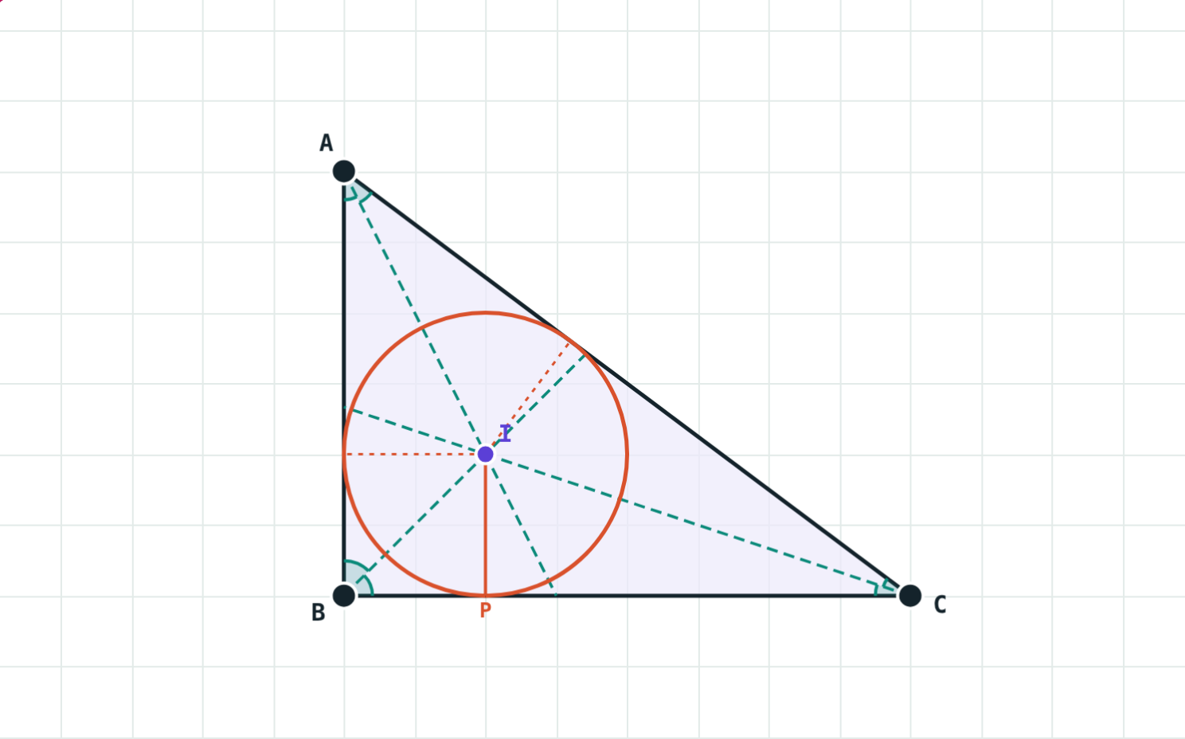
Build the circles yourself
Open the Incircle and Circumcircle lesson on the Visual Science & Maths website. Drag the vertices and press “Play construction”.
Next chapter: Co-ordinate Geometry
Notes:
Homework: construct the incircle and circumcircle of a triangle with sides 7, 8 and 9 cm.

