Slide 1
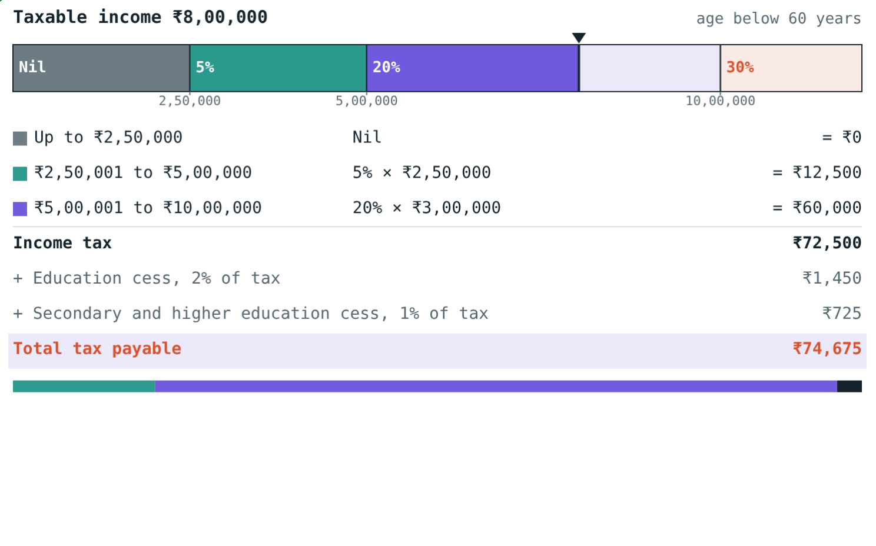
Income Tax
STD 9 MATHEMATICS PART I · CH. 6 FINANCIAL PLANNING
Lesson 2 · Visual Science & Maths
Notes:
Goal: students can find taxable income after deductions and compute income tax and cess with the textbook's slab table (financial year 2017–18). Stress that rates change every Union Budget.

Slide 2
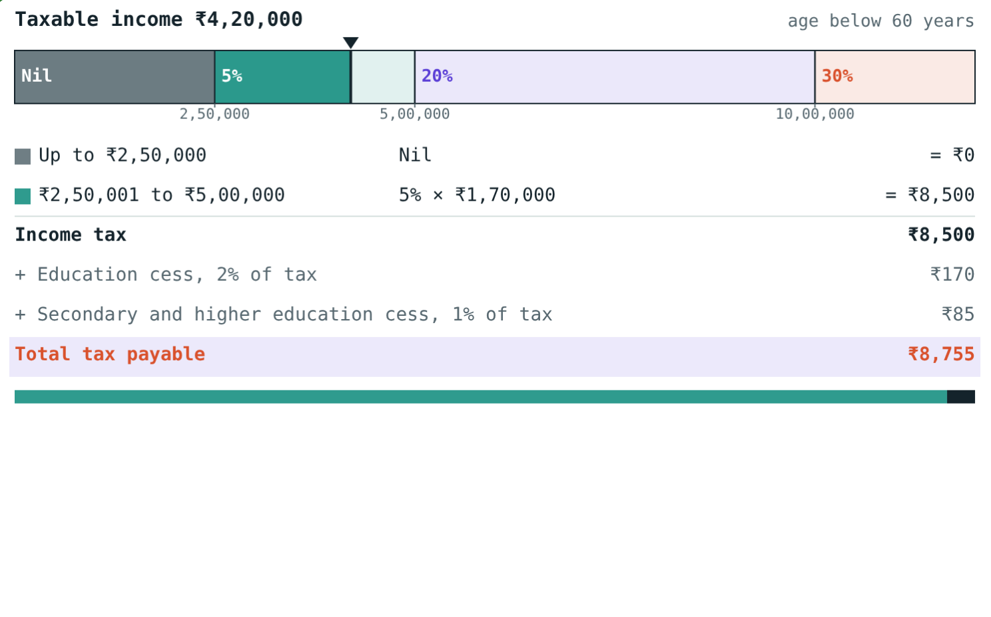
Who pays for the roads?
Schools, hospitals, roads, railways and defence all cost money. The government collects most of it as taxes.
How much tax does a person earning ₹4,20,000 a year pay?
With the textbook slabs: ₹8,755
Notes:
Paying taxes honestly is a citizen's duty.

Slide 3



Taxes and PAN
Direct tax
Indirect tax
PAN
Paid directly to the government, e.g. income tax.
Collected by the seller from the buyer, e.g. GST.
10-character Permanent Account Number from the Income Tax Department.
Notes:
Financial year: 1 April to 31 March. FY 2017–18 is assessed in assessment year 2018–19.

Slide 4
Taxable income
Taxable = Income − Deductions
80C: PPF, GPF, LIC, NSC, tuition fees
80C deduction is at most ₹1,50,000
80G: donations, e.g. PM's National Relief Fund
₹9,60,000 − ₹1,60,000 = ₹8,00,000
Notes:
Mr Patil saved ₹1,70,000 under 80C but only ₹1,50,000 counts.

Slide 5
Textbook slab rates (FY 2017–18)
Taxable income | Below 60 | 60 to 80 | Above 80
Up to ₹2,50,000 | Nil | Nil | Nil
₹2,50,001–₹3,00,000 | 5% above 2.5 L | Nil | Nil
₹3,00,001–₹5,00,000 | 5% above 2.5 L | 5% above 3 L | Nil
₹5,00,001–₹10,00,000 | ₹12,500 + 20% | ₹10,000 + 20% | 20% above 5 L
Above ₹10,00,000 | ₹1,12,500 + 30% | ₹1,10,000 + 30% | ₹1,00,000 + 30%
Notes:
Rates change in every Union Budget; these are the textbook's, not today's. Current rates: incometax.gov.in. Then add education cess 2% and secondary and higher education cess 1% of the income tax.

Slide 6
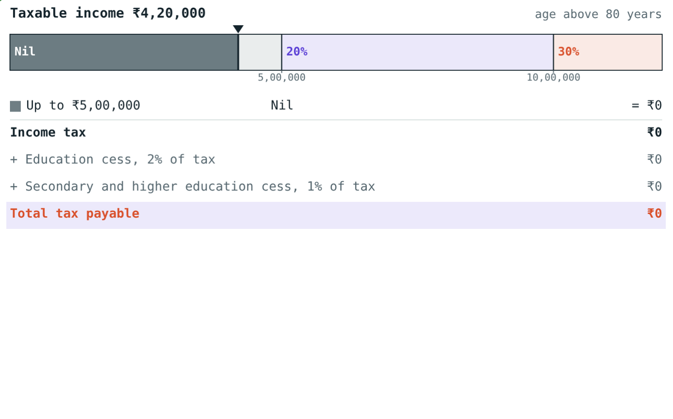
Age matters
₹4,20,000 is in the 5% slab: total tax ₹8,755.
The same income is in the nil slab: no tax.
Notes:
The nil limit is ₹2,50,000, ₹3,00,000 or ₹5,00,000 depending on age.

Slide 7
Worked examples
The 5% slab
Deductions first
Age 32, taxable income ₹4,20,000.
Age 45, income ₹9,60,000, 80C ₹1,70,000, donation ₹10,000.
5% of (4,20,000 − 2,50,000) = 8,500
Cess 170 + 85; total ₹8,755
Taxable = 9,60,000 − 1,60,000 = 8,00,000
12,500 + 20% of 3,00,000 = 72,500
+ 1,450 + 725 = ₹74,675
Notes:
Cess is a percentage of the income tax, not of the income.

Slide 8
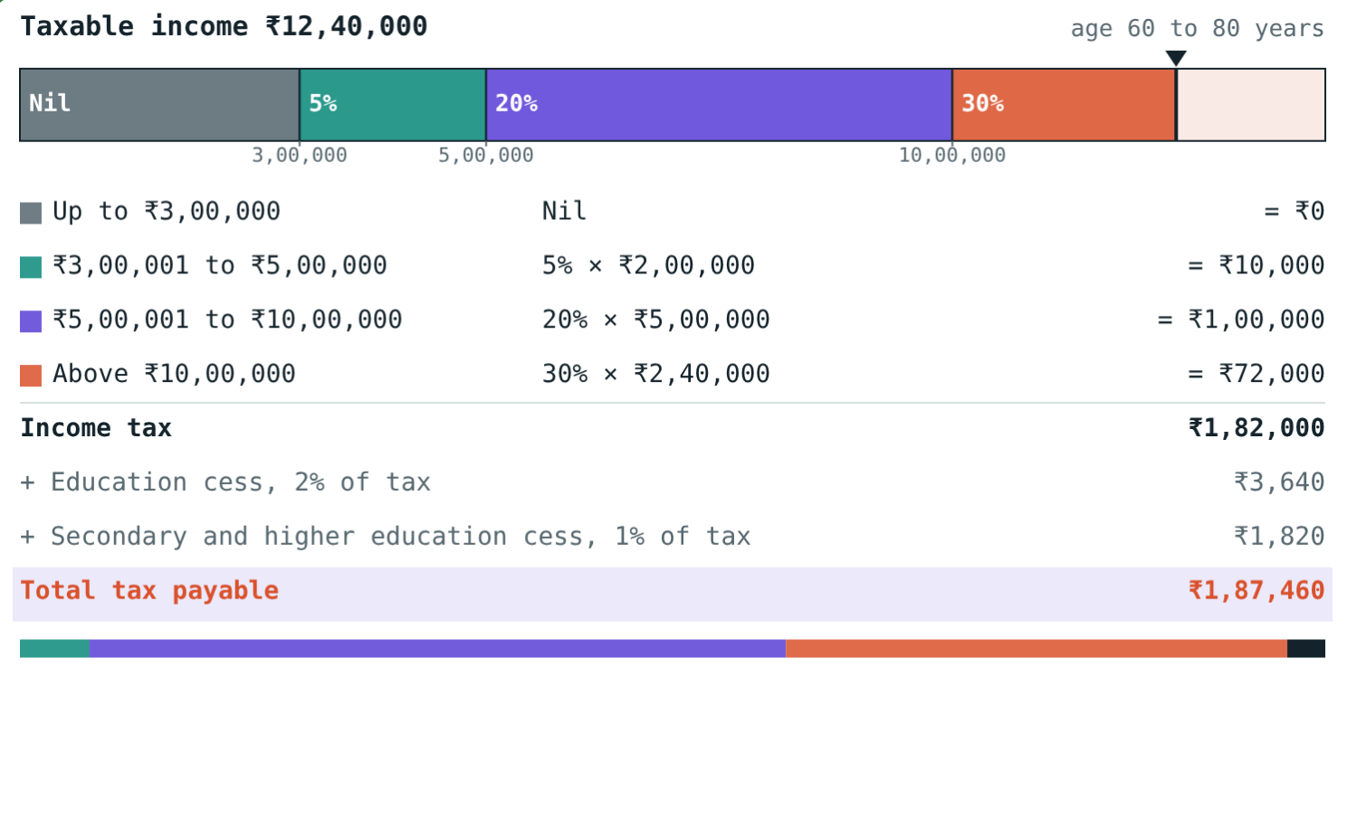
Worked example: a senior citizen
Mrs Rao is 68. Her taxable income is ₹12,40,000. Find her total tax.
1,10,000 + 30% of 2,40,000 = 1,82,000
Cess: 3,640 + 1,820
Total tax = ₹1,87,460
Age 68, taxable income ₹12,40,000
Notes:
₹1,10,000 = 5% of 2,00,000 + 20% of 5,00,000 for the 60 to 80 age group.

Slide 9
Why deductions help
Income ₹9,60,000; deductions ₹1,60,000:
₹8,00,000
taxable income
₹74,675
total tax
Without deductions the taxable income would be ₹9,60,000 and the tax higher: ₹1,07,635.
Mr Patil, age 45
Notes:
Without deductions: 12,500 + 20% of 4,60,000 = 1,04,500; cess 3,135; total ₹1,07,635. Compare with ₹74,675 to see the saving.

Slide 10

Common mistakes
Whole income at 5%
All 80C savings deducted
5% applies only above the nil limit.
At most ₹1,50,000.
Cess on income
Wrong age column
Cess is 2% + 1% of the income tax.
Check the age first.
Notes:
Most errors come from skipping the taxable-income step.

Slide 11
Quick check
1
Is GST or income tax a direct tax?
2
Age 40, taxable ₹3,60,000: income tax before cess?
3
Age 70, taxable ₹2,90,000: income tax?
4
Income tax ₹20,000: total cess at 2% + 1%?
Notes:
Answers: 1) Income tax. 2) ₹5,500. 3) Nil. 4) ₹600.

Slide 12
Fill the slabs yourself
Open the Income Tax lesson on the Visual Science & Maths website. Change the income, age and deductions and watch the slabs fill.
Next chapter: Statistics
Notes:
Homework: textbook practice set on income tax, checked with the simulation.

