Slide 1
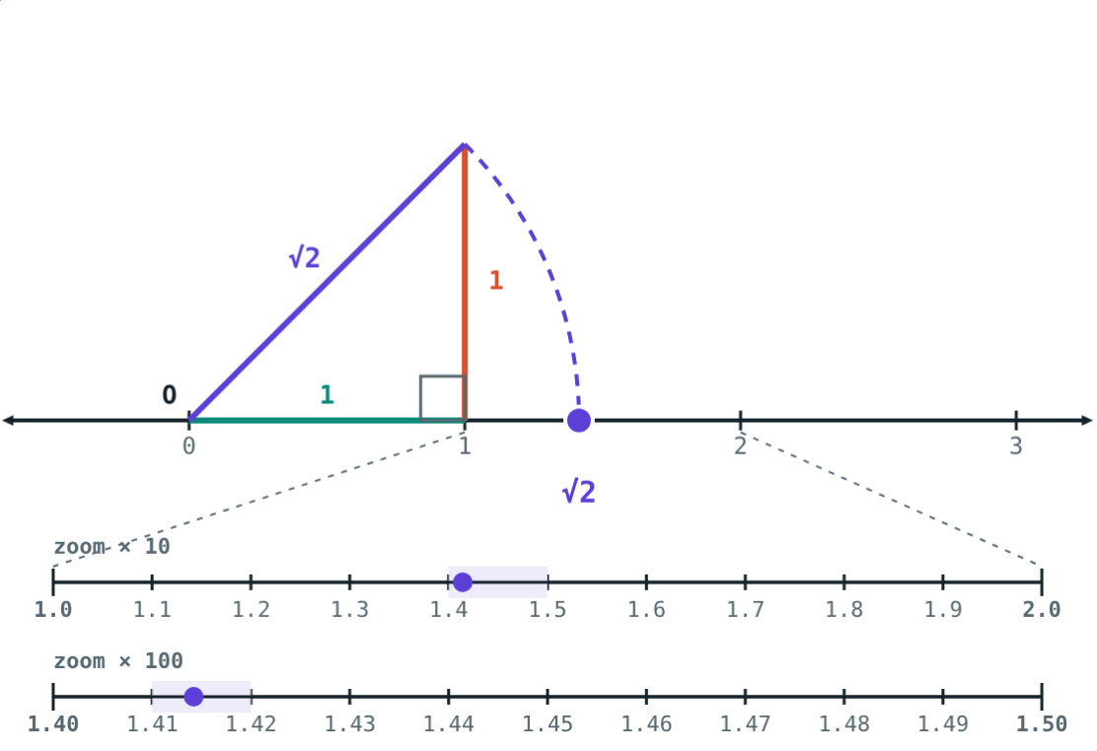
Irrational and Real Numbers
STD 9 MATHEMATICS PART I · CH. 2 REAL NUMBERS
Lesson 2 · Visual Science & Maths
Notes:
Goal: students recognise irrational numbers, can show √2 and √5 on the number line, know the order properties, and can use absolute value as distance.

Slide 2
A length with no end
The diagonal of a 1 by 1 square is √2 = 1.41421356… The digits never stop and never repeat.
Can we still mark it exactly on the number line?
Swing the hypotenuse down with a compass
Notes:
Answer: yes, with a ruler and compass. Exactness comes from the construction, not the decimal.

Slide 3
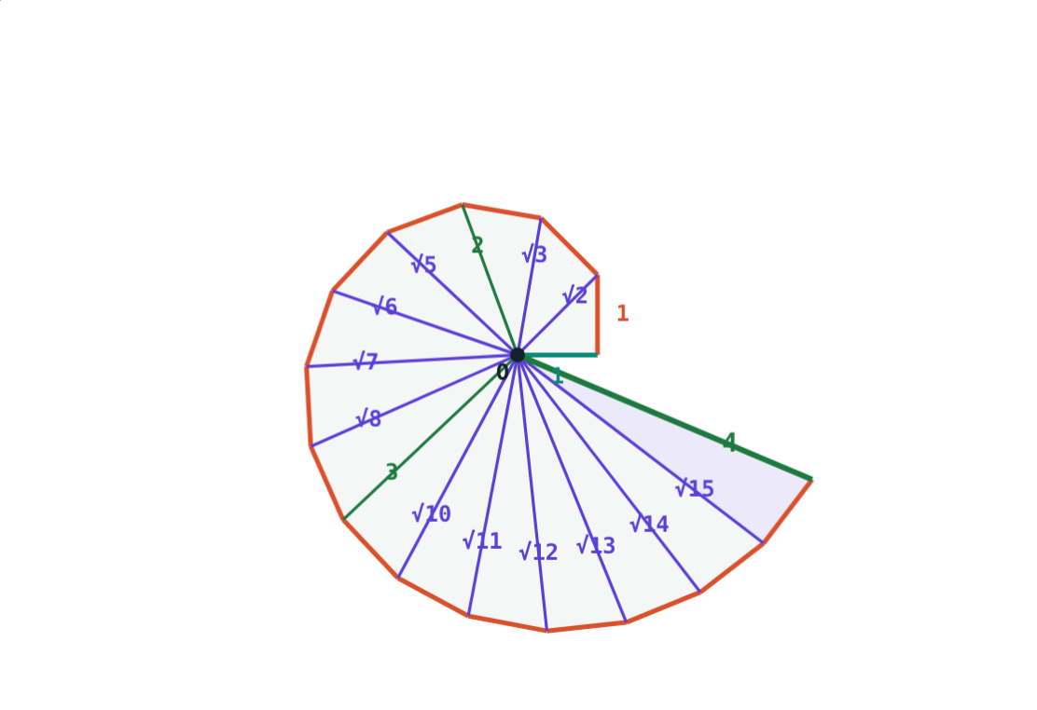
Irrational numbers
Decimal form is non-terminating and non-recurring
Cannot be written as p/q
√2, √3, √5, π are irrational
√n is irrational if n is not a perfect square
Rational + irrational is irrational: 5 + √3
Spiral of square roots
Notes:
22/7 is only an approximation of π. The indirect proof that √2 is irrational is on the lesson page.

Slide 4
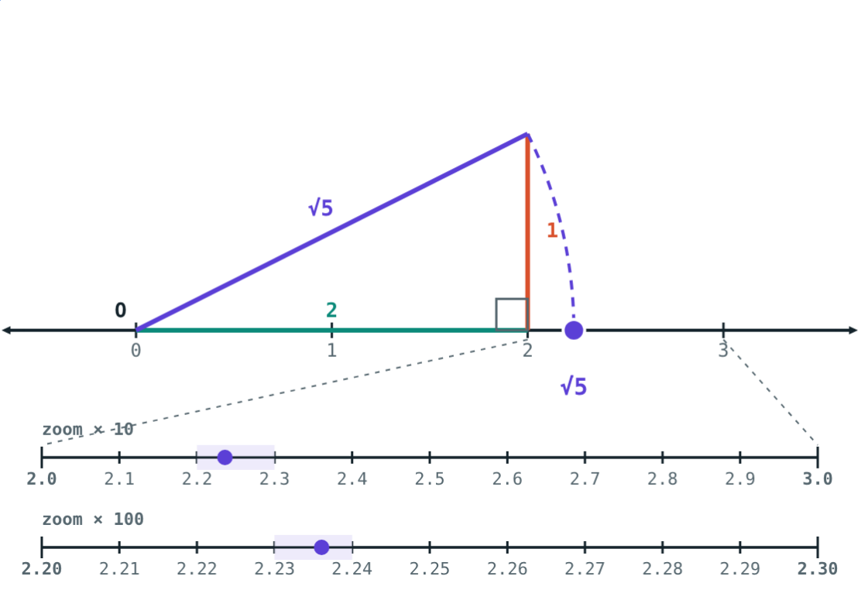
√n on the number line
Find legs with a² + b² = n
√5: legs 2 and 1
Hypotenuse OB = √n
Arc with centre O cuts the line at √n
√3: stand a side of 1 on √2
2² + 1² = 5
Notes:
Have students draw √5 and √10 (legs 3 and 1) on graph paper.

Slide 5
Real numbers
Q
√2
R
√−9
Rational
Irrational
Real
Not real
p/q: terminating or recurring decimals.
Non-terminating, non-recurring decimals.
Both together: one point on the line for each.
No real number squares to a negative.
Notes:
N ⊂ W ⊂ I ⊂ Q ⊂ R.

Slide 6
Order properties
If… | then…
a and b are real | exactly one: a < b, a = b, a > b
a < b and b < c | a < c
a < b | a + c < b + c
a < b and c > 0 | ac < bc
a < b and c < 0 | ac > bc (order reverses)
Notes:
Use the Order view of the simulation: 2 < 5 but −4 > −10.

Slide 7
Worked example: √5 on the line
Show √5 on the number line.
5 = 2² + 1²: OA = 2, AB = 1 ⊥ line
OB² = 4 + 1 = 5, so OB = √5
Arc, centre O, radius OB: OP = √5
OP = √5 ≈ 2.236
Notes:
Remind students to draw the perpendicular with a set square.

Slide 8
Worked examples
Absolute value
Between two irrationals
Solve |x + 2| = 3.
Three rational numbers between √2 and √3?
Distance from −2 is 3
x = −2 + 3 or −2 − 3: x = 1 or −5
√2 ≈ 1.414, √3 ≈ 1.732
1.5, 1.6, 1.7
Notes:
Any terminating decimal is rational, so decimals are the easiest way to find rationals between two numbers.

Slide 9
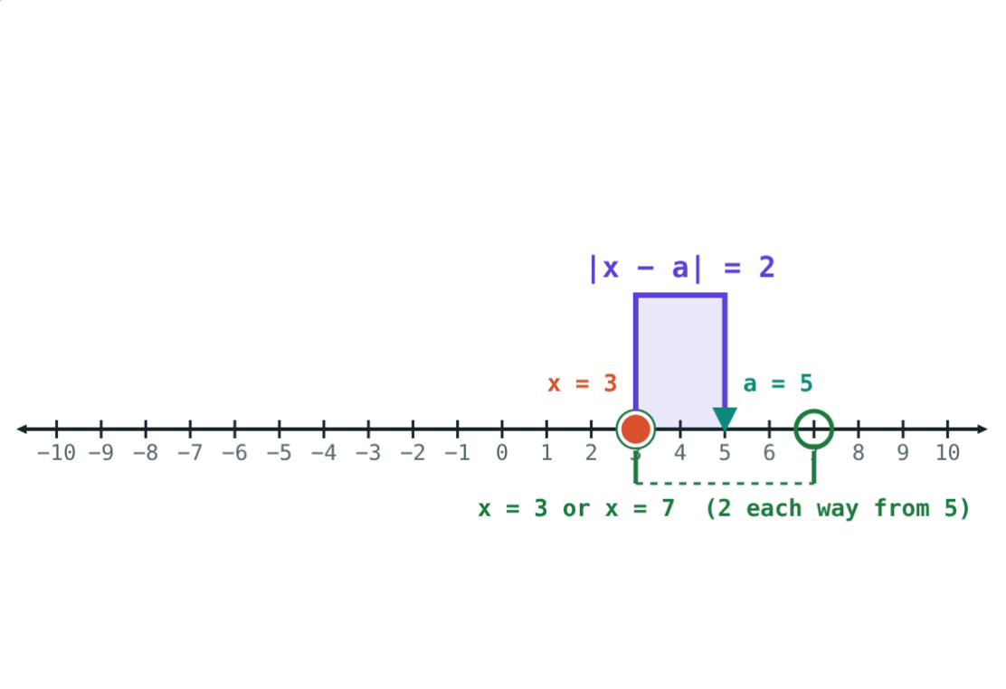
Absolute value is distance
|x| = x if x > 0, 0 if x = 0, −x if x < 0.
|−6| = 6
distance from 0
3 or 7
|x − 5| = 2
A distance is never negative.
|x − 5| = 2
Notes:
|x − a| is the distance between x and a on the number line.

Slide 10

Common mistakes
22/7 is π
Every root is irrational
It is a rational approximation; π is irrational.
√49 = 7 and √0.25 = 0.5 are rational.
|−8| = −8
Forgetting to flip
Absolute value is a distance: |−8| = 8.
a < b and c < 0 give ac > bc.
Notes:
The last one returns in inequalities in later classes.

Slide 11
Quick check
1
Which is irrational: 0.2525…, √49, √7 or 22/7?
2
Find |−9| + |4|.
3
If a < b, compare −2a and −2b.
4
Which legs of a right triangle give √10?
Notes:
Answers: 1) √7. 2) 13. 3) −2a > −2b. 4) 3 and 1, since 9 + 1 = 10.

Slide 12
Build your own roots
Open the Irrational and Real Numbers lesson on the Visual Science & Maths website. Construct √2 to √20 and grow the spiral.
Next lesson: Surds and rationalising
Notes:
Homework: draw the spiral of square roots up to √10 on paper.

