Slide 1
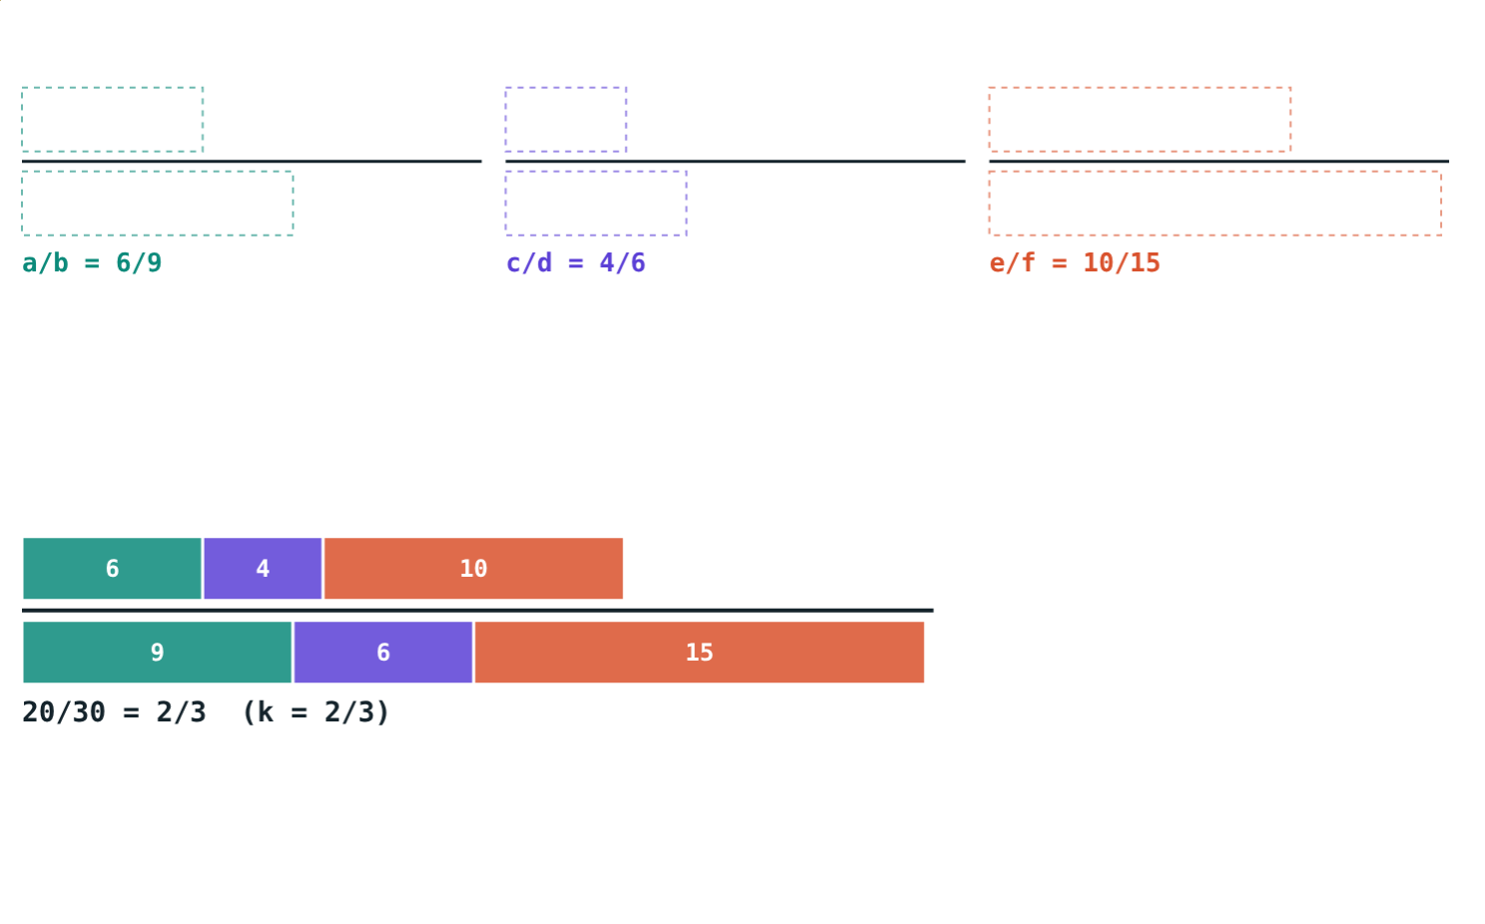
Theorem on Equal Ratios and the k Method
STD 9 MATHEMATICS PART I · CH. 4 RATIO AND PROPORTION
Lesson 3 · Visual Science & Maths
Notes:
Goal: students can state and prove the theorem on equal ratios, use the k method to prove identities, and find a mean proportional.

Slide 2
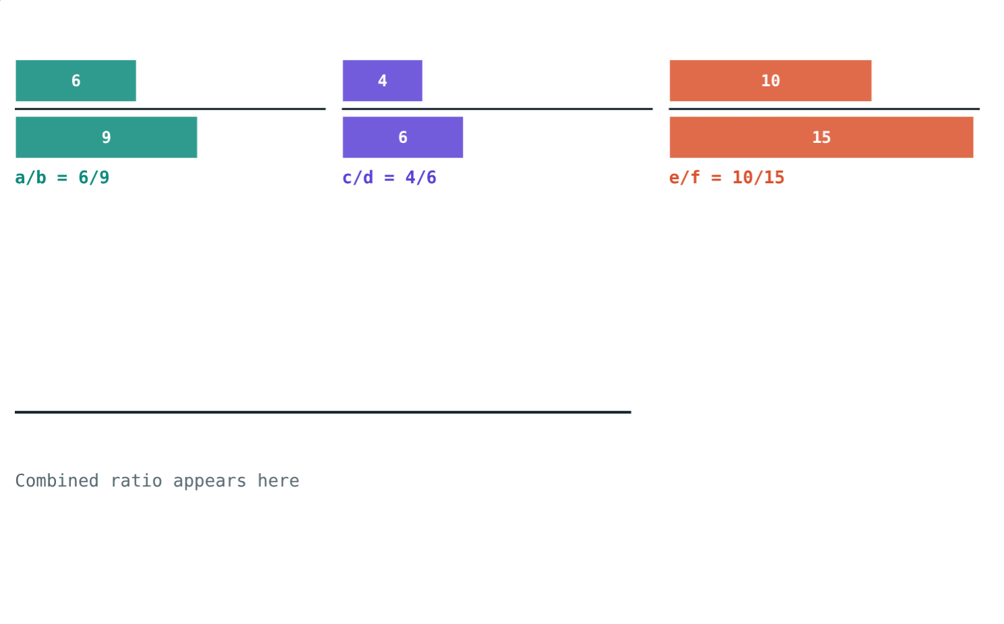
Pour the bags together
Three bags of nuts each have almonds : cashews = 2 : 3. Tip them into one bowl.
What is the ratio in the bowl?
6/9 = 4/6 = 10/15
Notes:
Most students guess 2 : 3 straight away. The theorem says why.

Slide 3
Theorem on equal ratios
a/b = c/d = e/f = (a + c + e)/(b + d + f)
Add the numerators, add the denominators
The new ratio equals each ratio
Works only when the ratios are equal
(6 + 4 + 10)/(9 + 6 + 15) = 20/30 = 2/3
Notes:
Contrast with 1/2 + 1/3, which is not 2/5.

Slide 4
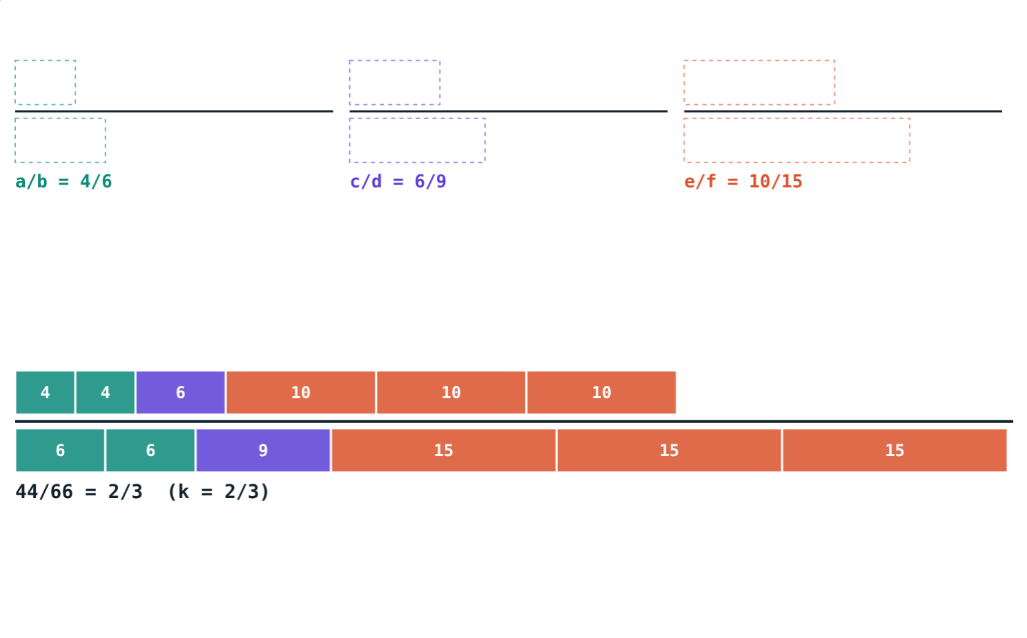
With l, m and n
(la + mc + ne)/(lb + md + nf)
Take l, m, n copies of each ratio
The combined ratio is still equal
lb + md + nf must not be 0
(2×4 + 6 + 3×10)/(2×6 + 9 + 3×15) = 44/66 = 2/3
Notes:
The simulation only uses positive l, m, n; the textbook allows any numbers with a non-zero denominator.

Slide 5
The k method
= k
a = bk
k
Name it
Rewrite
Simplify
Let a/b = c/d = e/f = k.
a = bk, c = dk, e = fk.
Every piece of the top is k times the bottom.
Notes:
Proof: (la + mc + ne)/(lb + md + nf) = k(lb + md + nf)/(lb + md + nf) = k.

Slide 6
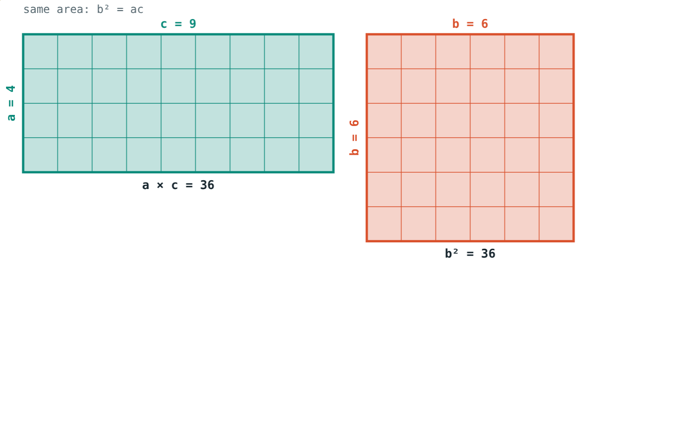
Continued proportion
a/b = b/c ⇒ b² = ac
b is the mean proportional of a and c
b = √(ac)
4, 6, 9: 6² = 36 = 4 × 9
Rectangle 4 × 9 and square 6 × 6: equal areas
Notes:
With k: b = ck and a = ck².

Slide 7
Worked examples
Theorem
Mean proportional
a/2 = b/3 = c/4. Find (a + b + c)/b.
Find the mean proportional of 8 and 18.
a = 2k, b = 3k, c = 4k
9k ÷ 3k = 3
b² = 8 × 18 = 144
b = 12
Notes:
Check the second: 8/12 = 12/18 = 2/3.

Slide 8
Worked example: prove it
If a/b = c/d, show (a² + c²)/(b² + d²) = ac/bd.
a = bk, c = dk
Left: k²(b² + d²)/(b² + d²) = k²
Right: bk·dk/bd = k²
Each piece is k times its partner
Notes:
Both sides reduce to the same expression in k: the identity is proved.

Slide 9
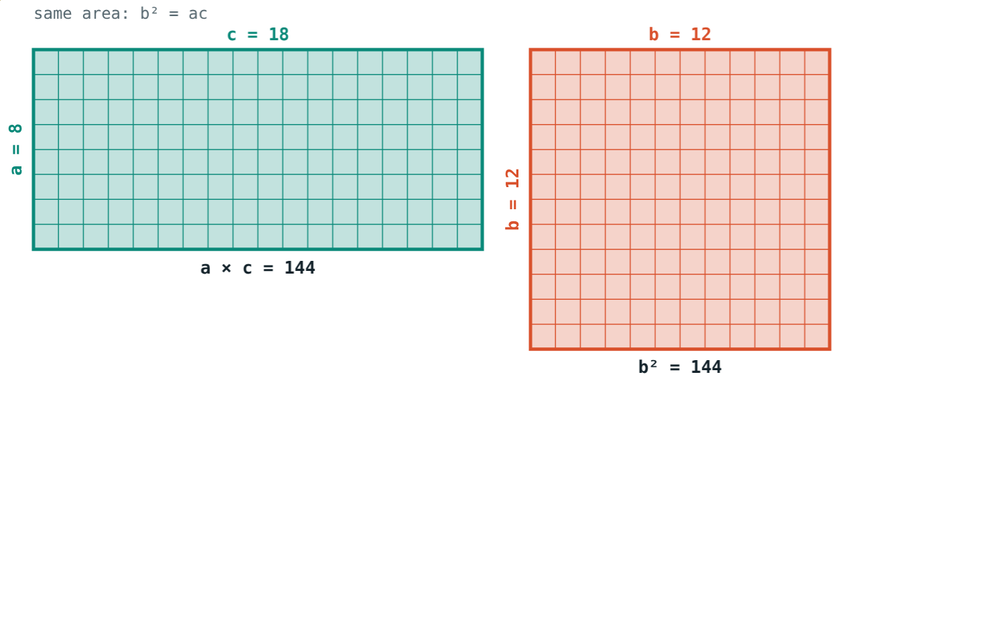
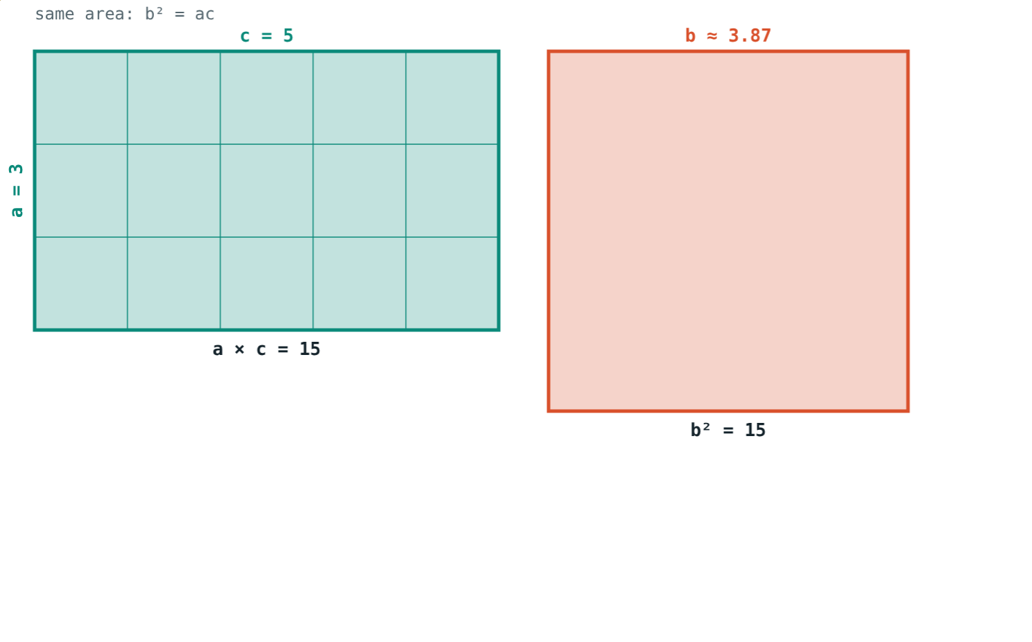
Whole or not?
b = √144 = 12: 8, 12, 18.
b = √15 ≈ 3.87.
Notes:
The mean proportional is a whole number only when ac is a perfect square.

Slide 10

Common mistakes
Adding any fractions
Writing a = k/b
1/2 + 1/3 is not 2/5.
From a/b = k, a = bk.
Zero denominator
Averaging
lb + md + nf ≠ 0.
Mean proportional of 4 and 9 is 6, not 6.5.
Notes:
Ask why the theorem does not contradict the first card.

Slide 11
Quick check
1
a/b = c/d = 2/5. Find (a + c)/(b + d).
2
a/2 = b/3 = c/4. Find (a + b + c)/b.
3
Find the mean proportional of 4 and 16.
4
3, x, 12 are in continued proportion. Find x (x > 0).
Notes:
Answers: 1) 2/5. 2) 3. 3) 8. 4) 6.

Slide 12
Combine the ratios yourself
Open the k method lesson on the Visual Science & Maths website. Press “Combine” and change l, m and n.
Next chapter: Linear Equations in Two Variables
Notes:
Homework: textbook practice set on the theorem on equal ratios and continued proportion.

