Slide 1
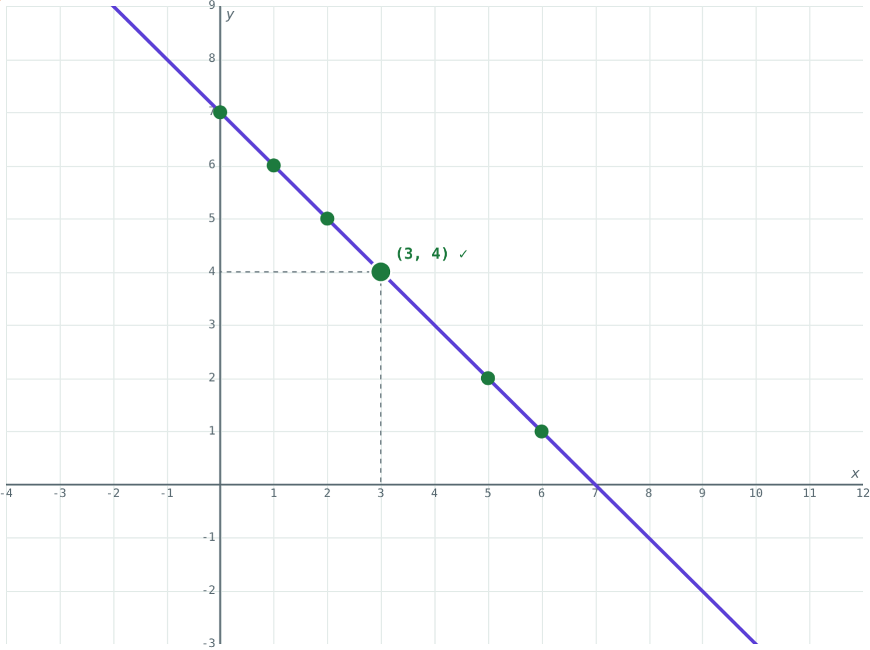
Linear Equations in Two Variables
STD 9 MATHEMATICS PART I · CH. 5 LINEAR EQUATIONS IN TWO VARIABLES
Lesson 1 · Visual Science & Maths
Notes:
Goal: students can write a linear equation in general form, test whether a pair is a solution, and see that the solutions form a line.

Slide 2
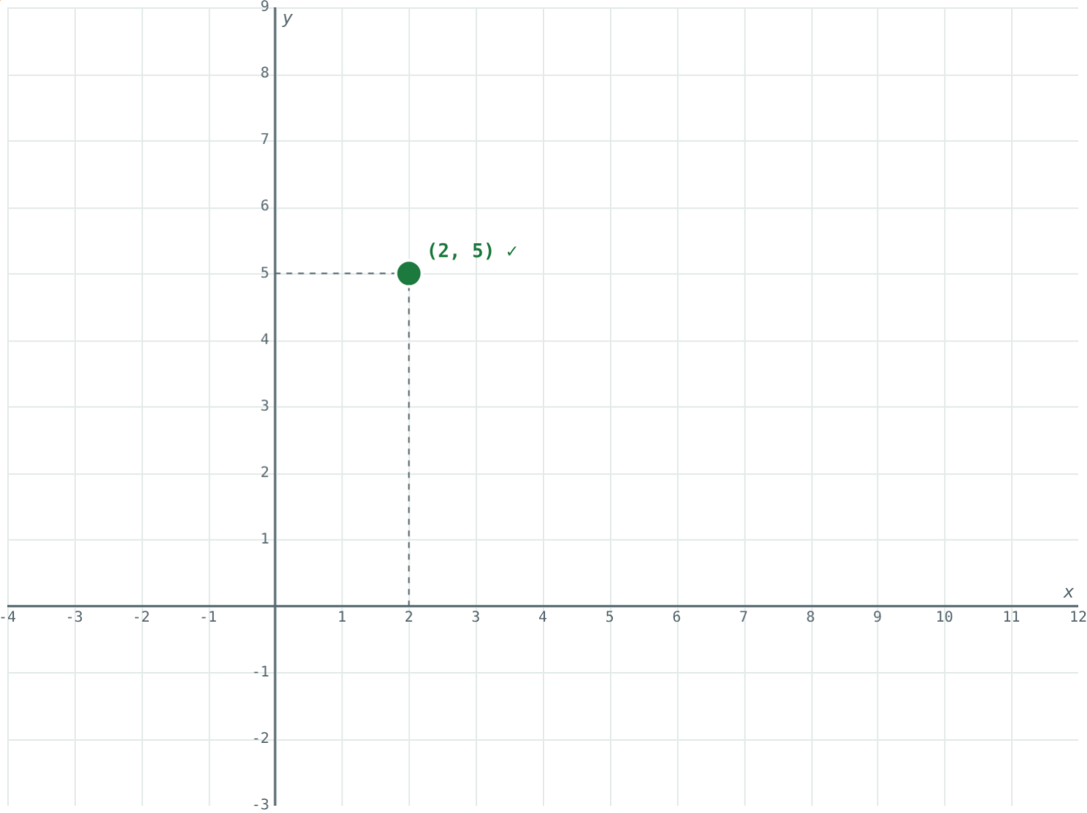
Seven sweets
Rahul and Sneha share 7 sweets. Rahul could have 1 and Sneha 6, or 3 and 4, or 5 and 2.
How many answers does x + y = 7 have?
(2, 5) is one of them
Notes:
Let the class call out pairs; record them on the board for later plotting.

Slide 3
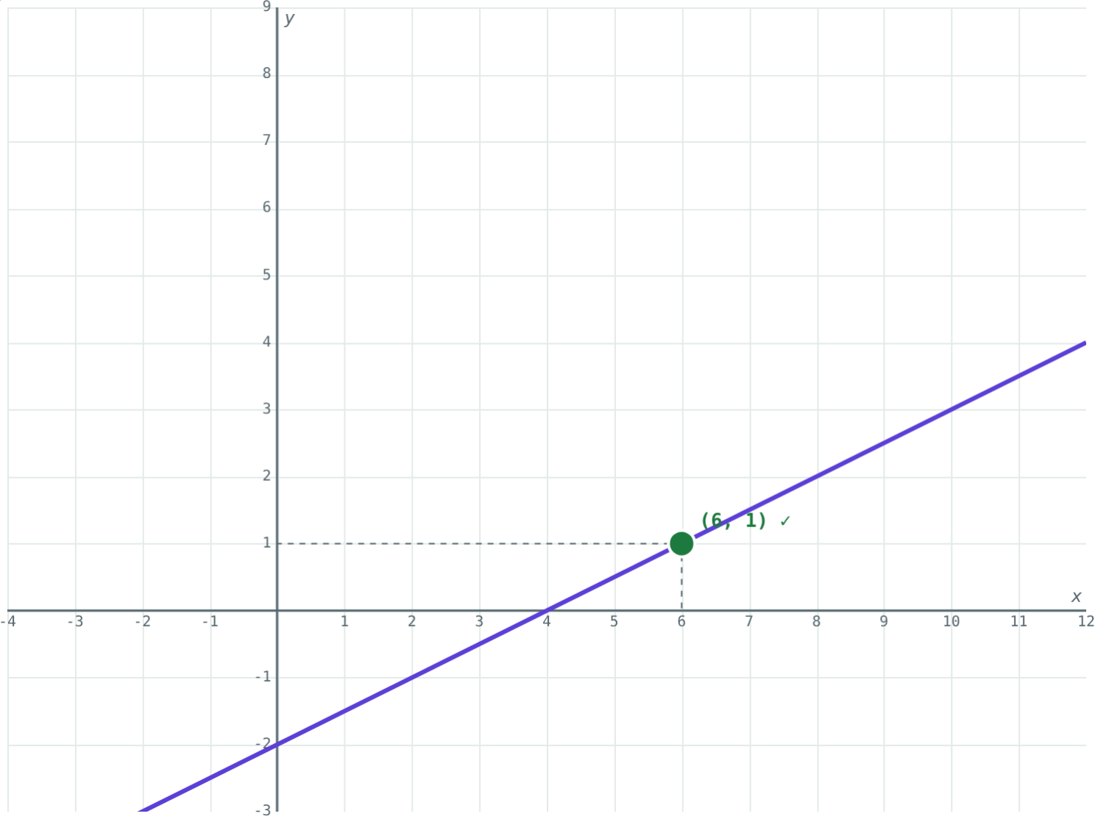
General form
ax + by + c = 0
Two variables, each to the power 1
a and b are not both zero
3x − 4y = −12 becomes 3x − 4y + 12 = 0
x − 2y − 4 = 0
Notes:
Moving every term to one side is the only skill needed here; watch the signs.

Slide 4
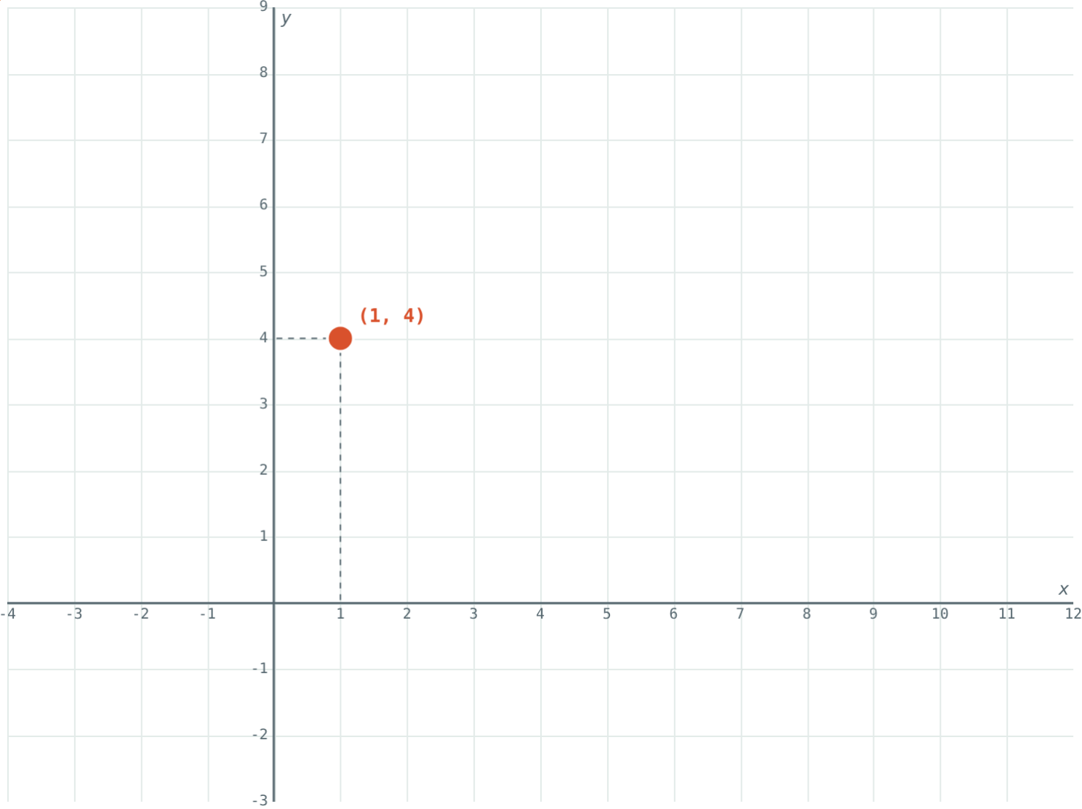
Solution or not?
2 + 5 = 7: a solution.
2 + 12 = 14 ≠ 12: not a solution.
Notes:
A solution is an ordered pair: x first, then y.

Slide 5
The solutions form a line
Choose any x, work out y
So there are infinitely many solutions
Plotted, they all lie on one straight line
Every point on the line is a solution
Marked solutions of x + y = 7
Notes:
This is why the equations are called linear. The graph is from the NCERT book; it helps students see the idea.

Slide 6
Reading the line
y = 0
x = 0
∞
x-axis
y-axis
Solutions
Put y = 0 to find where the line crosses the x-axis.
Put x = 0 to find where it crosses the y-axis.
One equation, infinitely many pairs (x, y).
Notes:
For 2x + 3y = 12 the line crosses at (6, 0) and (0, 4).

Slide 7
Worked examples
General form
Testing pairs
Write 2x = 5y − 3 in the form ax + by + c = 0.
Are (3, 2) and (1, 4) solutions of 2x + 3y = 12?
2x − 5y + 3 = 0
a = 2, b = −5, c = 3
(3, 2): 6 + 6 = 12 → yes
(1, 4): 2 + 12 = 14 → no
Notes:
Always substitute into the left side and compare with the right side.

Slide 8
Worked example: finding solutions
Find three solutions of x − 2y = 4.
x = 4 + 2y
y = 0, 1, 2 gives x = 4, 6, 8
Solutions: (4, 0), (6, 1), (8, 2)
x − 2y = 4
Notes:
Choosing y first avoids fractions here.

Slide 9
Where the line meets the axes
Put each variable equal to 0 in turn:
(4, 0)
on the x-axis
(0, −2)
on the y-axis
Two points are enough to draw the whole line.
x − 2y = 4
Notes:
Students can check both points in the simulation.

Slide 10

Common mistakes
Pair the wrong way round
“Only one answer”
(x, y): x always comes first.
One equation has infinitely many solutions.
Testing one side
Sign slips
Compare the left side with the right side.
2x = 5y − 3 → 2x − 5y + 3 = 0.
Notes:
Ask students to find their own example of each slip.

Slide 11
Quick check
1
Is x² + y = 4 a linear equation in two variables?
2
Which pair is a solution of x + 2y = 10: (2, 3) or (4, 3)?
3
How many solutions does 3x + y = 9 have?
4
Where does x + y = 7 cross the y-axis?
Notes:
Answers: 1) No, x is squared. 2) (4, 3). 3) Infinitely many. 4) (0, 7).

Slide 12
Hunt for solutions yourself
Open the Linear Equations lesson on the Visual Science & Maths website. Drag the point and mark every solution you find.
Next lesson: Solving simultaneous equations
Notes:
Homework: find five solutions of 2x + y = 10 and plot them on graph paper.

