Slide 1
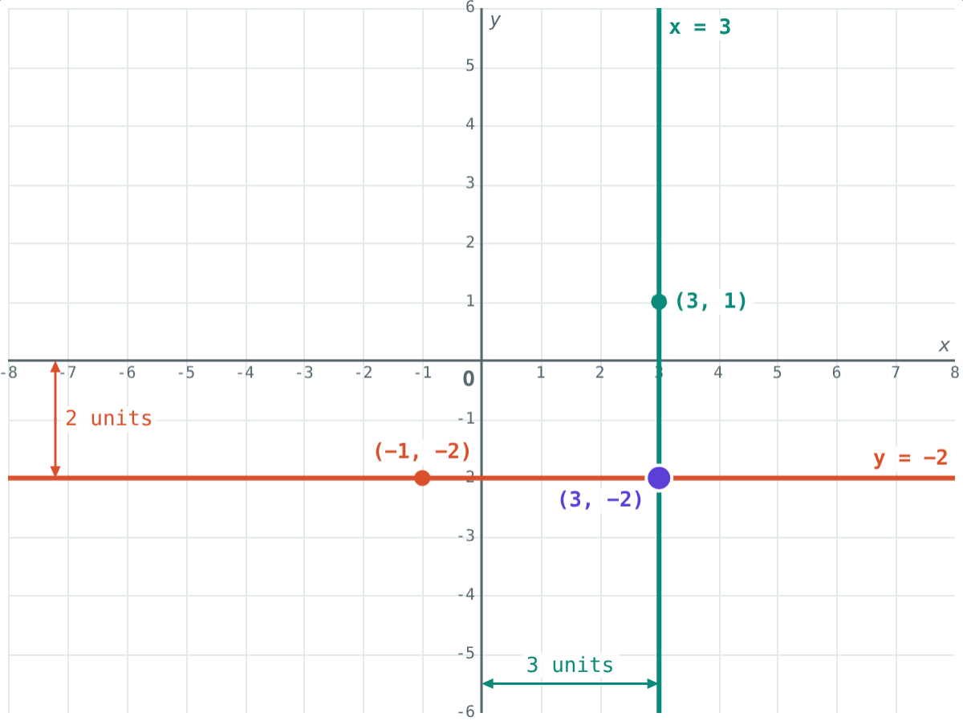
Lines Parallel to the Axes
STD 9 MATHEMATICS PART II · CH. 7 CO-ORDINATE GEOMETRY
Lesson 2 · Visual Science & Maths
Notes:
Goal: students can write the equation of a line parallel to an axis, give its distance from the axis, and find where two such lines meet.

Slide 2
A road due north
A road runs north from a point 3 km east of the gate. However far you walk along it, you stay 3 km east.
Which co-ordinate never changes on that road?
Every point on the vertical line has x = 3
Notes:
Plot (3, −2), (3, 0), (3, 1), (3, 4) with the class first and ask what they have in common.

Slide 3
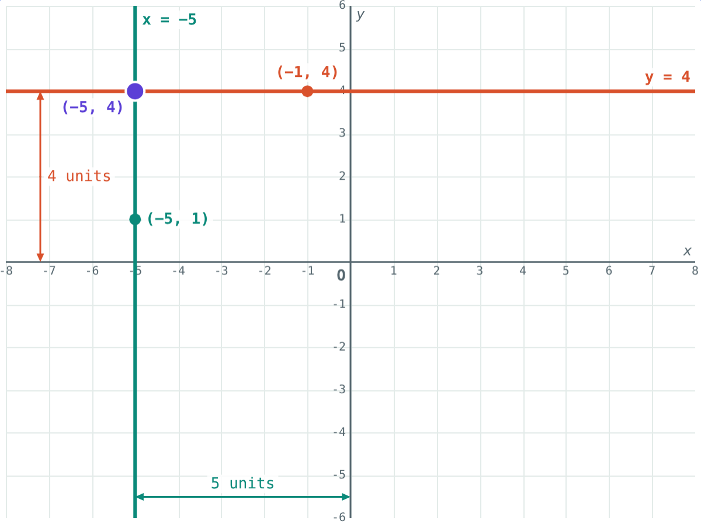
Parallel to the Y-axis
x = a
Every point has the same x co-ordinate a
Distance from the Y-axis: |a| units
a > 0: right of the Y-axis
a < 0: left of the Y-axis
x = −5 is 5 units left of the Y-axis
Notes:
x = −5 is a vertical line, even though only x appears in it.

Slide 4
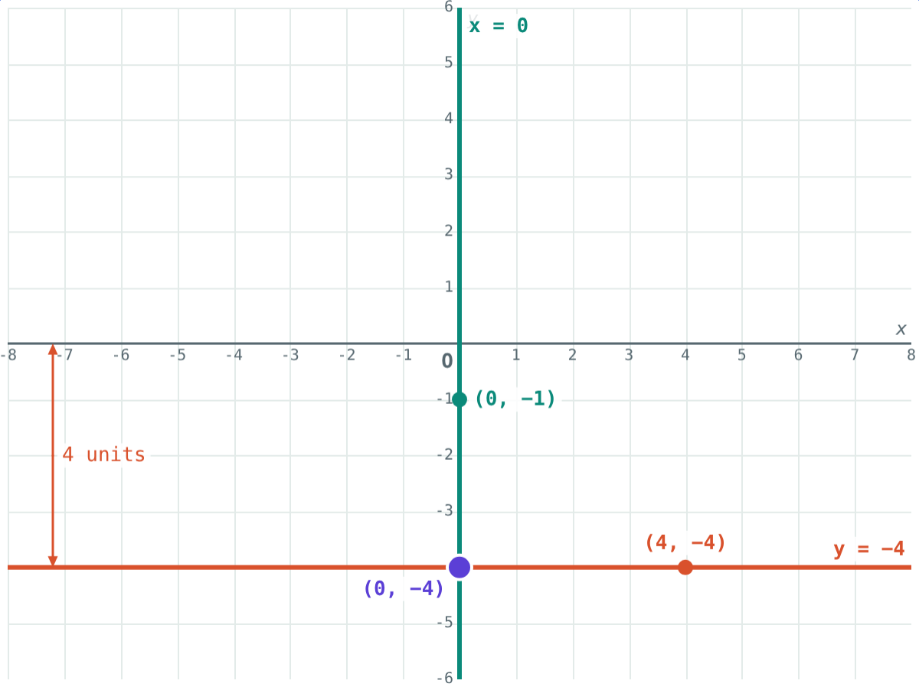
Parallel to the X-axis
y = b
Every point has the same y co-ordinate b
Distance from the X-axis: |b| units
b > 0: above the X-axis
b < 0: below the X-axis
y = −4 is 4 units below the X-axis
Notes:
(−4, −4) and (0, −4) both have y co-ordinate −4, so both are on y = −4.

Slide 5
Special cases
y = 0
x = 0
x + 5 = 0
(a, b)
The X-axis
The Y-axis
Rearrange first
Meeting point
Every point on the X-axis has y co-ordinate 0.
Every point on the Y-axis has x co-ordinate 0.
x = −5: parallel to the Y-axis, 5 units to its left.
x = a and y = b meet at exactly one point, (a, b).
Notes:
2y − 7 = 0 gives y = 3.5. Two lines x = a and x = c are parallel and never meet.

Slide 6
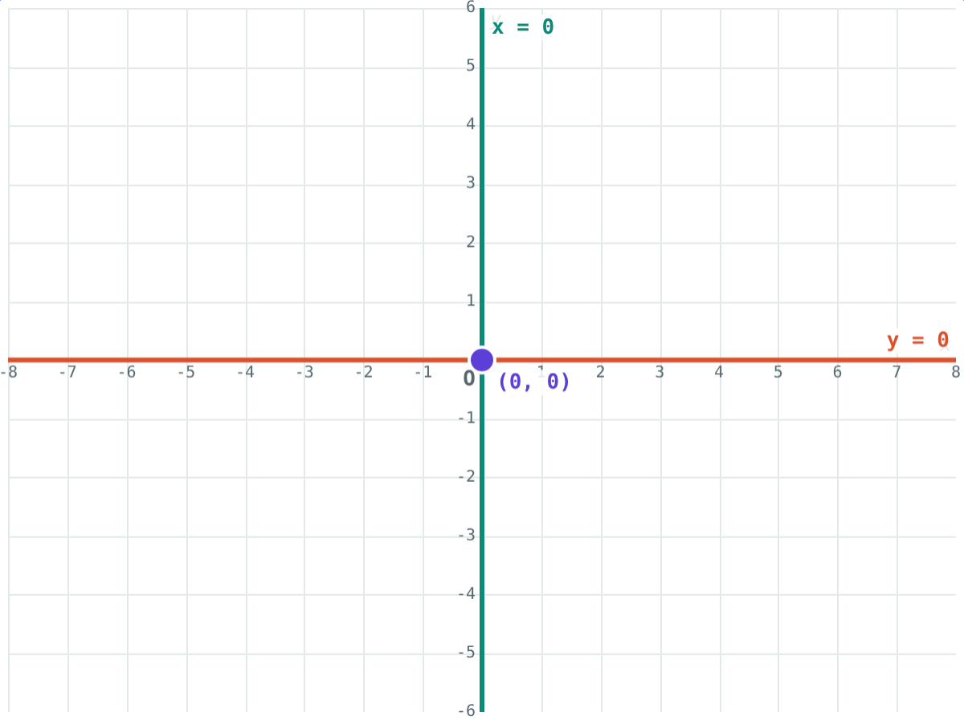
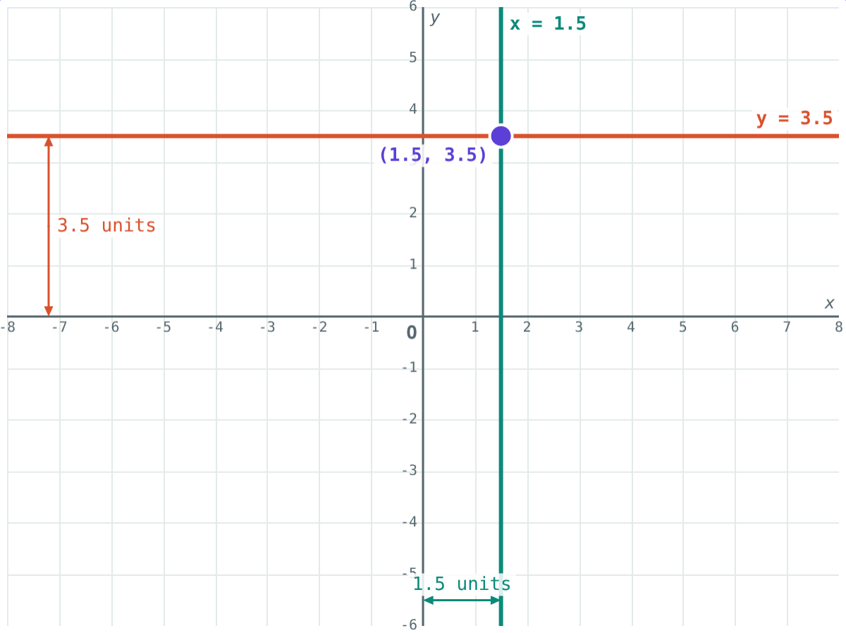
Where the lines meet
x = 0 and y = 0 meet at the origin (0, 0).
y = 3.5 meets x = 1.5 at (1.5, 3.5).
Notes:
Ask for the meeting point of x = −2 and y = 7 before showing any picture: (−2, 7).

Slide 7
Worked examples
Below the X-axis
Through a point
Line parallel to the X-axis, 4 units below it. Do A(2, −4), B(−4, 2), C(0, −4) lie on it?
Lines through P(−5, 2) parallel to the axes.
Equation: y = −4
y co-ordinate −4: A and C yes, B no
Parallel to the Y-axis: x = −5
Parallel to the X-axis: y = 2
Notes:
x = −5 is 5 units left of the Y-axis; y = 2 is 2 units above the X-axis.

Slide 8
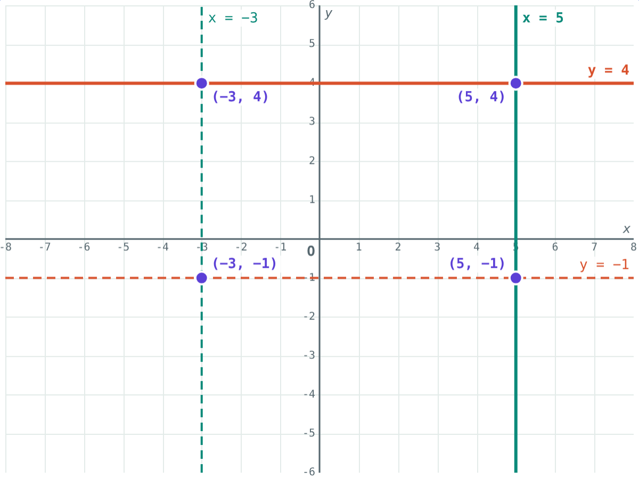
Worked example: four lines
Draw x + 3 = 0, x − 5 = 0, y + 1 = 0 and 2y − 8 = 0. What do they enclose?
x = −3, x = 5, y = −1, y = 4
Corners (−3, −1), (5, −1), (5, 4), (−3, 4)
8 by 5: a rectangle
x = −3, x = 5, y = −1, y = 4
Notes:
Width 5 − (−3) = 8 units, height 4 − (−1) = 5 units.

Slide 9
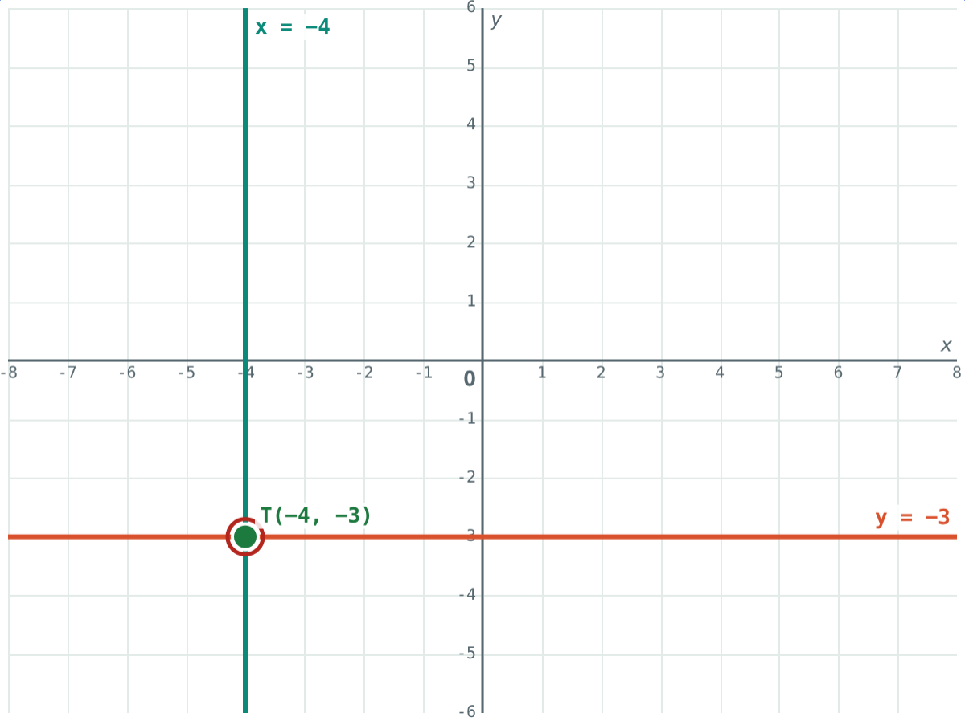
Hit the target
To pass through T(−4, −3) you need:
x = −4
parallel to the Y-axis
y = −3
parallel to the X-axis
The two lines through any point (a, b) are x = a and y = b.
Both lines pass through T(−4, −3)
Notes:
In the simulation, “Hit the target” gives new points to practise with.

Slide 10

Common mistakes
Mixing up directions
Wrong axis equation
x = 3 is vertical, parallel to the Y-axis.
X-axis: y = 0. Y-axis: x = 0.
Not rearranging
Negative distance
x + 6 = 0 is x = −6, not x = 6.
x = −4 is 4 units from the Y-axis.
Notes:
The first mistake is the most common: the equation names x, but the line is vertical.

Slide 11
Quick check
1
What is the equation of the X-axis?
2
Describe the line y − 6 = 0.
3
Where do x = −2 and y = 7 meet?
4
Which point is on x = 4: (1, 4), (4, −9) or (0, 4)?
Notes:
Answers: 1) y = 0. 2) Parallel to the X-axis, 6 units above it. 3) (−2, 7). 4) (4, −9).

Slide 12
Move the lines yourself
Open the Lines Parallel to the Axes lesson on the Visual Science & Maths website. Drag x = a and y = b and play “Hit the target”.
Next chapter: Trigonometry
Notes:
Homework: draw x = −1, x = 3, y = 0 and y = 2; find the corners and the size of the rectangle (4 by 2).

