Slide 1
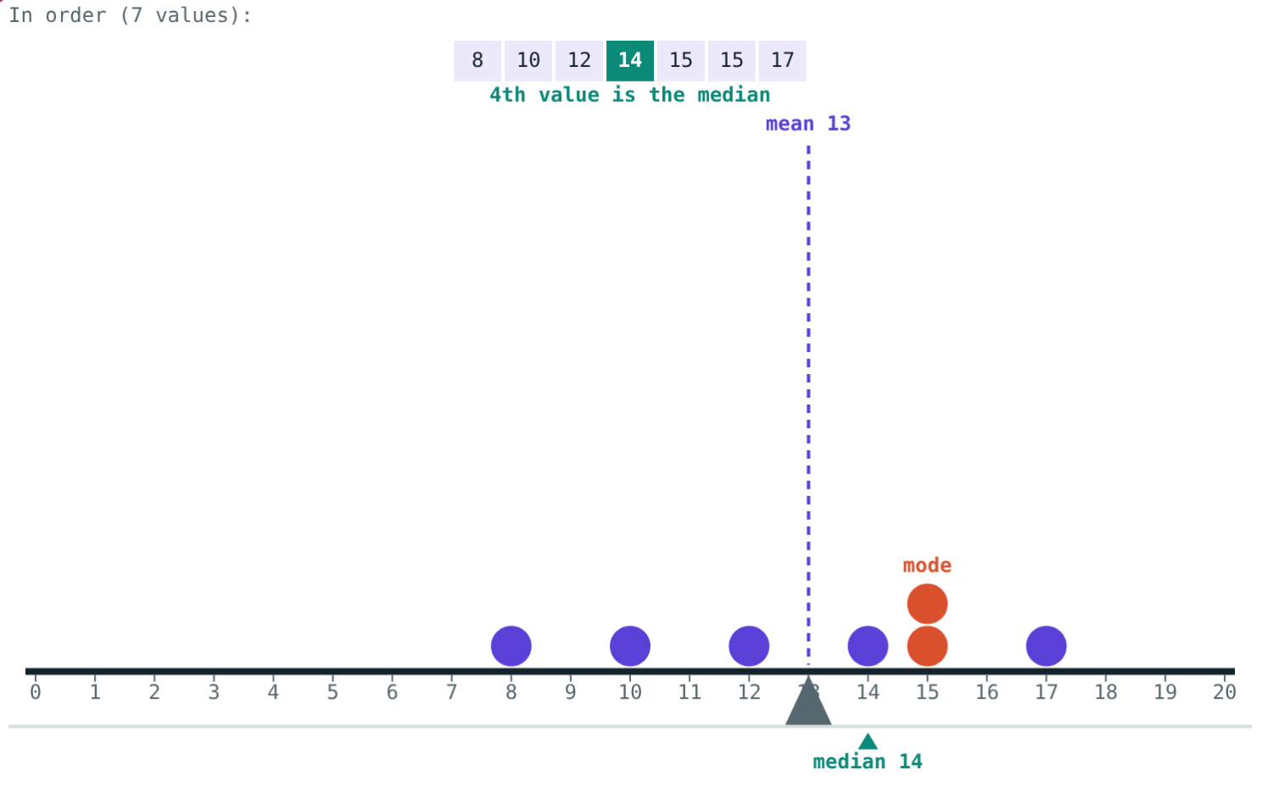
Mean, Median and Mode
STD 9 MATHEMATICS PART I · CH. 7 STATISTICS
Lesson 3 · Visual Science & Maths
Notes:
Goal: students can find the mean (also from a frequency table), the median for odd and even n, and the mode.

Slide 2
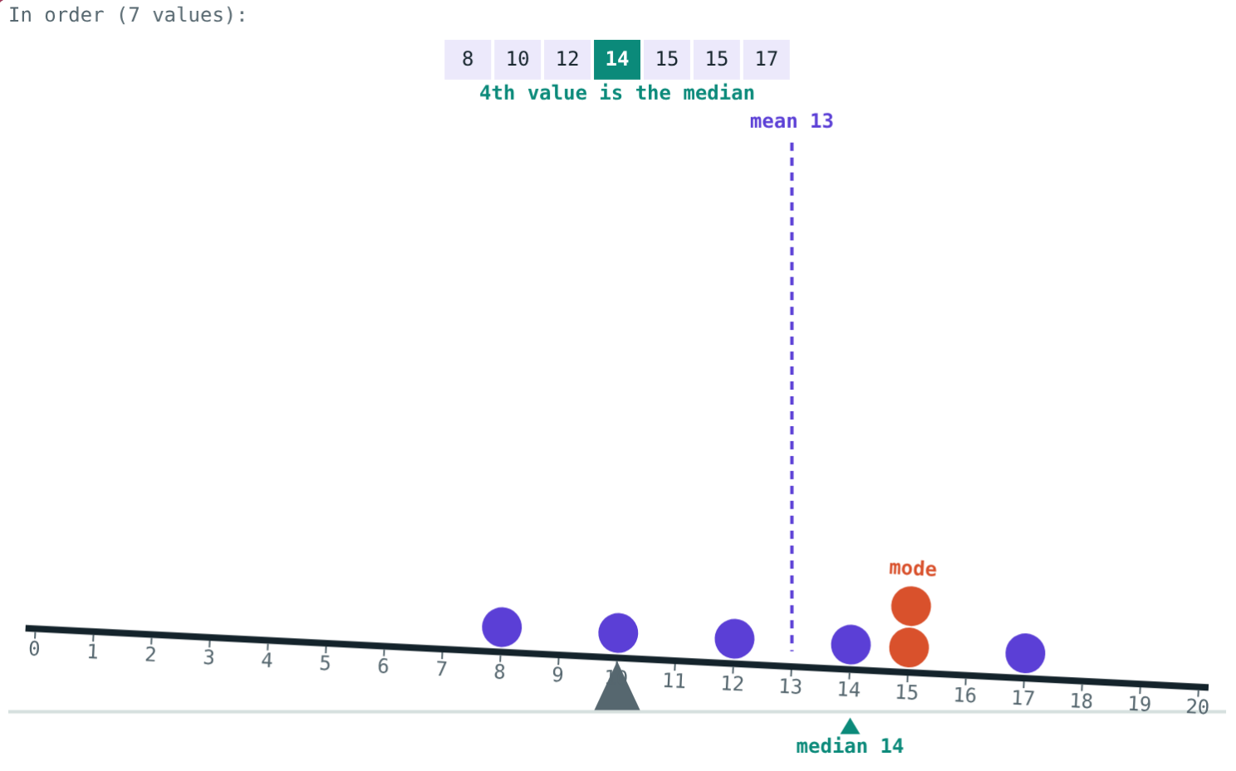
One number for the whole class
Seven students scored 12, 15, 8, 17, 15, 10 and 14 out of 20.
Which single number best describes these marks?
The support is at 10: the see-saw tips
Notes:
Let students suggest numbers. Each of mean, median and mode is a fair answer.

Slide 3
Mean: the balance point
Mean = sum ÷ number
91 ÷ 7 = 13
The data balances at the mean
It need not be one of the values
Balanced at 13
Notes:
x̄ = Σxᵢ ÷ n.

Slide 4
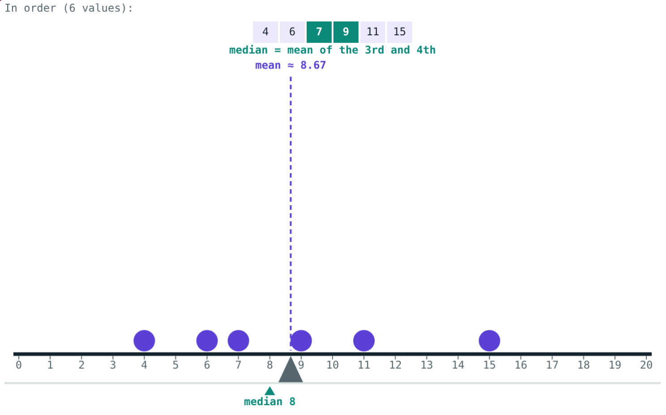
Median: the middle value
n = 7: the 4th value, 14.
n = 6: (7 + 9) ÷ 2 = 8.
Notes:
Always arrange in ascending order first. Odd: ((n+1)/2)th. Even: mean of (n/2)th and (n/2 + 1)th.

Slide 5
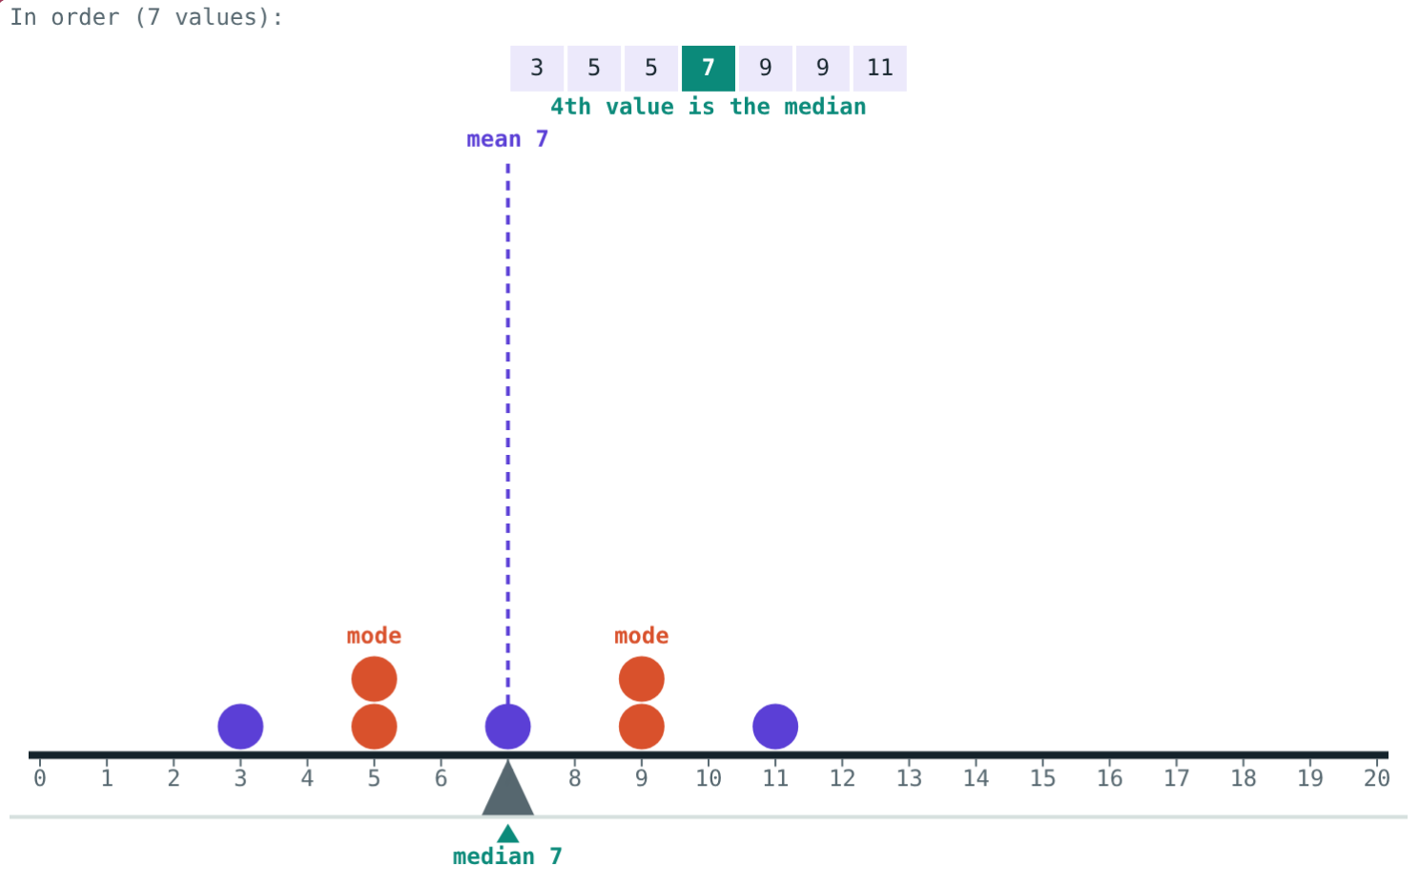
Mode: the most frequent
The value with the highest frequency
There can be more than one mode
If every value occurs once, no mode
Two modes: 5 and 9
Notes:
A shoe shop cares about the mode.

Slide 6
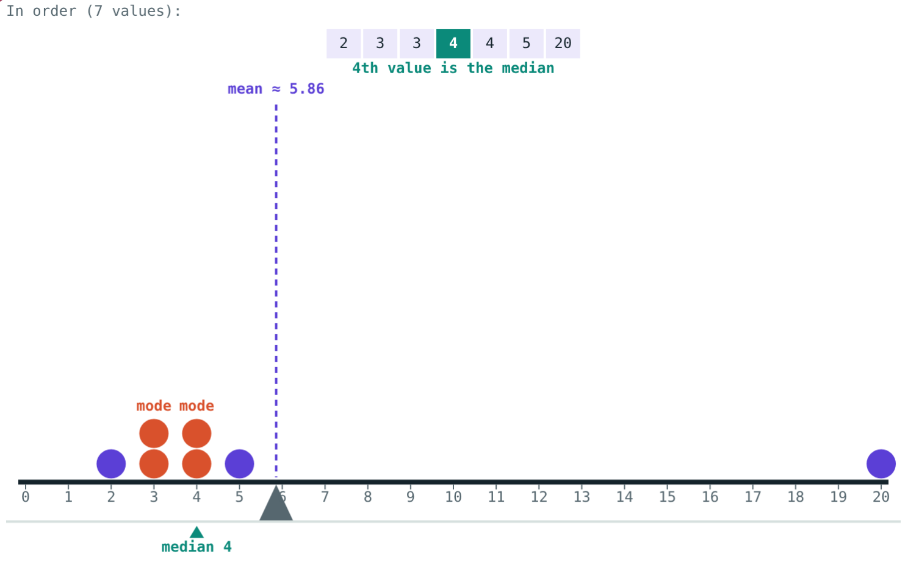
One far value
The value 20 pulls the mean but not the median:
≈ 5.86
mean
4
median
With an unusual value, the median often describes the data better.
2, 3, 3, 4, 4, 5, 20
Notes:
41 ÷ 7 ≈ 5.86.

Slide 7
Worked examples
All three
Even n
12, 15, 8, 17, 15, 10, 14
4, 9, 11, 6, 15, 7
Mean 91 ÷ 7 = 13
Order: 8, 10, 12, 14, 15, 15, 17; median 14
Mode 15
Order: 4, 6, 7, 9, 11, 15
Median = (7 + 9) ÷ 2 = 8
Notes:
The median of an even set need not be one of the values.

Slide 8
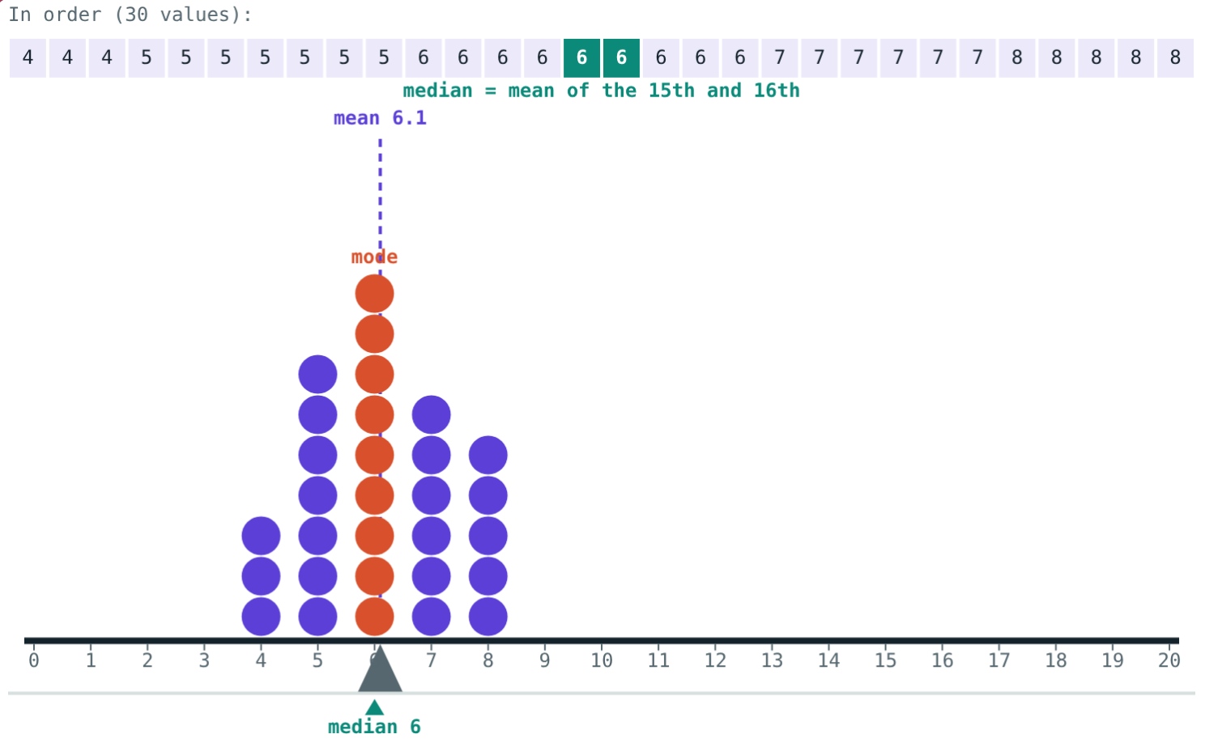
Worked example: frequency table
Sizes 4, 5, 6, 7, 8 with frequencies 3, 7, 9, 6, 5. Find the mean, median and mode.
Σfx = 12 + 35 + 54 + 42 + 40 = 183
Mean = 183 ÷ 30 = 6.1
15th and 16th are 6: median 6
Highest f = 9: mode 6
Shoe sizes of 30 students
Notes:
Divide by N = 30, not by 5 (the number of rows).

Slide 9
Shoe sizes at a glance
From the frequency table:
183
Σfᵢxᵢ
6.1
mean = 183 ÷ 30
Median and mode are both size 6.
Sizes 4 to 8, N = 30
Notes:
Cumulative frequencies 3, 10, 19, 25, 30: the 15th and 16th observations are both 6.

Slide 10

Common mistakes
Not sorting
One middle value
Arrange in order before the median.
Even n: mean of the two middle values.
Frequency as mode
Dividing by rows
The mode is the value, not its count.
Mean = Σfᵢxᵢ ÷ N.
Notes:
Have students make up data that trips each mistake.

Slide 11
Quick check
1
Mean of 4, 7, 10, 3?
2
Median of 3, 9, 5, 12, 6, 8?
3
Mode of 2, 4, 4, 5, 7, 7, 7, 9?
4
Σfᵢxᵢ = 240 and N = 40. The mean?
Notes:
Answers: 1) 6. 2) 7. 3) 7. 4) 6.

Slide 12
Balance the data yourself
Open the Mean, Median and Mode lesson on the Visual Science & Maths website. Drag the dots and watch the balance point, the middle and the tallest stack move.
Next: all maths chapters (end of Part I)
Notes:
Homework: find the mean, median and mode of your last ten test scores.

