Slide 1
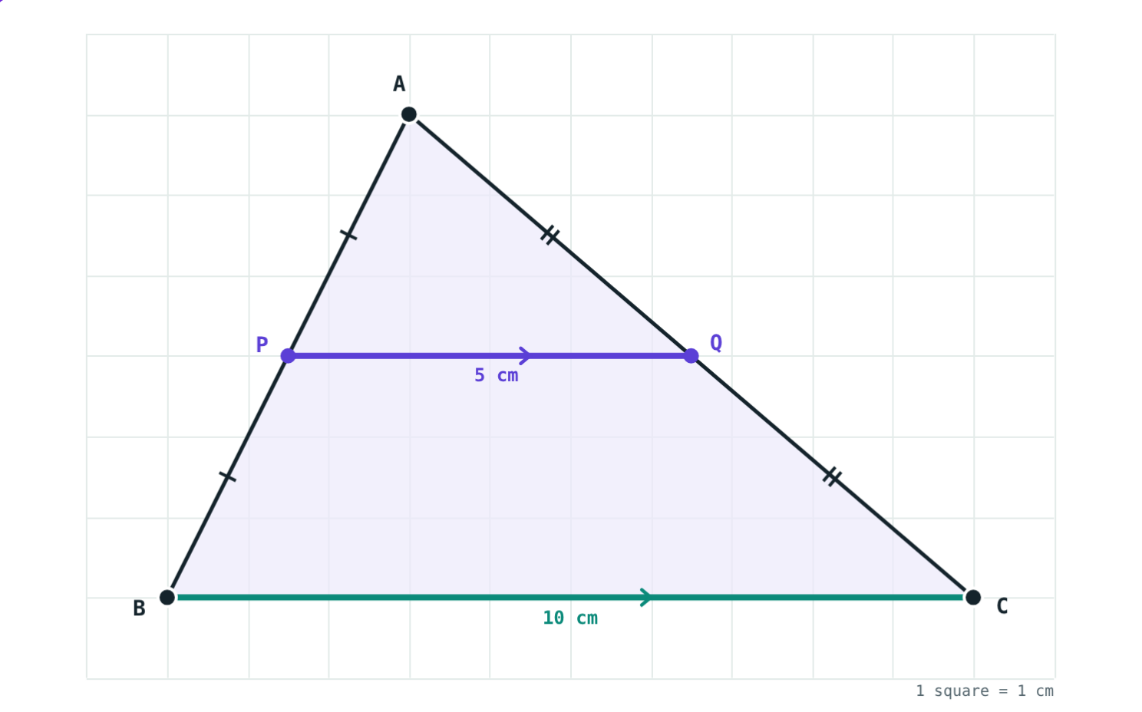
The Midpoint Theorem
STD 9 MATHEMATICS PART II · CH. 5 QUADRILATERALS
Lesson 3 · Visual Science & Maths
Notes:
Goal: students can state and use the midpoint theorem and its converse, and apply them to quadrilaterals and trapeziums.

Slide 2
Halfway across
Mark the middle of two sides of any triangle and join the marks.
How does that segment compare with the third side?
BC = 10 cm, PQ = 5 cm
Notes:
Let each student draw a different triangle and measure. Everyone gets “half and parallel”.

Slide 3
Midpoint theorem
PQ ∥ BC and PQ = ½ BC
The segment joining the midpoints of any two sides of a triangle
is parallel to the third side
and is half of it
P, Q: midpoints of AB and AC
Notes:
Textbook wording: the segment joining midpoints of any two sides of a triangle is parallel to the third side and half of it.

Slide 4
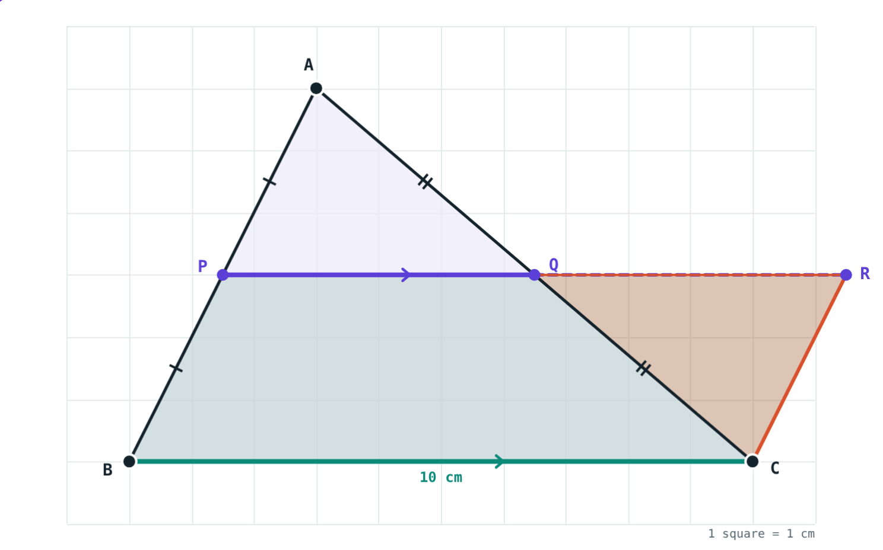
Why it is true
Extend PQ to R with QR = PQ; join CR
△AQP and △CQR are congruent (S-A-S)
So CR = AP = PB and CR ∥ AB
PBCR is a parallelogram: PR = BC, so PQ = ½ BC
△APQ turned half a turn about Q
Notes:
The parallelogram test used: one pair of opposite sides parallel and congruent (last lessons).

Slide 5
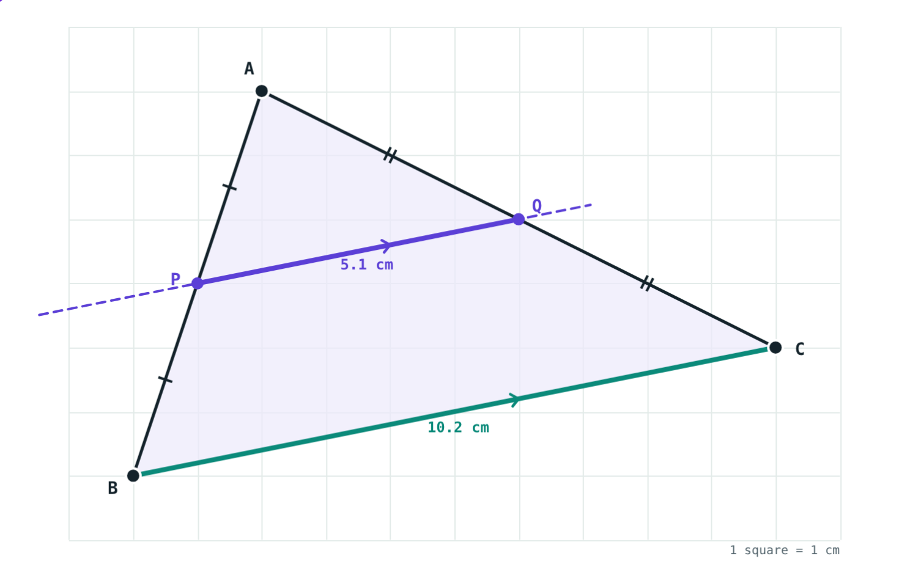
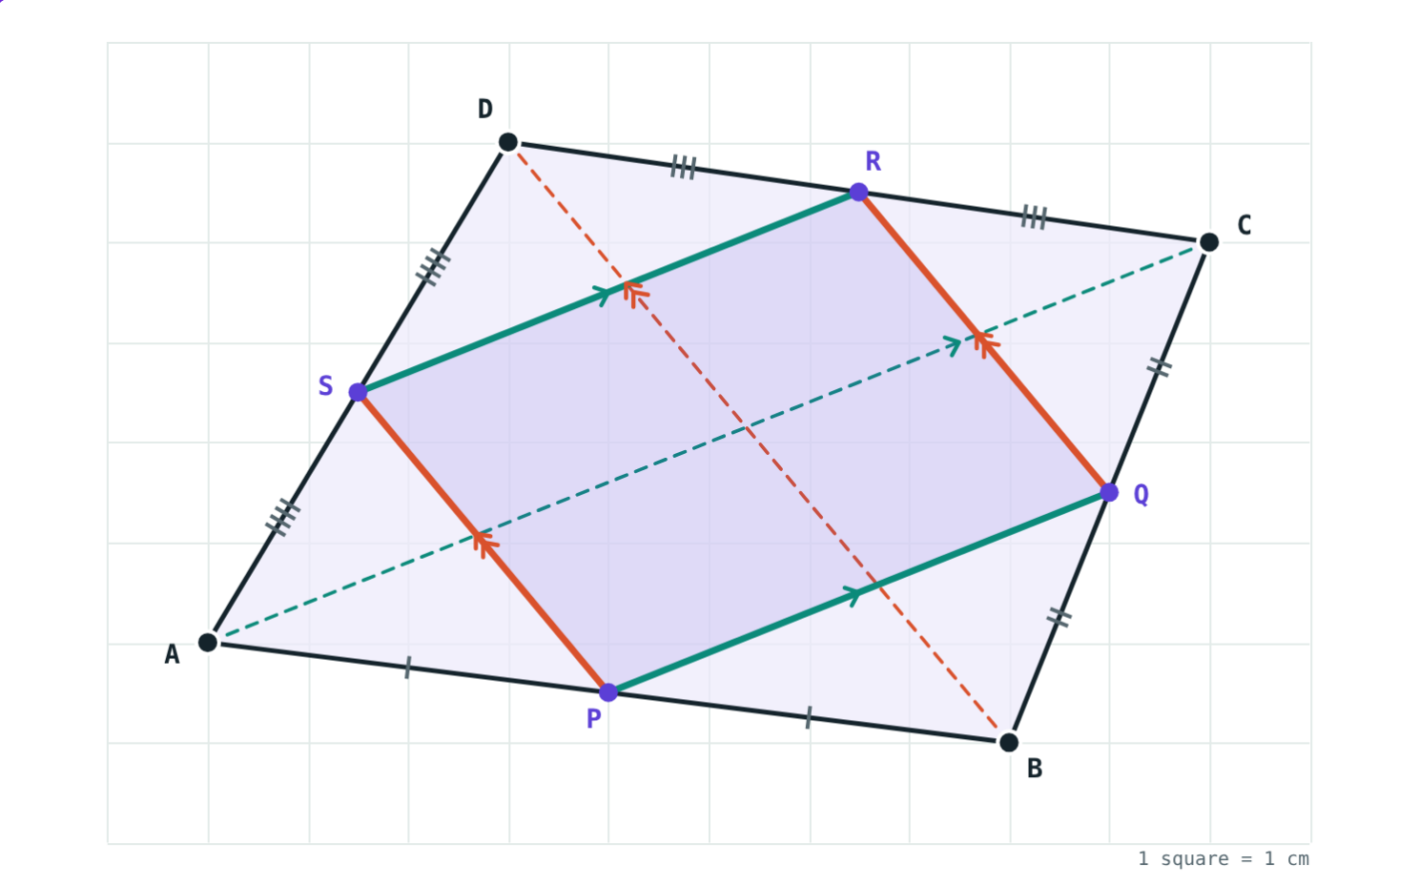
The converse and a use
Line through P parallel to BC: AQ = QC = 4.47 cm.
Join the midpoints: always a parallelogram.
Notes:
Converse: a line through the midpoint of one side, parallel to another side, bisects the third side.

Slide 6
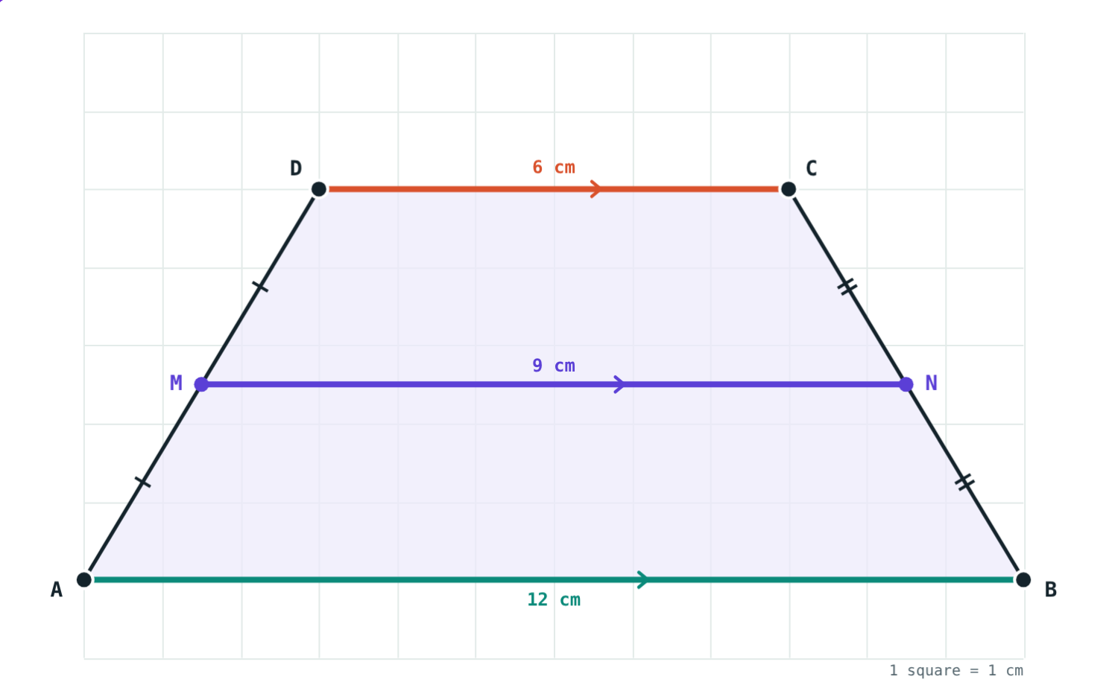
Trapezium
MN = ½ (AB + DC)
M, N: midpoints of the non-parallel sides
MN is parallel to AB and DC
Its length is half the sum of the parallel sides
½ (12 + 6) = 9 cm
Notes:
Proof idea: join A to N and extend to meet line DC; then use the midpoint theorem in the new triangle.

Slide 7
Worked examples
Find PQ
Midpoint triangle
P, Q are midpoints of AB and AC; BC = 9 cm. Find PQ.
Sides 8, 10, 12 cm. Find the perimeter of the midpoint triangle.
PQ = ½ BC = ½ × 9
PQ = 4.5 cm
New sides: 4, 5, 6 cm
Perimeter 15 cm
Notes:
The midpoint triangle always has half the perimeter.

Slide 8
Worked example: a trapezium
AB ∥ DC, AB = 12 cm, DC = 6 cm. M, N are midpoints of AD and BC. Find MN.
MN = ½ (AB + DC)
= ½ (12 + 6)
MN = 9 cm
AB ∥ DC
Notes:
Students can drag the corners in the Trapezium view to test other lengths.

Slide 9
Midpoints of a quadrilateral
Each side of PQRS is half a diagonal of ABCD:
5.39
PQ = SR = ½ AC (cm)
3.91
QR = PS = ½ BD (cm)
Opposite sides are parallel and equal, so PQRS is a parallelogram.
PQRS inside ABCD
Notes:
If AC ⊥ BD, PQRS is a rectangle; if AC = BD, a rhombus.

Slide 10

Common mistakes
PQ = BC
Parallel to the wrong side
PQ is half of BC; BC is double PQ.
PQ is parallel to the side without P or Q.
Any parallel segment is half
Mixing up the converse
Only the one through the midpoints.
Start: one midpoint + a parallel line. Prove: the other midpoint.
Notes:
Draw a parallel line nearer to A to show the third mistake.

Slide 11
Quick check
1
P, Q are midpoints of AB and AC and PQ = 7 cm. Find BC.
2
A line through the midpoint of AB, parallel to BC, meets AC at Q. AC = 10 cm. Find AQ.
3
Join the midpoints of any quadrilateral in order. What shape do you get?
4
Sides 6, 8, 10 cm: find the perimeter of the midpoint triangle.
Notes:
Answers: 1) 14 cm. 2) 5 cm (converse). 3) A parallelogram. 4) 12 cm.

Slide 12
Test the theorem yourself
Open the Midpoint Theorem lesson on the Visual Science & Maths website. Drag A anywhere and press “Show why”.
Next chapter: Circle
Notes:
Homework: prove that the midpoints of the sides of a rectangle form a rhombus.

