Slide 1
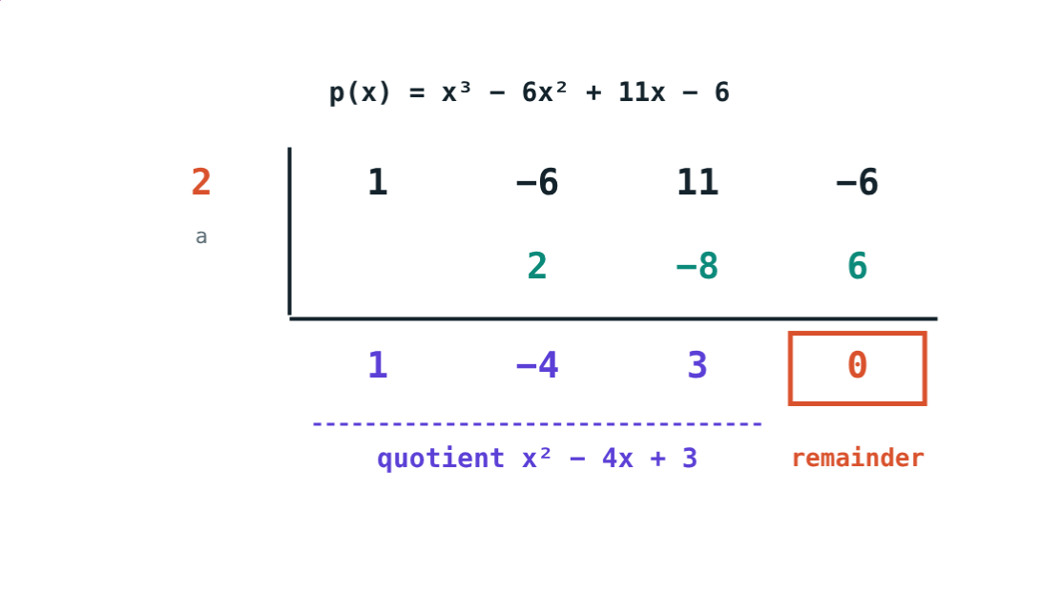
Operations and Synthetic Division
STD 9 MATHEMATICS PART I · CH. 3 POLYNOMIALS
Lesson 2 · Visual Science & Maths
Notes:
Goal: students can add, subtract and multiply polynomials, state the division algorithm, and divide by x − a with synthetic division.

Slide 2
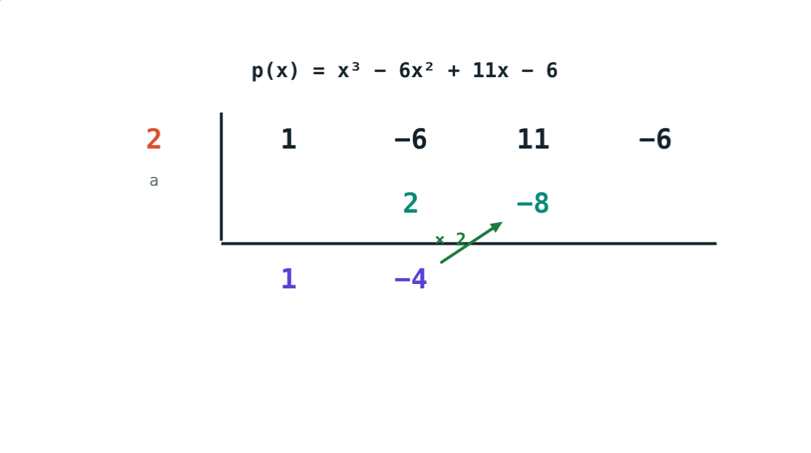
Division without x
To divide x³ − 6x² + 11x − 6 by x − 2 you only need the numbers 1, −6, 11, −6 and 2.
How can a table of numbers do the division?
Bring down, multiply, add…
Notes:
Do the long division on the board first; then show how the table copies it.

Slide 3
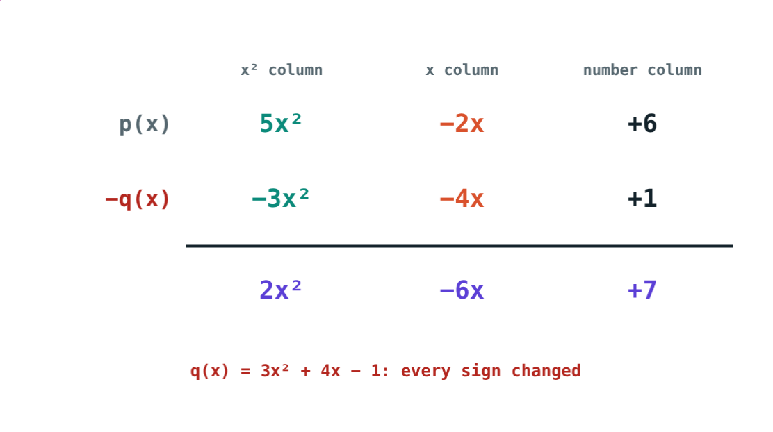
Add and subtract
Collect like terms: same power of x
Line up x² under x², x under x
To subtract, change every sign, then add
(5x² − 2x + 6) − (3x² + 4x − 1) = 2x² − 6x + 7
Subtracting: signs of q(x) changed
Notes:
Brackets with a minus in front are the main source of errors.

Slide 4
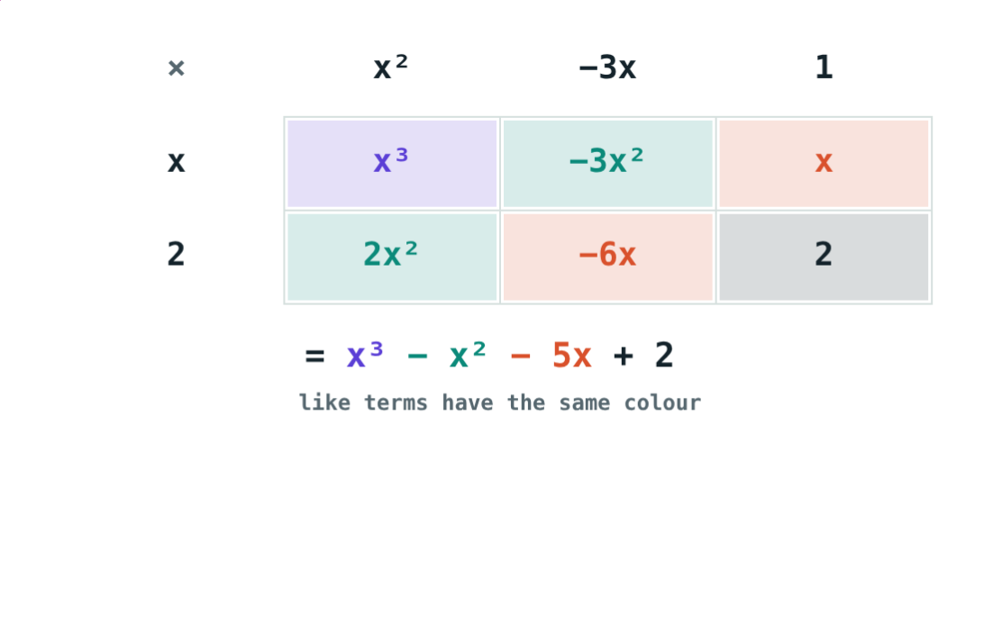
Multiply
Every term times every term
xᵐ × xⁿ = xᵐ⁺ⁿ
Then collect like terms
Degree of product = sum of degrees
(x + 2)(x² − 3x + 1) = x³ − x² − 5x + 2
Notes:
The grid shows like terms in the same colour.

Slide 5
Division algorithm
p(x) = s(x) × q(x) + r(x)
Dividend = Divisor × Quotient + Remainder
r(x) = 0, or degree r(x) < degree s(x)
Dividing by x − a leaves a number
Quotient x² − 4x + 3, remainder 0
Notes:
Long division of polynomials follows the same steps as long division of numbers.

Slide 6
Synthetic division by x − a
1
2
3
4
Coefficients
Bring down
× a, then add
Read
Standard form, 0 for missing powers. a on the left.
Write the first coefficient below the line.
Multiply by a, write under the next, add. Repeat.
Last number: remainder. Others: the quotient.
Notes:
For x + 3, a = −3.

Slide 7
Worked examples
Subtract
Multiply
(5x² − 2x + 6) − (3x² + 4x − 1)
(2x − 3)(x² + x − 2)
5x² − 2x + 6 − 3x² − 4x + 1
= 2x² − 6x + 7
2x³ + 2x² − 4x − 3x² − 3x + 6
= 2x³ − x² − 7x + 6
Notes:
Check by putting x = 1 in both sides.

Slide 8
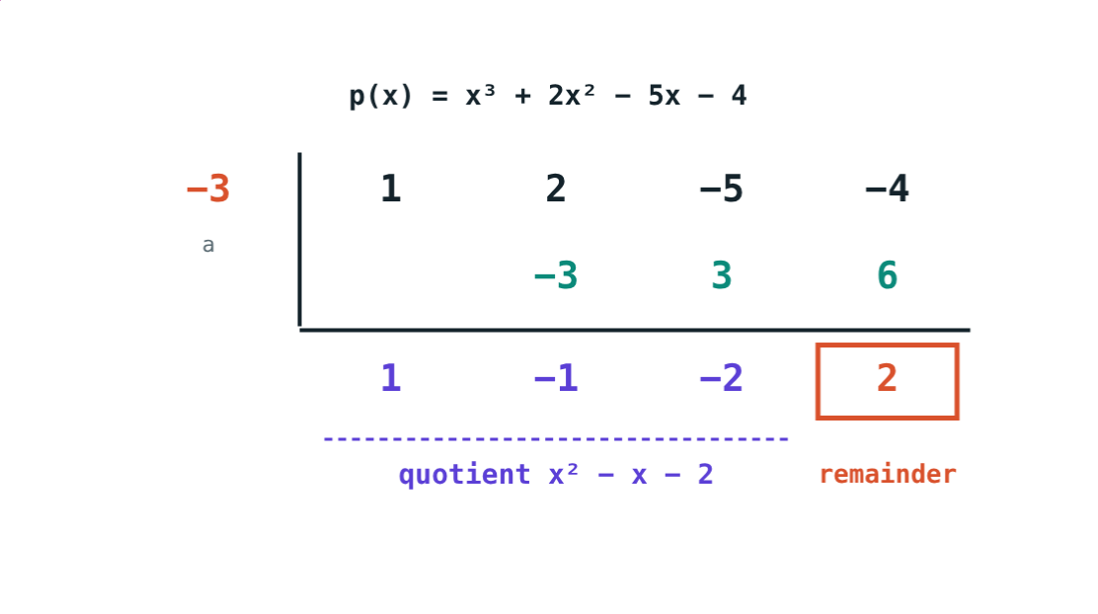
Worked example: divide by x + 3
Divide x³ + 2x² − 5x − 4 by x + 3.
a = −3: 1, −1, −2 | 2
Quotient x² − x − 2, remainder 2
= (x + 3)(x² − x − 2) + 2
a = −3
Notes:
Write the answer in the form Dividend = Divisor × Quotient + Remainder.

Slide 9
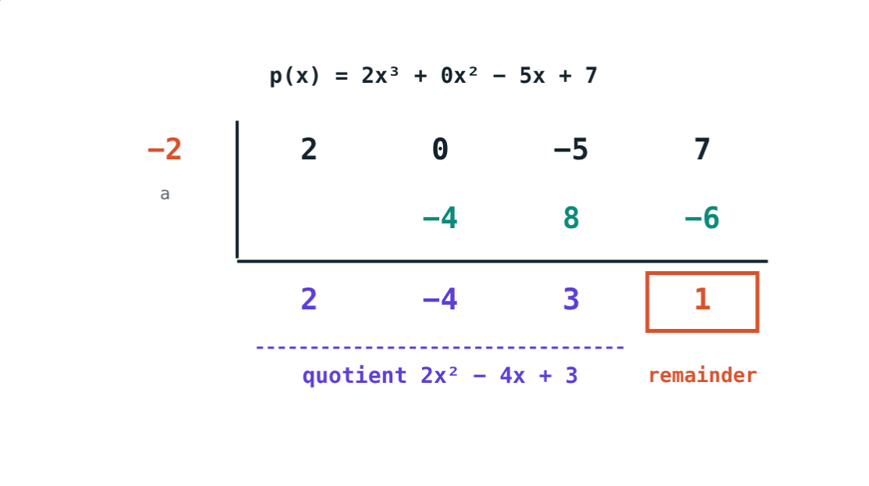
A missing power
There is no x² term, so its coefficient is 0:
2, 0, −5, 7
coefficients
1
remainder
(2x³ − 5x + 7) ÷ (x + 2)
Quotient 2x² − 4x + 3.
Notes:
Without the 0, every later column shifts and the answer is wrong.

Slide 10

Common mistakes
Skipping a power
+3 for x + 3
Write 0 for a missing term.
Use a = −3.
One sign changed
Multiplying degrees
−(x² + 2x − 4) = −x² − 2x + 4.
Degrees add in a product.
Notes:
The first two mistakes are only in synthetic division.

Slide 11
Quick check
1
Add (3x² + x − 2) and (x² − 4x + 5).
2
Find the degree of (x² + 1)(x³ − 2).
3
Dividing by x + 4, which number goes on the left?
4
Quotient x² + 2, remainder 3, divisor x − 1. Find p(x).
Notes:
Answers: 1) 4x² − 3x + 3. 2) 5. 3) −4. 4) x³ − x² + 2x + 1.

Slide 12
Fill the table yourself
Open the Operations and Synthetic Division lesson on the Visual Science & Maths website. Watch every cell of the table fill.
Next lesson: Remainder and factor theorems
Notes:
Homework: divide x⁴ − 16 by x − 2 and check with the simulation.

