Slide 1
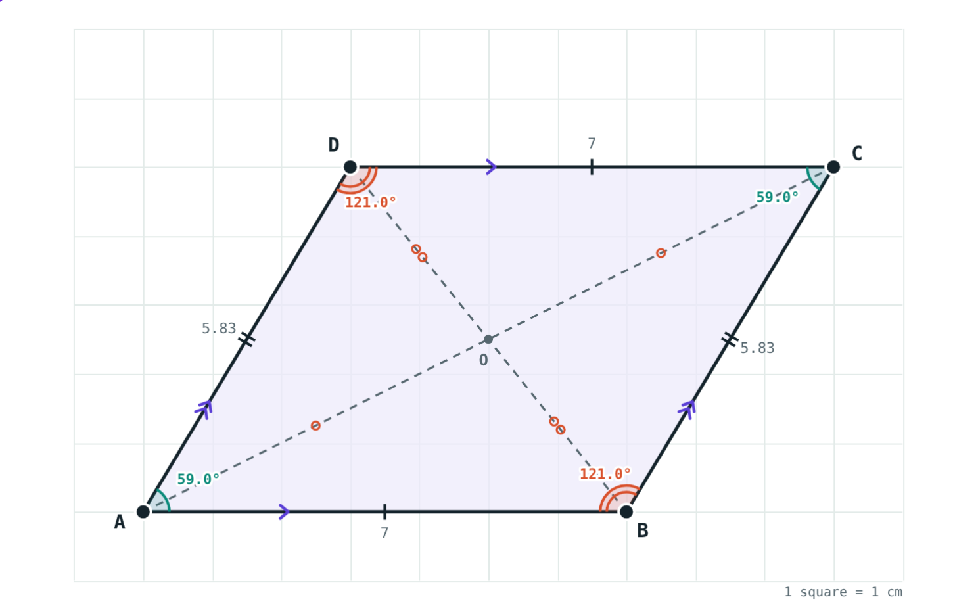
Parallelograms
STD 9 MATHEMATICS PART II · CH. 5 QUADRILATERALS
Lesson 1 · Visual Science & Maths
Notes:
Goal: students know the properties of a parallelogram (opposite sides and angles congruent, diagonals bisect each other, adjacent angles supplementary) and the tests for a parallelogram.

Slide 2
A gate that leans
Push a rectangular gate sideways. It slants, but its opposite bars stay parallel.
What stays the same when it leans?
Opposite bars stay parallel
Notes:
A folding gate or a scissor lift shows the same thing.

Slide 3
What is a parallelogram?
Both pairs of opposite sides are parallel
□ABCD: AB ∥ DC and AD ∥ BC
Opposite sides: AB and DC; adjacent sides: AB and BC
Opposite angles: ∠A and ∠C; adjacent: ∠A and ∠B
Arrows mark parallel sides
Notes:
Read the letters in order round the shape to find opposite sides.

Slide 4
Properties
AB = CD
∠A = ∠C
AO = OC
180°
Opposite sides
Opposite angles
Diagonals
Adjacent angles
Opposite sides of a parallelogram are congruent.
Opposite angles of a parallelogram are congruent.
The diagonals bisect each other.
Adjacent angles are supplementary.
Notes:
Proof: diagonal AC splits the parallelogram into △ABC ≅ △CDA (A-S-A, using alternate angles).

Slide 5
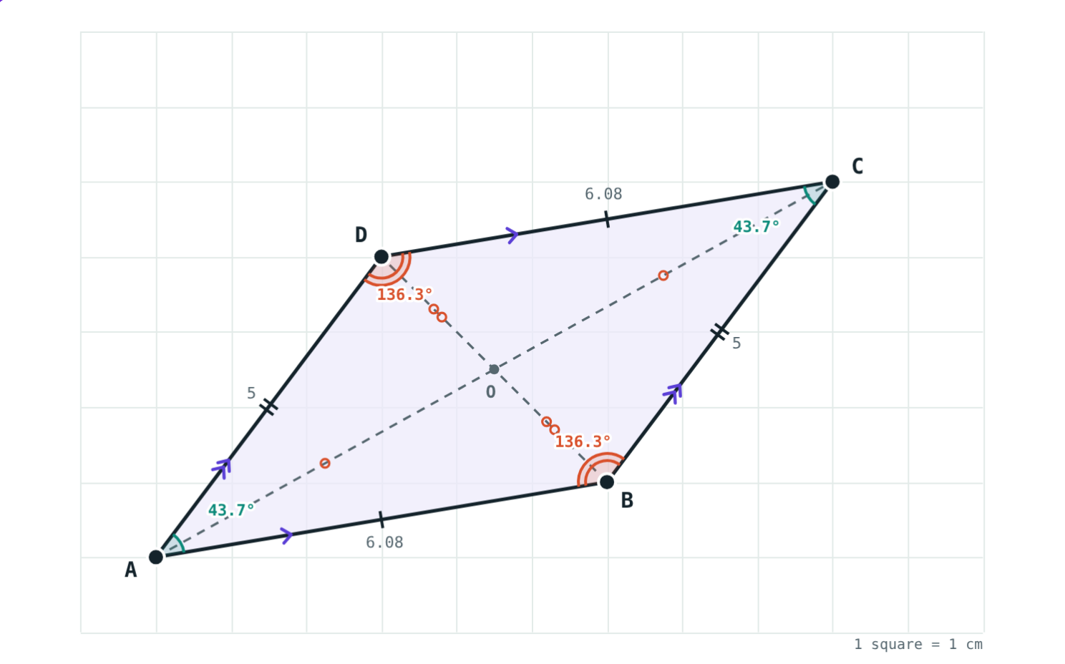
Tests for a parallelogram
A quadrilateral is a parallelogram if any one of these is true:
Both pairs of opposite sides congruent
Both pairs of opposite angles congruent
Diagonals bisect each other
One pair of opposite sides parallel and congruent
AB and DC: parallel and congruent
Notes:
Stress “any one”: a single test is enough.

Slide 6
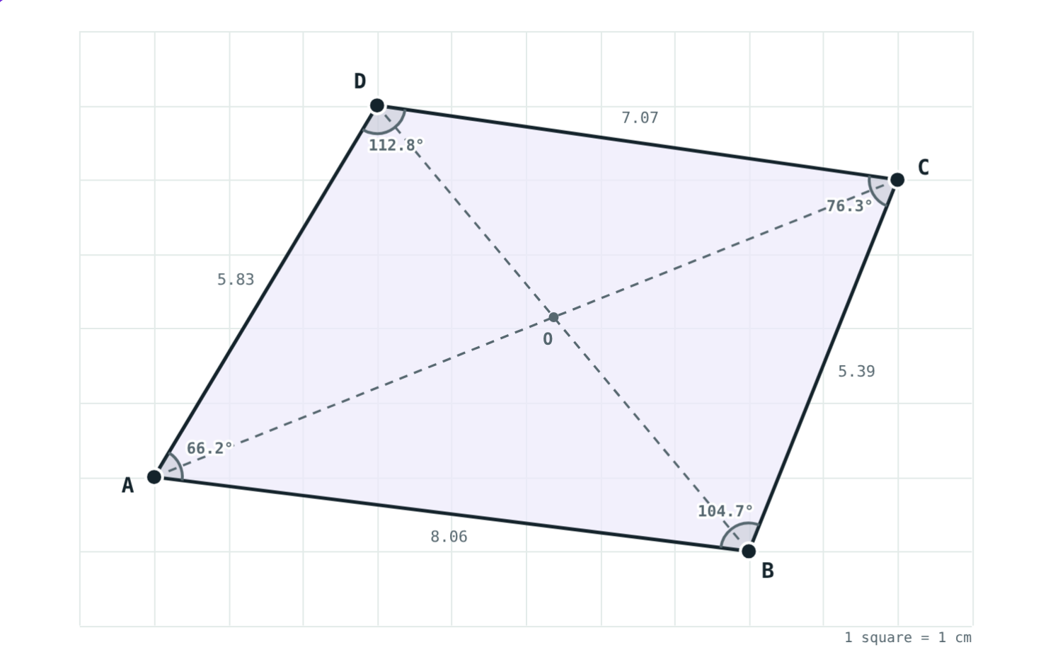
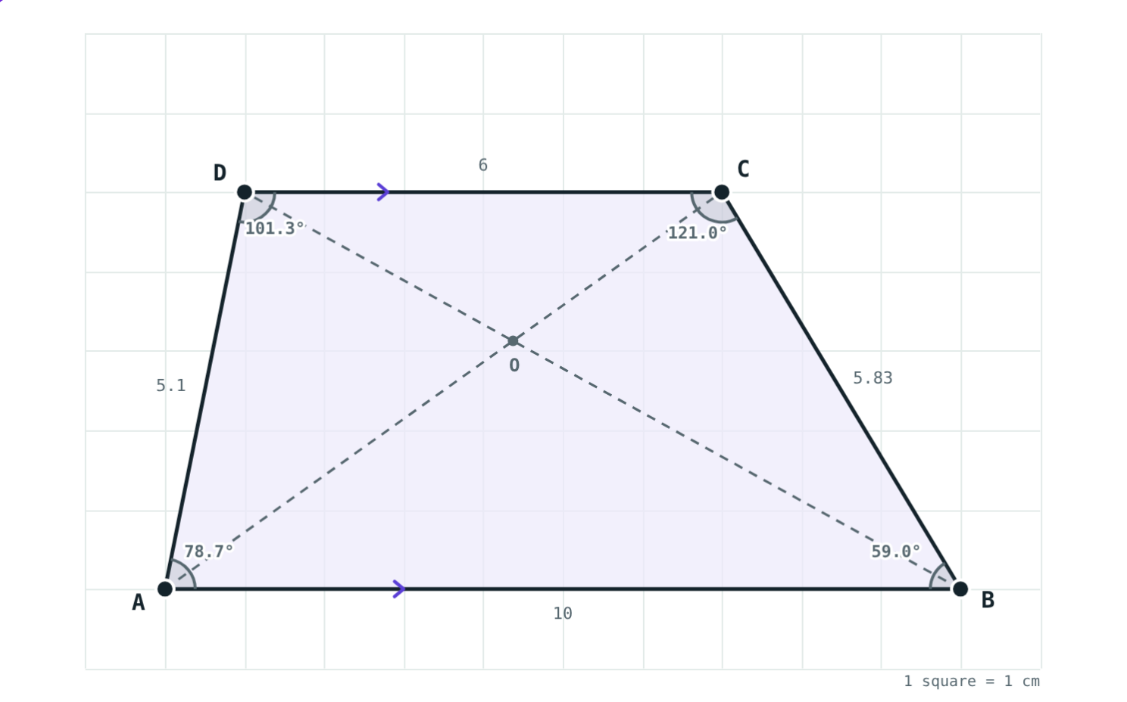
Not parallelograms
No parallel sides: every test fails.
Only AB ∥ DC: AB = 10, CD = 6.
Notes:
One pair of parallel sides is not enough, unless that pair is also congruent.

Slide 7
Worked examples
Angles
Sides
In parallelogram PQRS, ∠P = 70°. Find the other angles.
Perimeter 64 cm and AB : BC = 5 : 3. Find the sides.
∠R = ∠P = 70° (opposite)
∠Q = 180° − 70° = 110°
∠R = 70°, ∠Q = ∠S = 110°
2(AB + BC) = 64, AB + BC = 32
8k = 32, k = 4
AB = CD = 20 cm, BC = AD = 12 cm
Notes:
Example 2 uses the ratio method from Algebra.

Slide 8
Worked example: use a test
On a centimetre grid A is at (1, 1), B (7, 2), C (10, 6), D (4, 5). Is ABCD a parallelogram?
A to B: 6 right, 1 up
D to C: 6 right, 1 up
AB ∥ DC and AB = DC: a parallelogram
A(1, 1), B(7, 2), C(10, 6), D(4, 5)
Notes:
The simulation confirms BC = DA = 5 cm and ∠A = ∠C ≈ 43.7°.

Slide 9
Diagonals bisect each other
In the parallelogram on the left:
5.59
AO = OC (cm)
3.2
BO = OD (cm)
The halves are equal, but the two diagonals are not equal to each other.
AB = 7 cm, BC = 5.83 cm
Notes:
Equal diagonals happen only in a rectangle or square; that is the next lesson.

Slide 10

Common mistakes
Adjacent angles equal
Diagonals equal
Opposite angles are equal; adjacent ones add to 180°.
They bisect each other but are equal only in a rectangle.
One parallel pair is enough
Opposite vs adjacent
That is a trapezium. The pair must also be congruent.
In □ABCD, AB is opposite DC, not BC.
Notes:
Ask students to give a counter-example shape for each wrong idea.

Slide 11
Quick check
1
In parallelogram ABCD, ∠B = 125°. Find ∠D.
2
In parallelogram ABCD, ∠A = 72°. Find ∠B.
3
Diagonals of parallelogram PQRS meet at O and PO = 6 cm. Find PR.
4
Is “one pair of opposite sides parallel” enough to prove a parallelogram?
Notes:
Answers: 1) 125° (opposite angles). 2) 108° (adjacent angles are supplementary). 3) 12 cm. 4) No: a trapezium has one parallel pair.

Slide 12
Bend the parallelogram yourself
Open the Parallelograms lesson on the Visual Science & Maths website. Tick “Keep ABCD a parallelogram” and drag the corners.
Next lesson: Rectangle, rhombus, square and trapezium
Notes:
Homework: draw a parallelogram on squared paper and measure its sides, angles and diagonal halves.

