Slide 1
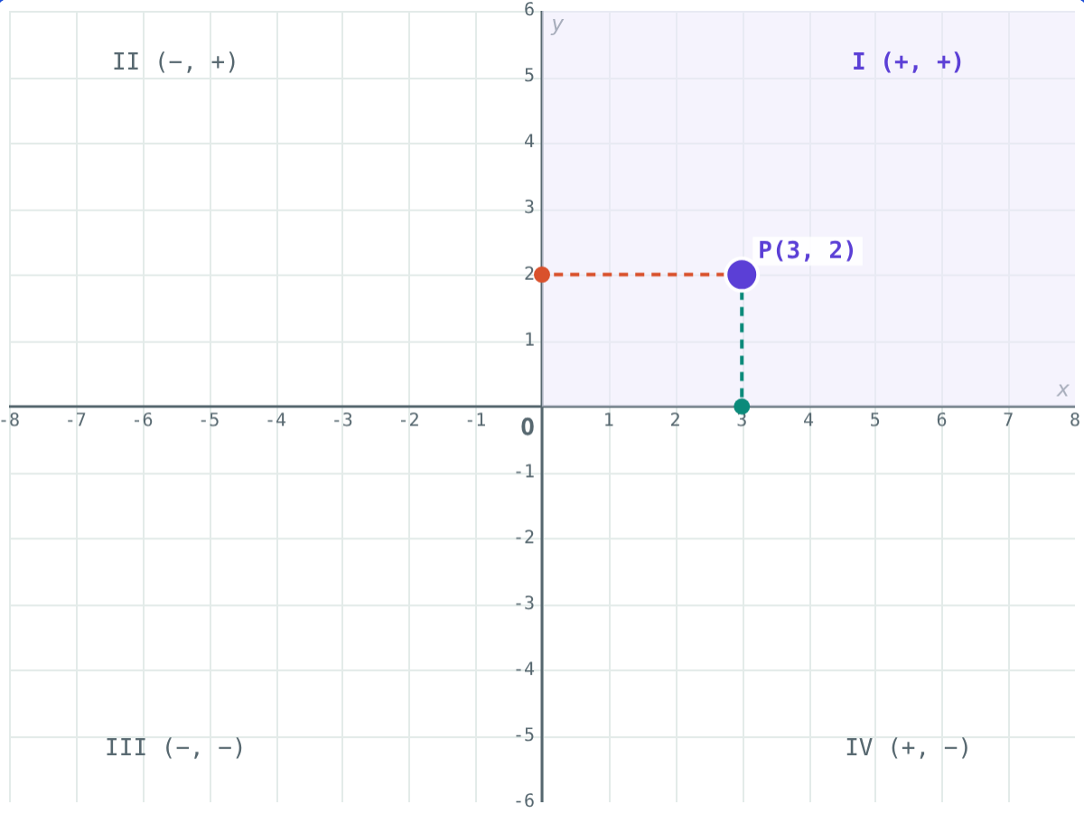
Axes, Quadrants and Plotting Points
STD 9 MATHEMATICS PART II · CH. 7 CO-ORDINATE GEOMETRY
Lesson 1 · Visual Science & Maths
Notes:
Goal: students can name the axes and origin, read and write the co-ordinates of a point, give the quadrant from the signs, and plot any point.

Slide 2
Two numbers, one place
“Meet me at the bench two steps east and three steps north of the gate.” One number fixes a point on a line. A point in a plane needs two.
How do we give every point of a page its own address?
P(3, 2): 3 right, 2 up from O
Notes:
Ask how a cinema seat is found: row and seat number. Two numbers, in a fixed order.

Slide 3
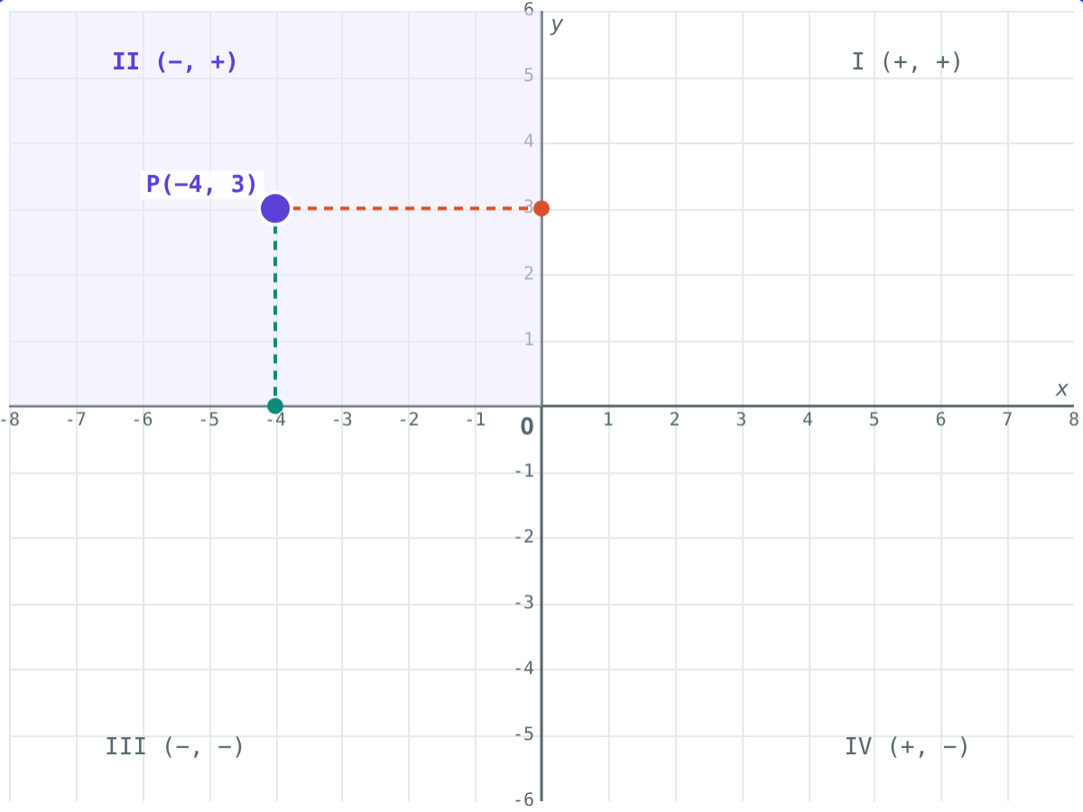
Axes and origin
X-axis: the horizontal number line
Y-axis: the vertical number line
They meet at right angles at the origin O
Right of O and above O: positive
Left of O and below O: negative
Perpendiculars from P meet the axes at −4 and 3
Notes:
Start from one number line: point A 4 units left of O has co-ordinate −4. Then add the second line.

Slide 4
Co-ordinates of a point
P(x, y)
Drop perpendiculars from P to both axes
Foot on the X-axis: the x co-ordinate
Foot on the Y-axis: the y co-ordinate
x first: (x, y) is an ordered pair
The origin is O(0, 0)
x co-ordinate 3, y co-ordinate 2
Notes:
Stress the order. (3, 2) and (2, 3) are different points.

Slide 5
Quadrants and signs
Quadrant | x co-ordinate | y co-ordinate | Example
I (top right) | + | + | (4, 1)
II (top left) | − | + | (−2, 5)
III (bottom left) | − | − | (−6, −3)
IV (bottom right) | + | − | (1, −4)
On the X-axis | any | 0 | (7, 0)
On the Y-axis | 0 | any | (0, −5)
Notes:
Quadrants are numbered anticlockwise from the top right. Points on an axis are not in any quadrant.

Slide 6
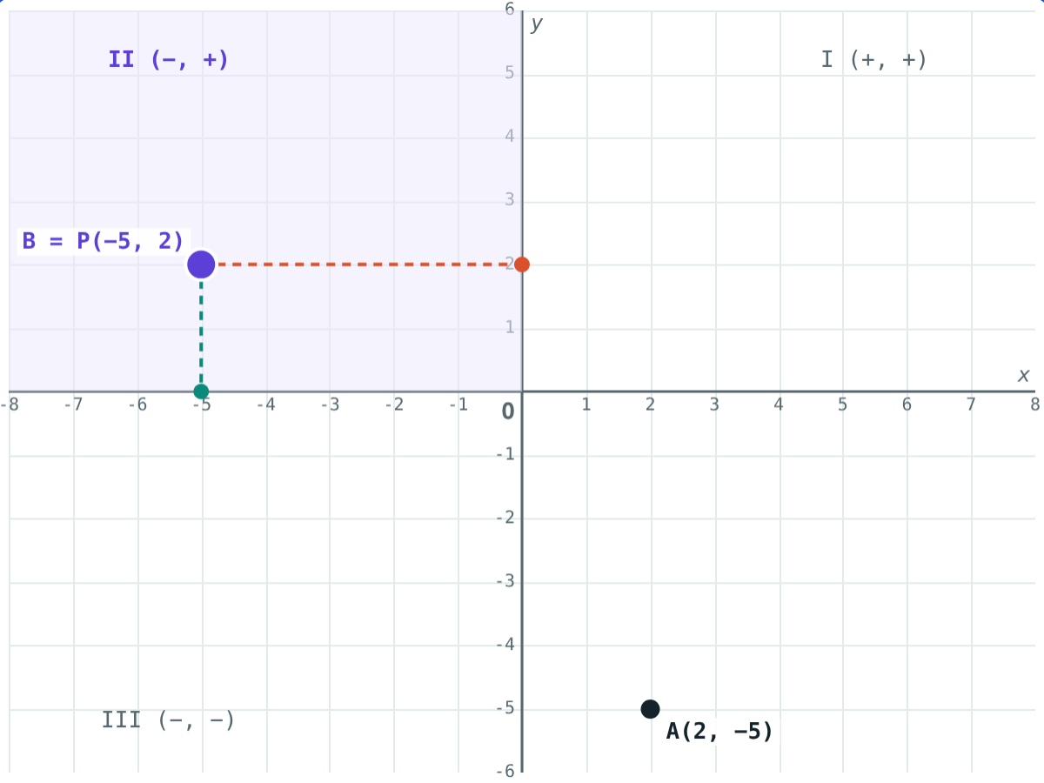
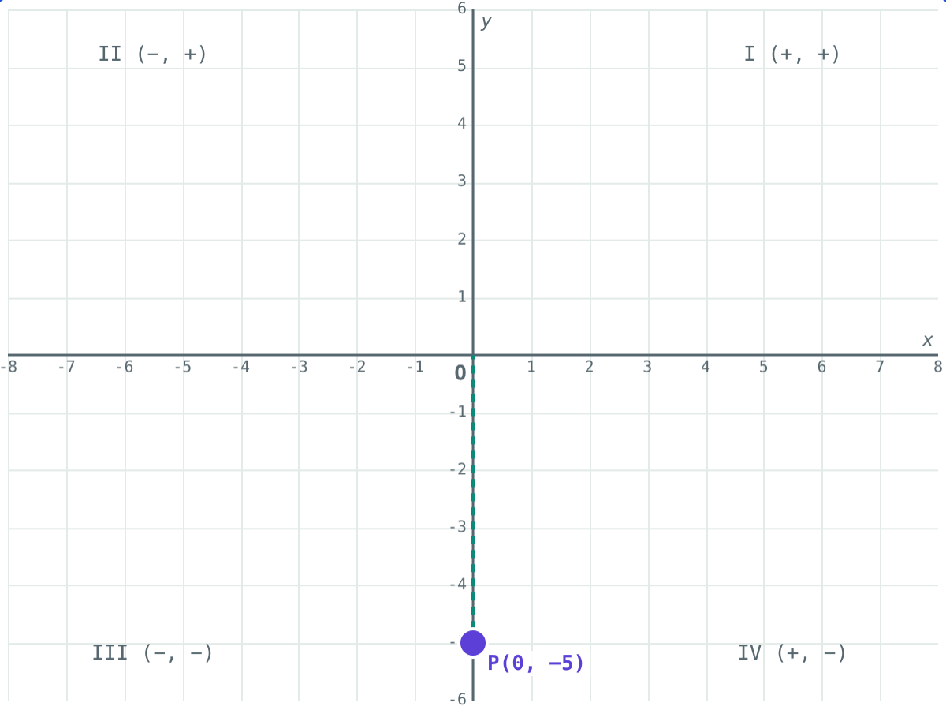
Order matters
A(2, −5) is in Quadrant IV; B(−5, 2) is in Quadrant II.
(0, −5): x is 0, so it is on the Y-axis, in no quadrant.
Notes:
Ask: which co-ordinate is 0 for every point on the X-axis? (y)

Slide 7
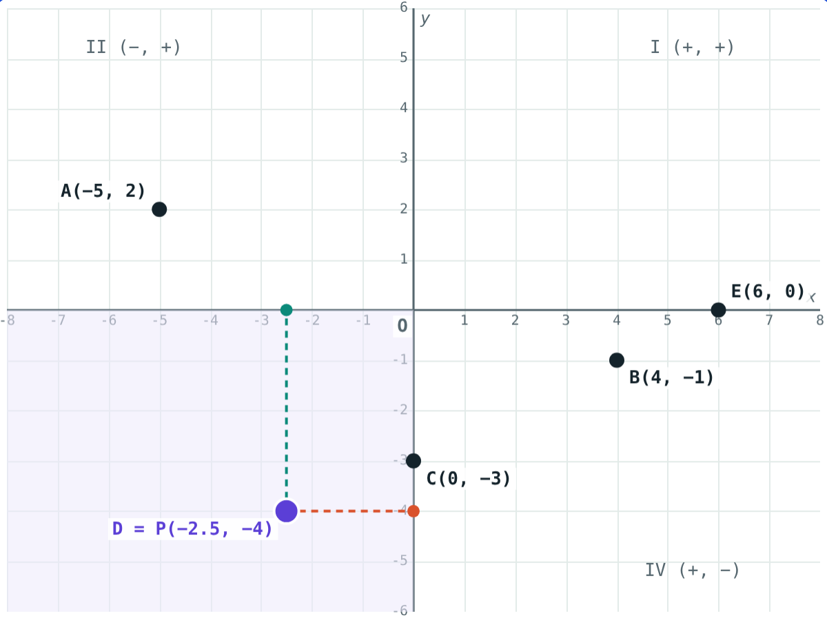
Worked example: quadrant or axis?
Where do A(−5, 2), B(4, −1), C(0, −3), D(−2.5, −4) and E(6, 0) lie?
A (−, +): Quadrant II
B (+, −): Quadrant IV
C: x = 0, on the Y-axis
D (−, −): Quadrant III
E: y = 0, on the X-axis
A, B, C, D and E plotted
Notes:
Look at the signs only; there is no need to plot.

Slide 8
Worked examples
Plot and name
Reason with signs
Plot P(−4, −2), Q(3, −2), R(3, 2), S(−4, 2) and join them. What is PQRS?
(a, b) is in Quadrant II. Where is (b, a)?
PQ = 3 − (−4) = 7, QR = 2 − (−2) = 4
Right angles at every corner: rectangle 7 by 4
a < 0 and b > 0
(b, a) has signs (+, −): Quadrant IV
Notes:
For the second example, test with numbers: (−3, 5) and (5, −3).

Slide 9
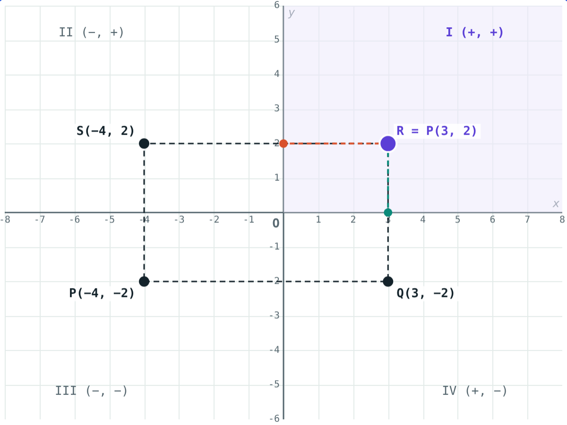
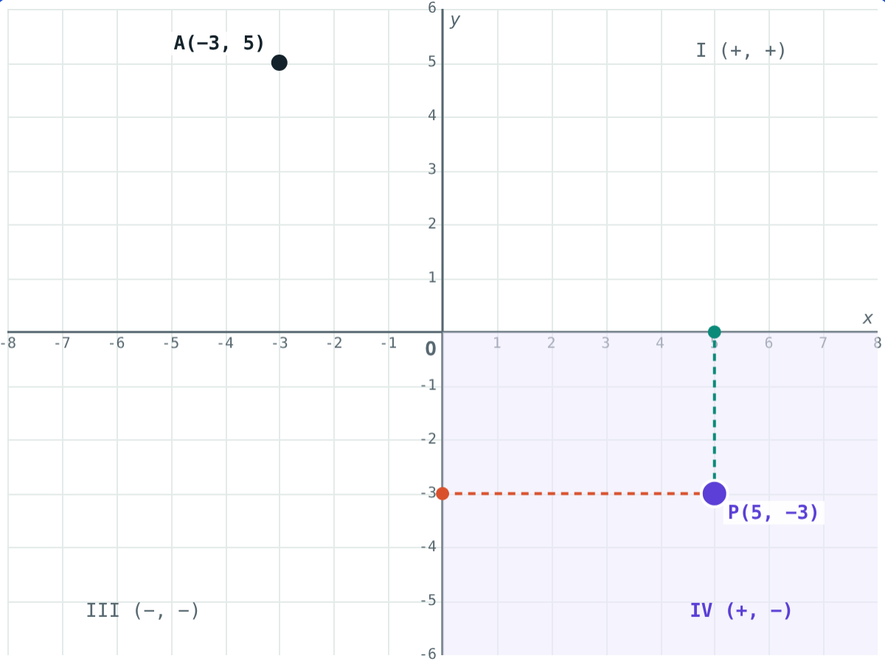
See the answers
PQRS is a rectangle, 7 units by 4 units.
(−3, 5) is in Quadrant II; (5, −3) is in Quadrant IV.
Notes:
Students can set both pictures up in the simulation from the worked examples.

Slide 10

Common mistakes
Writing y first
Ignoring the minus sign
(x, y): (1, 4) is 1 right and 4 up.
x = −3 is 3 units left of O.
Axis points in a quadrant
Clockwise numbering
(0, 6) and (−2, 0) are on the axes.
I, II, III, IV go anticlockwise from the top right.
Notes:
Ask a student to plot (1, 4) and (4, 1) on the board to show the first mistake.

Slide 11
Quick check
1
In which quadrant does (−7, −2) lie?
2
Where does the point (0, 4) lie?
3
x is positive and y is negative. Which quadrant?
4
From O, how do you move to plot (−2, 5)?
Notes:
Answers: 1) Quadrant III. 2) On the Y-axis. 3) Quadrant IV. 4) 2 units left, then 5 units up.

Slide 12
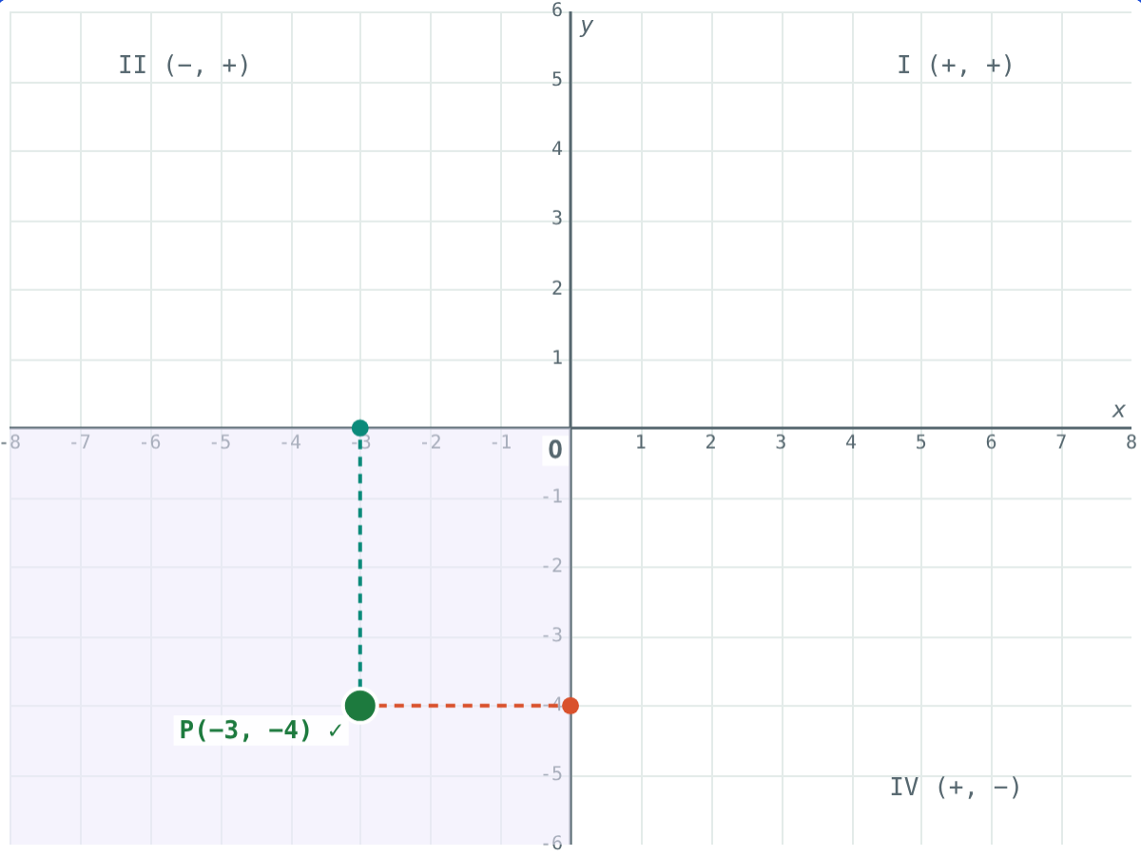
Plot the points yourself
Open the Axes, Quadrants and Plotting Points lesson on the Visual Science & Maths website. Try “Find the point”: the co-ordinates are hidden until you check.
Next lesson: Lines parallel to the axes
Notes:
Homework: plot six points of your choice, two on the axes, and name where each lies.

