Slide 1
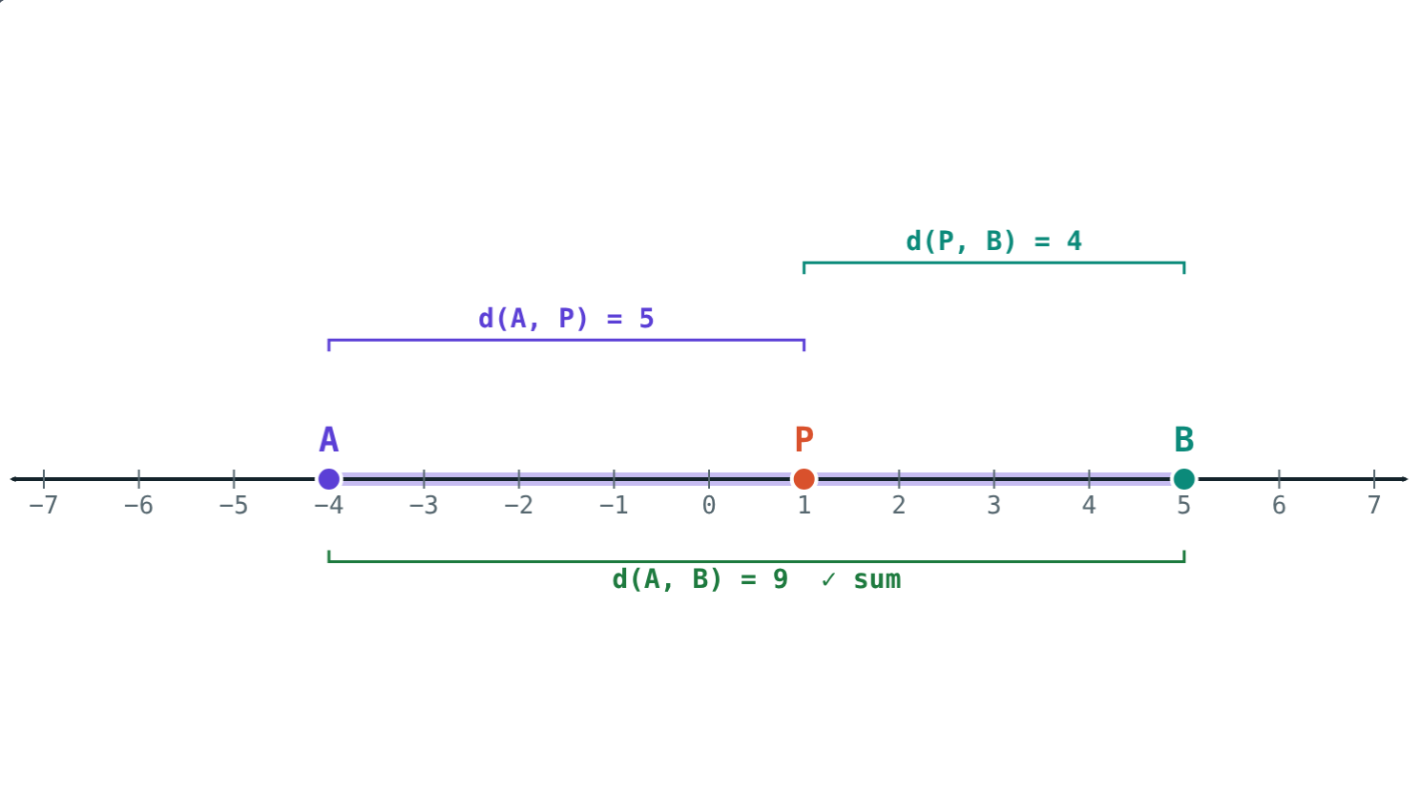
Points, Lines and Distance
STD 9 MATHEMATICS PART II · CH. 1 BASIC CONCEPTS IN GEOMETRY
Lesson 1 · Visual Science & Maths
Notes:
Goal: students can find the distance between two points from their co-ordinates, decide which of three points is between the others, and find a midpoint.

Slide 2
Three towns on a road
Asha walks 5 km from town A to town B, then 4 km more to town C. The road is straight.
How far is A from C? Could the answer be 1 km?
5 + 4 = 9: B is between A and C
Notes:
If B is between A and C the answer is 9 km. If C lies back between A and B, it is 1 km. Both are possible until we know the order.

Slide 3



Point, line and plane
Point
Line
Plane
Not defined. A sharp pencil tip suggests a point.
No end on either side. One line through two distinct points.
A flat surface without edges, like a table top that goes on.
Notes:
These are basic concepts: we understand them from examples, not definitions. Points on one line are collinear.

Slide 4
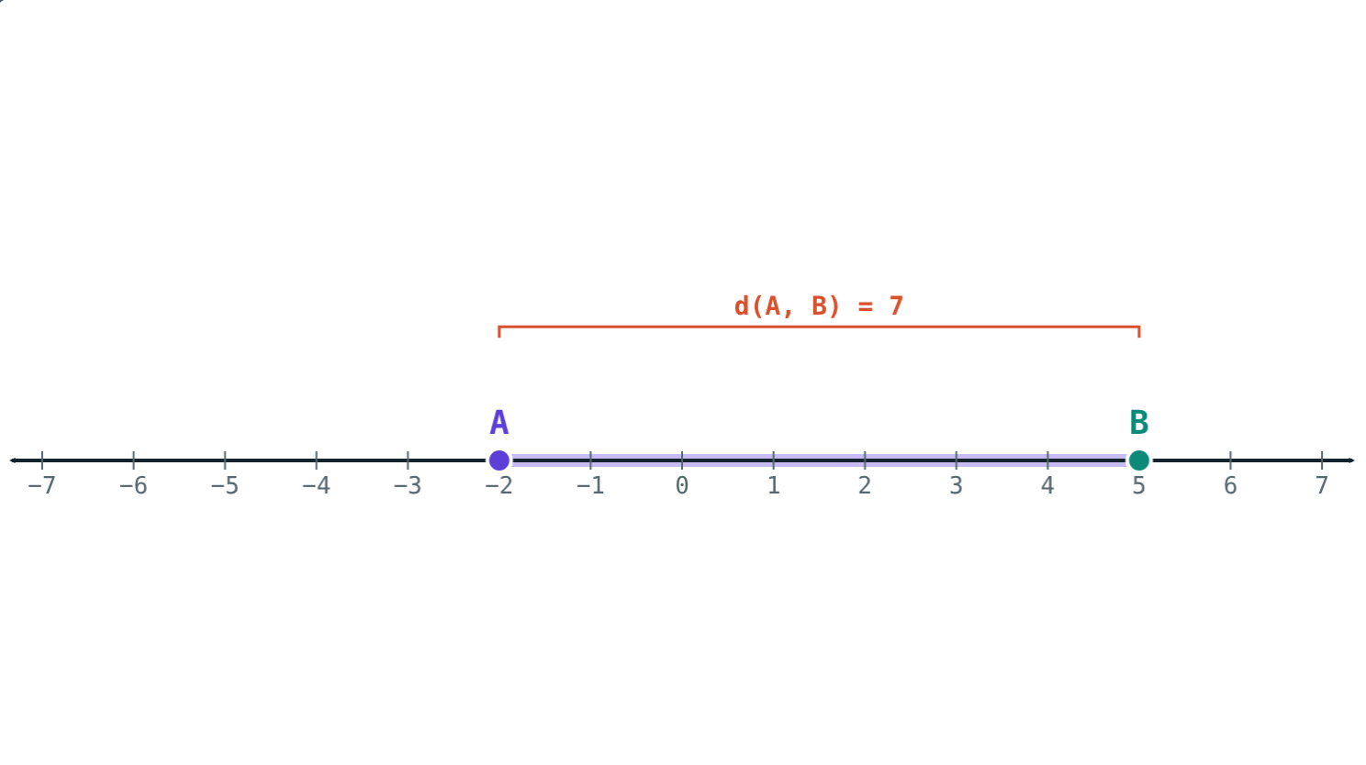
Distance between two points
d(A, B) = a − b if a > b
Every point on a line has a co-ordinate
Greater co-ordinate minus smaller
Never negative: d(A, B) = d(B, A)
5 − (−2) = 7
Notes:
Write negative co-ordinates in brackets before subtracting. It can also be written |a − b|.

Slide 5
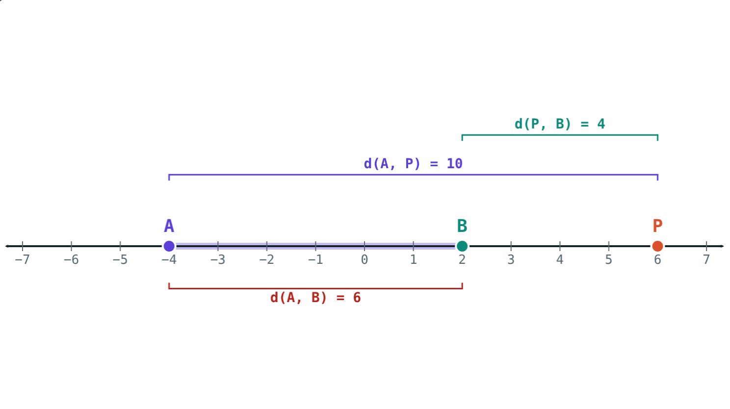
Betweenness: P-Q-R
5 + 4 = 9 = d(A, B), so P is between: A-P-B.
10 + 4 = 14 ≠ 6: P is not between A and B.
Notes:
Q is between P and R if the three points are distinct, collinear and d(P, Q) + d(Q, R) = d(P, R).

Slide 6
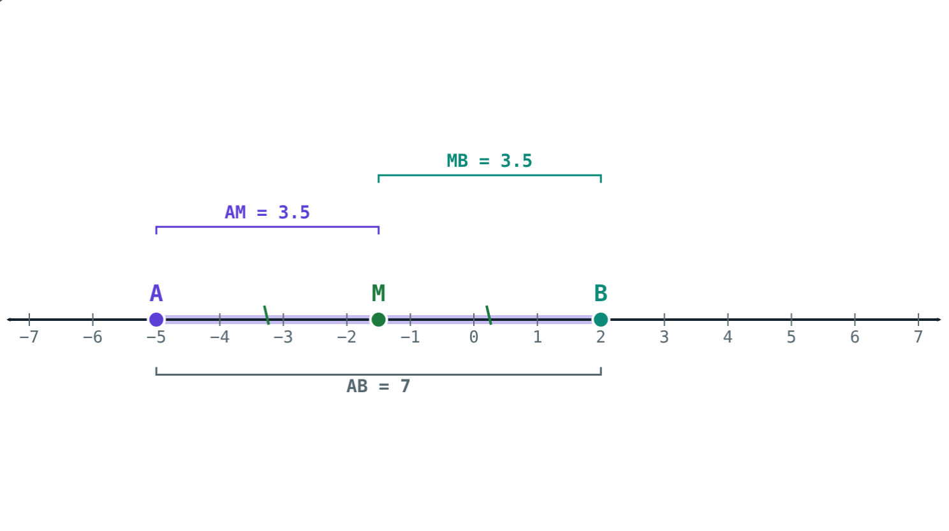
Segment, ray and midpoint
seg AB: A, B and all points between them
Equal lengths: congruent segments
Midpoint M: A-M-B and seg AM ≅ seg MB
Every segment has exactly one midpoint
M at (−5 + 2) ÷ 2 = −1.5
Notes:
Ray AB starts at A and goes on through B without end. If l(AB) < l(CD), seg AB < seg CD.

Slide 7
Worked examples
From co-ordinates
Which is between?
P and Q are at −3 and 4. Find d(P, Q).
d(A, B) = 5, d(B, C) = 8, d(A, C) = 3.
4 > −3, so 4 − (−3)
= 4 + 3 = 7
Largest: d(B, C) = 8
5 + 3 = 8, so B-A-C
Notes:
First find the largest distance; the point shared by the two smaller ones is in the middle.

Slide 8
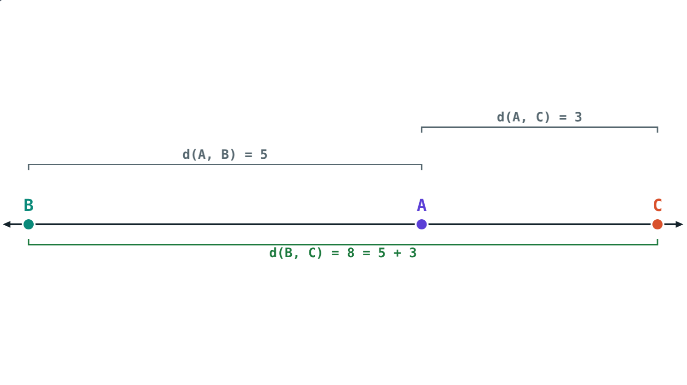
Worked example: two answers
X, Y, Z are collinear, d(X, Y) = 6 and d(Y, Z) = 2.5. Find d(X, Z).
X-Y-Z: 6 + 2.5 = 8.5
X-Z-Y: 6 − 2.5 = 3.5
d(X, Z) = 8.5 or 3.5
Draw both orders
Notes:
Y-X-Z is impossible because d(Y, Z) would then be more than 6.

Slide 9
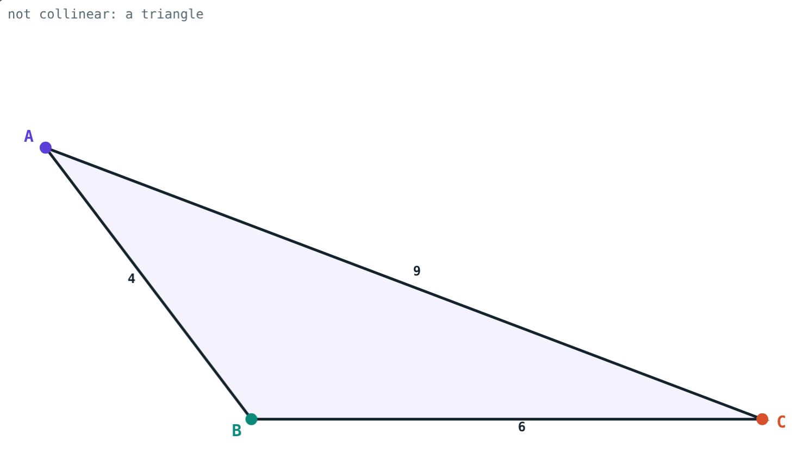
Collinear or not?
4 + 6 = 10 ≠ 9: not collinear, a triangle.
5 + 3 = 8: collinear, B-A-C.
Notes:
Three non-collinear points make a triangle.

Slide 10

Common mistakes
Negative distance
Sign slips
Subtract the smaller co-ordinate from the greater.
4 − (−3) = 4 + 3 = 7, not 1.
Guessing the middle
Halving the co-ordinate
Check that the two smaller distances add up.
Midpoint of −5 and 2 is −1.5, not 1.
Notes:
Ask students to find their own example of each slip.

Slide 11
Quick check
1
P and Q are at −5 and 3. Find d(P, Q).
2
d(A, B) = 7, d(B, C) = 4, d(A, C) = 11. Which point is between?
3
M is the midpoint of seg RS and l(RS) = 13. Find l(RM).
4
How many lines pass through two distinct points?
Notes:
Answers: 1) 3 − (−5) = 8. 2) 7 + 4 = 11, so B: A-B-C. 3) 6.5. 4) Exactly one.

Slide 12
Measure along the line yourself
Open the Points, Lines and Distance lesson on the Visual Science & Maths website. Drag the points and watch the distances add up.
Next lesson: Conditional statements and proofs
Notes:
Homework: find the two points at distance 6 from the point at −3 (answer: 3 and −9).

