Slide 1
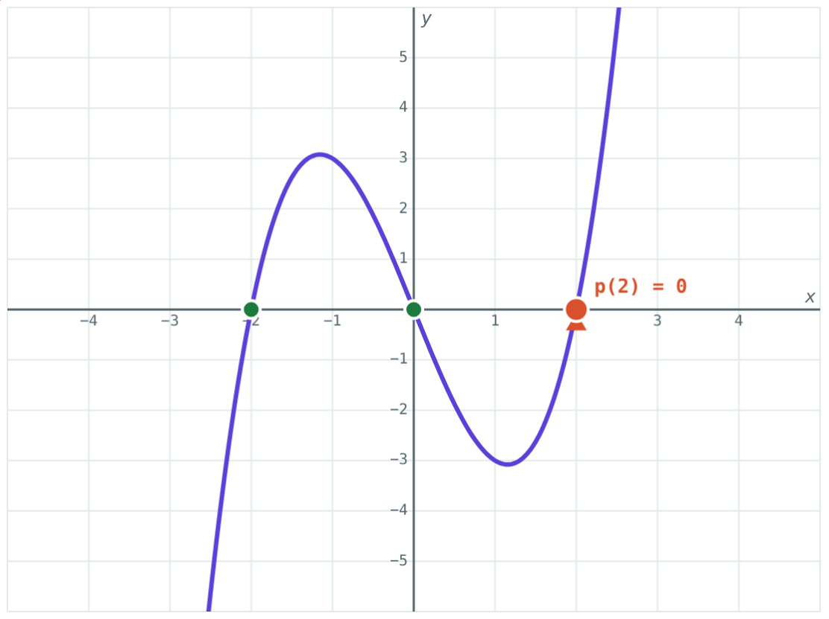
Polynomials and Their Degree
STD 9 MATHEMATICS PART I · CH. 3 POLYNOMIALS
Lesson 1 · Visual Science & Maths
Notes:
Goal: students can recognise a polynomial, state its degree and type, write coefficient and index forms, and find p(a).

Slide 2
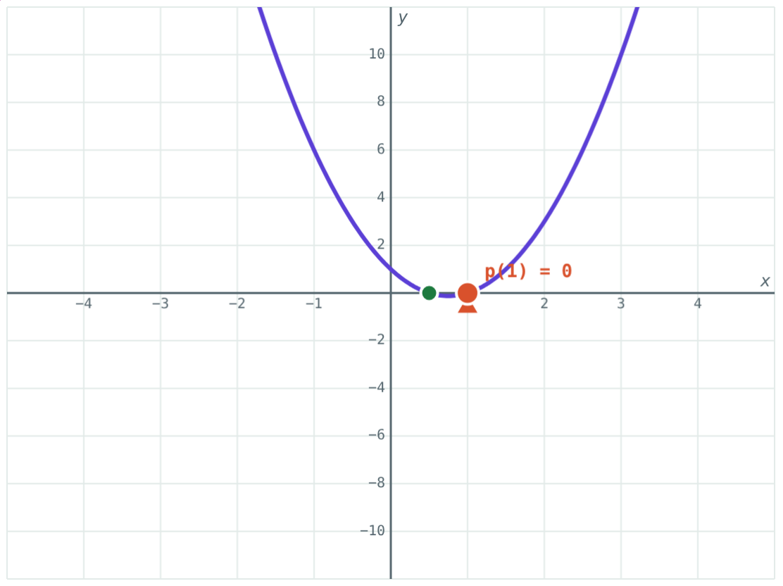
Polynomial or not?
3x² − 5x + 1, x + 1/x, √2 m − 4, √x + 2
Which of these are polynomials?
2x² − 3x + 1
Notes:
3x² − 5x + 1 and √2 m − 4 are polynomials. x + 1/x = x + x⁻¹ and √x + 2 = x^½ + 2 are not.

Slide 3
What is a polynomial?
Powers of the variable are whole numbers
Coefficients can be any real numbers
Written p(x), q(y), …
Degree: the highest power
Constant 7 has degree 0; zero polynomial: not defined
x³ − 4x: degree 3
Notes:
In two variables, the degree is the highest sum of powers in a term: 3x²y³ + 5xy has degree 5.

Slide 4
Types of polynomials
By terms | Example | By degree | Example
Monomial | −2x³ | Linear (1) | 3x − 6
Binomial | x³ − 4x | Quadratic (2) | 2x² − 3x + 1
Trinomial | y² + 5y − 1 | Cubic (3) | x³ − 4x
Notes:
A polynomial has one name from each column: x³ − 4x is a cubic binomial.

Slide 5
Three ways to write it
x⁴ − 2x + 5
(1,0,0,−2,5)
5x³ − x + 3
Standard form
Coefficient form
Index form
Terms in descending powers of x.
Only coefficients, with 0 for each missing power.
Written with the powers of x: (5, 0, −1, 3).
Notes:
Count the entries: 5 coefficients means the polynomial starts at x⁴.

Slide 6
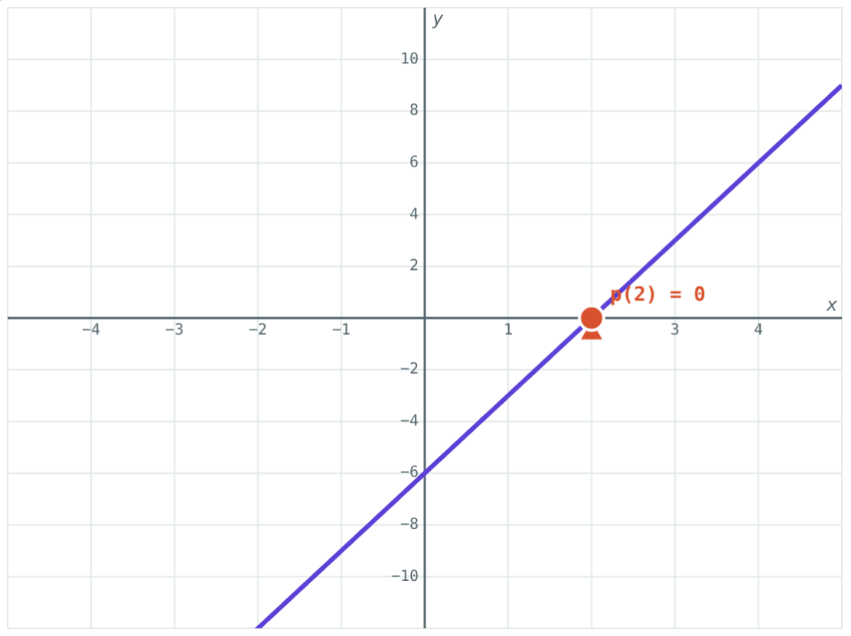
Value of a polynomial
Substitute a for x: p(a)
p(x) = x² − 3x + 2: p(2) = 0, p(−1) = 6
p(a) is the height of the graph at x = a
p(a) = 0: a is a zero
3x − 6: p(2) = 0
Notes:
Put negative values in brackets before squaring or cubing.

Slide 7
Worked examples
Degree and type
Coefficient and index form
7y³ − 2y + 4 and 5m
x³ − 5x + 2 and (2, −1, 0, 4)
7y³ − 2y + 4: cubic trinomial
5m: linear monomial
x³ − 5x + 2 → (1, 0, −5, 2)
(2, −1, 0, 4) → 2x³ − x² + 4
Notes:
The 0 in (1, 0, −5, 2) stands for the missing x² term.

Slide 8
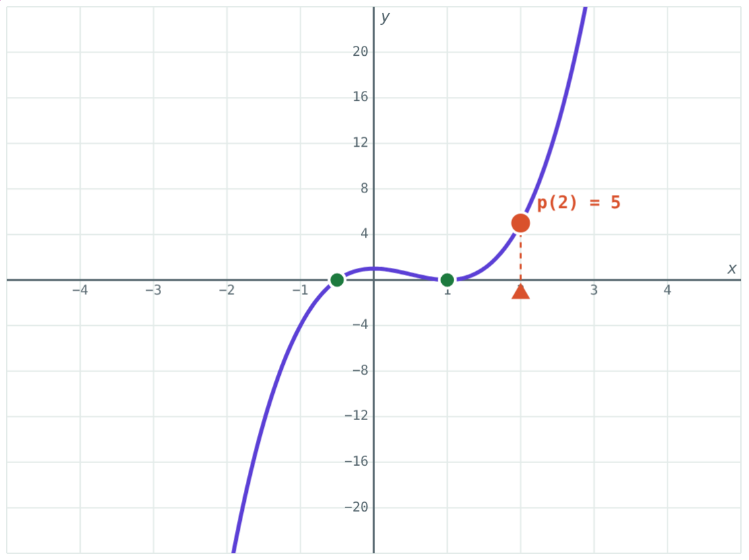
Worked example: values
For p(x) = 2x³ − 3x² + 1, find p(2) and p(−1).
p(2) = 16 − 12 + 1 = 5
p(−1) = −2 − 3 + 1 = −4
p(x) = 2x³ − 3x² + 1
Notes:
(−1)³ = −1 and (−1)² = 1.

Slide 9
Zeroes on the graph
Where the graph meets the x-axis, p(a) = 0:
−2, 0, 2
zeroes of x³ − 4x
p(2) = 0
8 − 8 = 0
A cubic can meet the x-axis up to 3 times.
x³ − 4x
Notes:
This prepares the factor theorem in lesson 3.

Slide 10

Common mistakes
Counting terms for degree
Missing zeroes
x³ − 4x has degree 3, not 2.
x³ − 2 is (1, 0, 0, −2).
Sign slips
x + 1/x
(−1)³ = −1, (−1)² = 1.
Power −1: not a polynomial.
Notes:
Ask students to check each with the simulation's readouts.

Slide 11
Quick check
1
Which is a polynomial: x + 1/x, √x + 2, 3x² − √2x + 1, x⁻² + 4?
2
State the degree of 5x³ − x⁴ + 2.
3
Write x³ − 2 in coefficient form.
4
If p(x) = x² − 5x + 6, find p(3).
Notes:
Answers: 1) 3x² − √2x + 1. 2) 4. 3) (1, 0, 0, −2). 4) 0.

Slide 12
Shape your own polynomial
Open the Polynomials lesson on the Visual Science & Maths website. Change the coefficients and drag x = a along the graph.
Next lesson: Operations and synthetic division
Notes:
Homework: write one example of each type (monomial to cubic) and find p(1) for each.

