Slide 1
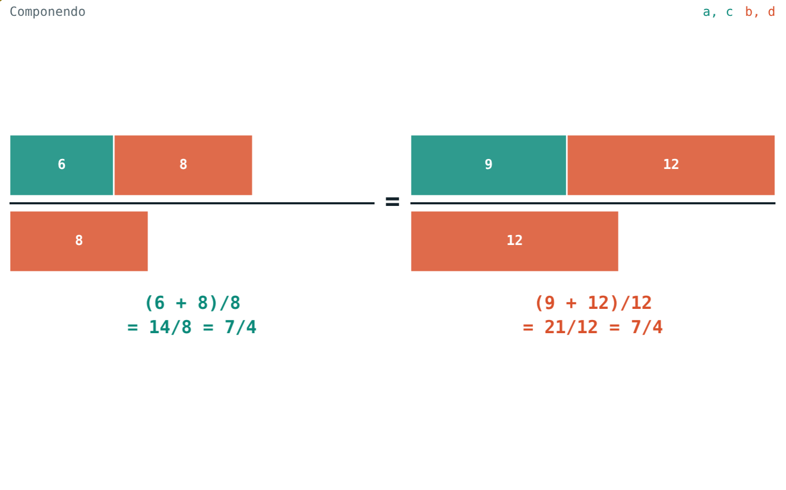
Properties of Equal Ratios
STD 9 MATHEMATICS PART I · CH. 4 RATIO AND PROPORTION
Lesson 2 · Visual Science & Maths
Notes:
Goal: students can state and use invertendo, alternando, componendo, dividendo and componendo-dividendo.

Slide 2
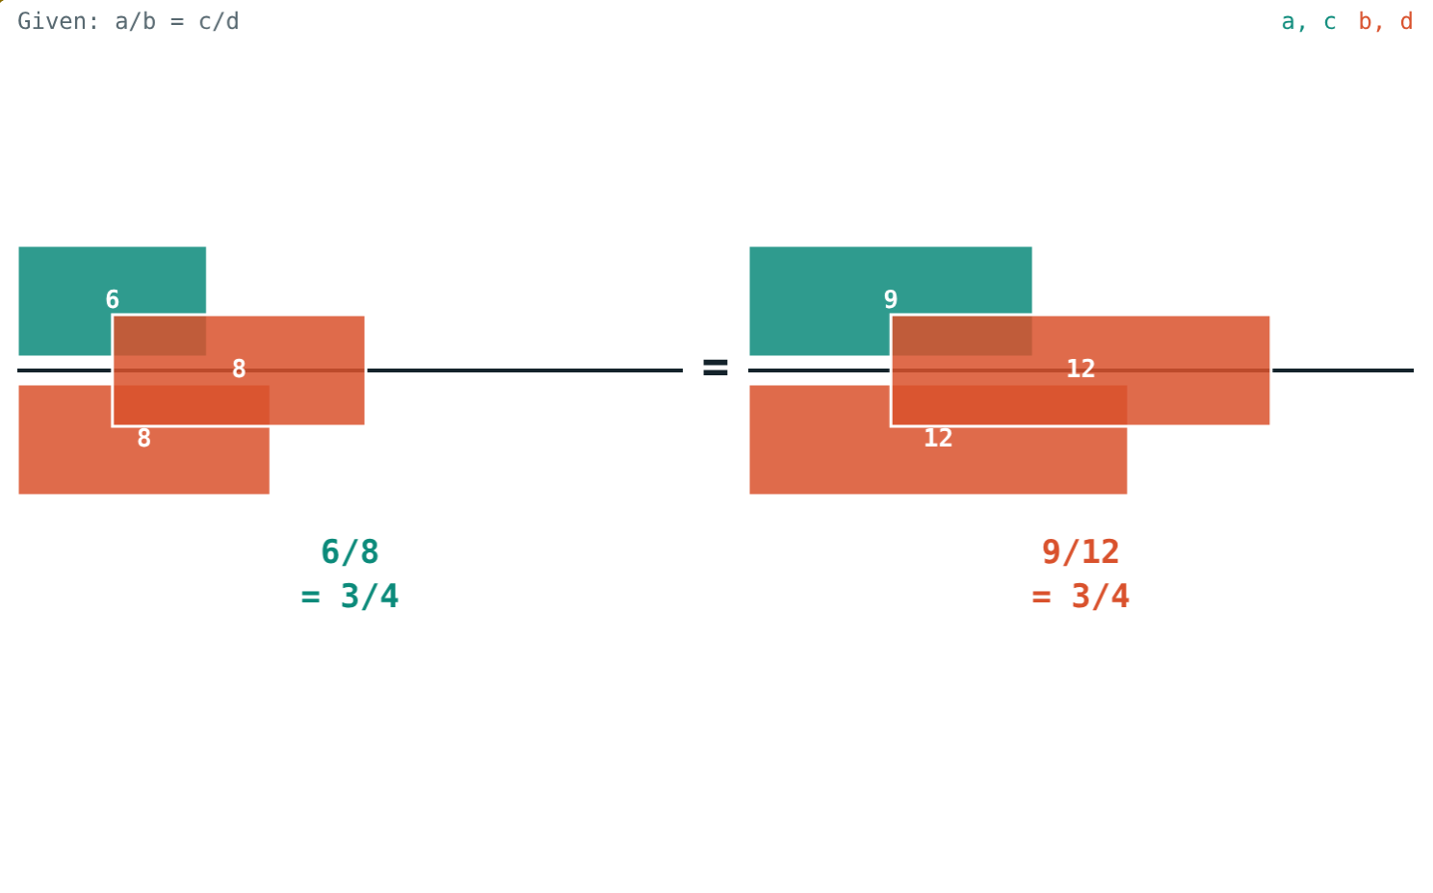
Change both, stay equal
6/8 = 9/12. Add each bottom to its top: 14/8 and 21/12.
Are they still equal?
The denominators slide up to join the numerators
Notes:
Let students check 14/8 = 7/4 and 21/12 = 7/4 by hand.

Slide 3
Five properties of a/b = c/d
Property | Result | 6/8 = 9/12
Invertendo | b/a = d/c | 8/6 = 12/9
Alternando | a/c = b/d | 6/9 = 8/12
Componendo | (a + b)/b = (c + d)/d | 14/8 = 21/12
Dividendo | (a − b)/b = (c − d)/d | −2/8 = −3/12
Componendo-dividendo | (a + b)/(a − b) = (c + d)/(c − d) | 14/−2 = 21/−3
Notes:
a, b, c, d positive; for componendo-dividendo a ≠ b and c ≠ d.

Slide 4
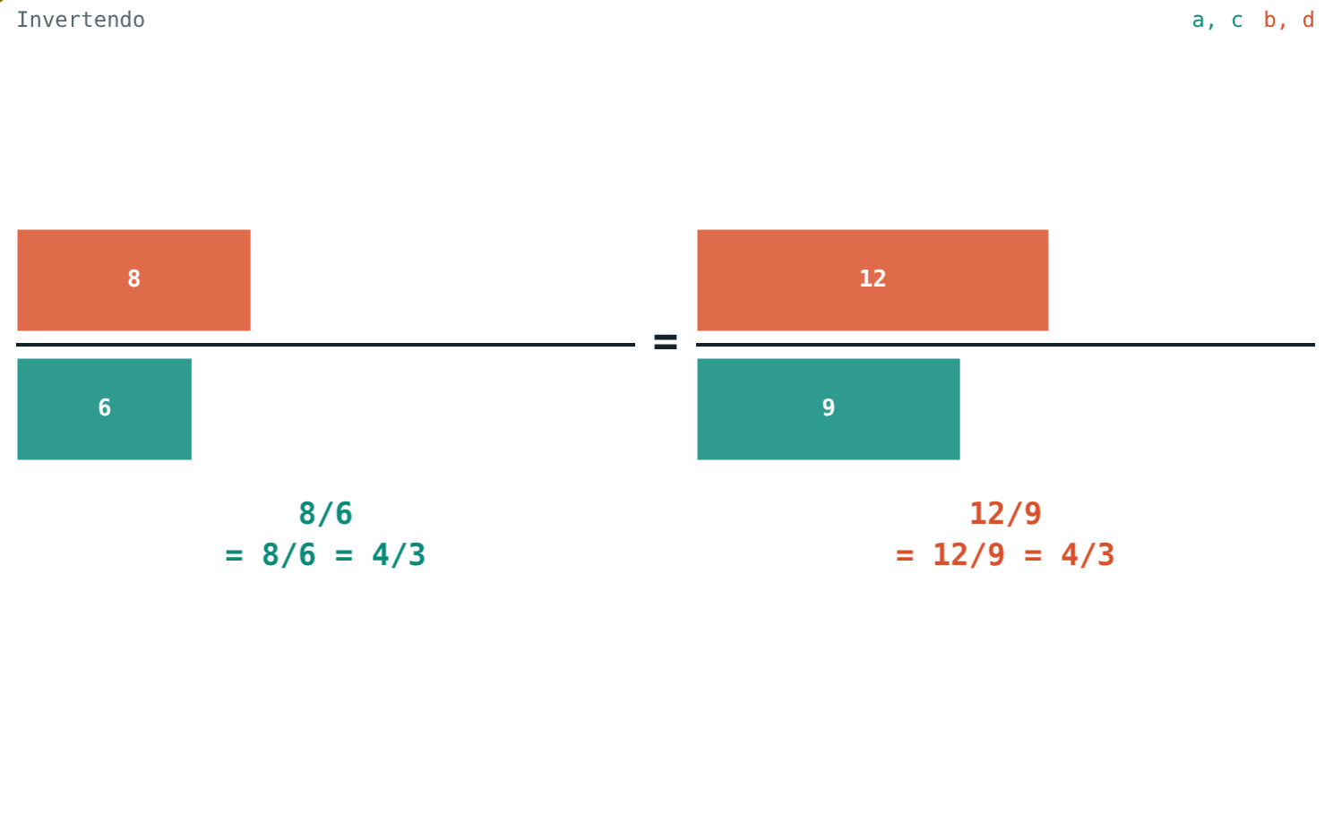
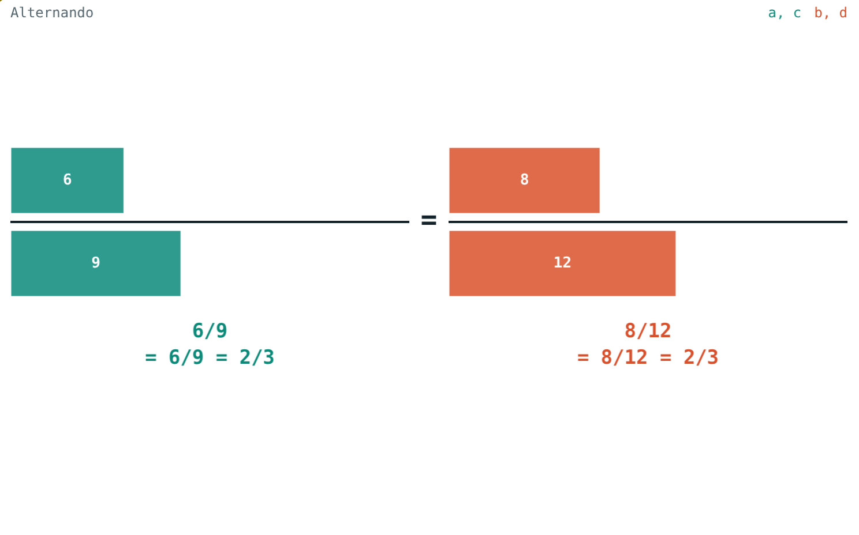
Turn and swap
8/6 = 12/9 = 4/3.
6/9 = 8/12 = 2/3.
Notes:
Alternando: first terms together, second terms together.

Slide 5
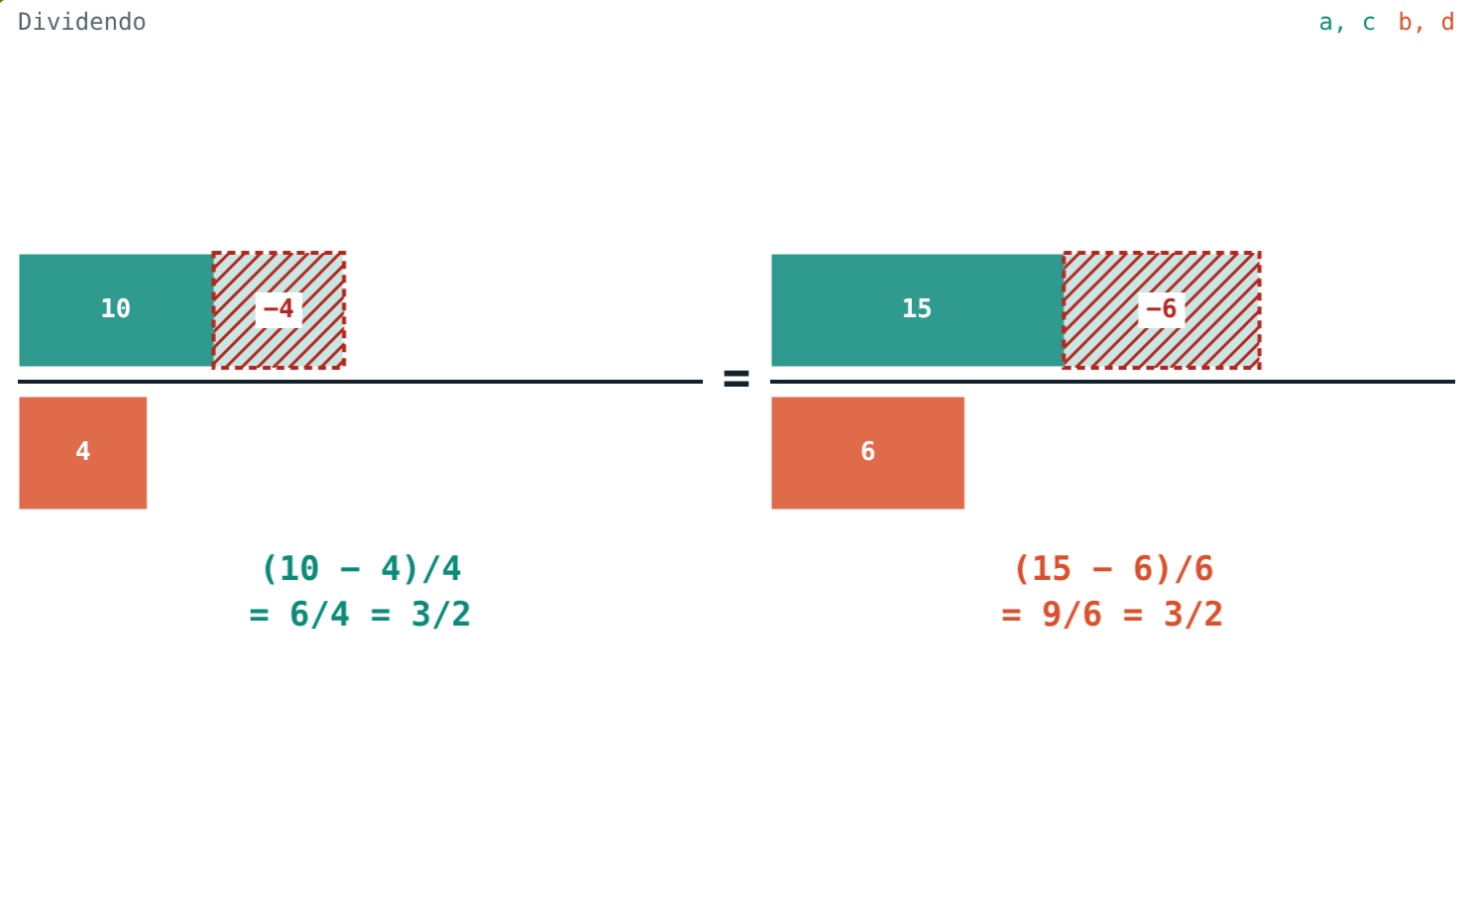
Add and take away
(6 + 8)/8 = (9 + 12)/12 = 7/4.
(10 − 4)/4 = (15 − 6)/6 = 3/2.
Notes:
Componendo is “add 1 to both sides”; dividendo is “subtract 1 from both sides”.

Slide 6
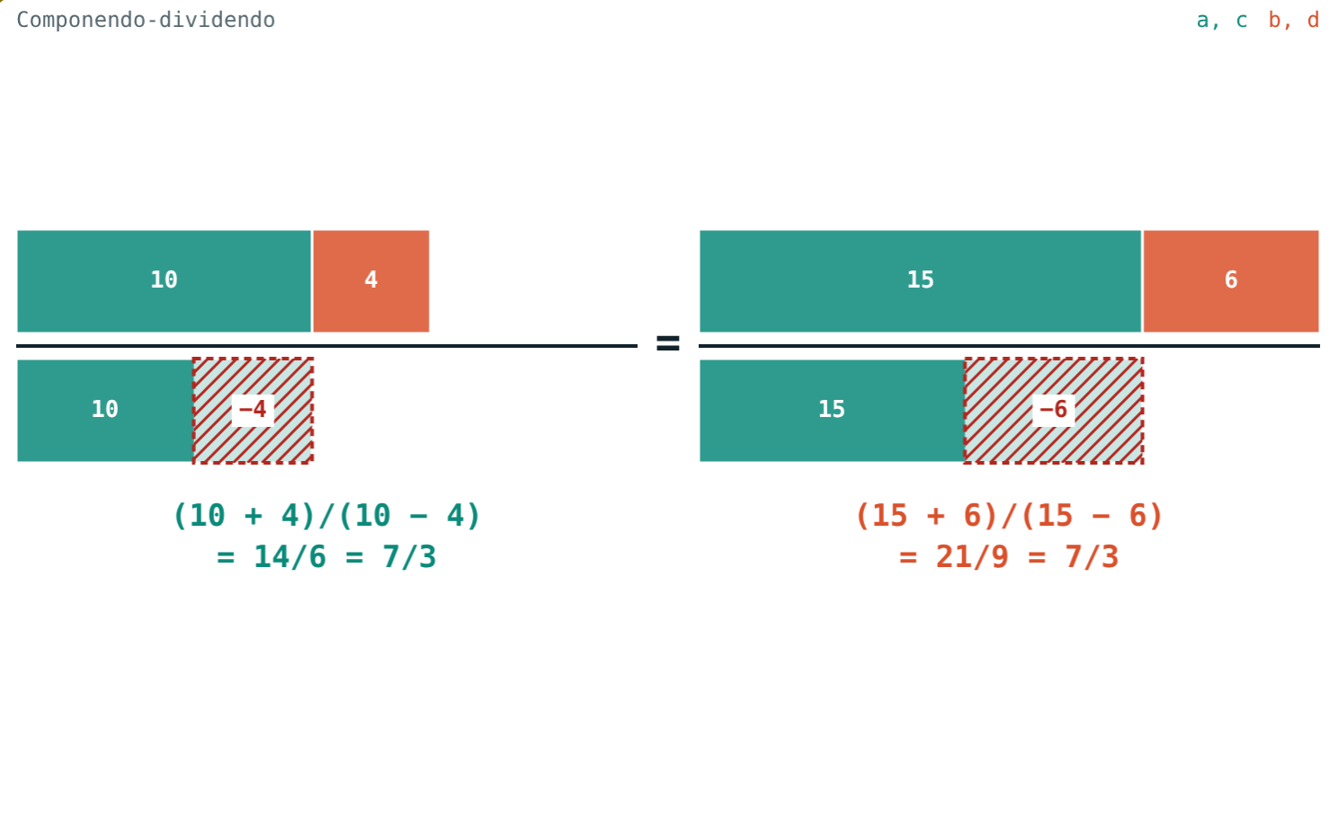
Componendo-dividendo
(a + b)/(a − b) = (c + d)/(c − d)
Divide the componendo result by the dividendo result
Needs a ≠ b and c ≠ d
Great for solving equations
14/6 = 21/9 = 7/3
Notes:
If a = b, a − b = 0 and we cannot divide.

Slide 7
Worked examples
Use the rules
New ratio first
a/b = 5/3. Find (a + b)/b and (a − b)/b.
a/b = 7/4. Find (5a + 4b)/(5a − 4b).
Componendo: 8/3
Dividendo: 2/3
5a/4b = 35/16
(35 + 16)/(35 − 16) = 51/19
Notes:
In the second example, make the ratio 5a/4b before applying componendo-dividendo.

Slide 8
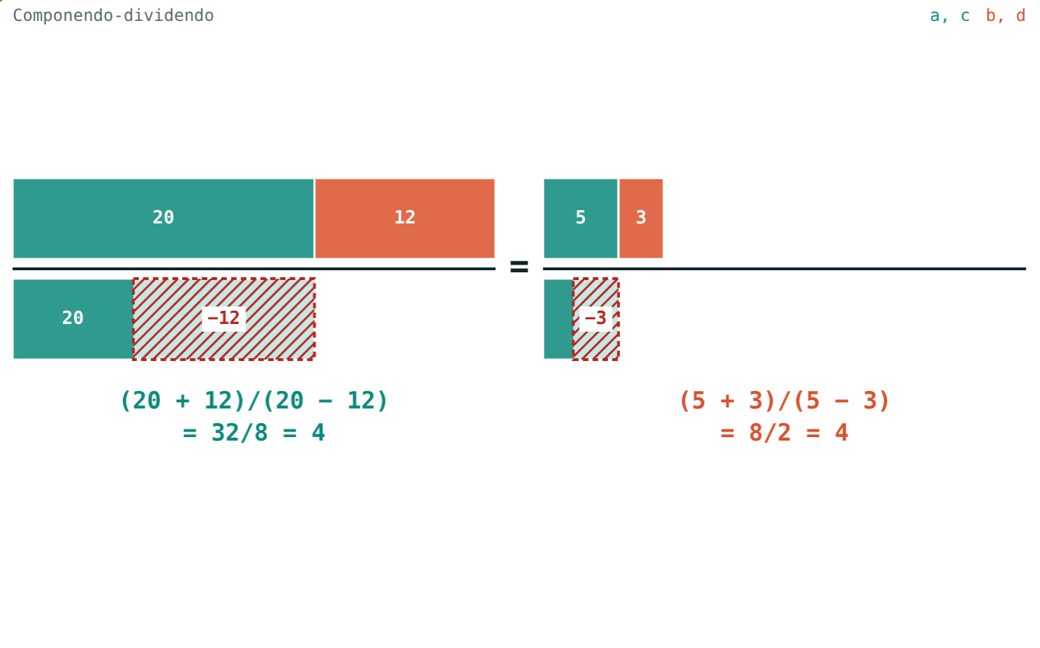
Worked example: solve
Solve (x + 4)/(x − 4) = 5/3.
Componendo-dividendo: 2x/8 = 8/2
x/4 = 4, x = 16
Check: 20/12 = 5/3 ✓
20/12 = 5/3: both sides give 4
Notes:
The x terms cancel in the denominator and the constants cancel in the numerator.

Slide 9
Why they work
1 ÷
÷ cd
+ 1
− 1
Invertendo
Alternando
Componendo
Dividendo
Take 1 ÷ each side.
ad = bc, divide by cd.
a/b + 1 = c/d + 1.
a/b − 1 = c/d − 1.
Notes:
Each property is just one step of ordinary algebra.

Slide 10

Common mistakes
Changing one side
Alternando wrongly
Do the same to both ratios.
a/c = b/d, not a/d = b/c.
Dividing by zero
Mixed differences
Componendo-dividendo needs a ≠ b.
a − b on the left, c − d on the right.
Notes:
Give a wrong worked line for each and let students spot it.

Slide 11
Quick check
1
a/b = 3/5. By invertendo, b/a = ?
2
a/b = 4/3. Find (a + b)/b.
3
x/y = 9/5. Find (x + y)/(x − y).
4
Which property turns a/b = c/d into a/c = b/d?
Notes:
Answers: 1) 5/3. 2) 7/3. 3) 14/4 = 7/2. 4) Alternando.

Slide 12
Watch the tapes move
Open the Properties of equal ratios lesson on the Visual Science & Maths website. Pick a property and press “Show the step”.
Next lesson: Theorem on equal ratios and the k method
Notes:
Homework: textbook practice set on properties of equal ratios, checked in the simulation.

