Slide 1
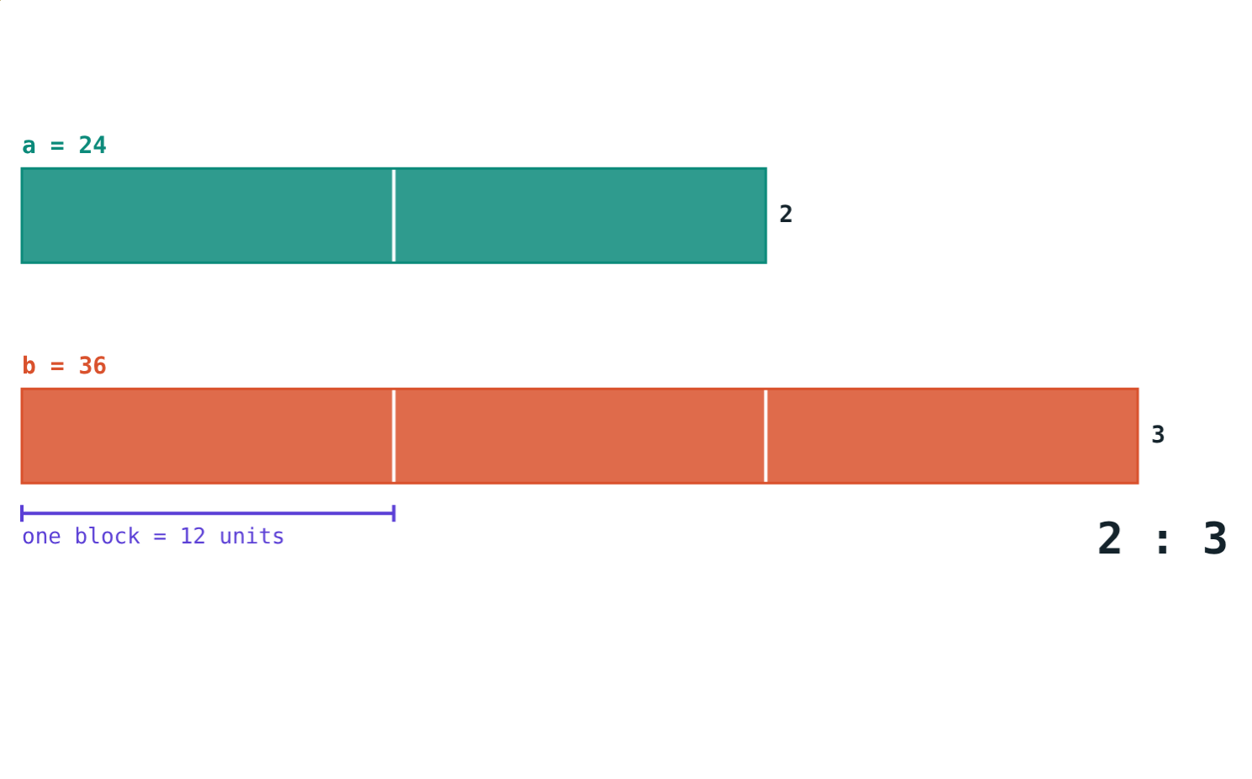
Ratio, Direct and Inverse Proportion
STD 9 MATHEMATICS PART I · CH. 4 RATIO AND PROPORTION
Lesson 1 · Visual Science & Maths
Notes:
Goal: students can write a ratio in simplest form, compare ratios, convert a ratio to a percentage, and recognise direct and inverse proportion.

Slide 2
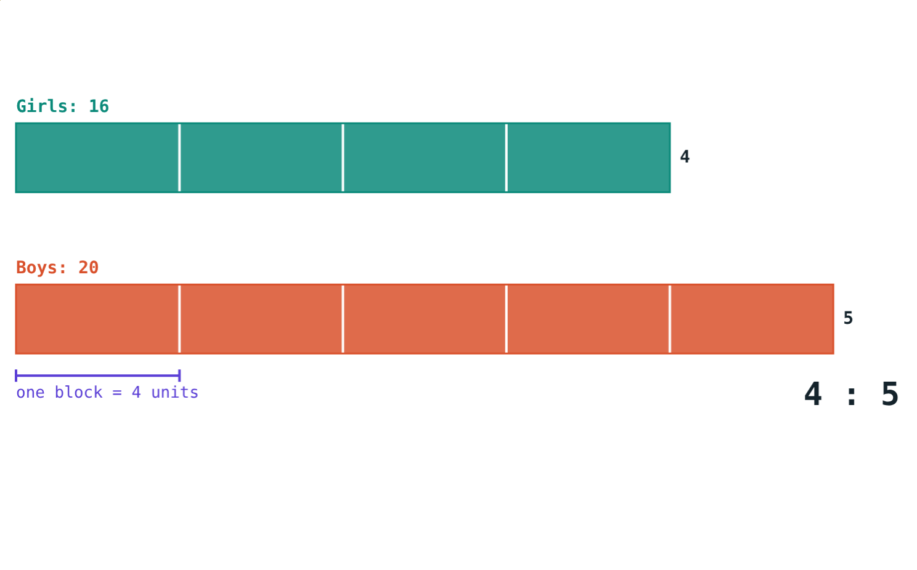
How many girls?
A class has 16 girls and 20 boys. For every 4 girls there are 5 boys.
How do we see 16 : 20 = 4 : 5?
Cut both tapes into blocks of 4
Notes:
Let students suggest other ways to say the same comparison: 4/5, 80%, 4 out of 9.

Slide 3
Ratio
a : b = a/b, b ≠ 0
Same kind, same unit
A ratio has no unit
a : b = ak : bk
Simplest form: divide by the HCF
24 : 36 = 2 : 3 (HCF 12)
Notes:
a is the first term (antecedent), b the second term (consequent). Order matters.

Slide 4
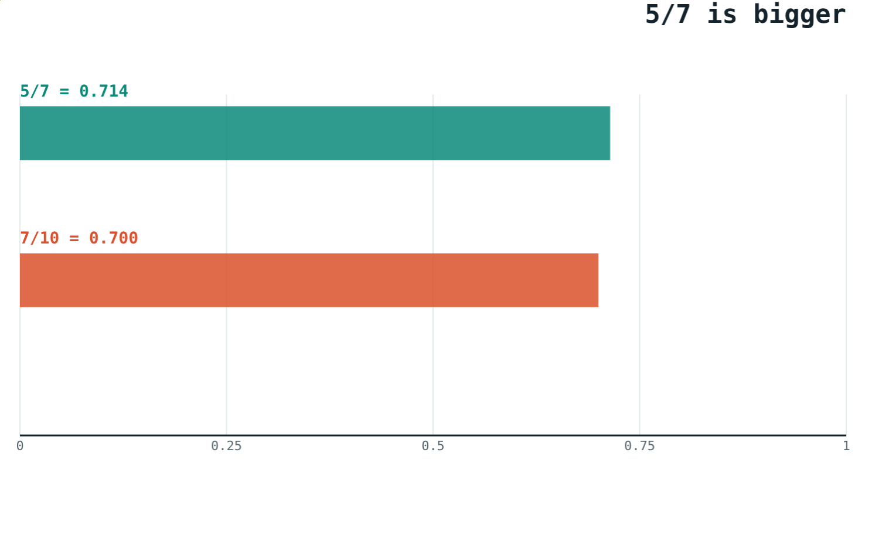
Comparing ratios
For positive numbers, compare a × d with b × c:
ad > bc means a/b > c/d
ad < bc means a/b < c/d
ad = bc: equal ratios, a, b, c, d in proportion
5 × 10 = 50 > 49 = 7 × 7
Notes:
Cross-multiplying avoids decimals.

Slide 5
Ratio as a percentage
x%
60%
80%
Meaning
3 : 5
16 : 20
A ratio with second term 100: x/100.
3/5 = 60/100.
16/20 = 4/5 = 80/100.
Notes:
Multiply the fraction by 100 to get the percentage.

Slide 6
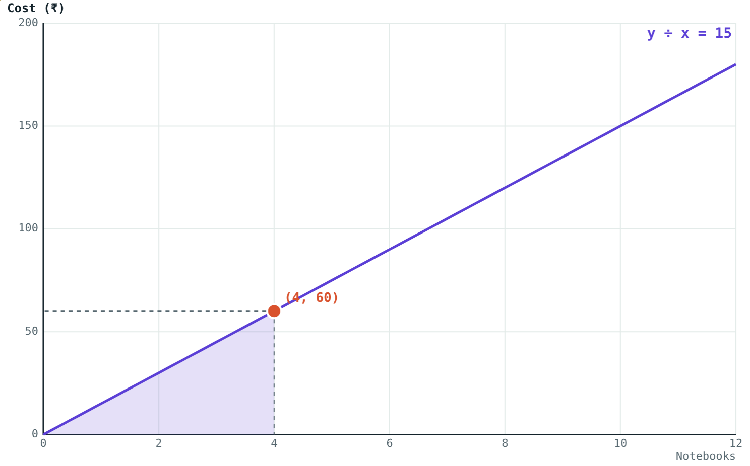
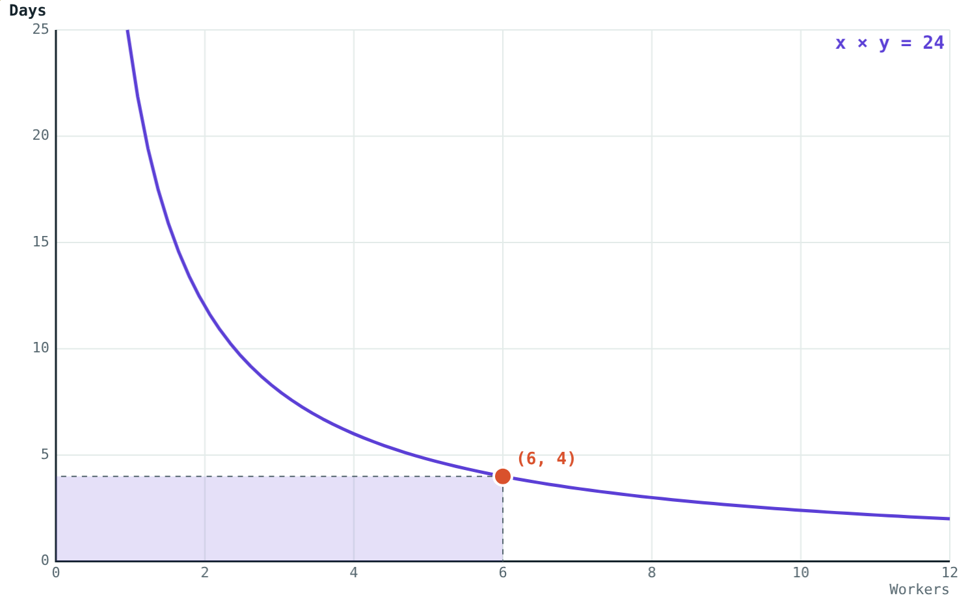
Direct or inverse?
Cost ÷ number stays 15: y = 15x.
Workers × days stays 24.
Ask: if one doubles, does the other double or halve?
Notes:
Direct: a straight line through the origin. Inverse: the rectangle under the point keeps its area.

Slide 7
Worked examples
Same units first
Compare
45 minutes to 2 hours: simplest form and percentage.
Which is greater, 5/7 or 7/10?
45 : 120 = 3 : 8
45/120 × 100 = 37.5%
5 × 10 = 50, 7 × 7 = 49
50 > 49, so 5/7 > 7/10
Notes:
2 hours = 120 minutes before anything else.

Slide 8
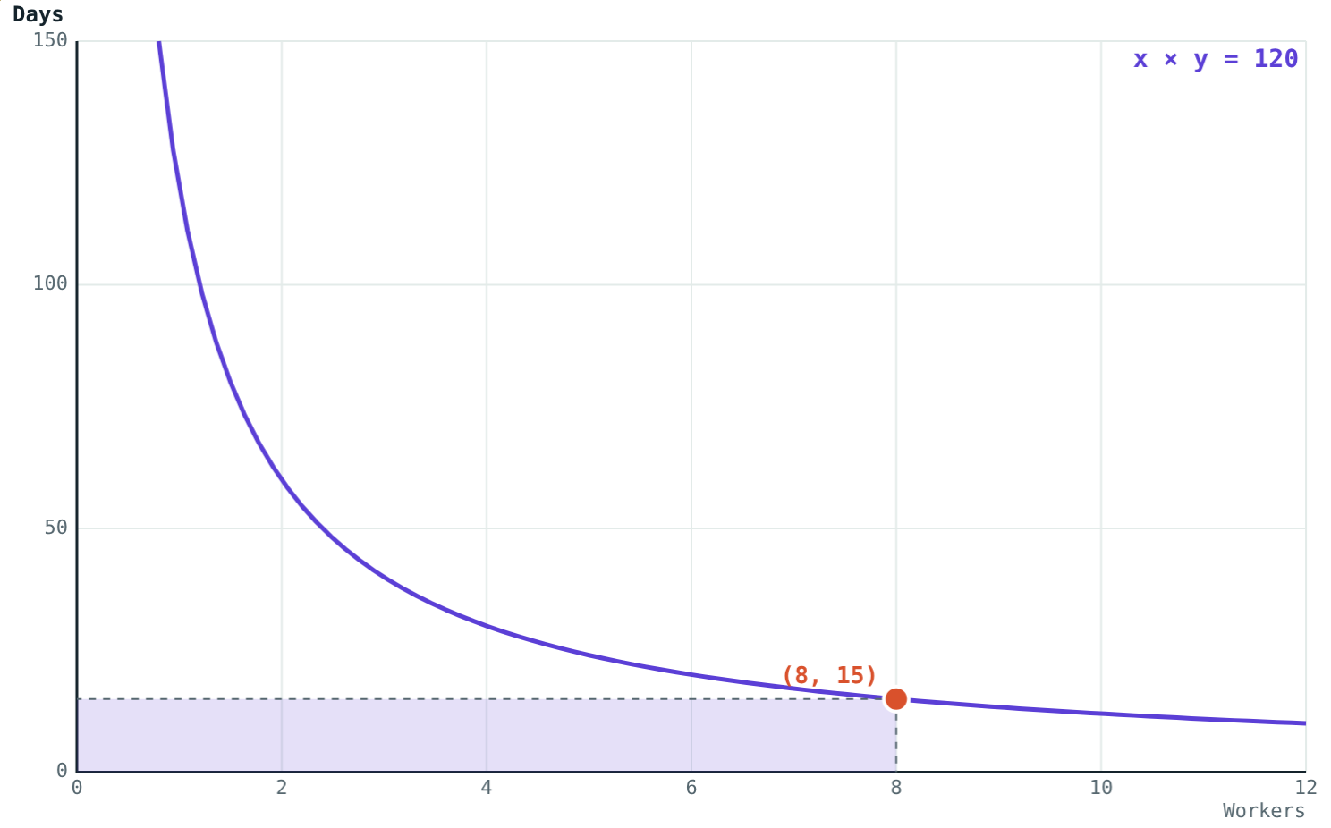
Worked example: inverse proportion
12 workers build a wall in 10 days. How many days for 8 workers?
12 × 10 = 120 worker-days
8 × y = 120, y = 15 days
Workers × days = 120
Notes:
Fewer workers, more days: inverse proportion.

Slide 9
Same ratio, many forms
One comparison, written three ways:
4 : 5
simplest form
80%
girls per 100 boys
4/9
girls in class
16 out of 36 students are girls: 16/36 = 4/9.
Girls : boys = 16 : 20
Notes:
Check that students see the difference between 4/5 (girls to boys) and 4/9 (girls to all).

Slide 10

Common mistakes
Mixing units
Swapping the order
2 hours = 120 minutes first.
Girls : boys is not boys : girls.
Comparing only tops
Direct or inverse?
Compare 5 × 10 with 7 × 7.
Doubles or halves?
Notes:
Use the hook numbers to illustrate each mistake.

Slide 11
Quick check
1
Write 42 : 56 in simplest form.
2
Find the ratio of 25 paise to ₹1.
3
Which is greater, 4/9 or 3/7?
4
6 taps fill a tank in 8 hours. How long would 4 taps take?
Notes:
Answers: 1) 3 : 4. 2) 1 : 4. 3) 4/9, since 28 > 27. 4) 12 hours (6 × 8 = 48 tap-hours).

Slide 12
See ratios as tapes and graphs
Open the Ratio and Proportion lesson on the Visual Science & Maths website. Move the sliders and watch what stays the same.
Next lesson: Properties of equal ratios
Notes:
Homework: find one direct and one inverse proportion at home and write a ratio for each.

