Slide 1
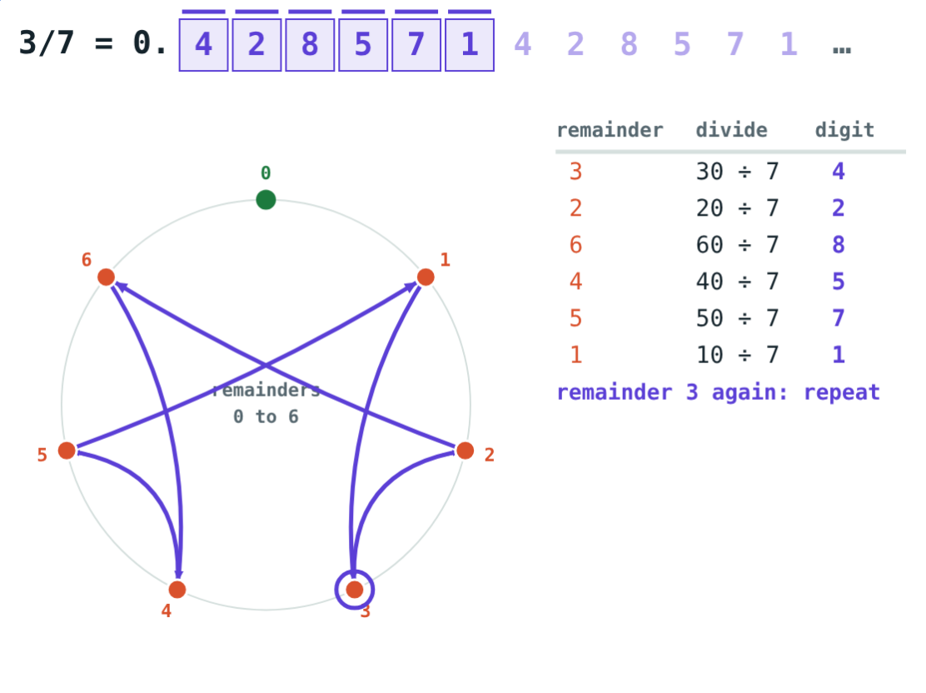
Rational Numbers and Decimals
STD 9 MATHEMATICS PART I · CH. 2 REAL NUMBERS
Lesson 1 · Visual Science & Maths
Notes:
Goal: students know the properties of rational numbers, can tell from the denominator whether a decimal terminates, and can turn a recurring decimal into p/q.

Slide 2
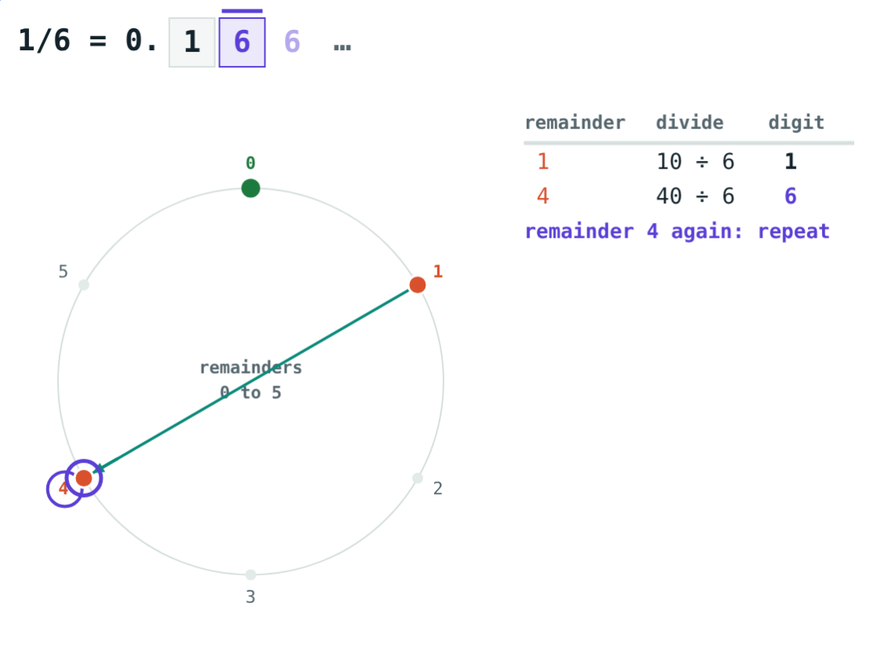
Why does it never stop?
1 ÷ 8 = 0.125 and the division stops. 1 ÷ 6 = 0.1666… and it goes on for ever.
Why do some fractions stop and others repeat?
1/6: the remainder 4 comes back
Notes:
Let students do both divisions by hand first. Ask them to write down every remainder.

Slide 3
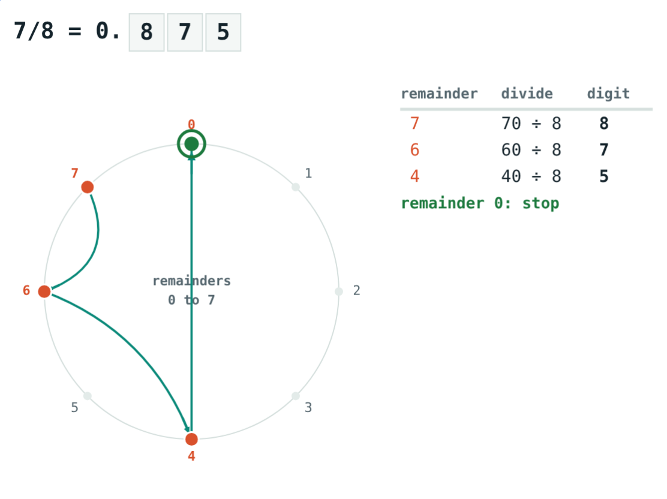
Rational numbers
p/q, q ≠ 0
p and q are integers
Every integer is rational: −4 = −4/1
Lowest terms: no common factor in p and q
Sum, difference, product and quotient (by a non-zero number) are rational
7/8 = 0.875
Notes:
The set of rational numbers is written Q.

Slide 4
Properties of rational numbers
Property | Addition | Multiplication
Commutative | a + b = b + a | a × b = b × a
Associative | (a + b) + c = a + (b + c) | (a × b) × c = a × (b × c)
Identity | a + 0 = a | a × 1 = a
Inverse | a + (−a) = 0 | a × 1/a = 1 (a ≠ 0)
Notes:
Also: multiplication distributes over addition, a(b + c) = ab + ac.

Slide 5
Two kinds of decimal
7/8 = 0.875: the remainder reaches 0.
3/7 = 0.428571428571…: the block repeats.
Notes:
We write the repeating block once with a bar over it. Some books put a dot over the repeating digit.

Slide 6
The denominator decides
0 … q−1
2s, 5s
3, 7, …
Only q remainders
Terminating
Recurring
So within q steps the remainder is 0 or one comes back.
In lowest terms, q has no prime factor other than 2 and 5.
q has any other prime factor: the digits repeat.
Notes:
Always cancel first: 21/28 = 3/4 terminates even though 28 has the factor 7.

Slide 7
Worked examples
Decide without dividing
A block of two digits
Do 13/40 and 7/30 terminate?
Write 0.727272… as p/q.
40 = 2³ × 5 → 13/40 = 0.325
30 = 2 × 3 × 5 → 7/30 = 0.2333… recurs
100x − x = 72, so 99x = 72
x = 72/99 = 8/11
Notes:
Use 100 because the repeating block has 2 digits.

Slide 8
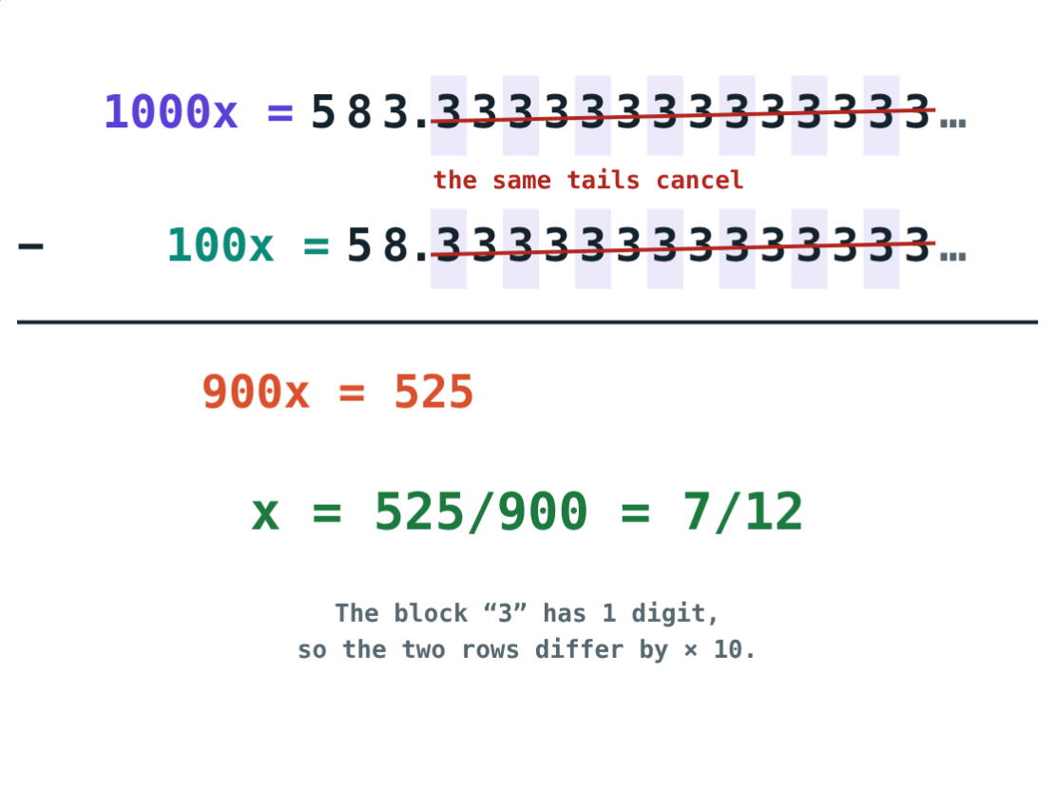
Worked example: digits before the block
Write 0.58333… as p/q.
100x = 58.333…, 1000x = 583.333…
900x = 525
x = 525/900 = 7/12
1000x − 100x: the tails cancel
Notes:
First move the non-repeating digits past the point, then one whole block more.

Slide 9
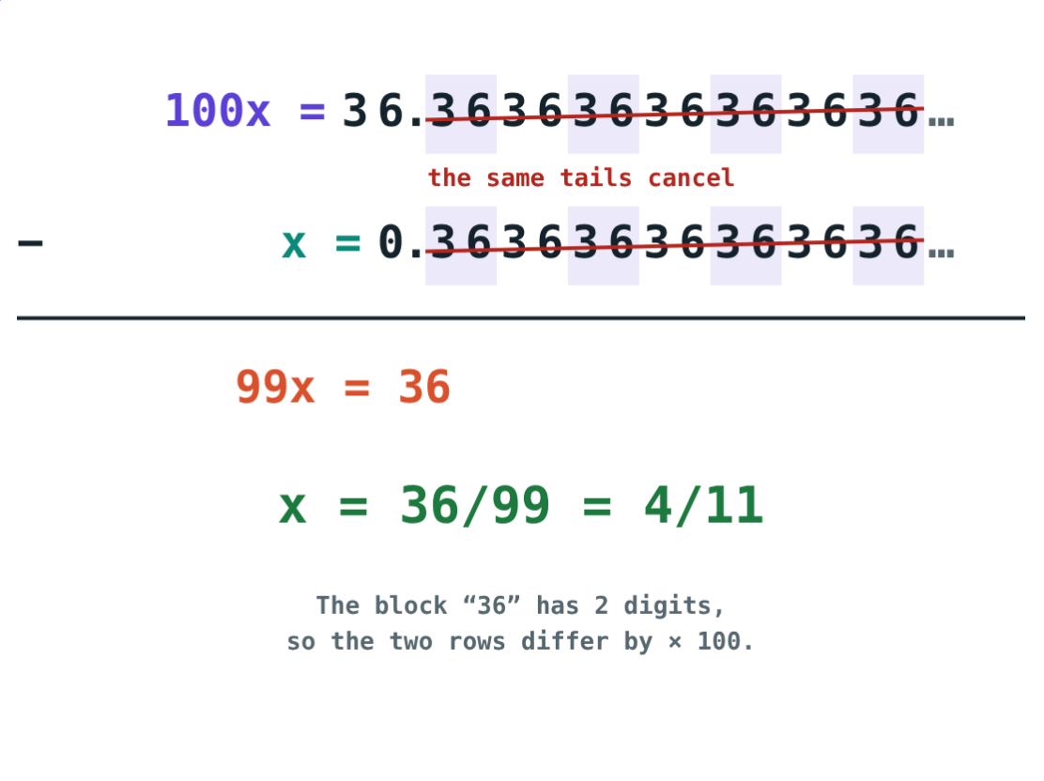
Recurring decimal to p/q
Let x = 0.3636… Multiply by 100 so the tails line up:
99x = 36
after subtracting
4/11
in lowest terms
Check: 4 ÷ 11 = 0.3636… ✓
0.3636… = 36/99
Notes:
Students can check every answer by dividing back in the simulation.

Slide 10

Common mistakes
Not cancelling first
Bar in the wrong place
21/28 = 3/4 terminates.
0.1666…: the bar goes on the 6 only.
Always multiplying by 10
“Long means irrational”
Use 100 for a 2-digit block, 1000 for 3.
1/17 repeats after 16 digits. Every p/q recurs or stops.
Notes:
Ask students to make up their own example of each mistake.

Slide 11
Quick check
1
Which has a terminating decimal: 5/12, 9/40, 4/15 or 2/3?
2
Write 0.444… as p/q.
3
What is the decimal form of 5/11?
4
2/3 + 1/5 = 1/5 + 2/3 shows which property?
Notes:
Answers: 1) 9/40 (40 = 2³ × 5). 2) 4/9. 3) 0.4545…, block 45. 4) Commutative property of addition.

Slide 12
Watch the remainders
Open the Rational Numbers and Decimals lesson on the Visual Science & Maths website. Choose any p/q and watch the remainder wheel.
Next lesson: Irrational and real numbers
Notes:
Homework: find a fraction whose repeating block has 6 digits, and explain why it cannot be longer than q − 1.

