Slide 1
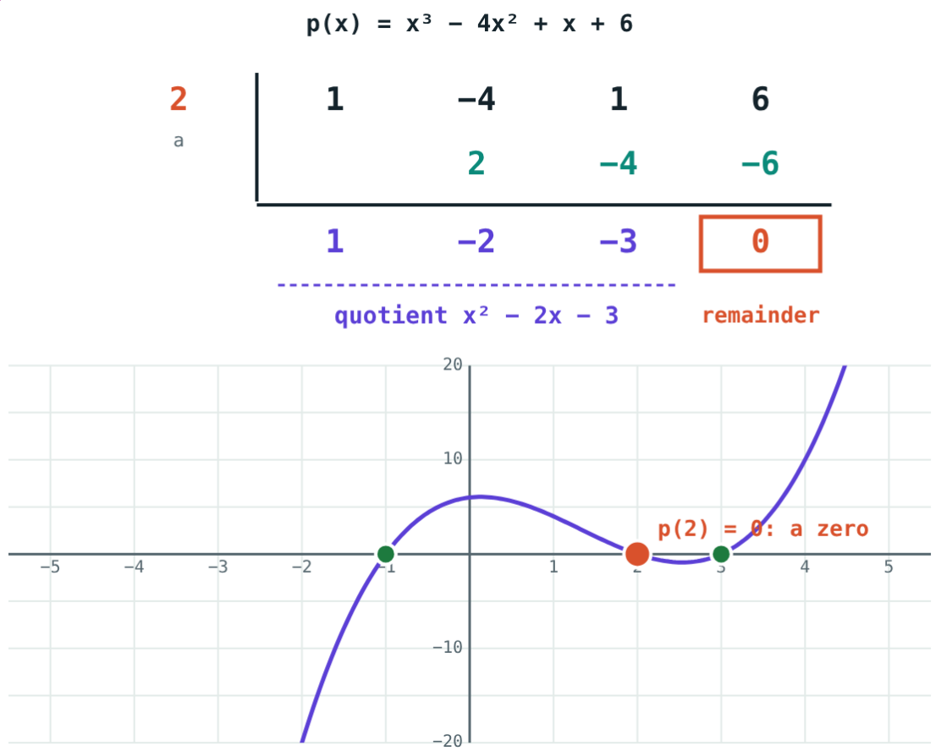
Remainder and Factor Theorems
STD 9 MATHEMATICS PART I · CH. 3 POLYNOMIALS
Lesson 3 · Visual Science & Maths
Notes:
Goal: students can use the remainder theorem, the factor theorem, and factorise a cubic.

Slide 2
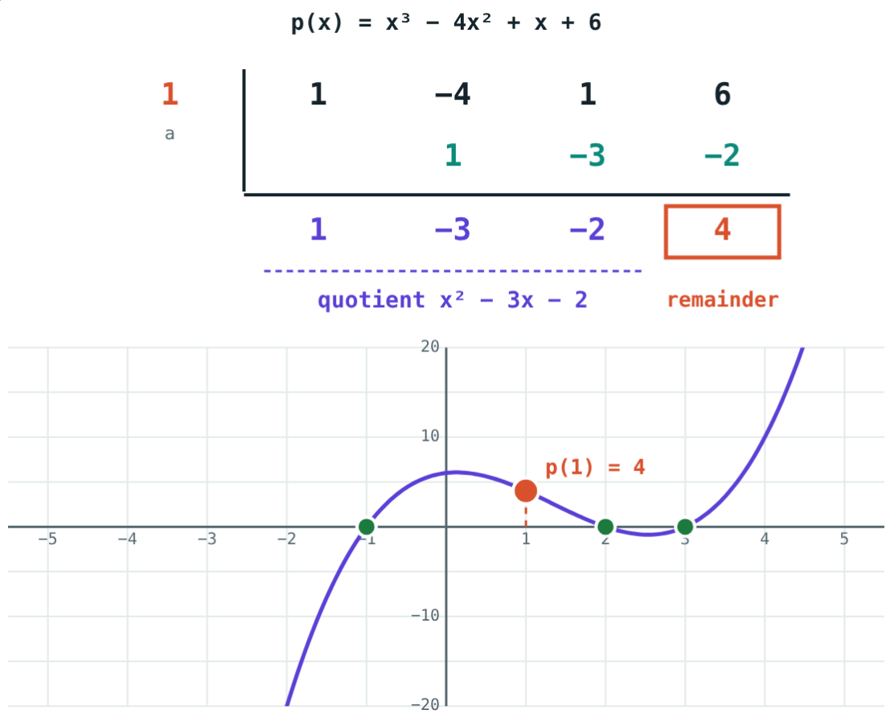
A three-second remainder
Divide x³ − 4x² + x + 6 by x − 1. The table takes a minute.
Can you find the remainder in three seconds?
p(1) = 1 − 4 + 1 + 6 = 4
Notes:
Let students do the division, then show that p(1) gives the same 4.

Slide 3
Remainder theorem
remainder = p(a)
When p(x) is divided by x − a
p(x) = (x − a)q(x) + r
Put x = a: p(a) = r
For x + a, find p(−a)
Remainder 4 = p(1)
Notes:
On the graph, the remainder is the height of the curve above x = a.

Slide 4
Factor theorem
If p(a) = 0, x − a is a factor
If x − a is a factor, p(a) = 0
a is then a zero of p(x)
The graph meets the x-axis at a
p(2) = 0: x − 2 is a factor
Notes:
The factor theorem is the remainder theorem with remainder 0.

Slide 5
Remainder or factor?
Remainder 4: x − 1 is not a factor.
Remainder 0: x − 2 is a factor.
Notes:
Same polynomial, two divisors.

Slide 6
Factorising a cubic
±1, ±2…
÷
( )( )
Try divisors
Divide
Factorise
Of the constant term, until p(a) = 0.
By x − a with synthetic division.
The quadratic quotient, by splitting the middle term.
Notes:
For x³ − x² − 10x − 8: p(1) = −18, p(−1) = 0, quotient x² − 2x − 8 = (x − 4)(x + 2).

Slide 7
Worked examples
Remainder
Unknown coefficient
x⁴ − 3x² + 2x + 5 ÷ (x − 1)
x − 2 is a factor of x³ + kx² − 4x − 8. Find k.
p(1) = 1 − 3 + 2 + 5
Remainder 5
p(2) = 8 + 4k − 8 − 8 = 0
4k = 8, k = 2
Notes:
Both use p(a) without any division.

Slide 8
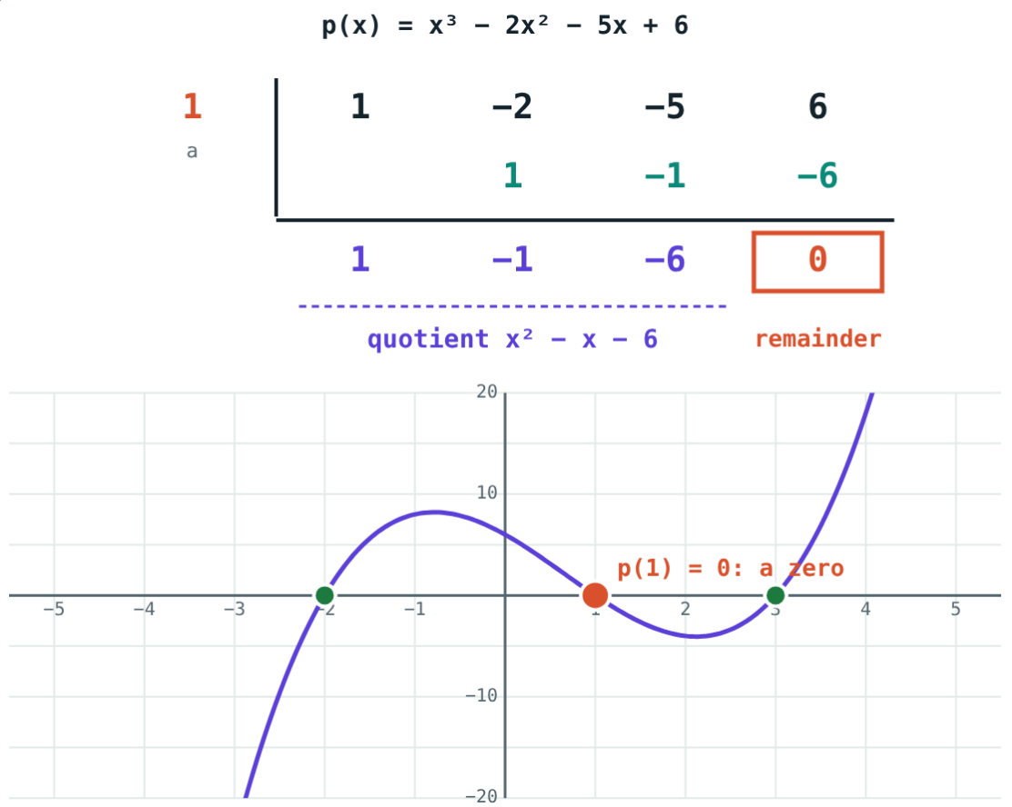
Worked example: factorise
Factorise x³ − 2x² − 5x + 6.
p(1) = 0, so x − 1 is a factor
Quotient x² − x − 6 = (x − 3)(x + 2)
(x − 1)(x + 2)(x − 3)
p(1) = 0
Notes:
Check by multiplying the factors back.

Slide 9
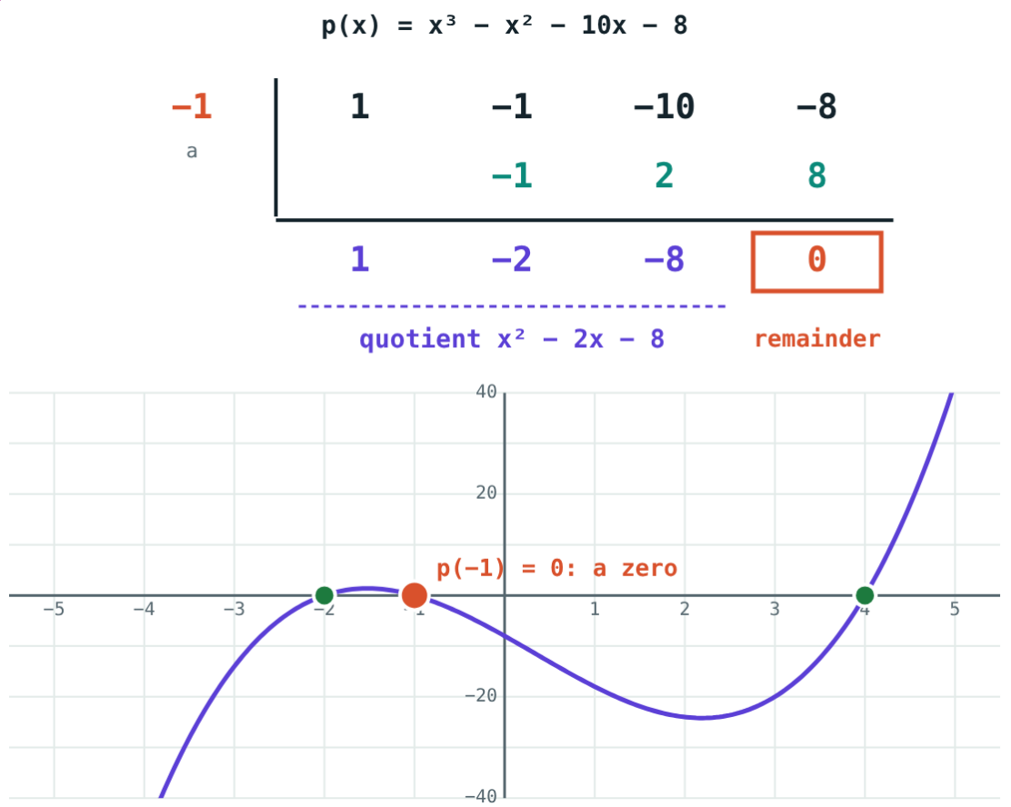
Finding a factor
Try a = 1: remainder −18. Try a = −1:
0
remainder at a = −1
x + 1
is a factor
So x³ − x² − 10x − 8 = (x + 1)(x + 2)(x − 4).
x³ − x² − 10x − 8
Notes:
The simulation's “Find a factor” button tries the divisors in turn.

Slide 10

Common mistakes
Wrong sign
p(a) gives the quotient
For x + 2, find p(−2).
It gives only the remainder.
One factor only
Random guesses
Factorise the quotient too.
Try divisors of the constant term.
Notes:
Ask students which mistake would give each wrong answer in the quiz.

Slide 11
Quick check
1
Remainder when x³ + 2x − 1 is divided by x − 1?
2
When is x − 3 a factor of p(x)?
3
Remainder when x² + 5x + 7 is divided by x + 2?
4
Which is a factor of x³ − 7x + 6: x + 1, x − 1, x + 2 or x − 3?
Notes:
Answers: 1) 2. 2) When p(3) = 0. 3) 1. 4) x − 1.

Slide 12
Hunt for factors
Open the Remainder and Factor Theorems lesson on the Visual Science & Maths website. Press “Find a factor” and watch the graph.
Next chapter: Ratio and Proportion
Notes:
Homework: factorise x³ − 6x² + 11x − 6 and check with the simulation.

