Slide 1
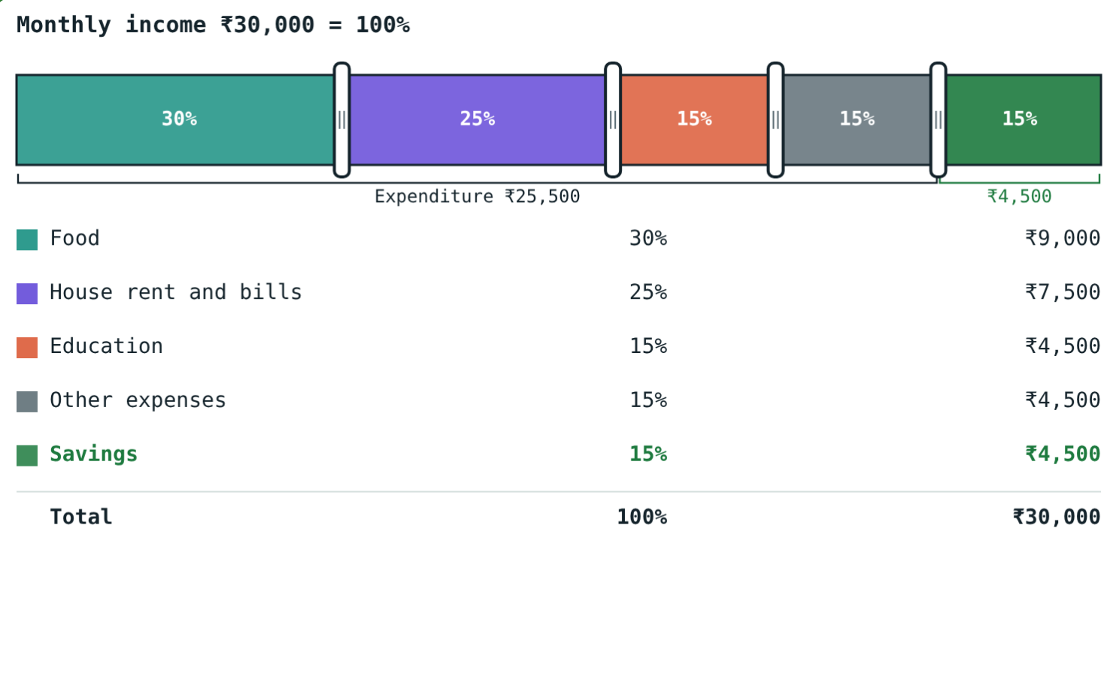
Savings and Investment
STD 9 MATHEMATICS PART I · CH. 6 FINANCIAL PLANNING
Lesson 1 · Visual Science & Maths
Notes:
Goal: students can find savings and savings percentage from a budget, compare investment options by safety, returns and liquidity, and compare gains using simple and compound interest.

Slide 2
Where does the money go?
A family earns ₹30,000 a month. Food, rent, school fees and other bills take ₹25,500.
How much is left, and where should it be kept?
₹4,500 left: 15% of the income
Notes:
Ask students to list their own family's expenses before showing the bar.

Slide 3
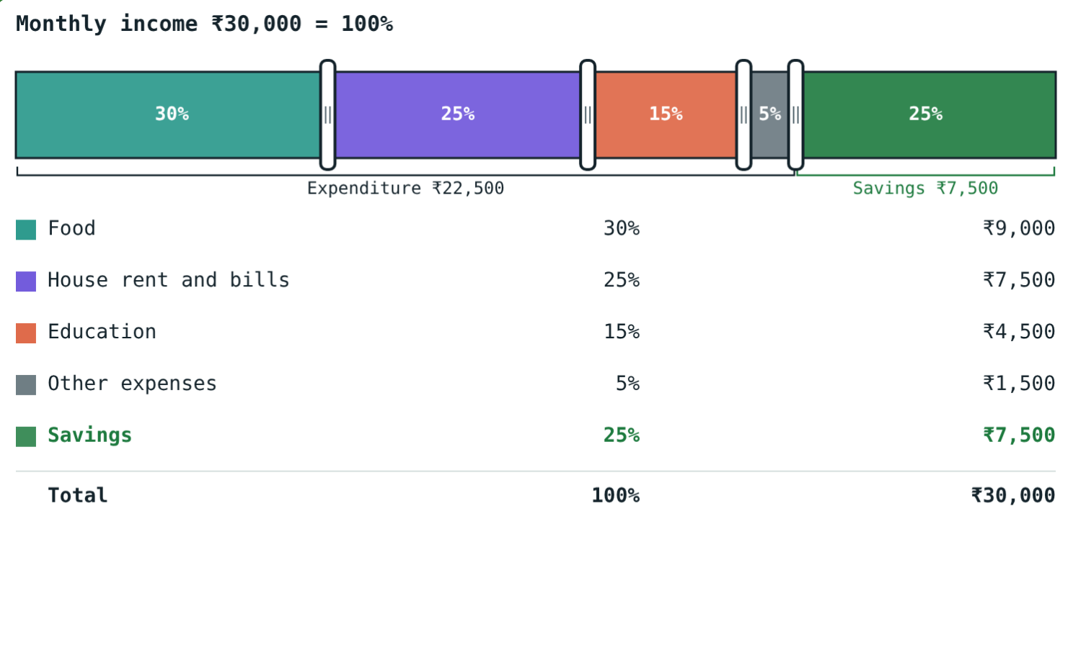
Savings
Savings = Income − Expenditure
Income: money earned
Expenditure: money spent
Budget: a written plan of both
Savings % = savings ÷ income × 100
Cut other expenses to 5%: savings rise to 25%
Notes:
Financial planning means deciding in advance how to spend and save.

Slide 4
Where to invest
Option | What you get | Risk
Bank: savings, FD, RD | Interest at a fixed rate | Low
Post office: NSC, PPF and others | Interest fixed by the government | Low
Gold, land, houses | Price may rise; no interest | Medium
Shares | Share of profit; price rises or falls | High
Mutual funds | Experts invest pooled money | Depends on the fund
Notes:
Before investing ask three questions: is it safe, what does it earn, how fast can I get the money back (liquidity)?

Slide 5
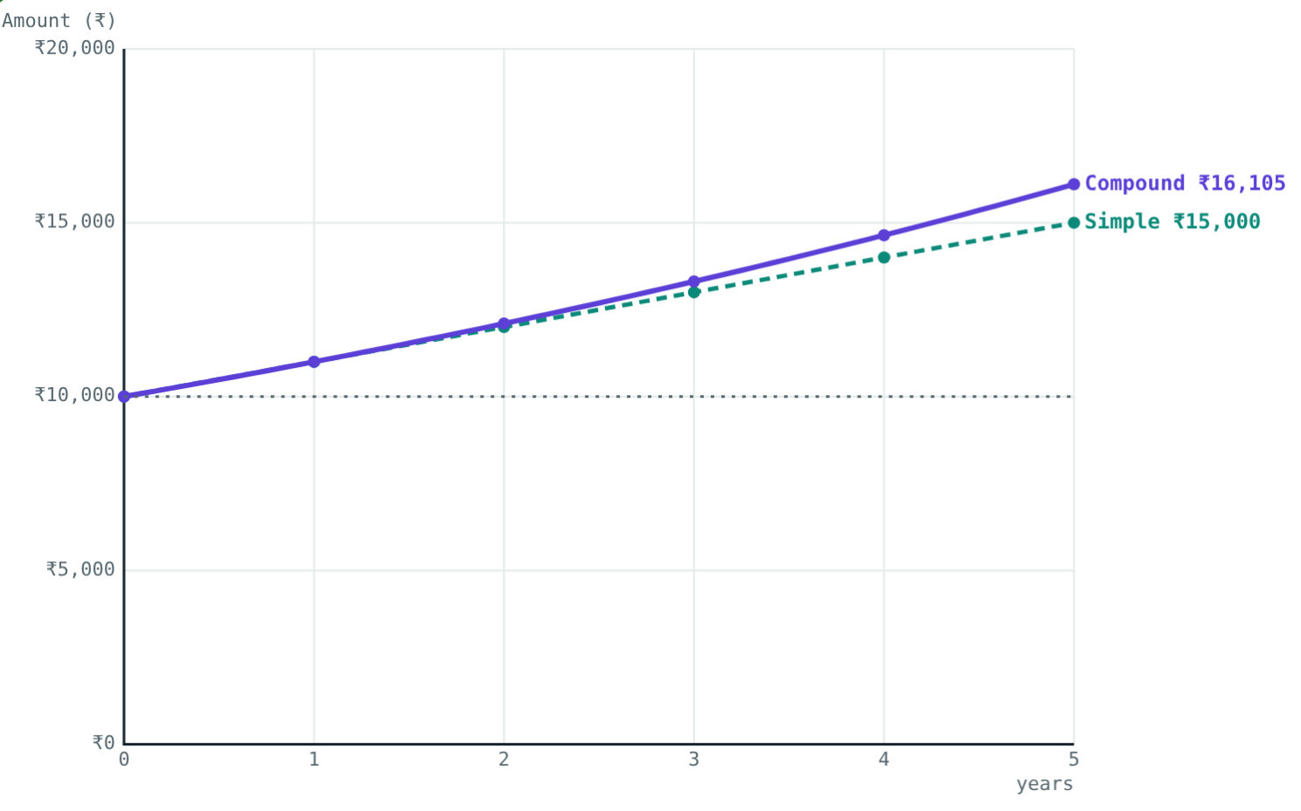
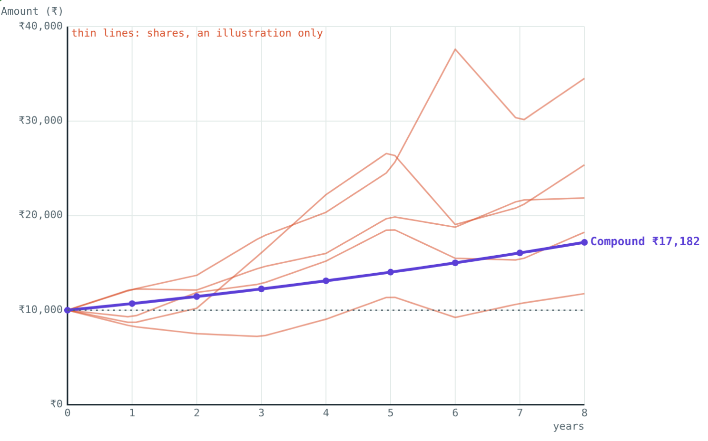
Simple vs compound interest
₹10,000 at 10% for 5 years: ₹15,000 simple, ₹16,105.10 compound.
Shares might end far above a deposit, or below it.
Higher possible return comes with higher risk. The share paths are an illustration only.
Notes:
I = PNR/100. A = P(1 + R/100)^N. Compound interest earns interest on interest.

Slide 6



Before you invest
Safety
Returns
Liquidity
Could any of the money be lost?
How much will it earn each year?
How quickly can you take it out when needed?
Notes:
Spreading savings over several options balances these three.

Slide 7
Worked examples
Income from savings
Split investment
Ravi saves 15% of his income: ₹3,600 a month. Find his income.
₹40,000: part at 6%, rest at 8% simple interest. Interest in a year ₹2,900.
15x/100 = 3600
x = 3600 × 100 ÷ 15 = ₹24,000
x + y = 40000; 6x + 8y = 290000
2y = 50000: ₹15,000 and ₹25,000
Notes:
Check the second: 900 + 2,000 = 2,900.

Slide 8
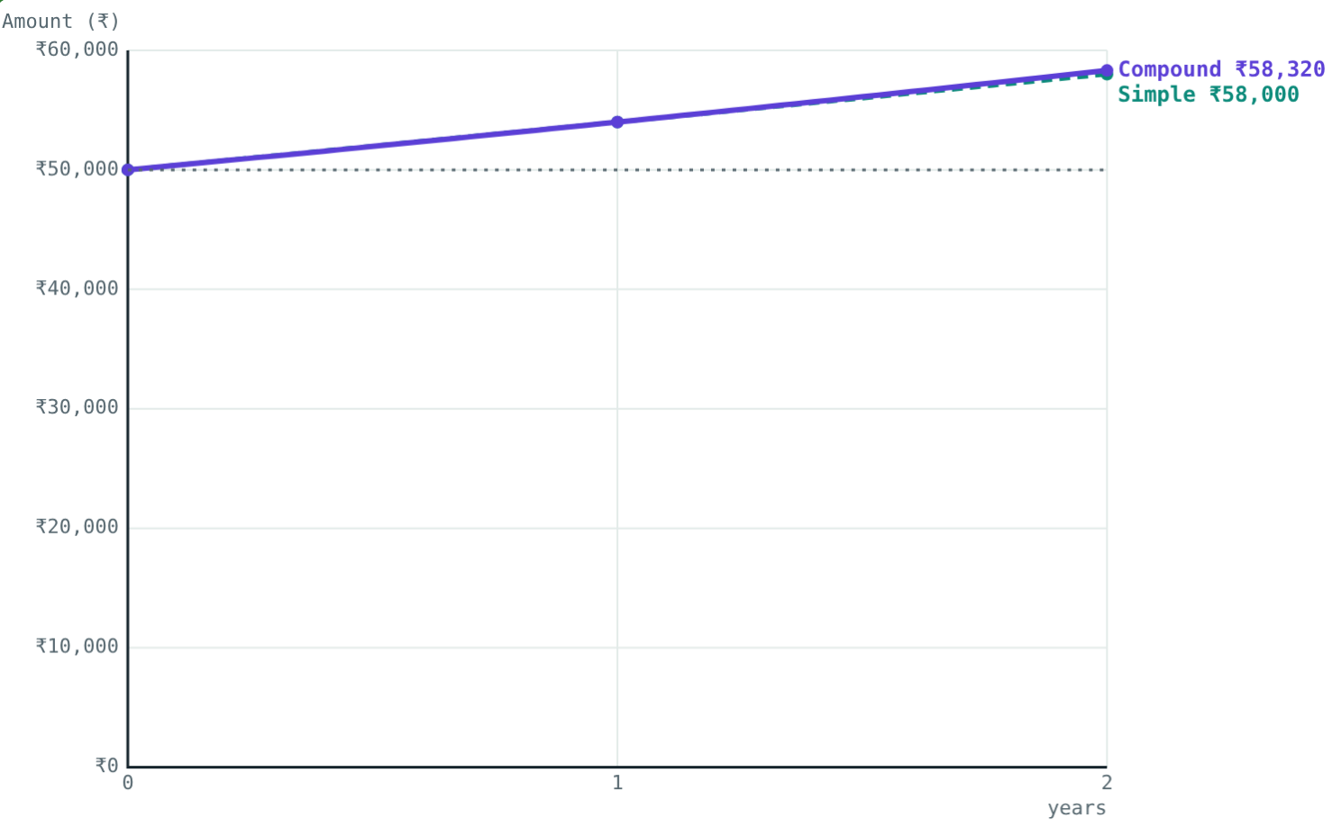
Worked example: which gained more?
Asha: ₹50,000 in an FD at 8% compound interest for 2 years. Neha: shares bought for ₹30,000, sold for ₹36,000.
Asha: A = 50000 × 1.08² = 58,320, gain 16.64%
Neha: gain 6,000 ÷ 30,000 × 100 = 20%
Neha gained more, but with more risk
₹50,000 at 8% for 2 years
Notes:
Compare percentages, not rupees, when the amounts invested differ.

Slide 9
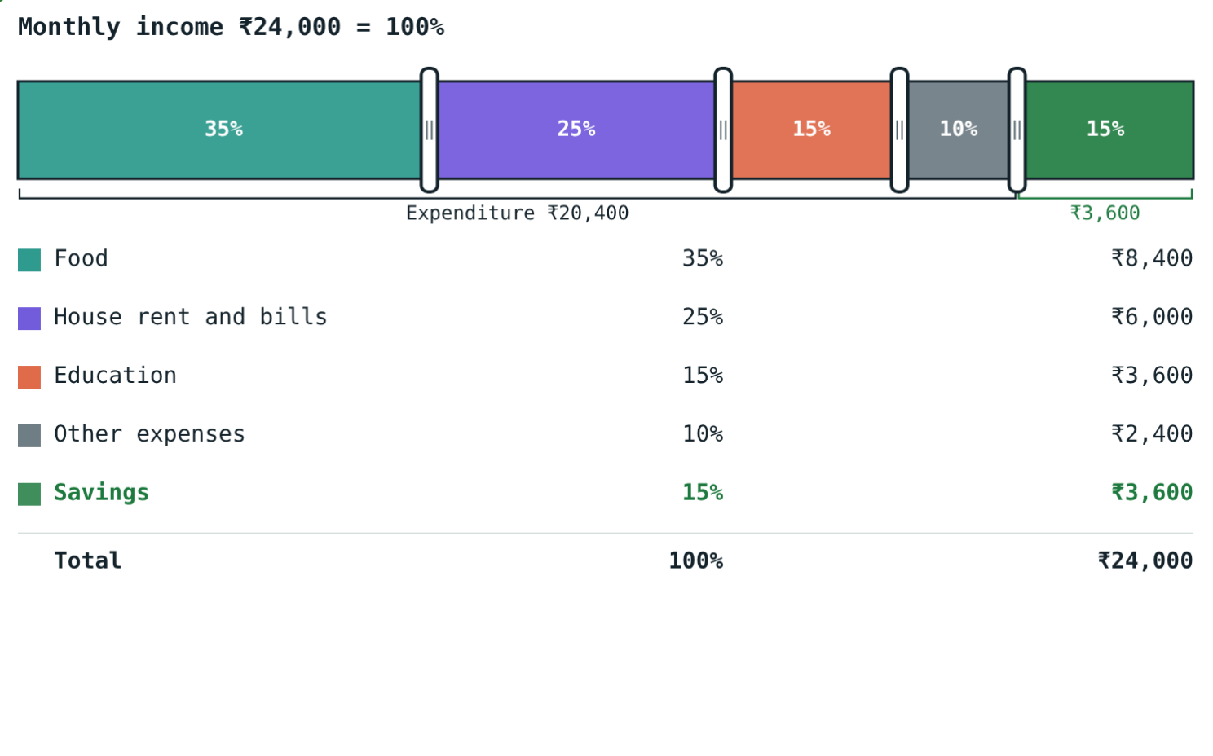
Ravi's budget
Saving 15% of ₹24,000:
₹3,600
saved each month
₹43,200
saved in a year
Expenditure = ₹24,000 − ₹3,600 = ₹20,400.
Income ₹24,000
Notes:
Ask: what if Ravi saved 20% instead? (₹4,800 a month.)

Slide 10

Common mistakes
Wrong total for %
CI on the first principal
Savings % = savings ÷ income × 100.
Each year's interest is on that year's starting amount.
Comparing rupees
Ignoring risk
Compare percentage gains.
Shares and gold can fall in value.
Notes:
Ask students for an example of each.

Slide 11
Quick check
1
Income ₹40,000, expenditure ₹34,000. What % is saved?
2
₹20,000 at 10% compound interest: amount after 2 years?
3
Which has the highest risk: FD, post office scheme, shares, RD?
4
12% of Meera's income is ₹4,800. Find her income.
Notes:
Answers: 1) 15%. 2) ₹24,200. 3) Shares. 4) ₹40,000.

Slide 12
Plan your own budget
Open the Savings and Investment lesson on the Visual Science & Maths website. Drag the budget handles and watch an investment grow.
Next lesson: Income tax
Notes:
Homework: make a monthly budget for a family of four and find its savings percentage.

