Slide 1
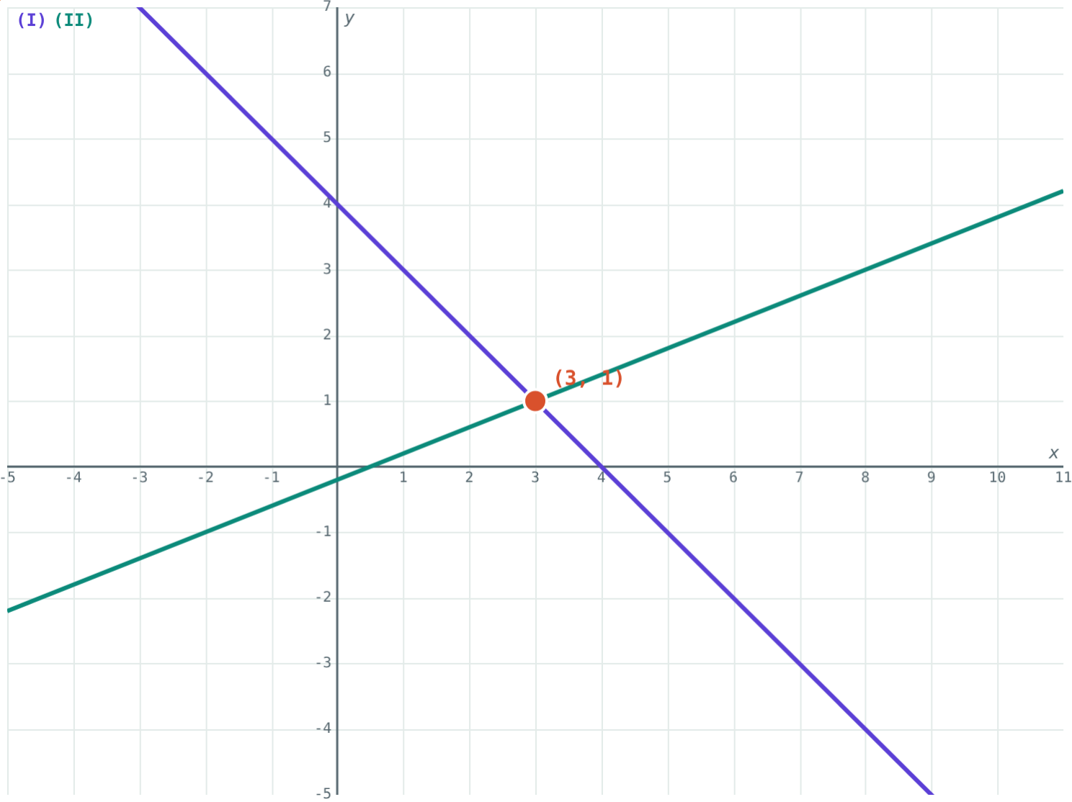
Solving Simultaneous Equations
STD 9 MATHEMATICS PART I · CH. 5 LINEAR EQUATIONS IN TWO VARIABLES
Lesson 2 · Visual Science & Maths
Notes:
Goal: students can solve a pair of linear equations by elimination and by substitution, and check the answer.

Slide 2
Two clues, one answer
x + y = 4 has endless solutions. So does 2x − 5y = 1. But only one pair satisfies both.
How do we find it?
The lines cross at (3, 1)
Notes:
Point out that the crossing point is the only point on both lines.

Slide 3
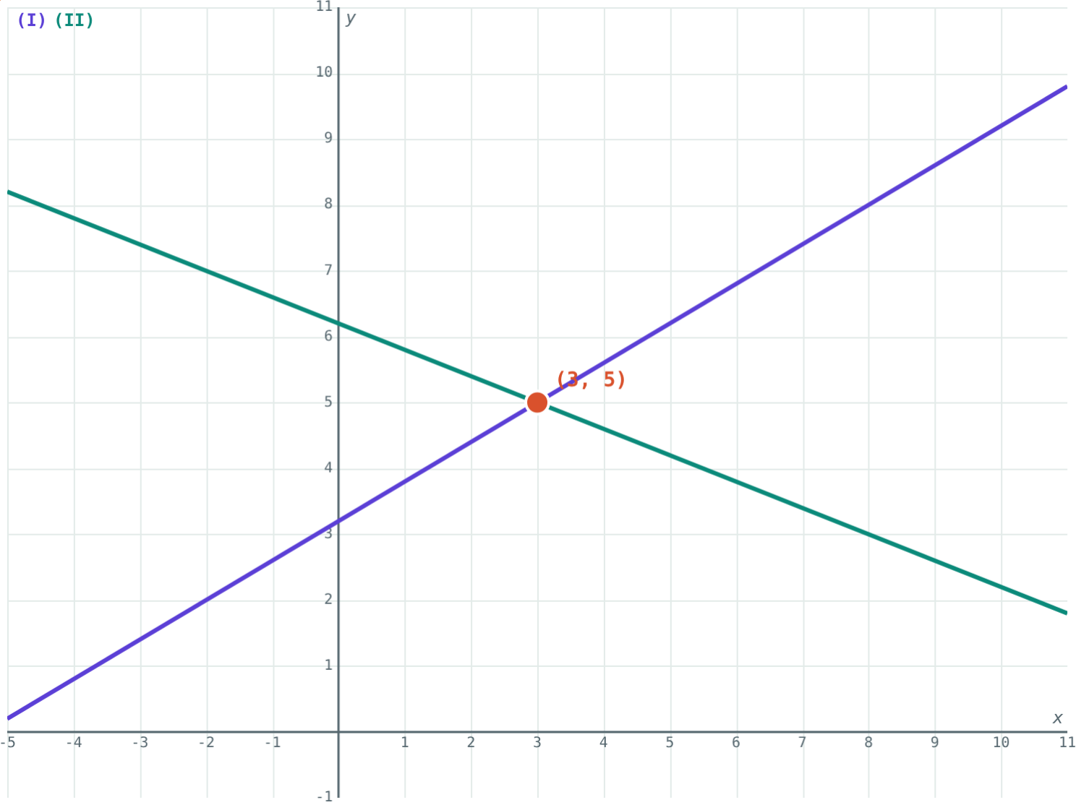
Elimination
Make the coefficients of one variable equal
Add or subtract to remove it
Solve for the other variable
Substitute back for the first
3x − 5y = −16, 2x + 5y = 31: add
Notes:
Same signs: subtract. Opposite signs: add.

Slide 4
Elimination step by step
×5
+
x = 3
Multiply (I)
Add (II)
Solve
x + y = 4 becomes 5x + 5y = 20.
5x + 5y + 2x − 5y = 20 + 1, so 7x = 21.
Then y = 4 − 3 = 1.
Notes:
Write each new equation on its own line, as in the simulation's steps.

Slide 5
Substitution
Make one variable the subject
Put that expression into the other equation
Solve, then substitute back
x = 4 − y, then 2(4 − y) − 5y = 1
Notes:
Choose the variable with coefficient 1 to avoid fractions.

Slide 6
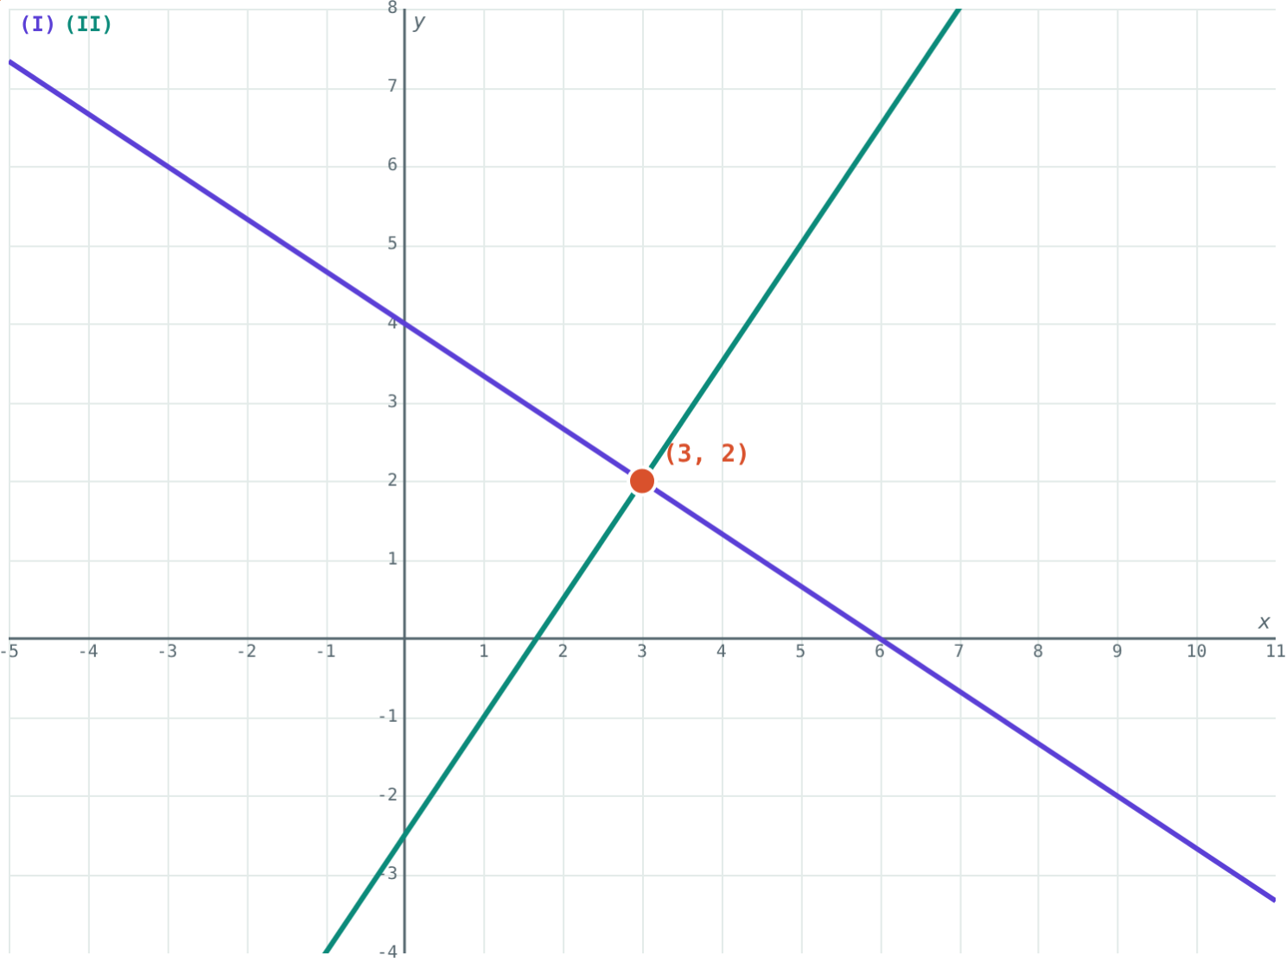
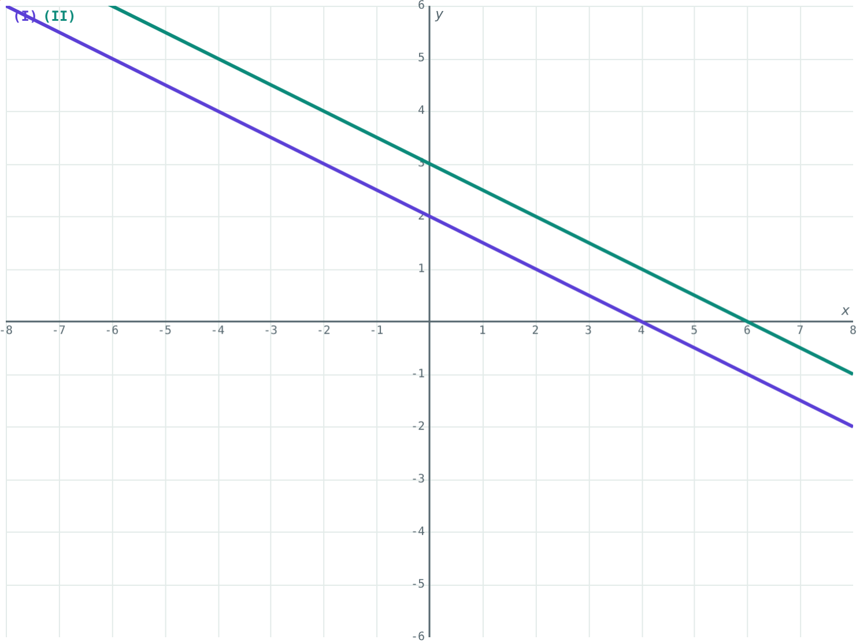
One answer or none
One solution: (3, 2).
No solution at all.
Notes:
If both equations describe the same line, there are infinitely many solutions.

Slide 7
Worked examples
Add to eliminate
Multiply first
3x − 5y = −16 and 2x + 5y = 31
2x + 3y = 12 and 3x − 2y = 5
Add: 5x = 15, x = 3
6 + 5y = 31, y = 5
×2 and ×3: 4x + 6y = 24, 9x − 6y = 15
13x = 39, x = 3, y = 2
Notes:
Check each answer in both original equations.

Slide 8
Worked example: substitution
Solve y = 2x − 1 and 3x + 2y = 12.
3x + 2(2x − 1) = 12
7x − 2 = 12, x = 2
y = 2(2) − 1 = 3
Check answers by where the lines cross
Notes:
Brackets matter: 2(2x − 1) = 4x − 2.

Slide 9
Always check
Put x = 3, y = 1 into both:
3 + 1 = 4
equation (I) ✓
6 − 5 = 1
equation (II) ✓
If either check fails, look for a sign slip.
x + y = 4 and 2x − 5y = 1
Notes:
Checking takes ten seconds and catches most errors.

Slide 10

Common mistakes
Add vs subtract
Multiplying one side
Same signs: subtract. Opposite signs: add.
Multiply every term, including the right side.
Stopping halfway
No check
Find both x and y.
Substitute into both equations.
Notes:
Ask students to explain the first rule using an example.

Slide 11
Quick check
1
Solve x + y = 10 and x − y = 2.
2
To eliminate y from 2x + 3y = 7 and 5x − 3y = 14, do you add or subtract?
3
On a graph, where is the solution of two simultaneous equations?
4
How many solutions do x + 2y = 4 and 2x + 4y = 12 have?
Notes:
Answers: 1) x = 6, y = 4. 2) Add. 3) Where the two lines cross. 4) None: the lines are parallel.

Slide 12
Watch the steps yourself
Open the Simultaneous Equations lesson on the Visual Science & Maths website. Set any pair and press “Show the steps”.
Next lesson: Word problems
Notes:
Homework: textbook practice set questions, checked with the simulation.

