Slide 1
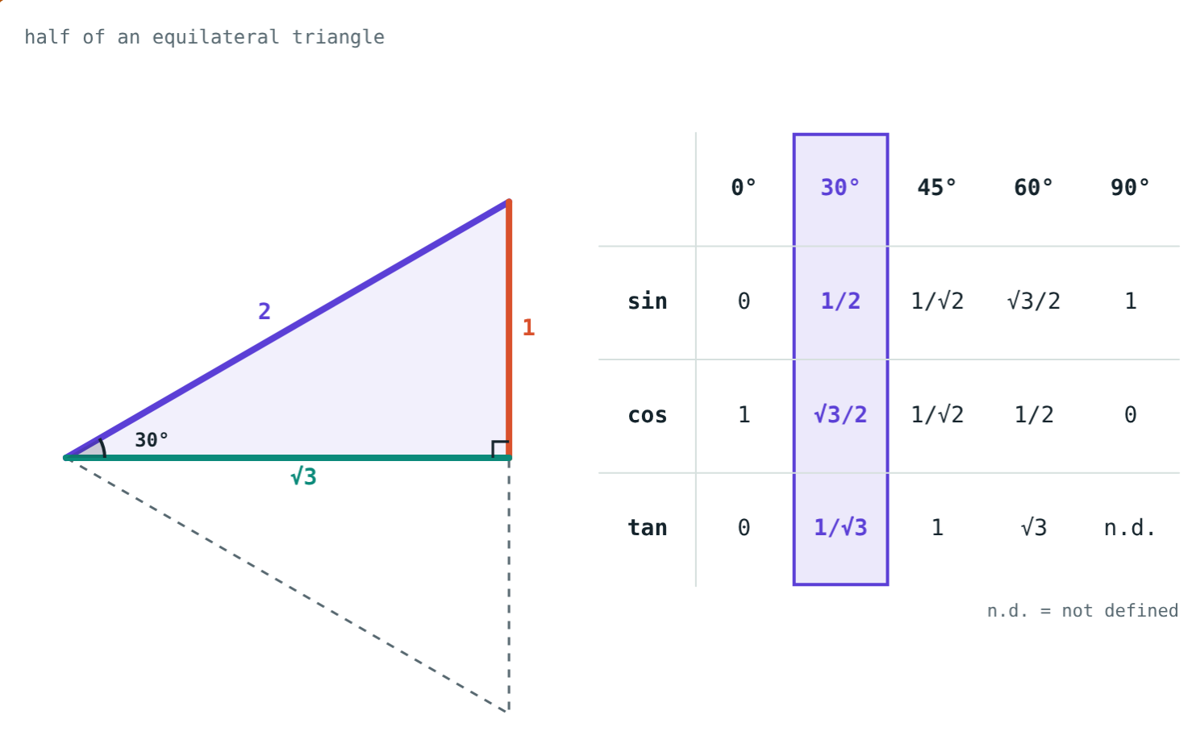
Ratios of Special Angles
STD 9 MATHEMATICS PART II · CH. 8 TRIGONOMETRY
Lesson 2 · Visual Science & Maths
Notes:
Goal: students can work out and remember sin, cos and tan of 0°, 30°, 45°, 60° and 90°, and use them in problems.

Slide 2
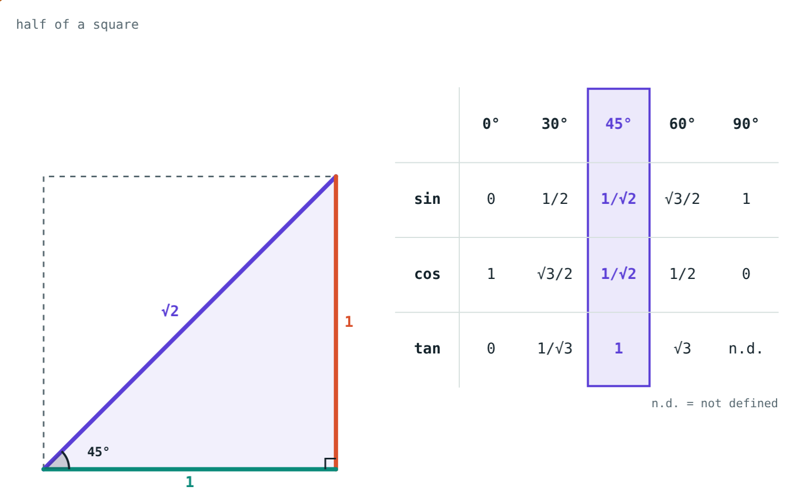
Your two set squares
One set square is half of an equilateral triangle. The other is half of a square.
What exact ratios are hiding in them?
Half of a square: angles 45°, 45°, 90°
Notes:
Pass real set squares round; ask students to find the 30°, 45° and 60° corners.

Slide 3
30° and 60°
Sides 1, √3, 2
Halve an equilateral triangle of side 2
Altitude = √(4 − 1) = √3
sin 30° = 1/2, cos 30° = √3/2, tan 30° = 1/√3
sin 60° = √3/2, cos 60° = 1/2, tan 60° = √3
Opposite 30° is 1, the hypotenuse is 2
Notes:
The short side faces the small angle: that is how to remember which is which.

Slide 4
45°
Sides 1, 1, √2
Halve a square of side 1 along a diagonal
Diagonal = √(1 + 1) = √2
sin 45° = cos 45° = 1/√2
tan 45° = 1
Both legs are 1
Notes:
1/√2 ≈ 0.707. Some books write it as √2/2; it is the same number.

Slide 5
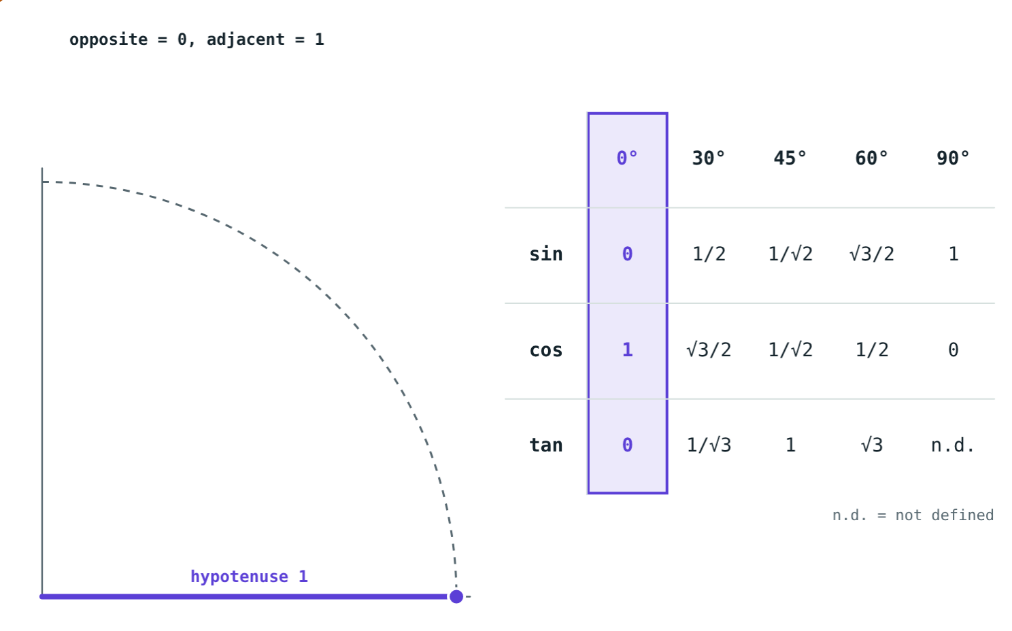
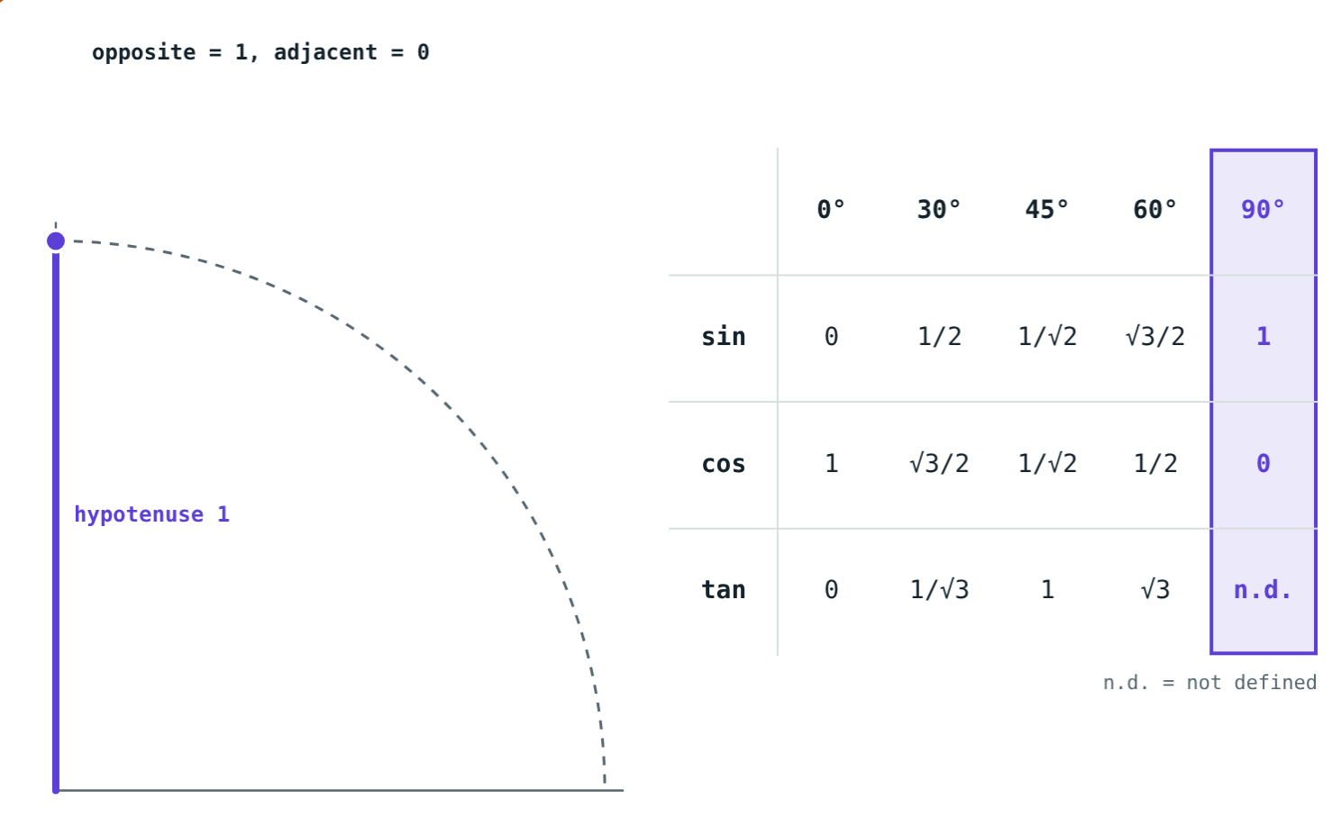
0° and 90°
Opposite 0, adjacent 1: sin 0° = 0, cos 0° = 1, tan 0° = 0
Opposite 1, adjacent 0: sin 90° = 1, cos 90° = 0, tan 90° not defined
Notes:
Keep the hypotenuse 1 and shrink or grow the angle; tan 90° would need division by 0.

Slide 6
The table
θ | 0° | 30° | 45° | 60° | 90°
sin θ | 0 | 1/2 | 1/√2 | √3/2 | 1
cos θ | 1 | √3/2 | 1/√2 | 1/2 | 0
tan θ | 0 | 1/√3 | 1 | √3 | not defined
Notes:
sin rises 0 → 1 while cos falls 1 → 0 with the same values. Every column obeys sin²θ + cos²θ = 1.

Slide 7
Worked examples
Evaluate
Squares of ratios
6 sin 30° − 2 tan 45°
2 cos²45° + tan²60°
6 × 1/2 − 2 × 1
= 3 − 2 = 1
cos²45° = 1/2, tan²60° = 3
2 × 1/2 + 3 = 4
Notes:
Square the ratio, not the angle: cos²45° = (1/√2)².

Slide 8
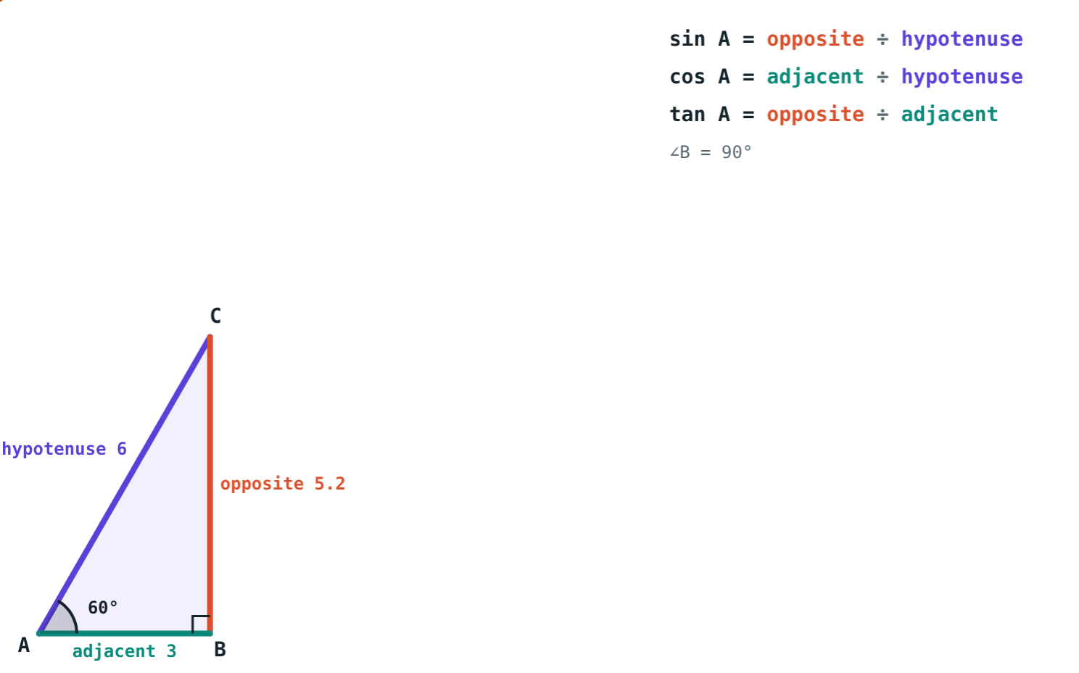
Worked example: a ladder
A 6 m ladder makes 60° with the ground. How high does it reach, and how far is its foot from the wall?
Height = 6 sin 60° = 3√3 ≈ 5.20 m
Distance = 6 cos 60° = 3 m
Hypotenuse 6, ∠A = 60°
Notes:
The ladder is the hypotenuse; the wall is opposite the 60° angle.

Slide 9
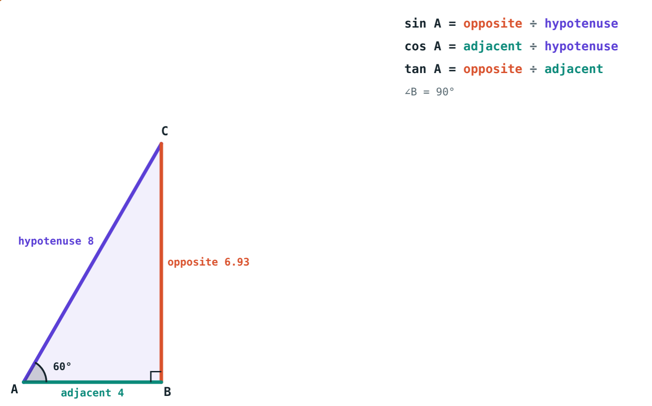
Check with a measured triangle
The simulation measures the sides:
6.93 ÷ 8
opposite ÷ hypotenuse
≈ 0.866
= √3/2 = sin 60°
Measured ratios agree with the exact table values.
∠A = 60°, hypotenuse 8 cm
Notes:
Students can draw a 60° angle with a protractor, measure, and divide.

Slide 10

Common mistakes
Swapping 30° and 60°
tan 90° = 0
sin 30° = cos 60° = 1/2.
tan 90° is not defined.
Adding angles
sin 45° = 1/2
sin (30° + 60°) ≠ sin 30° + sin 60°.
sin 45° = 1/√2 ≈ 0.707.
Notes:
For the third mistake: sin 90° = 1, but 1/2 + √3/2 ≈ 1.37.

Slide 11
Quick check
1
What is tan 60°?
2
Find sin 30° + cos 60°.
3
Which is not defined: sin 90°, cos 90°, tan 0° or tan 90°?
4
Hypotenuse 10 cm, one angle 30°. Find the side opposite 30°.
Notes:
Answers: 1) √3. 2) 1. 3) tan 90°. 4) 5 cm (10 × 1/2).

Slide 12
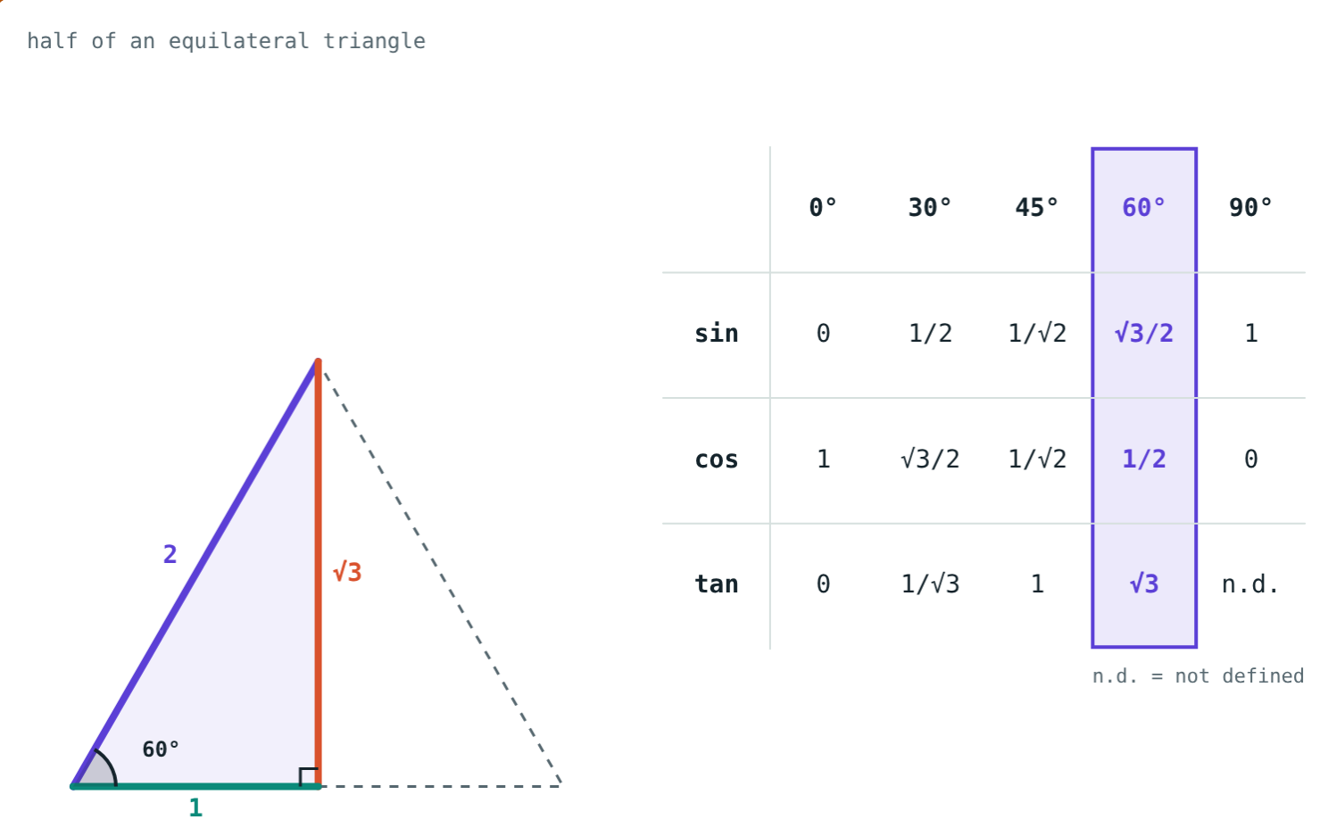
Light up the table
Open the Ratios of Special Angles lesson on the Visual Science & Maths website. Pick each angle and see where its values come from.
Next chapter: Surface Area and Volume
Notes:
Homework: textbook practice set 8.2, then write the table from memory.

