Slide 1
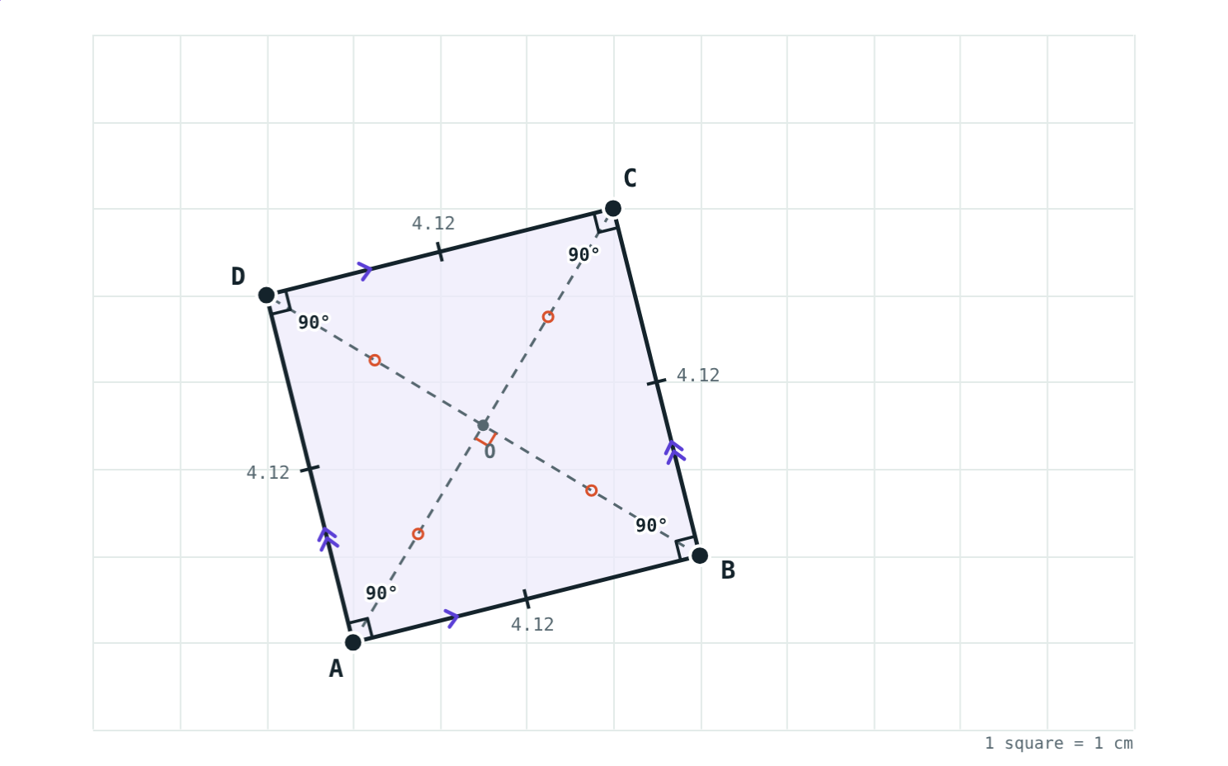
Rectangle, Rhombus, Square and Trapezium
STD 9 MATHEMATICS PART II · CH. 5 QUADRILATERALS
Lesson 2 · Visual Science & Maths
Notes:
Goal: students know the definitions of rectangle, rhombus, square, trapezium and isosceles trapezium, and the properties of their diagonals.

Slide 2
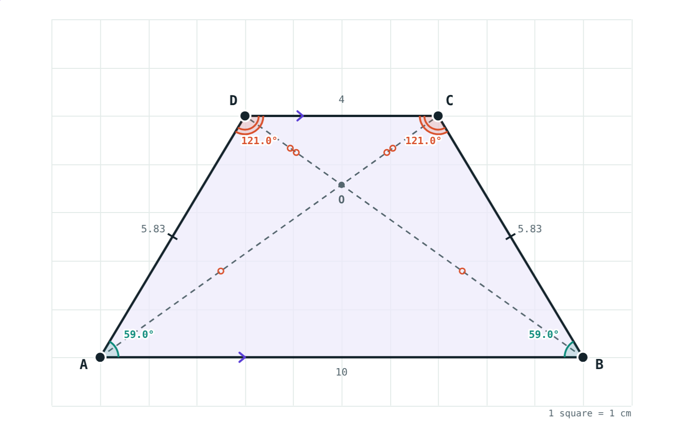
Shapes around us
A door, a floor tile turned on its corner, a bucket seen from the side.
Which special quadrilateral is each one?
A bucket from the side: an isosceles trapezium
Notes:
Door: rectangle. Tile on its corner: square (or rhombus). Bucket: isosceles trapezium.

Slide 3
Definitions
Shape | Definition
Rectangle | All angles are right angles
Rhombus | All sides are congruent
Square | All sides and all angles congruent
Trapezium | Only one pair of opposite sides parallel
Isosceles trapezium | Non-parallel sides congruent
Notes:
Rectangle, rhombus and square are all parallelograms; a trapezium is not.

Slide 4
The diagonals tell them apart
The diagonals… | Rectangle | Rhombus | Square
bisect each other | ✓ | ✓ | ✓
are congruent | ✓ | – | ✓
are perpendicular | – | ✓ | ✓
bisect the opposite angles | – | ✓ | ✓
Notes:
A square has every property, because it is both a rectangle and a rhombus.

Slide 5
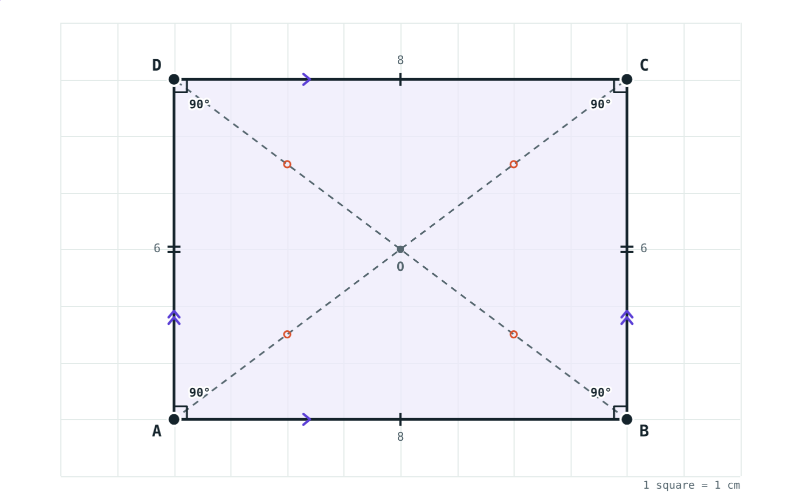
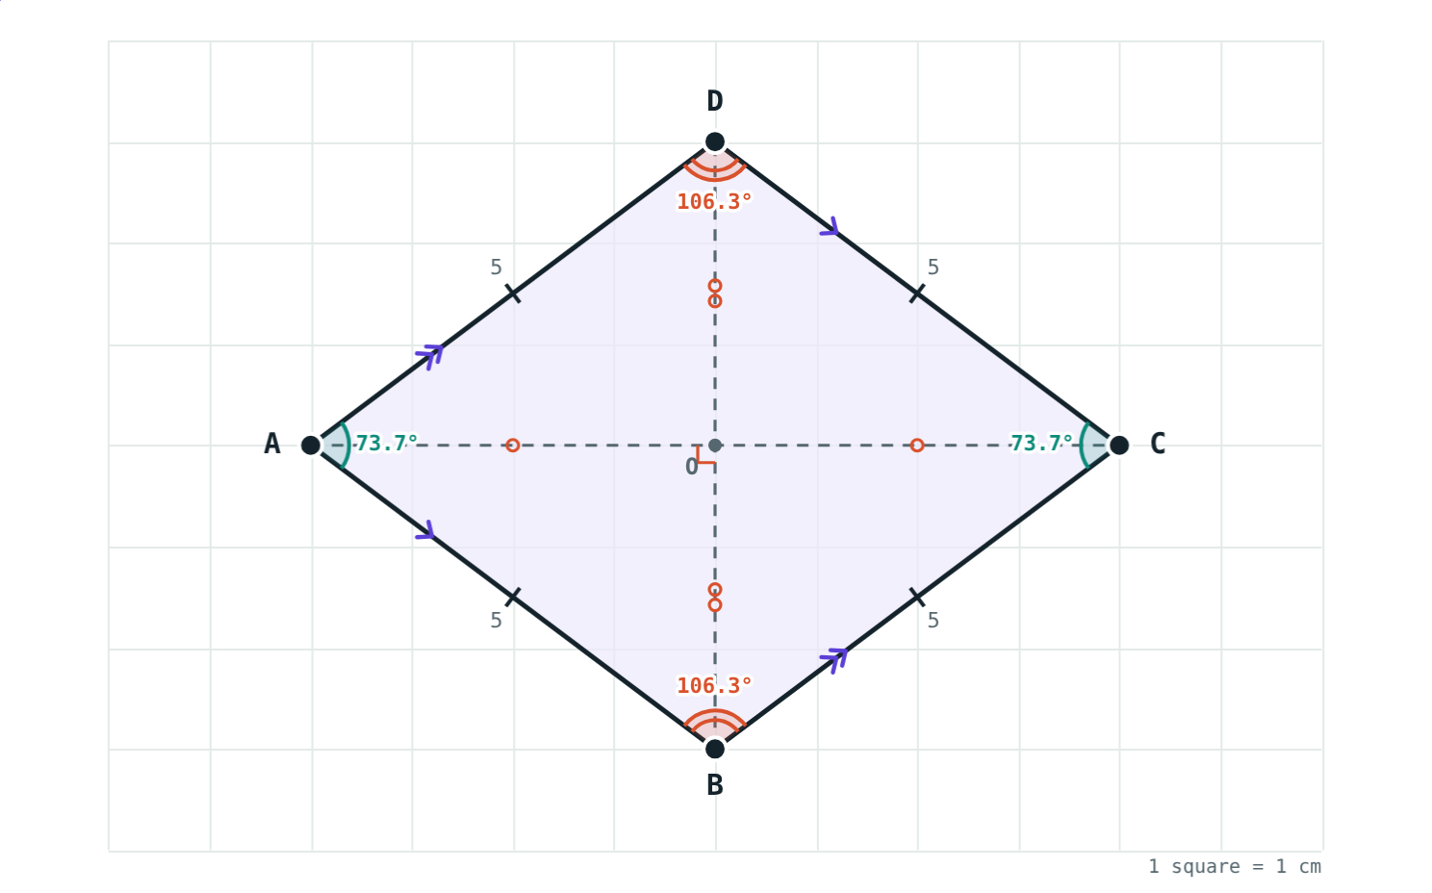
Rectangle and rhombus
Rectangle 8 × 6: AC = BD = 10 cm.
Rhombus: sides 5 cm, diagonals meet at 90°.
Notes:
Equal diagonals versus perpendicular diagonals: the key difference.

Slide 6
Trapeziums
AB ∥ DC, so ∠A + ∠D = 180° and ∠B + ∠C = 180°
Isosceles trapezium: AD = BC
Its base angles are congruent
Its diagonals are congruent
∠A = ∠B ≈ 59°, ∠C = ∠D ≈ 121°
Notes:
The interior angles on the same side of a transversal between parallel lines are supplementary (Chapter 2).

Slide 7
Worked examples
Rectangle
Rhombus
AB = 8 cm, BC = 6 cm. Find AC, BD and AO.
Diagonals 8 cm and 6 cm. Find the side and perimeter.
AC = √(64 + 36) = 10 cm
BD = AC; AO = ½ AC
AC = BD = 10 cm, AO = 5 cm
Halves 4 and 3 meet at 90°
Side = √(16 + 9) = 5 cm
side 5 cm, perimeter 20 cm
Notes:
Both examples use Pythagoras inside the shape.

Slide 8
Worked example: isosceles trapezium
PQ ∥ SR and PS = QR. If ∠P = 65°, find the other angles.
∠Q = ∠P = 65° (base angles)
∠S = 180° − 65° = 115°
∠Q = 65°, ∠R = ∠S = 115°
Base angles are congruent
Notes:
Check: 65 + 65 + 115 + 115 = 360.

Slide 9
A tilted square
Every side goes 4 one way and 1 the other:
4.12 cm
each side
90°
each angle
A square need not sit flat on the grid.
A(3, 1), B(7, 2), C(6, 6), D(2, 5)
Notes:
Side = √(16 + 1) = √17 ≈ 4.12 cm. Diagonals are both √34 ≈ 5.83 cm and perpendicular.

Slide 10

Common mistakes
Rhombus diagonals equal
A square is not a rectangle
No: they are perpendicular. Equal diagonals mean rectangle.
It is, and it is a rhombus too.
All trapeziums: equal base angles
Perpendicular diagonals = rhombus
Only an isosceles trapezium.
A kite has them too; they must also bisect each other.
Notes:
Use the “Kite” button in the simulation for the last point.

Slide 11
Quick check
1
The diagonals of a rhombus are 10 cm and 24 cm. Find its side.
2
True or false: every square is a rhombus.
3
In square ABCD, find ∠ABD.
4
In rectangle PQRS, PR = 18 cm and the diagonals meet at O. Find QO.
Notes:
Answers: 1) 13 cm (√(25 + 144)). 2) True. 3) 45°. 4) 9 cm.

Slide 12
Make every shape yourself
Open the Rectangle, Rhombus, Square and Trapezium lesson on the Visual Science & Maths website. Drag a corner and watch the name change.
Next lesson: The midpoint theorem
Notes:
Homework: draw a family tree of quadrilaterals, from quadrilateral down to square.

