Slide 1
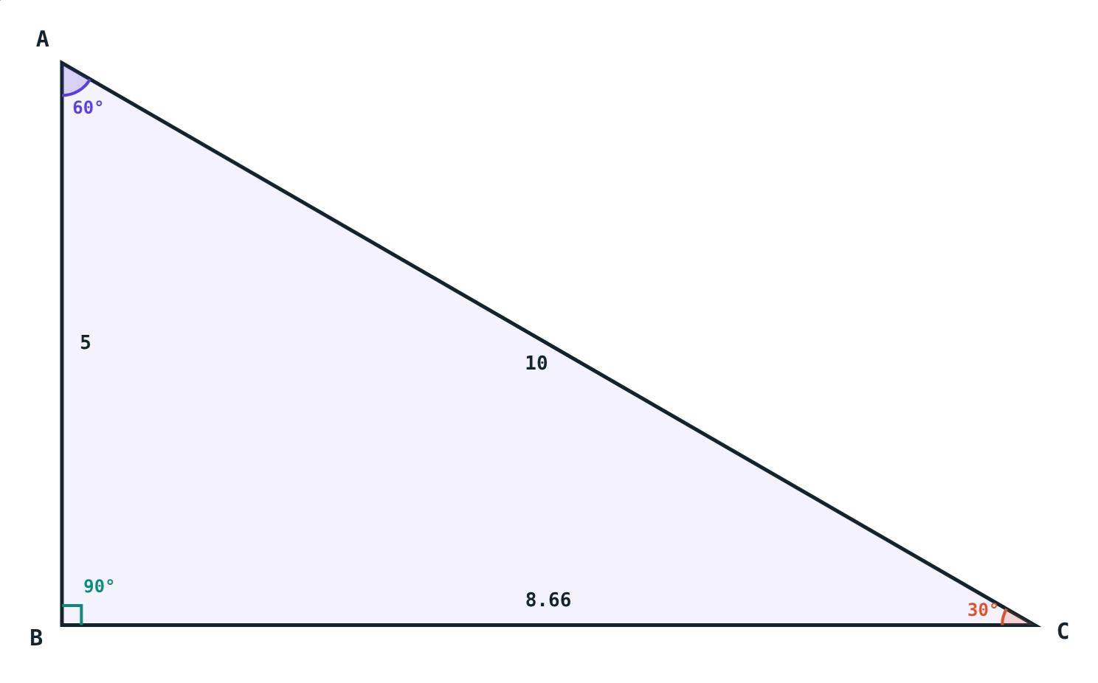
Isosceles and Right Triangles
STD 9 MATHEMATICS PART II · CH. 3 TRIANGLES
Lesson 3 · Visual Science & Maths
Notes:
Goal: students can use the isosceles triangle theorem, the 30°–60°–90° and 45°–45°–90° properties, the median on the hypotenuse, and side–angle inequalities.

Slide 2
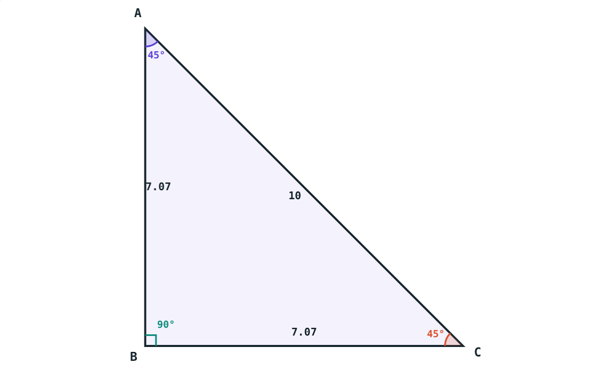
In your geometry box
Your two set squares are special triangles: one is 30°–60°–90°, the other 45°–45°–90°.
What do their sides have in common?
45°–45°–90°: legs equal
Notes:
Let students measure their own set squares.

Slide 3
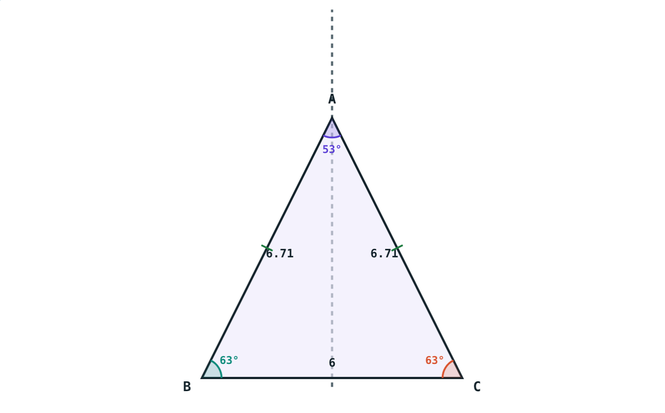
Isosceles triangle theorem
Equal sides → equal opposite angles
Converse: equal angles → equal opposite sides
Equilateral: all angles 60°
Apex lies on the perpendicular bisector of the base
AB = AC, so ∠B = ∠C
Notes:
The converse is equally important and often forgotten.

Slide 4
30°–60°–90° triangle
1 : √3 : 2
Opposite 30°: ½ hypotenuse
Opposite 60°: (√3/2) hypotenuse
Hypotenuse 10: sides 5 and 8.66
Notes:
It is half of an equilateral triangle.

Slide 5
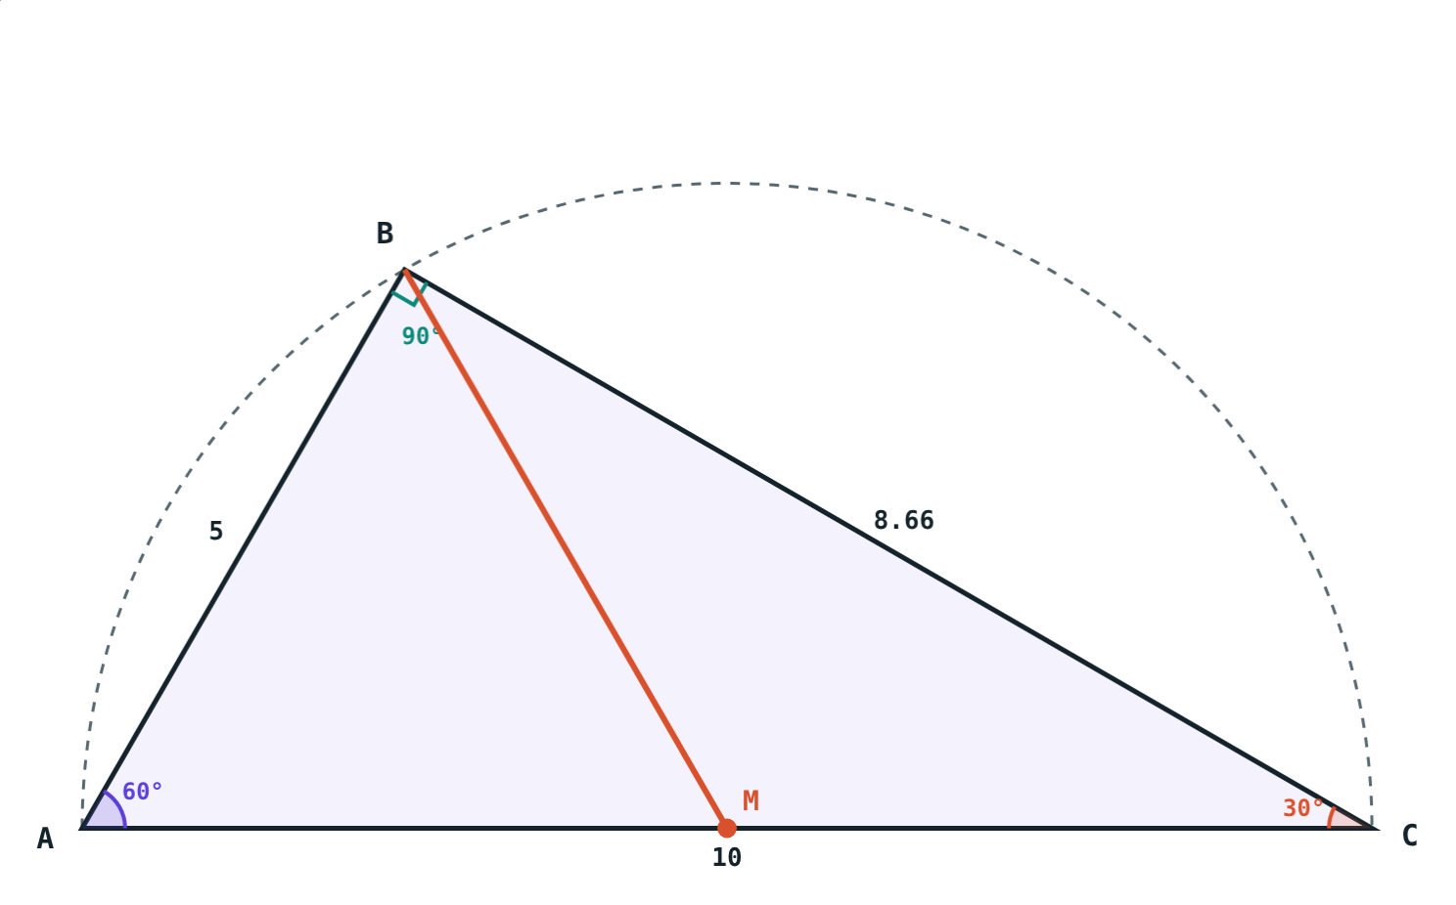
45°–45°–90° and the median
Each leg = hypotenuse ÷ √2.
BM = ½ AC, wherever B is.
Notes:
The median result comes from the circle through A, B and C.

Slide 6
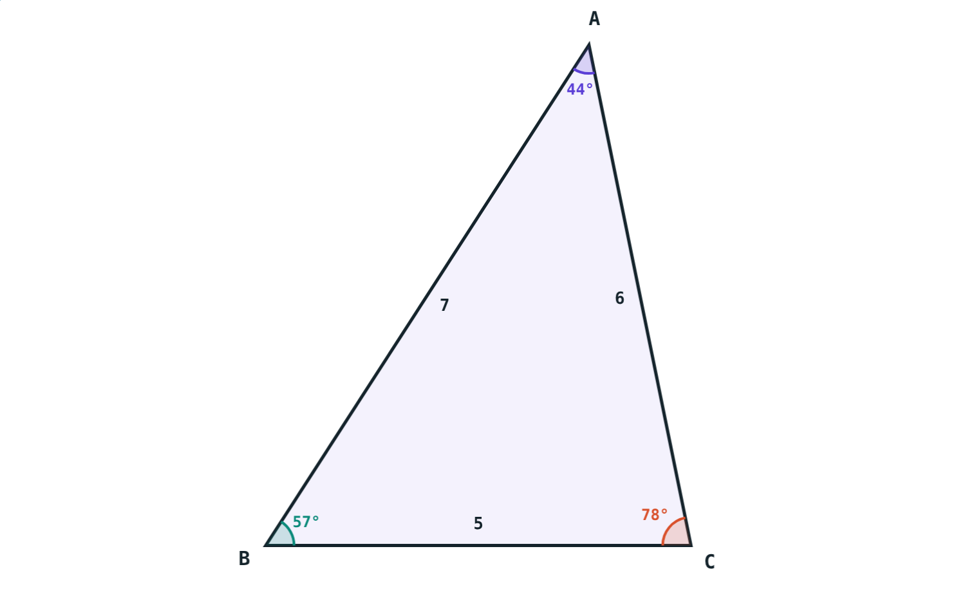
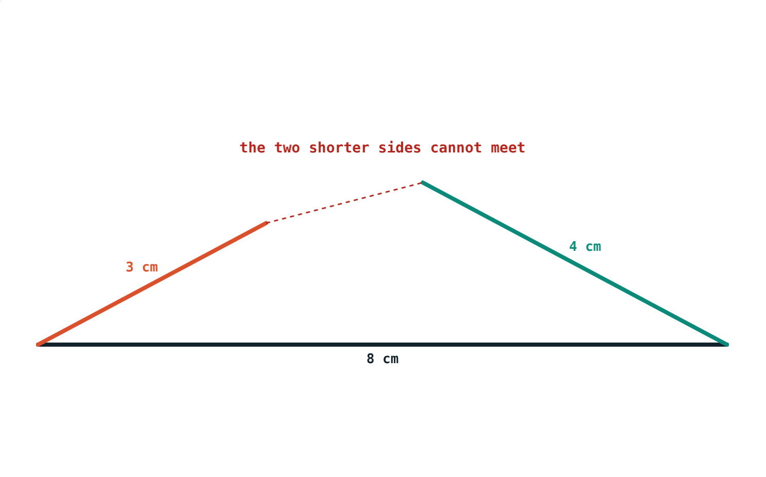
Sides and angles
Largest angle opposite the longest side.
3 + 4 < 8: no triangle.
Notes:
Any two sides must add up to more than the third.

Slide 7
Worked examples
Isosceles
30°–60°–90°
AB = AC and ∠A = 40°. Find ∠B and ∠C.
Hypotenuse 10 cm. Find the other sides.
∠B = ∠C; 2∠B = 140°
∠B = ∠C = 70°
Opposite 30°: 5 cm
Opposite 60°: 5√3 ≈ 8.66 cm
Notes:
Label the angles before writing any side.

Slide 8
Median on the hypotenuse
PR = √(144 + 25) = 13, and S is its midpoint:
13
hypotenuse PR
6.5
median QS
The median to the hypotenuse is half the hypotenuse.
∠Q = 90°, PQ = 12, QR = 5
Notes:
This matches the textbook's practice problem style.

Slide 9
Three ratios to remember
1 : 1
1 : √3 : 2
1 : 1 : √2
Isosceles legs
30°–60°–90°
45°–45°–90°
Equal sides, equal base angles.
Short side is half the hypotenuse.
Legs equal, hypotenuse √2 times a leg.
Notes:
These ratios return in trigonometry (chapter 8).

Slide 10

Common mistakes
Wrong equal angles
Halving the wrong side
They are opposite the equal sides.
The side opposite 30° is half the hypotenuse.
Any three lengths
Largest angle beside the longest side
Check: the two shorter add to more than the longest.
It is opposite it.
Notes:
Ask students to draw a counter-example for each.

Slide 11
Quick check
1
PQ = PR and ∠P = 50°. Find ∠Q.
2
A 30°–60°–90° triangle has hypotenuse 14 cm. Find the side opposite 30°.
3
Can 2, 3 and 6 cm form a triangle?
4
A right triangle has hypotenuse 15 cm. Find the median to the hypotenuse.
Notes:
Answers: 1) 65°. 2) 7 cm. 3) No, 2 + 3 < 6. 4) 7.5 cm.

Slide 12
Reshape the triangles yourself
Open the Isosceles and Right Triangles lesson on the Visual Science & Maths website. Try every view.
Next chapter: Constructions of Triangles
Notes:
Homework: textbook practice sets 3.3 and 3.4.

