Slide 1
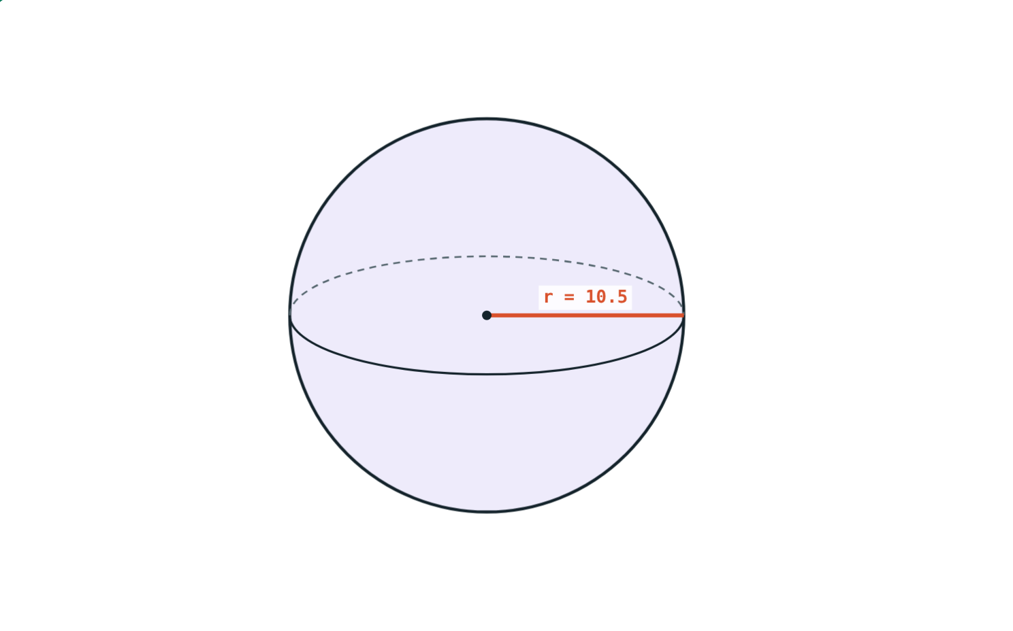
Spheres and Hemispheres
STD 9 MATHEMATICS PART II · CH. 9 SURFACE AREA AND VOLUME
Lesson 3 · Visual Science & Maths
Notes:
Goal: students can find the surface area and volume of a sphere, and the curved surface area, total surface area and volume of a hemisphere.

Slide 2
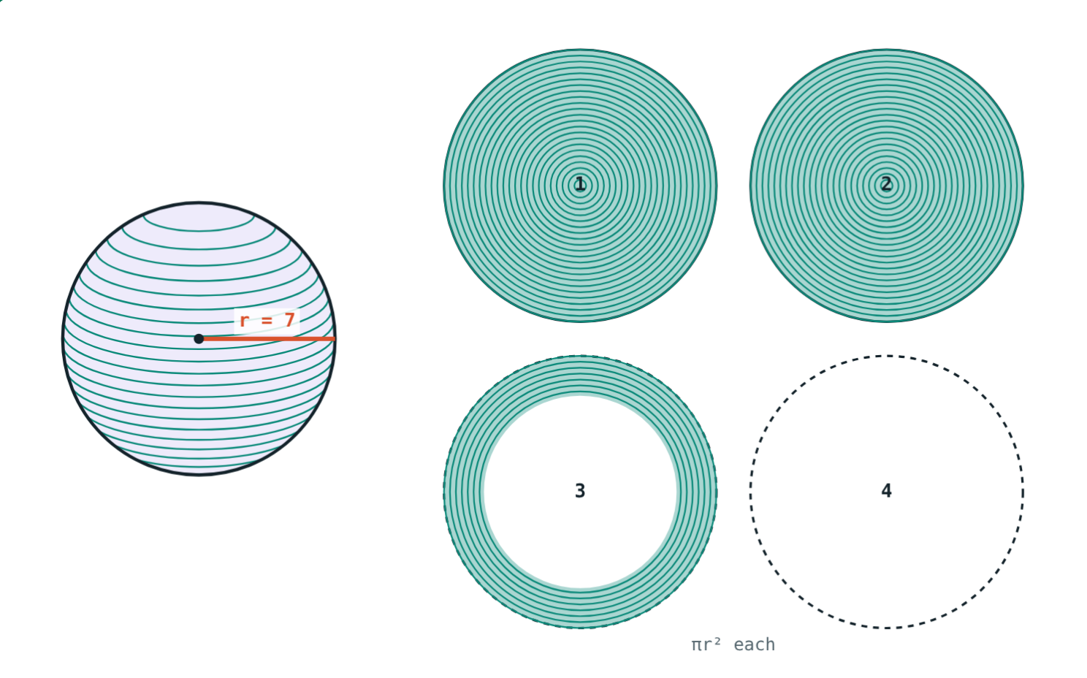
Wrap a ball in string
Wind string round a ball until it is covered. Then use the same string to fill circles as wide as the ball.
How many circles does the string fill?
Two and a half circles so far…
Notes:
Do the activity with a small ball and thick string if time allows. The answer is four.

Slide 3
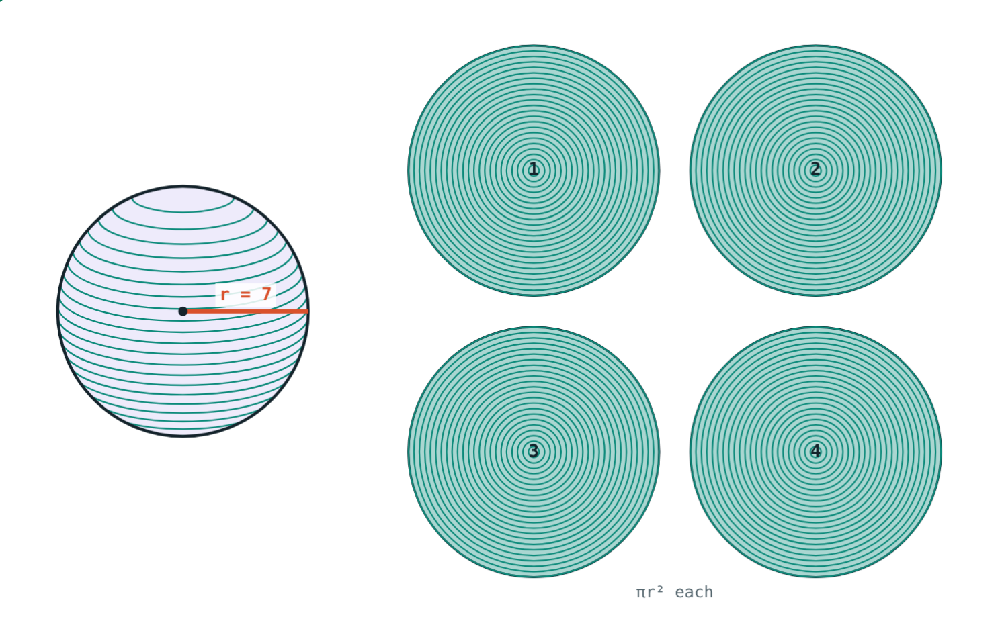
Surface area of a sphere
S = 4πr²
The string fills 4 circles of radius r
Each circle has area πr²
r = 7 cm: 4 × 154 = 616 cm² (π = 22/7)
Four circles of radius r
Notes:
Area always has r squared, so the units are cm².

Slide 4
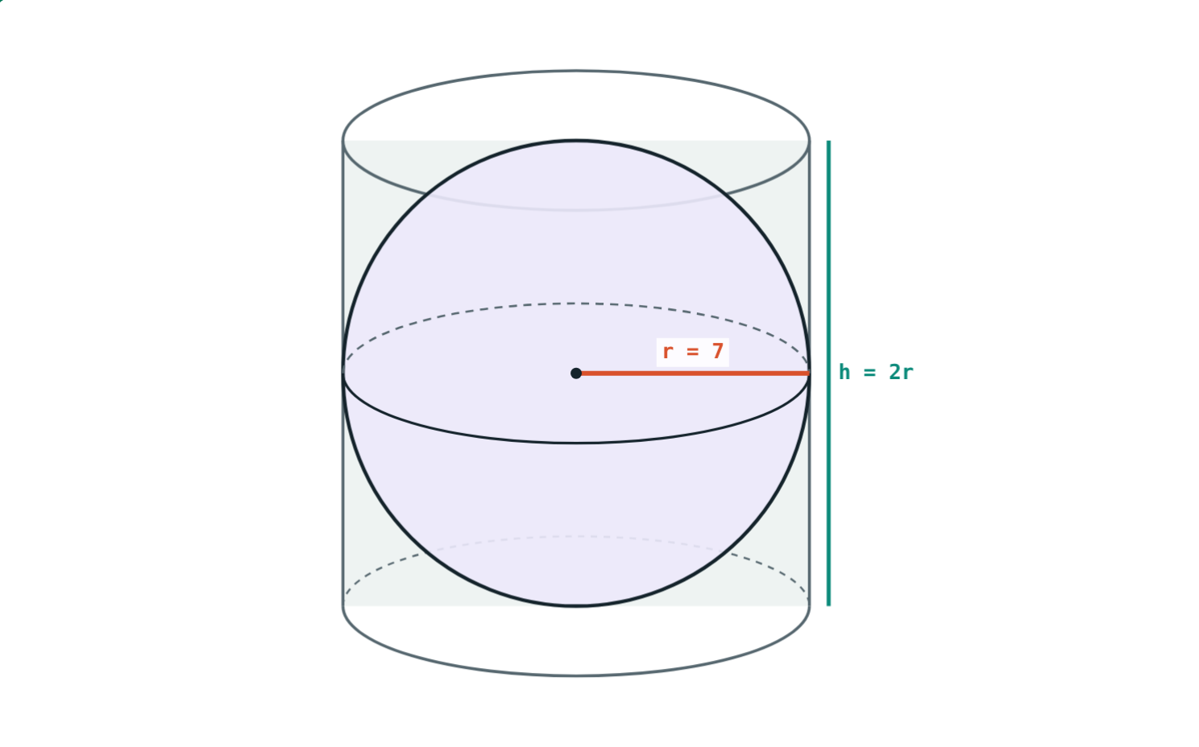
Volume of a sphere
V = ⁴⁄₃πr³
The sphere fits a cylinder of radius r, height 2r
Cylinder volume = 2πr³
Sphere = ⅔ of it = ⁴⁄₃πr³
Sphere : cylinder = 2 : 3
Notes:
Archimedes was so proud of this 2 : 3 result that he asked for it on his tombstone.

Slide 5
Hemisphere: half a sphere
2πr²
3πr²
⅔πr³
Curved surface
Solid hemisphere
Volume
Half of 4πr². A bowl has only this.
Curved 2πr² plus the flat circle πr².
Half of ⁴⁄₃πr³.
Notes:
Make sure students can say why the total is 3πr² and not 4πr² ÷ 2.

Slide 6
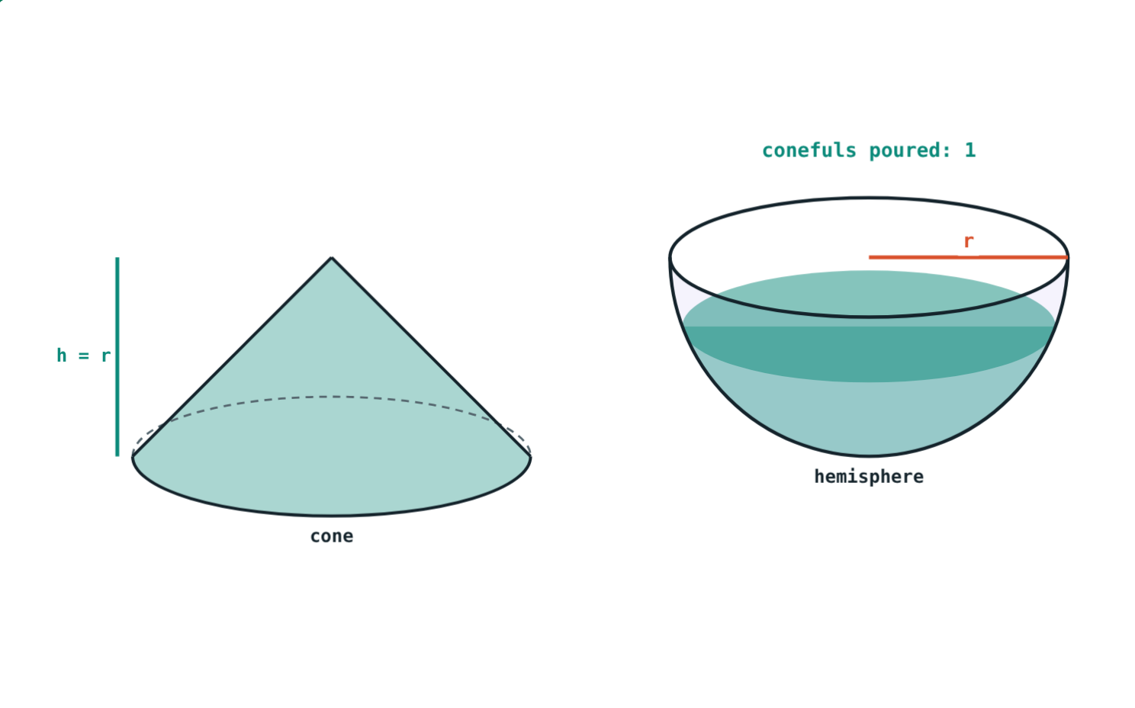
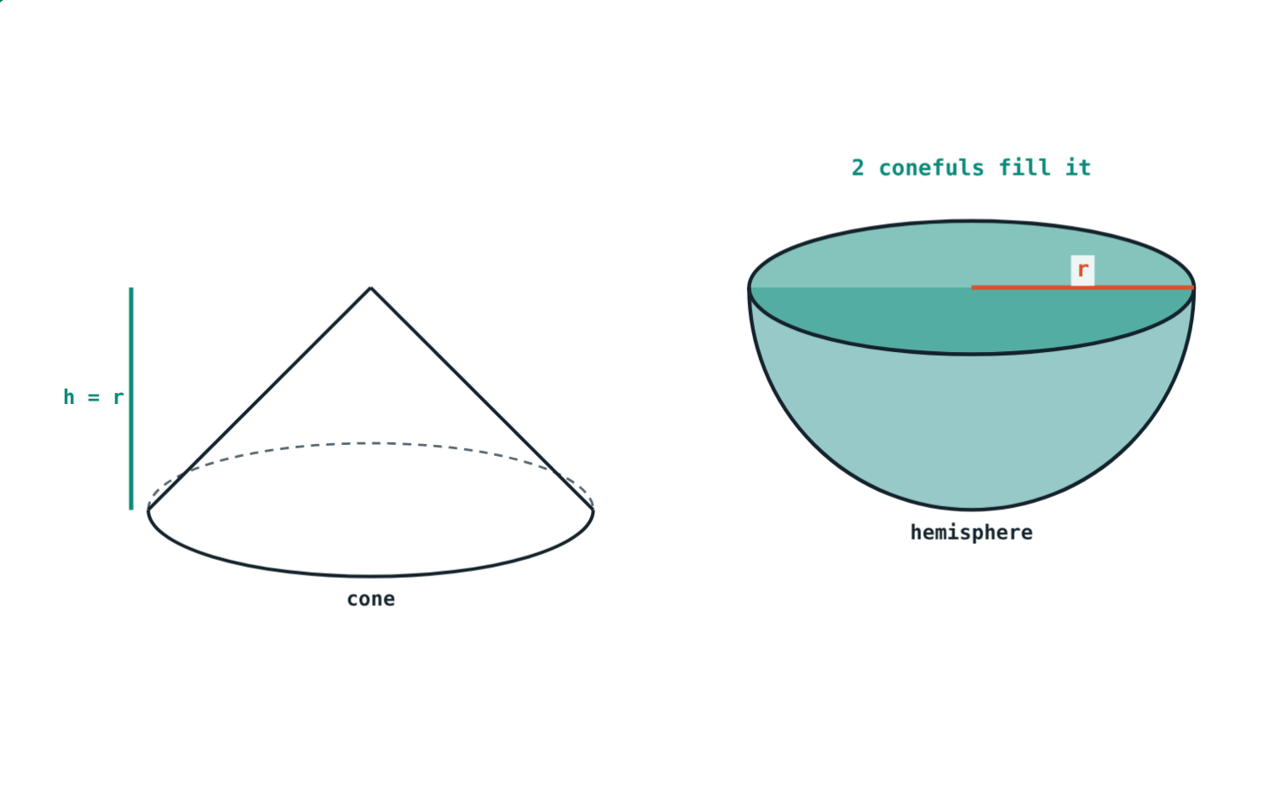
Two conefuls fill a hemisphere
Cone with h = r holds ⅓πr³ = 226.08 cm³ (r = 6, π = 3.14).
2 × ⅓πr³ = ⅔πr³ = 452.16 cm³: the hemisphere is full.
Notes:
This is the textbook activity with sand: a cone whose height equals its radius.

Slide 7
Worked example: a football
A ball has diameter 21 cm. Find its surface area and volume (π = 22/7).
r = 10.5 cm
4 × 22/7 × 10.5² = 1386 cm²
⁴⁄₃ × 22/7 × 10.5³ = 4851 cm³
Diameter 21 cm, so r = 10.5 cm
Notes:
Halve the diameter first. 22/7 × 10.5 = 33 makes the arithmetic easy.

Slide 8
Worked examples
Solid hemisphere
Radius from the surface
r = 6 cm (π = 3.14). Find curved SA, total SA and volume.
A sphere has surface area 1256 cm² (π = 3.14). Find r.
2 × 3.14 × 36 = 226.08 cm²
3 × 3.14 × 36 = 339.12 cm²
⅔ × 3.14 × 216 = 452.16 cm³
12.56 r² = 1256
r² = 100, r = 10 cm
Notes:
For the second example, divide by 4 × 3.14 = 12.56.

Slide 9
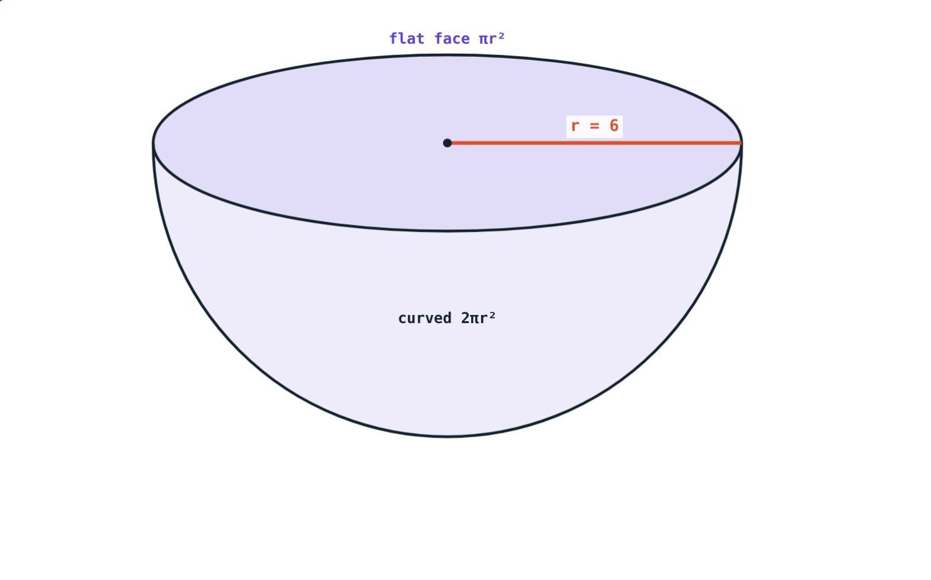
Double the radius
What happens when r becomes 2r?
× 4
surface area (r²)
× 8
volume (r³)
2² = 4 and 2³ = 8. This is true for every solid in this chapter.
Solid hemisphere, r = 6 cm
Notes:
Check in the simulation: a sphere with r = 5 has surface area 314 cm², and with r = 10 it has 1256 cm² (π = 3.14).

Slide 10

Common mistakes
Diameter as radius
r² or r³ mixed up
21 cm ball: r = 10.5 cm.
Surface: r², cm². Volume: r³, cm³.
2πr² for a solid
⅓πr³ for a hemisphere
Solid hemisphere: 3πr². Bowl: 2πr².
Half of ⁴⁄₃πr³ is ⅔πr³.
Notes:
Ask students which formula has which units before they calculate.

Slide 11
Quick check
1
A sphere has radius 7 cm. Find its surface area (π = 22/7).
2
Write the total surface area of a solid hemisphere of radius r.
3
Find the curved surface area of a hemisphere of radius 10 cm (π = 3.14).
4
The radius of a sphere is doubled. How many times larger is its volume?
Notes:
Answers: 1) 4 × 22/7 × 49 = 616 cm². 2) 3πr². 3) 2 × 3.14 × 100 = 628 cm². 4) 8 times.

Slide 12
Wind and pour yourself
Open the Spheres and Hemispheres lesson on the Visual Science & Maths website. Wind the string onto four circles and pour two conefuls into the hemisphere.
That completes the Surface Area and Volume chapter
Notes:
Homework: find the surface area and volume of a ball you have at home (measure its diameter with two books and a ruler).

