Slide 1
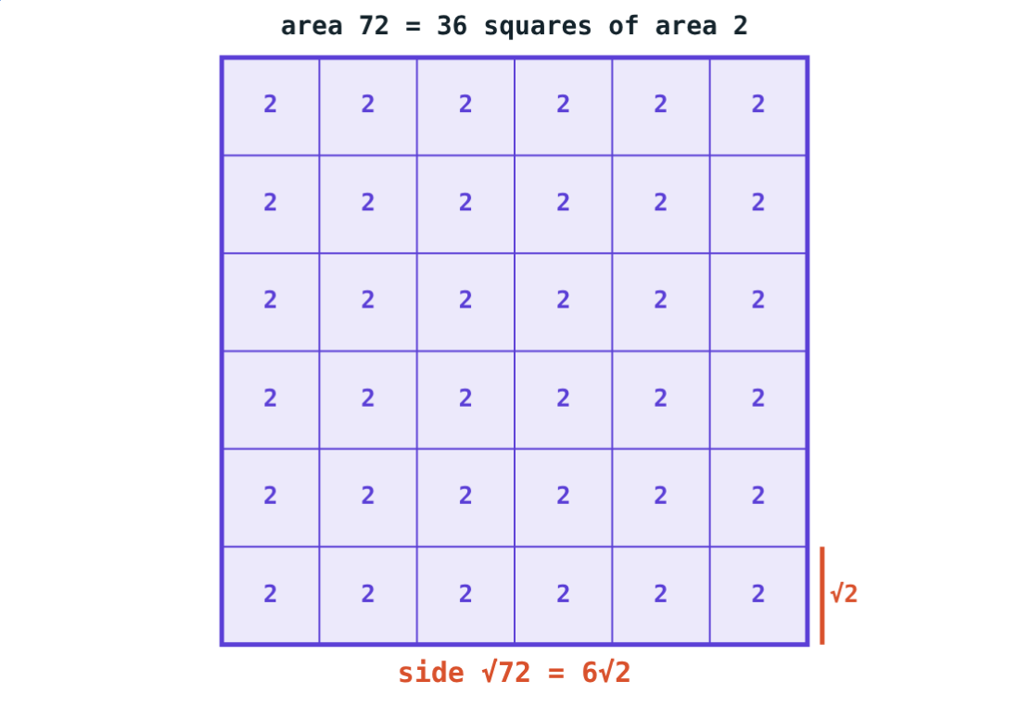
Surds and Rationalising
STD 9 MATHEMATICS PART I · CH. 2 REAL NUMBERS
Lesson 3 · Visual Science & Maths
Notes:
Goal: students can find the order of a surd, simplify, compare and operate on quadratic surds, and rationalise denominators, including with a conjugate.

Slide 2
Tidying √72
A square of area 72 can be cut into 36 small squares, each of area 2.
So how long is its side?
√72 = √(36 × 2) = 6√2
Notes:
Each small square has side √2, and there are 6 along each edge.

Slide 3
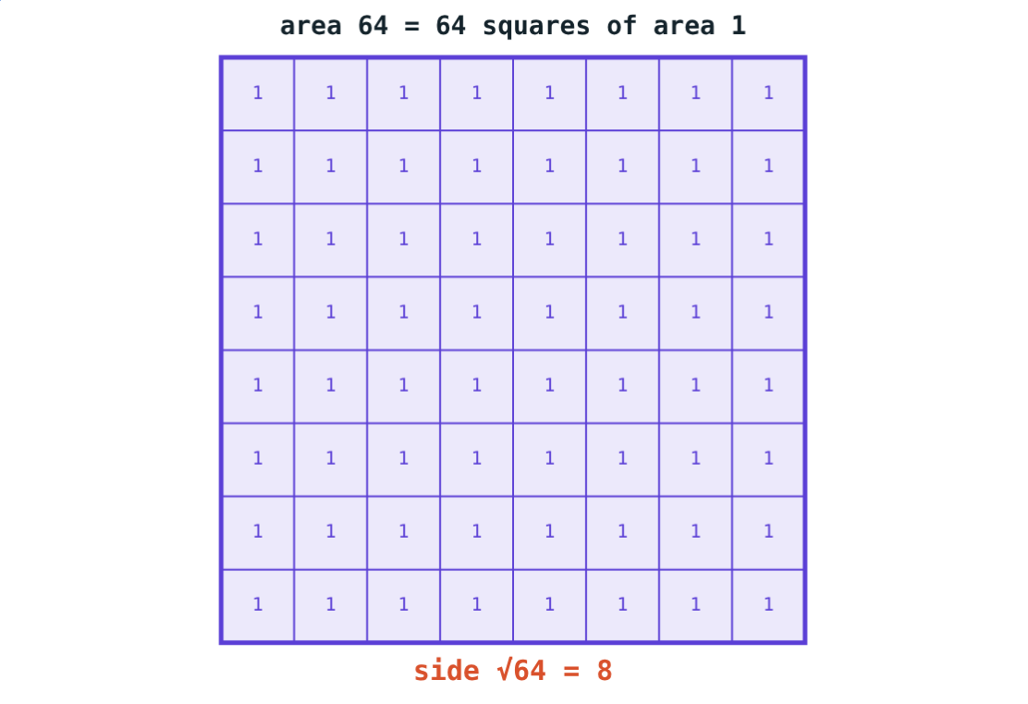
Surds
ⁿ√a irrational → surd of order n
a is a positive rational number
∛7 has order 3; √5 has order 2
Order 2: a quadratic surd
√64 = 8 is not a surd
Simplest form: take out square factors
√64 = 8: rational, not a surd
Notes:
In Std 9 we work only with quadratic surds.

Slide 4
Operations on surds
Operation | Rule | Example
Add, subtract | like surds only | 3√2 + 5√2 = 8√2
Simplify first | √ab = √a × √b | √50 − √18 = 2√2
Multiply | √a × √b = √ab | √6 × √15 = 3√10
Divide | √a ÷ √b = √(a/b) | √45 ÷ √5 = 3
Notes:
Like surds have the same number under the root in simplest form: √20 = 2√5 and 3√5 are like surds.

Slide 5
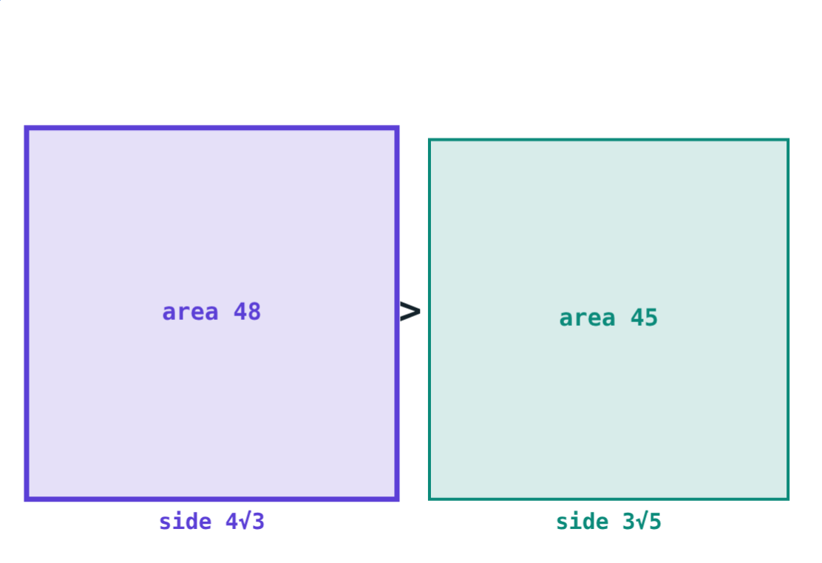
Comparing surds
Square both surds
The bigger square is the bigger surd
(4√3)² = 48, (3√5)² = 45
So 4√3 > 3√5
Areas 48 and 45
Notes:
This works because both numbers are positive.

Slide 6
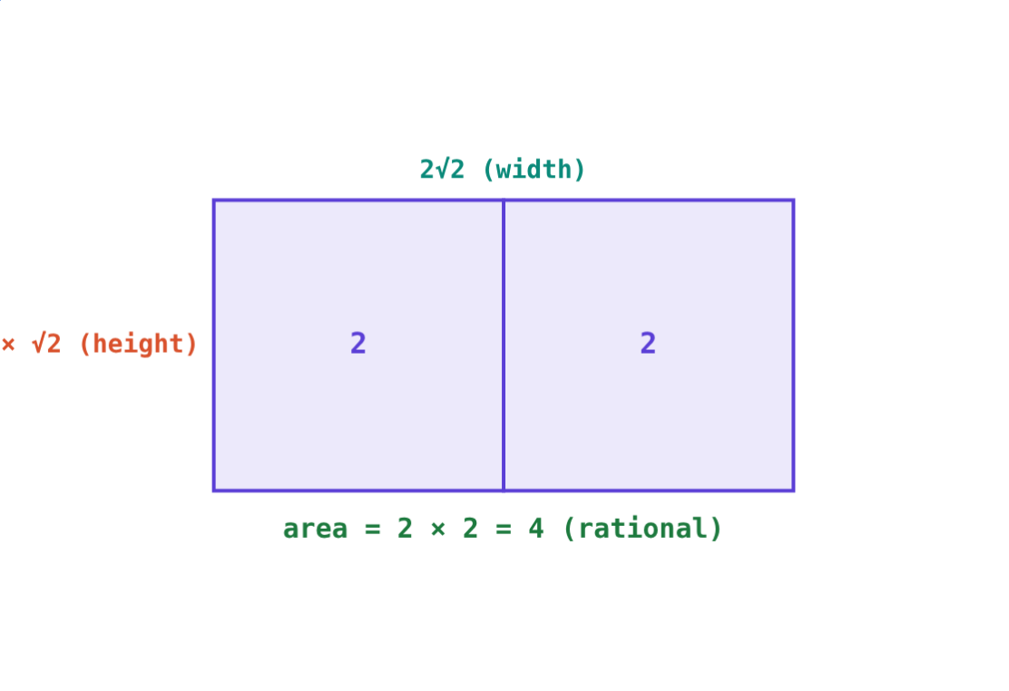
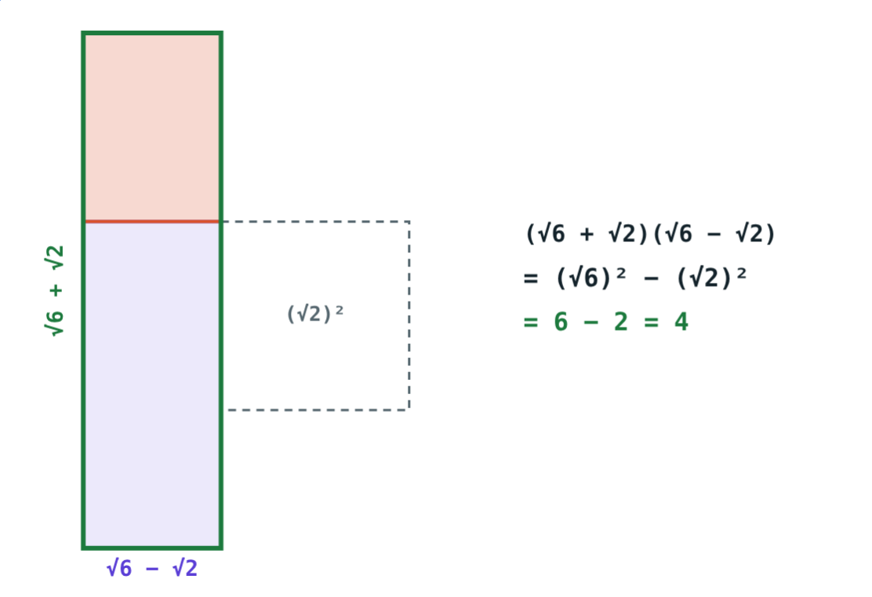
Rationalising the denominator
6/√8 = 6/(2√2) = 6√2/4 = 3√2/2
1/(√6 + √2) = (√6 − √2)/4
Multiply top and bottom by the same rationalising factor.
Notes:
(√a + √b)(√a − √b) = a − b, so a conjugate pair always has a rational product.

Slide 7
Worked examples
Simplify and add
Compare
√50 + √32 − √8
5√2 or 3√6?
5√2 + 4√2 − 2√2
= 7√2
Squares: 50 and 54
3√6 is greater
Notes:
Simplify every surd before deciding whether they are like surds.

Slide 8
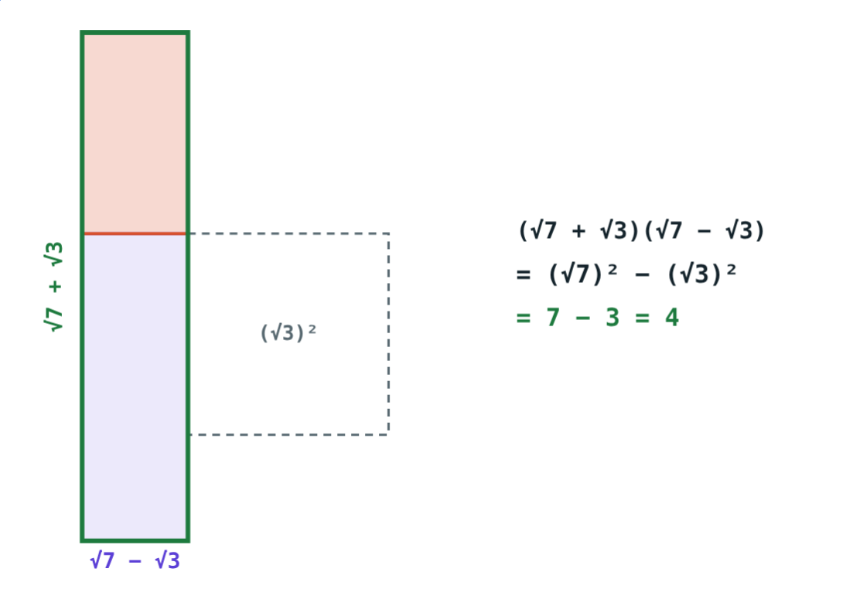
Worked example: conjugate
Rationalise (√7 − √3)/(√7 + √3).
× (√7 − √3) top and bottom
Bottom: 7 − 3 = 4; top: 10 − 2√21
= (5 − √21)/2
(√7)² − (√3)² = 4
Notes:
(√7 − √3)² = 7 − 2√21 + 3.

Slide 9
Why the conjugate works
Squaring each term removes the surds:
6 − 2 = 4
(√6)² − (√2)²
25 − 24 = 1
5² − (2√6)²
So 3/(5 + 2√6) = 15 − 6√6.
(A + B)(A − B) = A² − B²
Notes:
The picture moves a strip of the square to form the rectangle (A + B)(A − B).

Slide 10

Common mistakes
√(a + b) = √a + √b
√2 + √3 = √5
√(9 + 16) = 5, not 7.
Only like surds combine.
Same sign
Only the bottom
For 2 + √3 use 2 − √3.
Multiply the numerator too.
Notes:
Test the first mistake with numbers: it is the most common.

Slide 11
Quick check
1
State the order of the surd ∛10.
2
Write √98 in simplest form.
3
Which is greater: 2√7 or 3√3?
4
Give a rationalising factor of 4 + √3.
Notes:
Answers: 1) 3. 2) 7√2. 3) 2√7 (28 > 27). 4) 4 − √3; the product is 13.

Slide 12
Clear the denominator
Open the Surds lesson on the Visual Science & Maths website. Simplify, compare and rationalise step by step.
Next chapter: Polynomials
Notes:
Homework: rationalise 1/(3 + √7) and check the value with a calculator.

