Slide 1
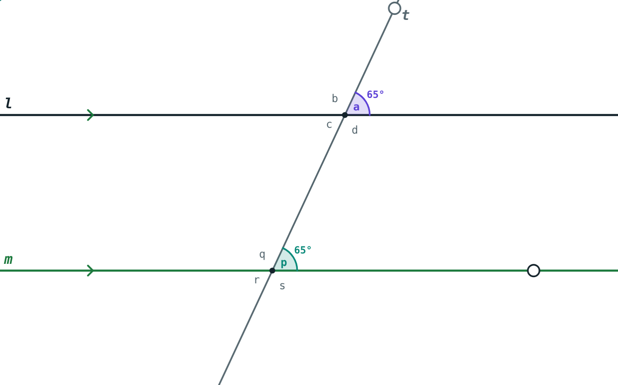
Tests for Parallel Lines
STD 9 MATHEMATICS PART II · CH. 2 PARALLEL LINES
Lesson 2 · Visual Science & Maths
Notes:
Goal: students can use the interior, alternate and corresponding angle tests to show two lines are parallel.

Slide 2
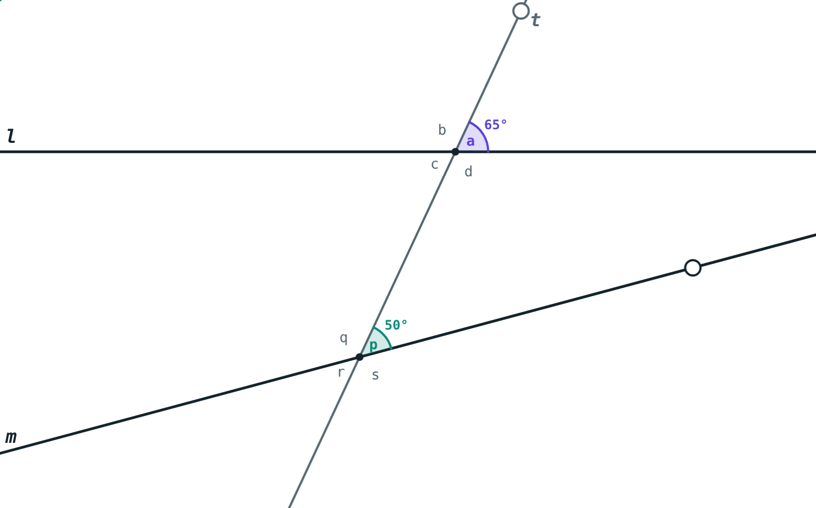
Is this shelf level?
A carpenter wants two shelves to be parallel. She cannot follow them to see if they meet.
Can one pair of angles tell her?
65° and 50°: the lines meet
Notes:
She measures the angles both shelves make with the same upright.

Slide 3
Properties and tests
Property: l ∥ m, so the angles are related
Test: the angles are related, so l ∥ m
Each test is a converse of a property
∠a = ∠p = 65°: l ∥ m
Notes:
Link back to converses in Chapter 1: here the converses are true.

Slide 4
The three tests
180°
=
=
Interior angle test
Alternate angle test
Corresponding test
Interior angles on one side supplementary → parallel.
A pair of alternate angles congruent → parallel.
A pair of corresponding angles congruent → parallel.
Notes:
Any one pair passing a test is enough.

Slide 5
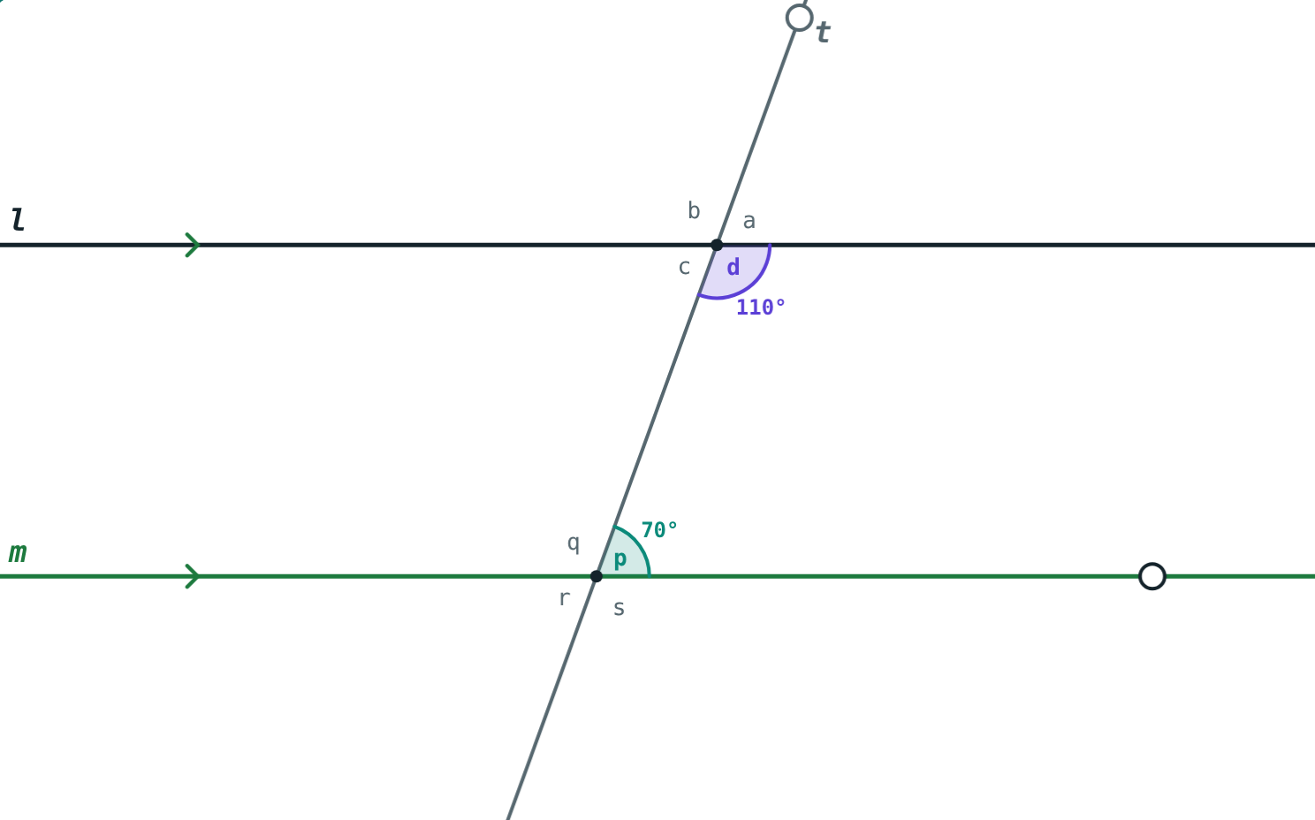
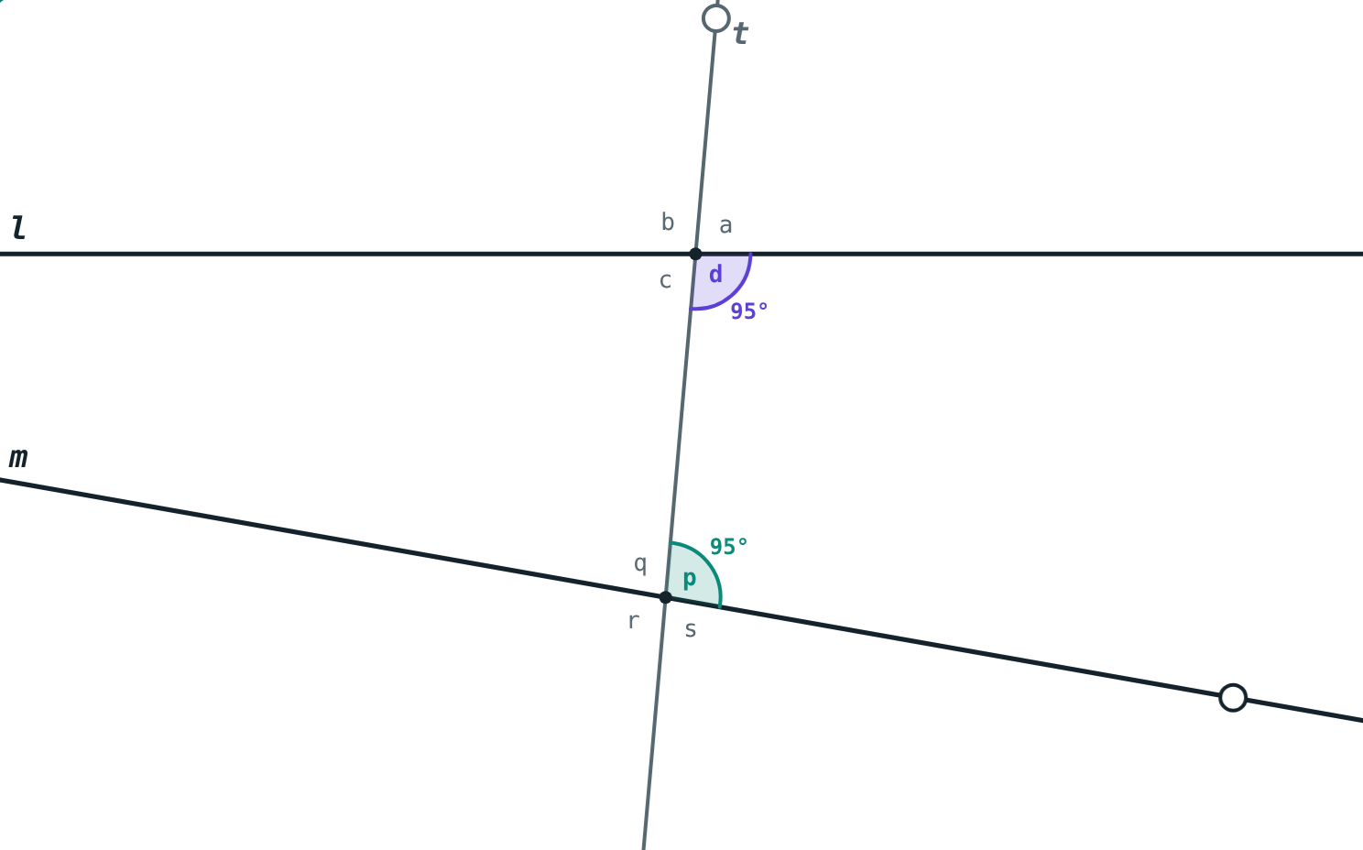
Pass or fail
110° + 70° = 180°: passes, so l ∥ m.
95° + 95° = 190°: fails, the lines meet.
Notes:
Interior angle test, indirect proof: if the lines met at T, the triangle there would have two angles adding to 180°, leaving 0° at T.

Slide 6
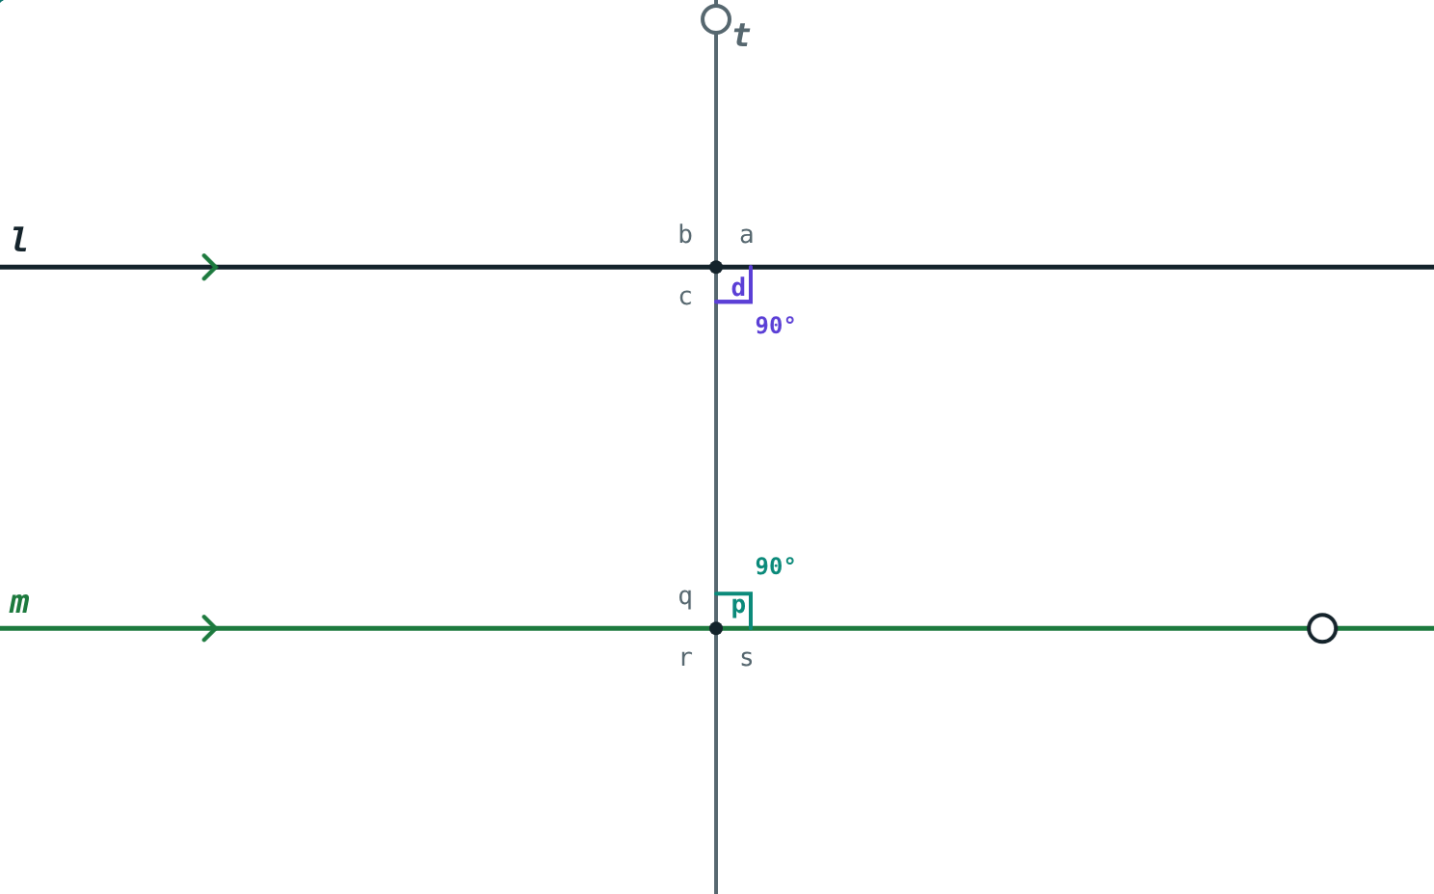
Two corollaries
A line perpendicular to two lines makes them parallel
Two lines parallel to a third line are parallel to each other
90° + 90° = 180°
Notes:
Both follow from the interior angle test.

Slide 7
Worked examples
Name the test
Find x
Corresponding angles ∠a = 72° and ∠p = 72°.
Interior angles (2x + 16)° and (3x − 6)°.
Equal corresponding angles
Corresponding angle test: l ∥ m
5x + 10 = 180
x = 34: 84° + 96° = 180°
Notes:
For the second, check by substituting x = 34 into both angles.

Slide 8
Worked example: corollaries
l ⊥ n and m ⊥ n. Line k ∥ m. How are k and l related?
l ⊥ n, m ⊥ n, so l ∥ m
k ∥ m and l ∥ m, so k ∥ l
l ⊥ t and m ⊥ t
Notes:
Two corollaries used one after the other.

Slide 9
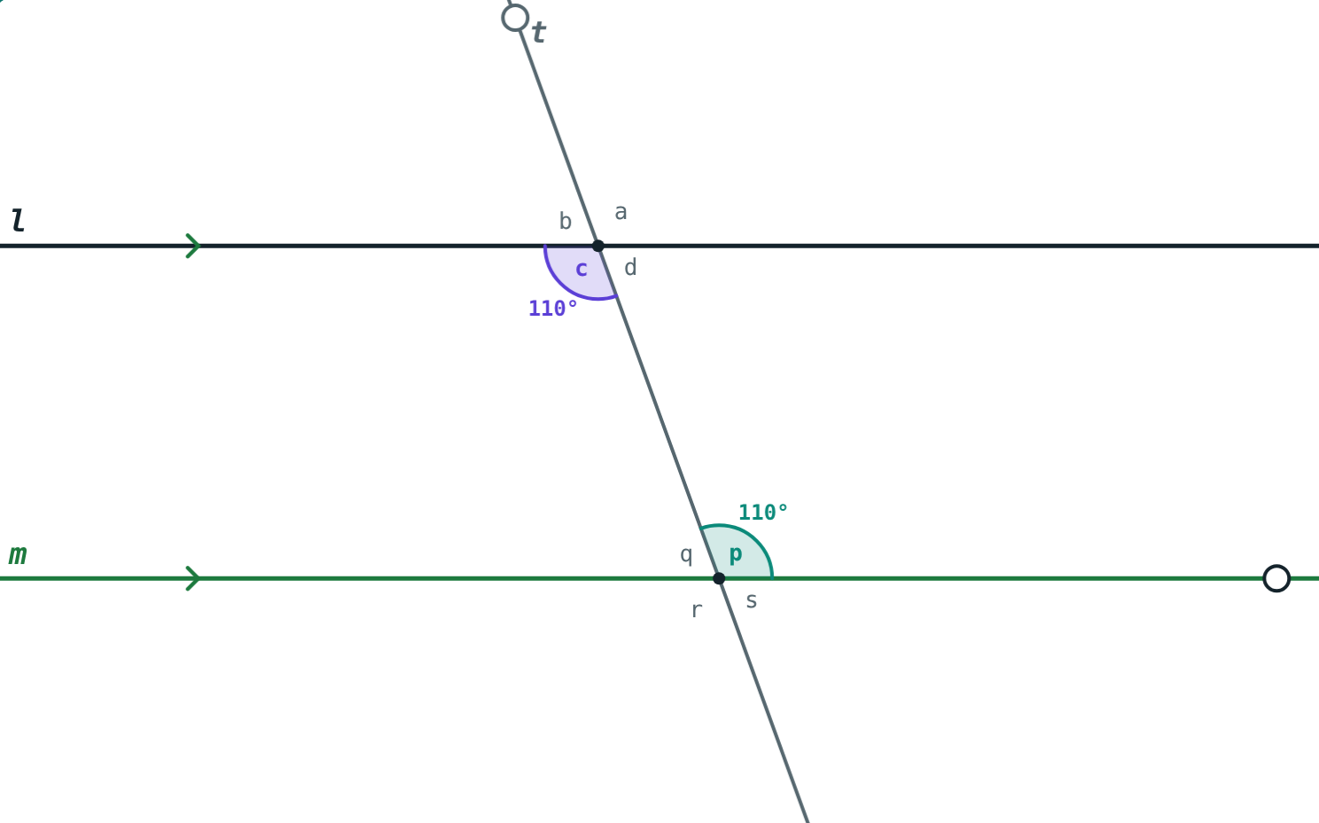
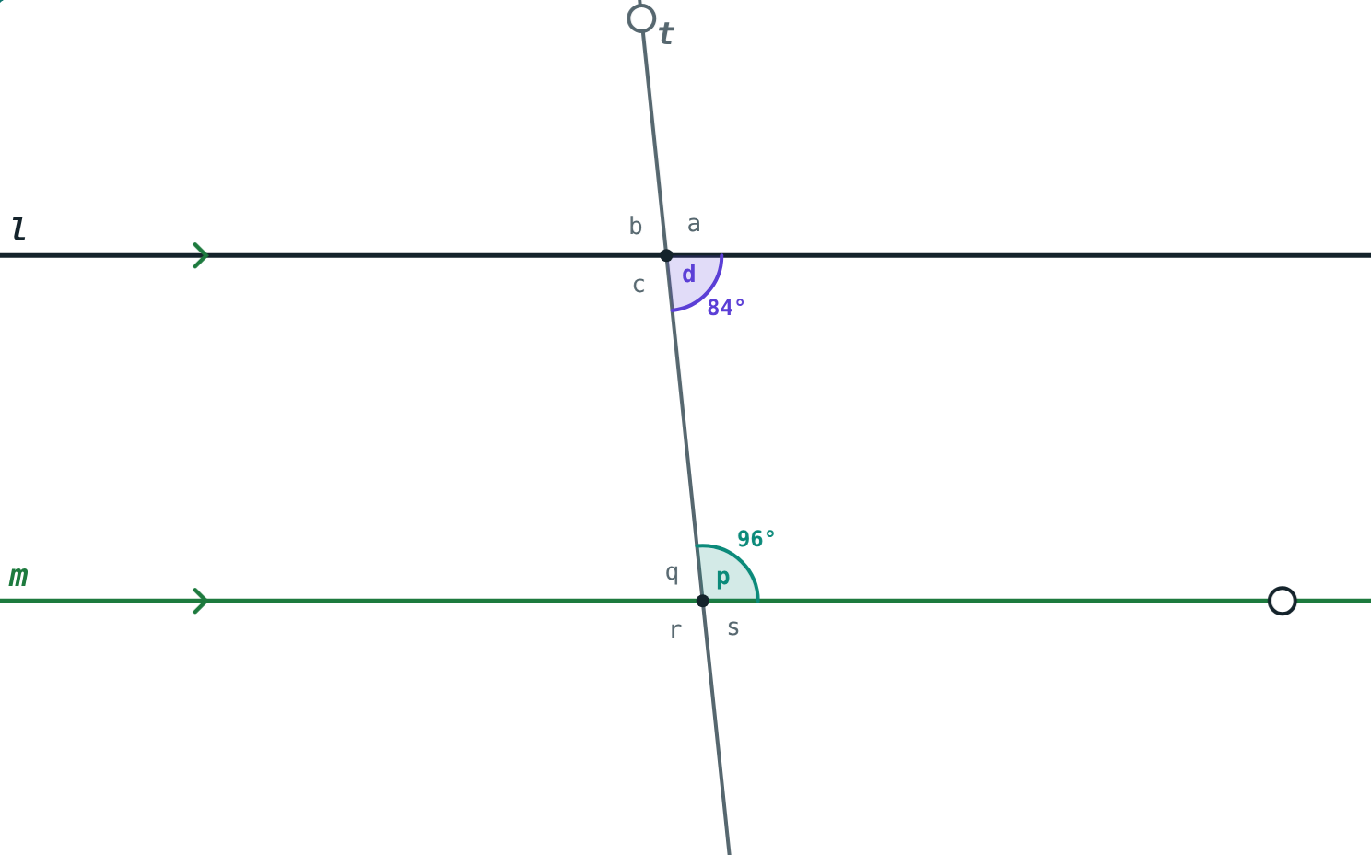
Two more passes
Alternate angles ∠c = ∠p = 110°: l ∥ m.
Interior angles 84° + 96° = 180°: l ∥ m.
Notes:
If ∠c = ∠p, then ∠d + ∠p = ∠d + ∠c = 180°, so the alternate test follows from the interior test.

Slide 10

Common mistakes
Testing the wrong pair
“Equal interior angles”
Vertically opposite angles say nothing about l and m.
They must add up to 180°.
Property or test?
Wrong positions
A test ends with l ∥ m.
Alternate: opposite sides; interior: same side.
Notes:
Have students say “by the … test” every time they conclude l ∥ m.

Slide 11
Quick check
1
Alternate angles are 63° and 63°. Are the lines parallel?
2
Interior angles on the same side are 95° and 95°. Are the lines parallel?
3
Corresponding angles are (3x + 5)° and 50°. Find x for l ∥ m.
4
l ⊥ n and m ⊥ n in one plane. How are l and m related?
Notes:
Answers: 1) Yes, alternate angle test. 2) No: 190° ≠ 180°. 3) x = 15. 4) l ∥ m.

Slide 12
Test the lines yourself
Open the Tests for Parallel Lines lesson on the Visual Science & Maths website. Set the angle at m and find the one value that makes the lines parallel.
Next chapter: Triangles
Notes:
Homework: draw two lines and a transversal, measure a pair of corresponding angles, and decide if the lines are parallel.

