Slide 1
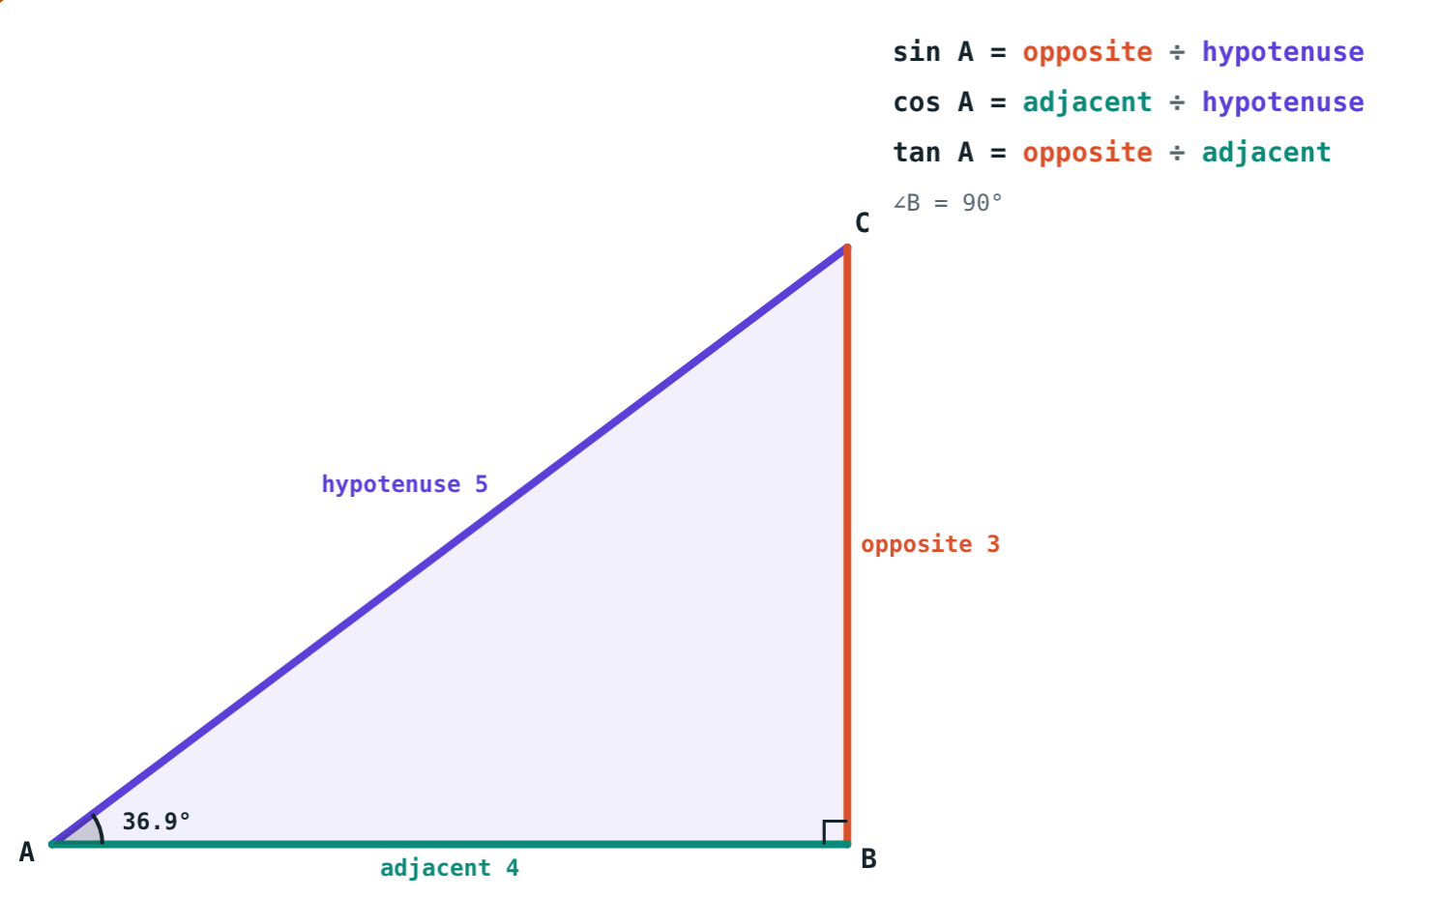
Trigonometric Ratios
STD 9 MATHEMATICS PART II · CH. 8 TRIGONOMETRY
Lesson 1 · Visual Science & Maths
Notes:
Goal: students can name the opposite and adjacent sides of an acute angle, find sin, cos and tan, and use sin²θ + cos²θ = 1.

Slide 2
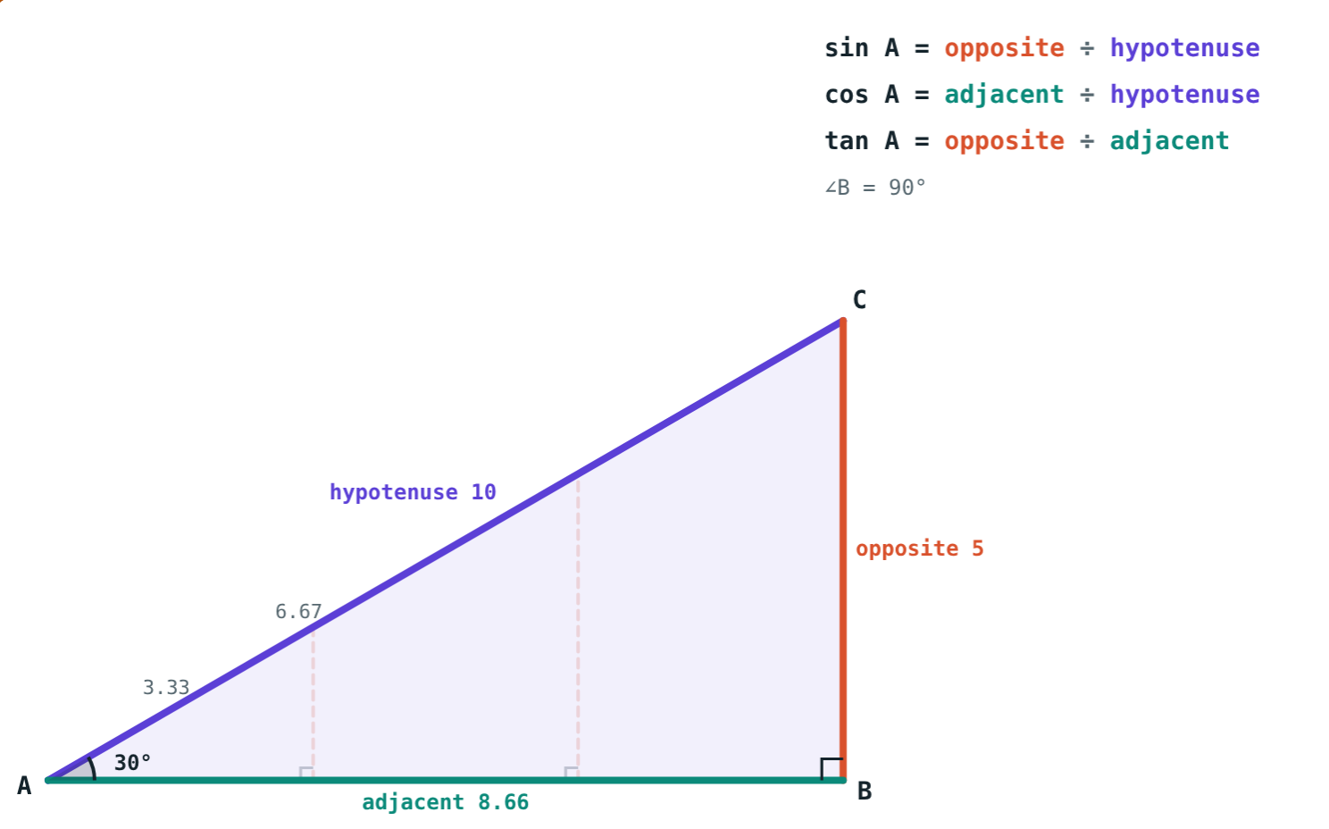
A tree you cannot climb
You stand 20 m from a tree and look up at its top. You can measure the angle, but not the height.
Can the angle tell you the height?
Same angle, any size: same shape
Notes:
Yes: in a right triangle the angle fixes the ratios of the sides. That is trigonometry.

Slide 3
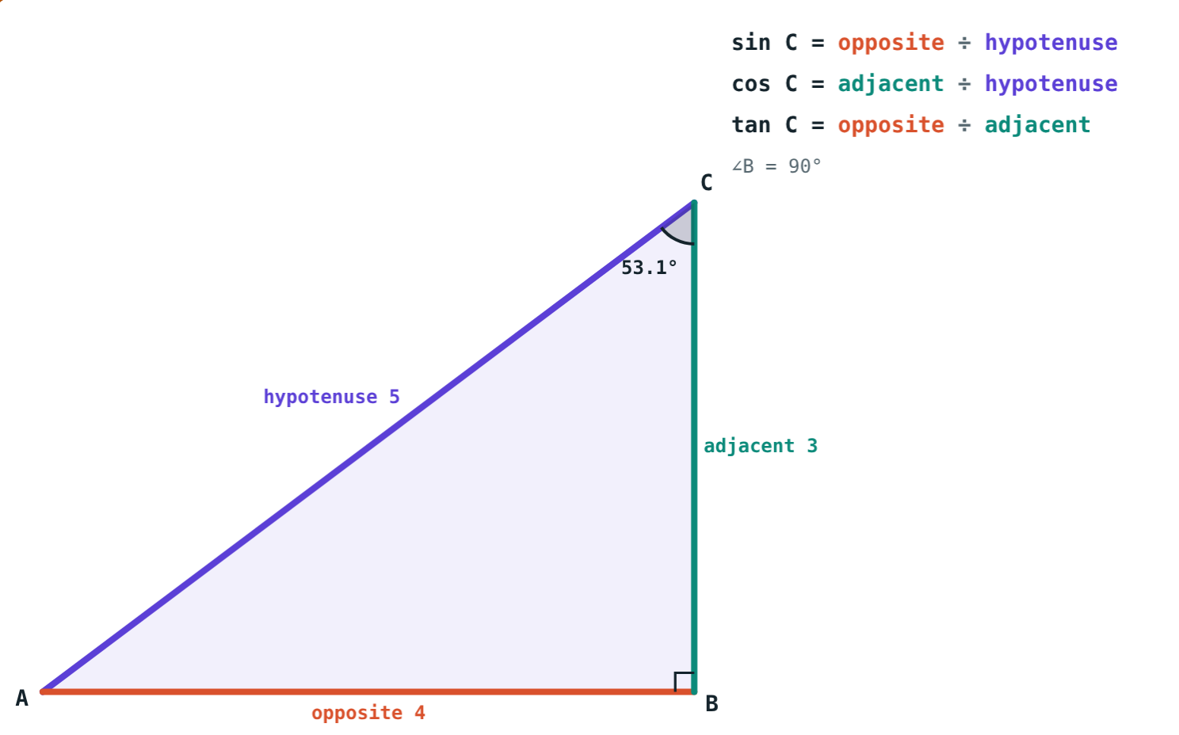
Naming the sides
∠B = 90°: AC, opposite the right angle, is the hypotenuse
For ∠A: BC is the opposite side, AB the adjacent side
For ∠C the two swap
The hypotenuse never changes
Seen from C: AB is opposite, BC adjacent
Notes:
Always say which angle you are looking from before naming sides.

Slide 4
Sine, cosine, tangent
sin θ = opposite ÷ hypotenuse
cos θ = adjacent ÷ hypotenuse
tan θ = opposite ÷ adjacent
Sides 3, 4, 5: sin A = 3/5, cos A = 4/5, tan A = 3/4
BC = 3, AB = 4, AC = 5
Notes:
sin θ is one number, a ratio belonging to θ, not sin × θ.

Slide 5
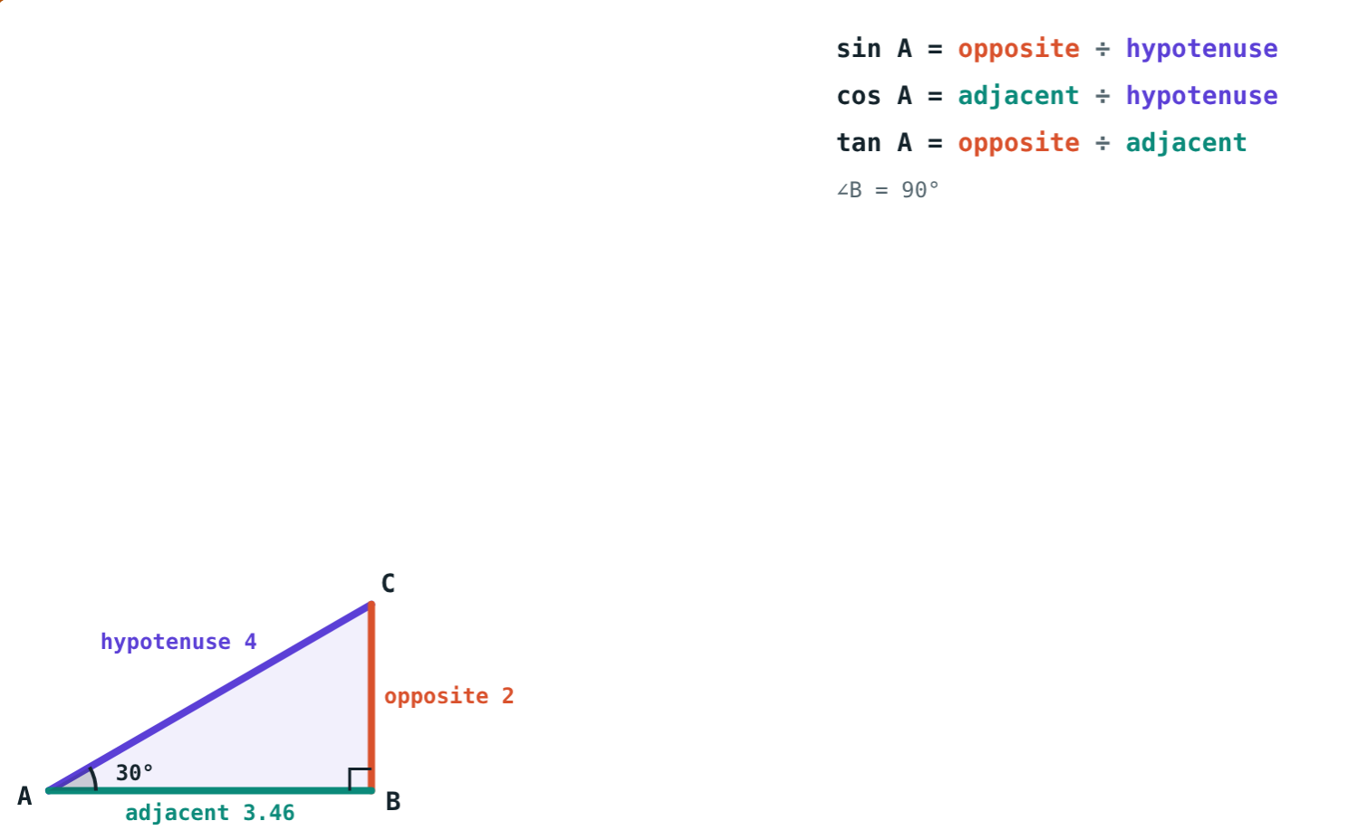
Only the angle matters
∠A = 30°, hypotenuse 4: sin 30° = 2 ÷ 4 = 0.5
∠A = 30°, hypotenuse 10: sin 30° = 5 ÷ 10 = 0.5
Right triangles with the same acute angle are similar, so their ratios are equal.
Notes:
Grow the triangle in the simulation: every side changes, the ratios do not.

Slide 6
Relations between the ratios
sin θ
cos θ
tan θ
= cos (90° − θ)
= sin (90° − θ)
= sin θ ÷ cos θ
The side opposite ∠A is adjacent to ∠C, and ∠A + ∠C = 90°.
For example cos 55° = sin 35°.
Divide: the hypotenuse cancels, leaving opposite ÷ adjacent.
Notes:
These come straight from naming the sides for each acute angle.

Slide 7
Worked examples
Ratios from the sides
One ratio gives the rest
△LMN: ∠M = 90°, LM = 8, MN = 6. Find sin N, cos N, tan N.
sin θ = 8/17. Find cos θ and tan θ.
LN = √(64 + 36) = 10
sin N = 8/10 = 4/5
cos N = 6/10 = 3/5
tan N = 8/6 = 4/3
Sides 8k and 17k; third = 15k
cos θ = 15/17
tan θ = 8/15
Notes:
For ∠N in △LMN: opposite LM = 8, adjacent MN = 6. Any k works for the 8/17 triangle.

Slide 8
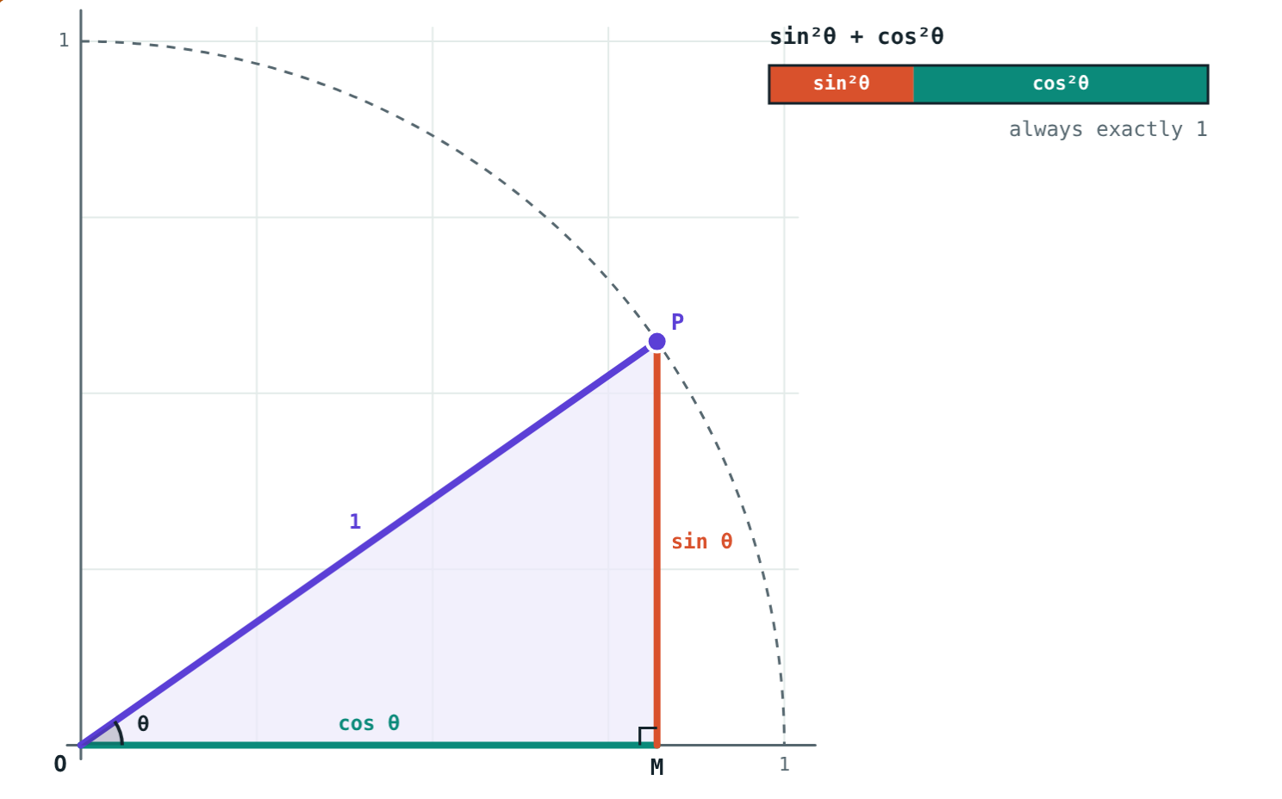
Worked example: complementary angles
Given sin 35° ≈ 0.574, find cos 55°.
35° + 55° = 90°
cos 55° = sin (90° − 55°) = sin 35°
cos 55° ≈ 0.574
sin 35° = cos 55° ≈ 0.574
Notes:
No calculator needed: complementary angles swap sin and cos.

Slide 9
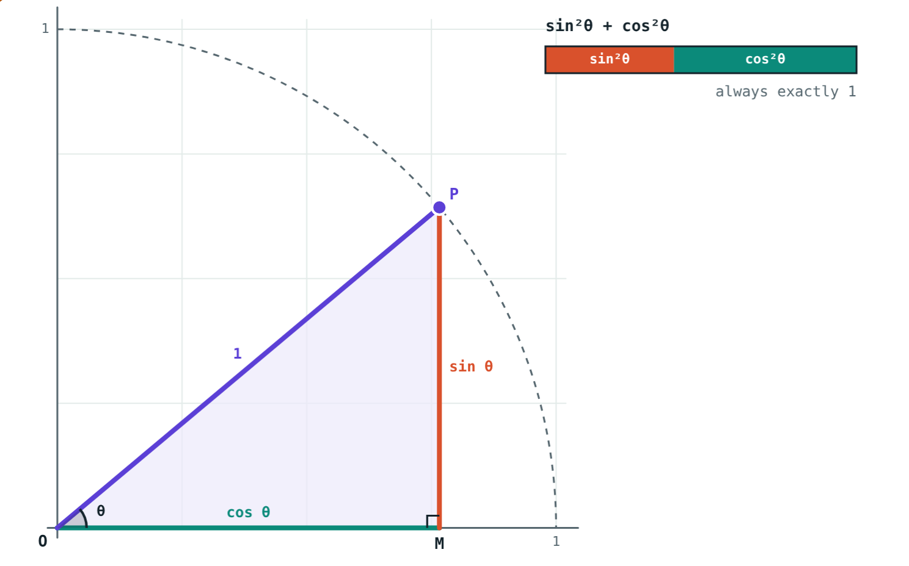
An important equation
Pythagoras ÷ hypotenuse²:
0.413 + 0.587
sin²40° + cos²40°
= 1
for every θ
sin²θ + cos²θ = 1, where sin²θ means (sin θ)².
Hypotenuse 1, θ = 40°
Notes:
With hypotenuse 1 the opposite side is sin θ and the adjacent side is cos θ, so this is just Pythagoras.

Slide 10

Common mistakes
Hypotenuse as adjacent
Fixed “opposite”
The adjacent side is the other side touching the angle.
Opposite and adjacent swap for the other acute angle.
sin θ = sin × θ
sin²θ = sin (θ²)
sin θ is one number, a ratio.
sin²θ = (sin θ)².
Notes:
Point at a triangle and ask students to name the sides for each acute angle in turn.

Slide 11
Quick check
1
In △PQR, ∠Q = 90°. Which side is opposite ∠P?
2
If sin θ = 3/5, what is cos θ?
3
A right triangle is doubled in size. What happens to sin θ?
4
sin 20° equals cos of which angle?
Notes:
Answers: 1) QR. 2) 4/5. 3) It stays the same. 4) cos 70°.

Slide 12
Grow the triangle yourself
Open the Trigonometric Ratios lesson on the Visual Science & Maths website. Change the size and watch sin, cos and tan stay put.
Next lesson: Ratios of special angles
Notes:
Homework: textbook practice set 8.1, checked with the simulation.

