Slide 1
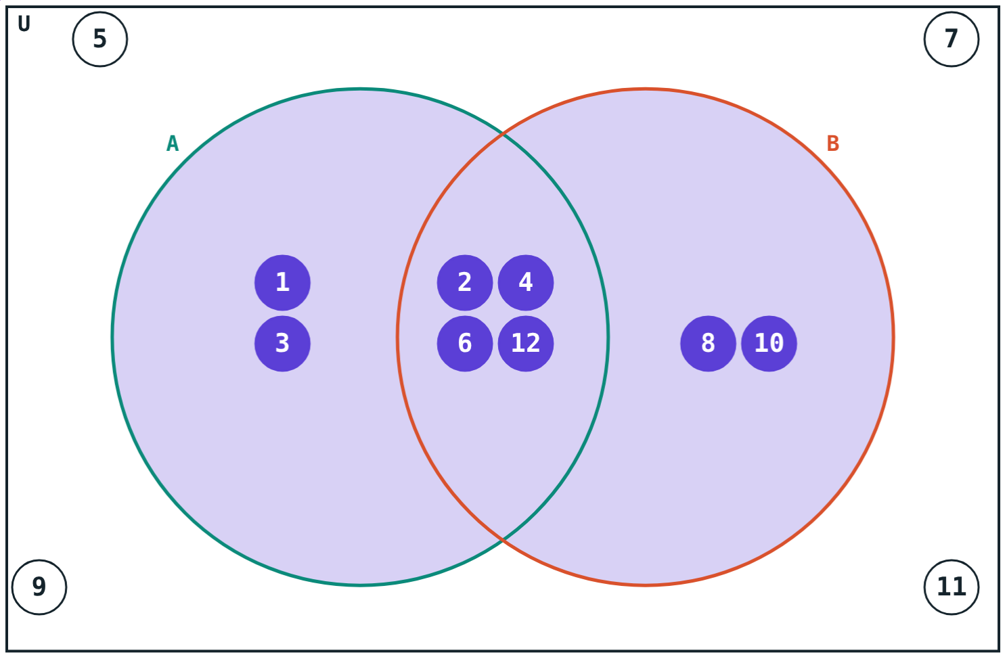
Union, Intersection and Counting
STD 9 MATHEMATICS PART I · CH. 1 SETS
Lesson 3 · Visual Science & Maths
Notes:
Goal: students can find A ∩ B and A ∪ B, state their properties, and use n(A ∪ B) = n(A) + n(B) − n(A ∩ B) in word problems.

Slide 2
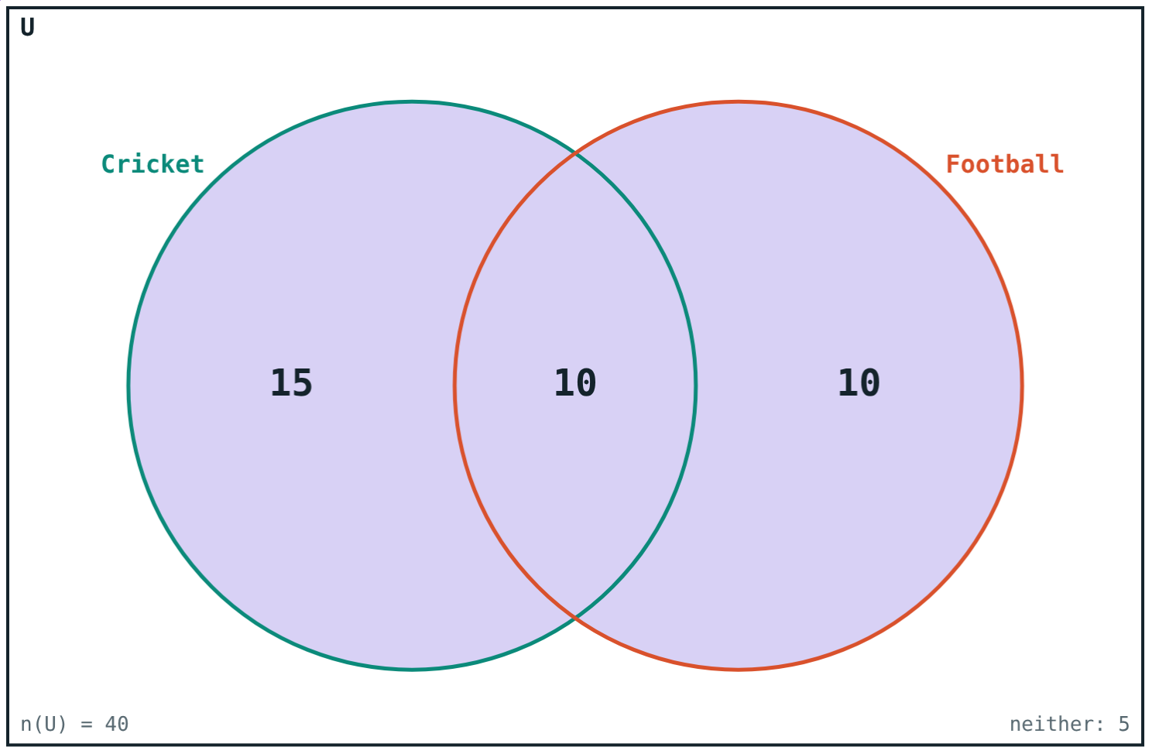
Counting twice
25 students play cricket and 20 play football. That is not 45 students.
Why not, and how many are there?
10 play both games
Notes:
Let students explain the double counting before showing the formula.

Slide 3
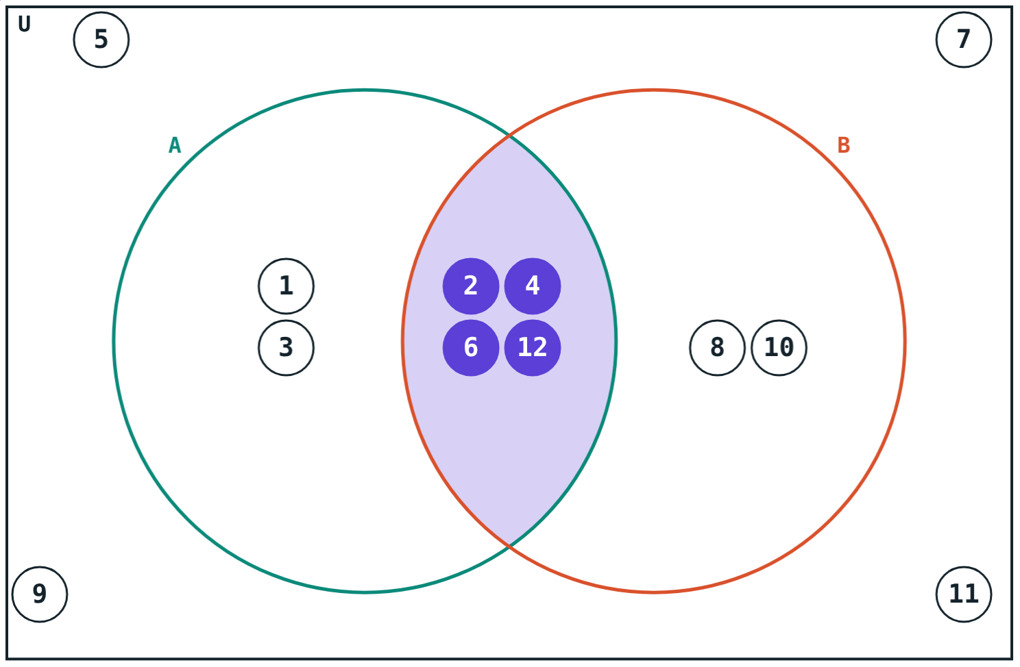
Intersection
A ∩ B = {x | x ∈ A and x ∈ B}
Elements common to both sets
The overlap of the circles
A ∩ B = ∅: disjoint sets
If A ⊆ B, then A ∩ B = A
A ∩ B = {2, 4, 6, 12}
Notes:
Also A ∩ B = B ∩ A, A ∩ A = A, A ∩ ∅ = ∅, A ∩ A′ = ∅.

Slide 4
Union
A ∪ B = {x | x ∈ A or x ∈ B}
Everything in A or B or both
Common elements written once
If A ⊆ B, then A ∪ B = B
A ∪ A′ = U
A ∪ B = {1, 2, 3, 4, 6, 8, 10, 12}
Notes:
Also A ∪ B = B ∪ A, A ∪ A = A, A ∪ ∅ = A.

Slide 5
Counting the union
n(A ∪ B) = n(A) + n(B) − n(A ∩ B)
The overlap is counted in n(A) and again in n(B)
Subtract it once
6 + 6 − 4 = 8
n(A) = 6, n(B) = 6, n(A ∩ B) = 4
Notes:
Count the tokens in the picture to confirm 8.

Slide 6
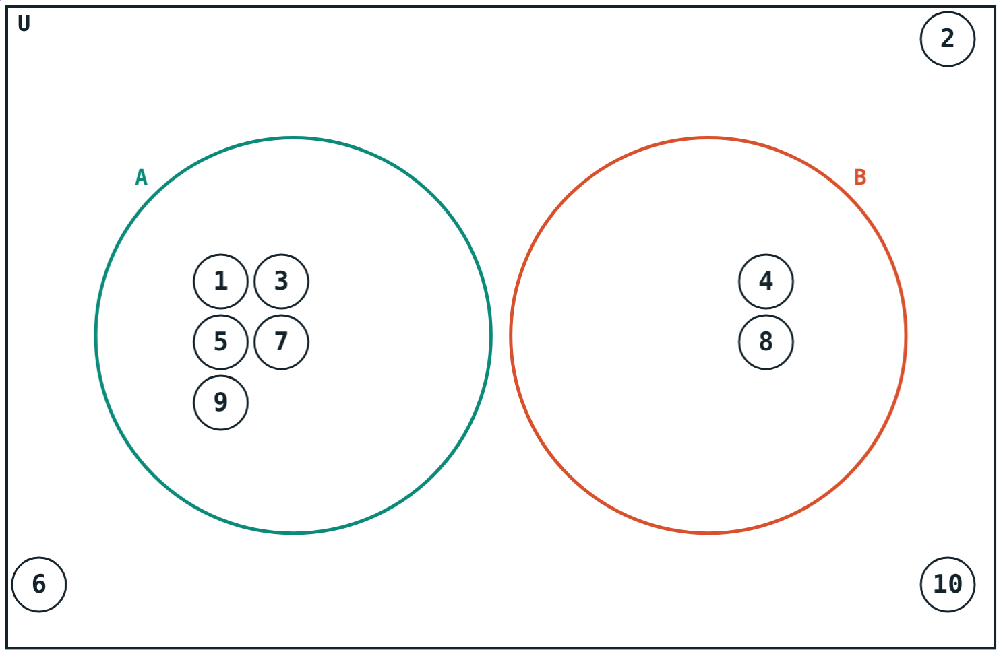
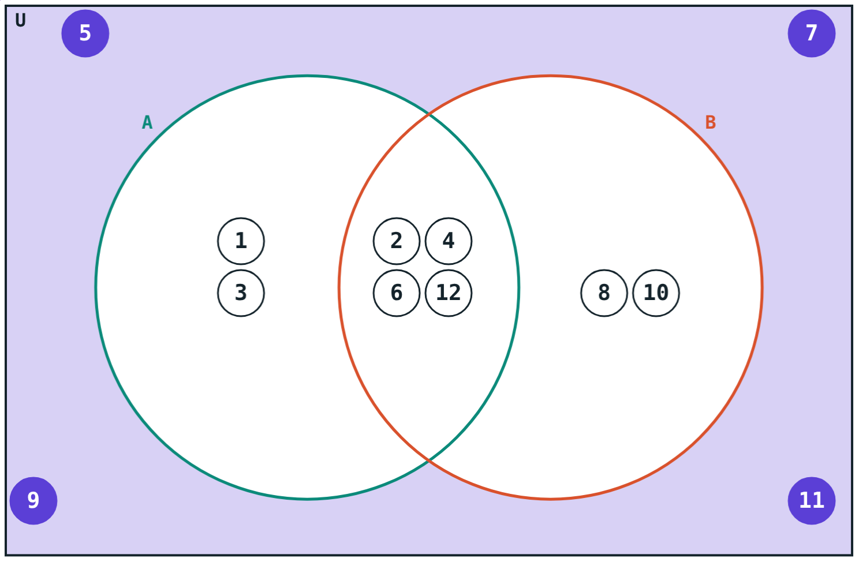
Two special cases
No overlap: 5 + 2 − 0 = 7.
(A ∪ B)′ = A′ ∩ B′ = {5, 7, 9, 11}.
Notes:
Shade both sides of De Morgan’s law in the simulation to see they are the same region.

Slide 7
Worked examples
Sets
Who speaks both?
A = factors of 12, B = even numbers ≤ 12. Verify the formula.
60 people; 38 speak Marathi, 30 Hindi, all at least one.
A ∩ B = {2, 4, 6, 12}
n(A ∪ B) = 6 + 6 − 4 = 8
60 = 38 + 30 − n(M ∩ H)
n(M ∩ H) = 8
Only Hindi: 30 − 8 = 22
Notes:
Write the formula first, then substitute.

Slide 8
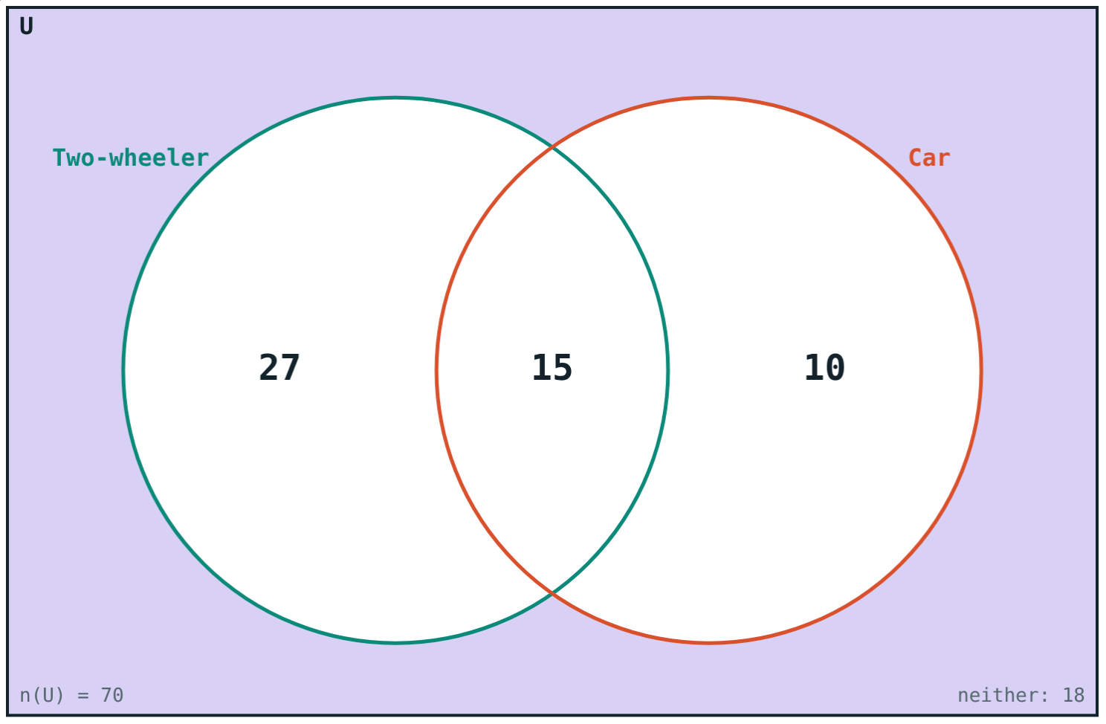
Worked example: neither
70 families: 42 have a two-wheeler, 25 a car, 15 both. How many have neither?
n(A ∪ B) = 42 + 25 − 15 = 52
Neither: 70 − 52 = 18
Two-wheeler and car owners
Notes:
Fill the Venn diagram from the middle outwards: 15, then 27 and 10, then 18.

Slide 9
Four regions
Start with the overlap, then subtract.
15
only cricket
10
only football
5
neither
15 + 10 + 10 + 5 = 40 = n(U).
40 students, 25 cricket, 20 football, 10 both
Notes:
Adding the four regions back to n(U) is a good check.

Slide 10

Common mistakes
Writing elements twice
Just adding
{2, 3} ∪ {3, 5} = {2, 3, 5}.
Subtract n(A ∩ B) once.
∩ or ∪?
“Only A” = n(A)?
∩ is “and”, ∪ is “or”.
Only A = n(A) − n(A ∩ B).
Notes:
Ask students which mistake gives the answer 45 in the hook.

Slide 11
Quick check
1
A = {2, 3, 5}, B = {3, 5, 7}. Find A ∪ B.
2
n(A) = 15, n(B) = 12, n(A ∩ B) = 5. Find n(A ∪ B).
3
If A ⊆ B, what is A ∩ B?
4
50 students like tea or coffee or both; 30 tea, 25 coffee. How many like both?
Notes:
Answers: 1) {2, 3, 5, 7}. 2) 22. 3) A. 4) 30 + 25 − 50 = 5.

Slide 12
Count without double counting
Open the Union and intersection lesson on the Visual Science & Maths website. Shade A ∩ B and A ∪ B and check the formula.
Next chapter: Real Numbers
Notes:
Homework: make up a survey word problem for a partner, with a Venn diagram answer.

