Slide 1
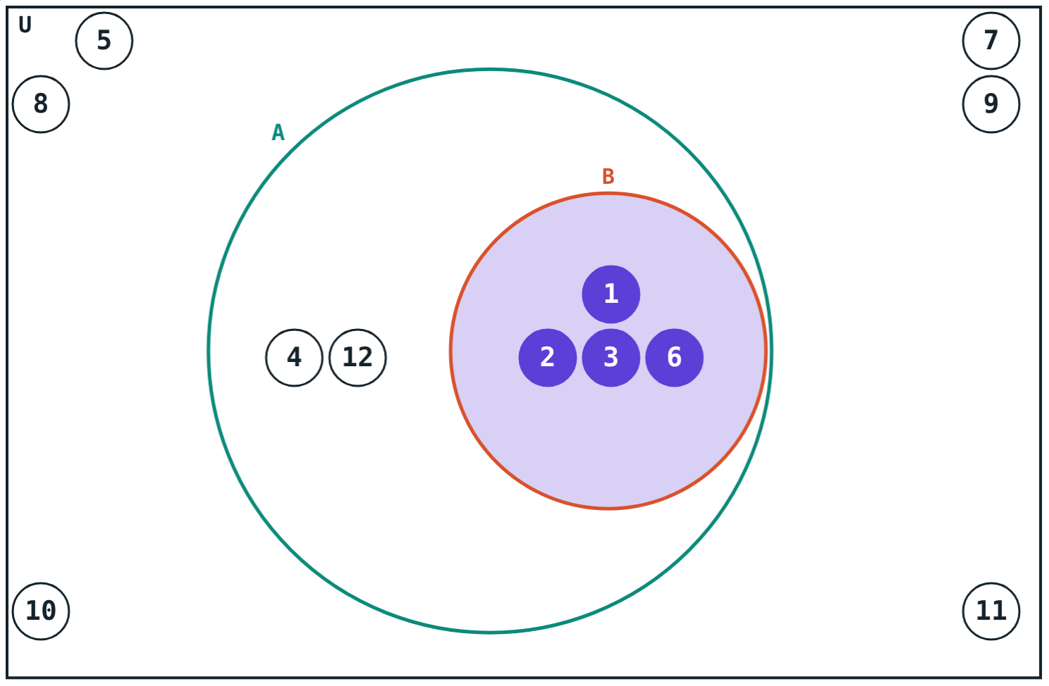
Venn Diagrams, Subsets and Complements
STD 9 MATHEMATICS PART I · CH. 1 SETS
Lesson 2 · Visual Science & Maths
Notes:
Goal: students can draw a Venn diagram, test whether one set is a subset of another, and find the complement of a set in a universal set.

Slide 2
Inside or outside?
Every factor of 6 is also a factor of 12. A picture makes this obvious.
How would you draw it?
Factors of 6 inside factors of 12
Notes:
Let students sketch first; then show the nested circles.

Slide 3
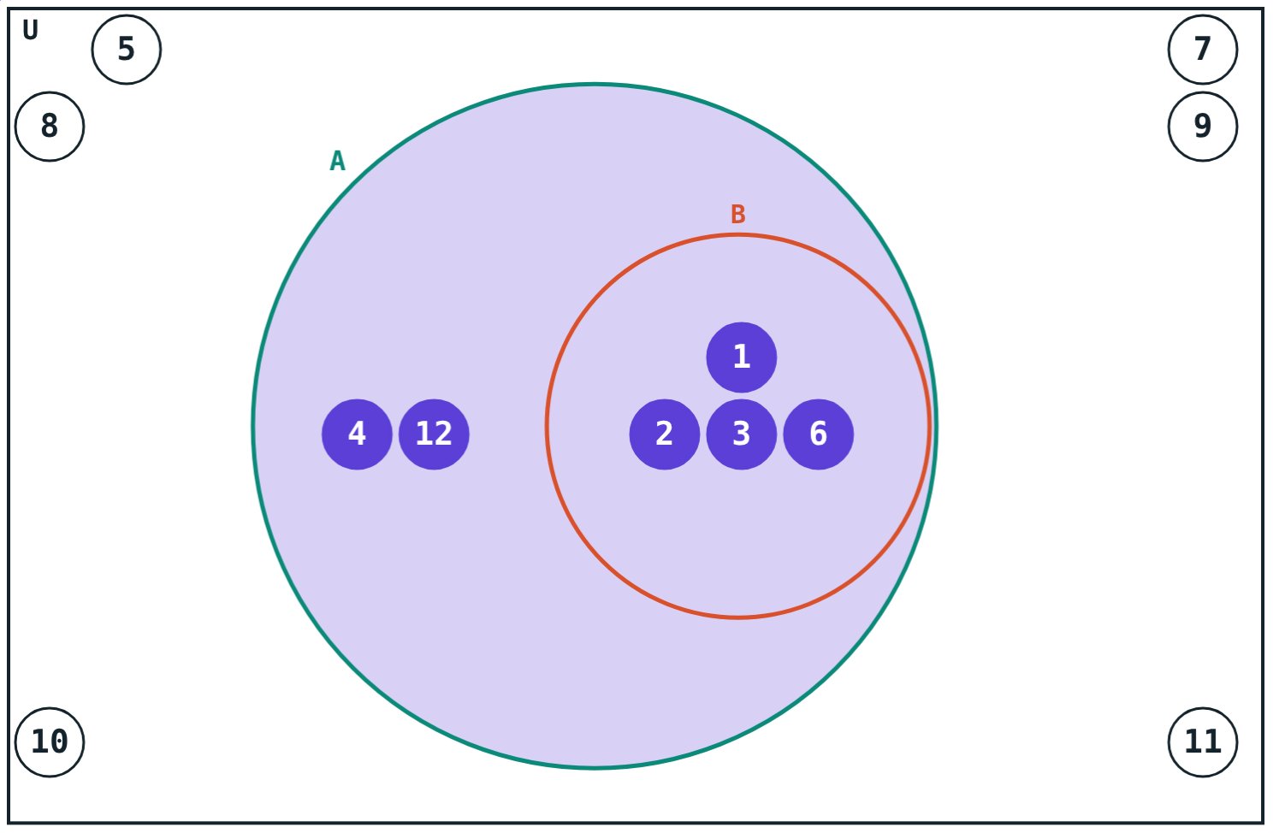
Venn diagrams
A closed figure stands for a set
Elements are written inside it
The universal set U is a rectangle
Every set we discuss lies inside U
U = {1, …, 12}, A = factors of 12
Notes:
The name comes from the English mathematician John Venn.

Slide 4
Subset
B ⊆ A
If every element of B is also an element of A, B is a subset of A.
A ⊆ A for every set
∅ ⊆ every set
A ⊆ B and B ⊆ A means A = B
{1, 2, 3, 6} ⊆ {1, 2, 3, 4, 6, 12}
Notes:
Also mention N ⊆ W ⊆ I.

Slide 5
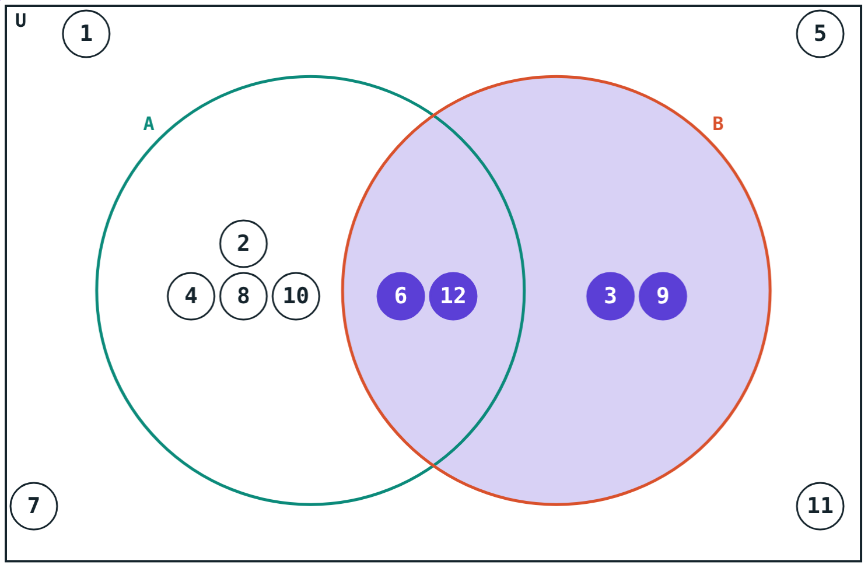
Subset or not?
Every element of B is in A: B ⊆ A.
3 ∈ B but 3 ∉ A: not a subset.
Notes:
One element outside A is enough to show B is not a subset.

Slide 6
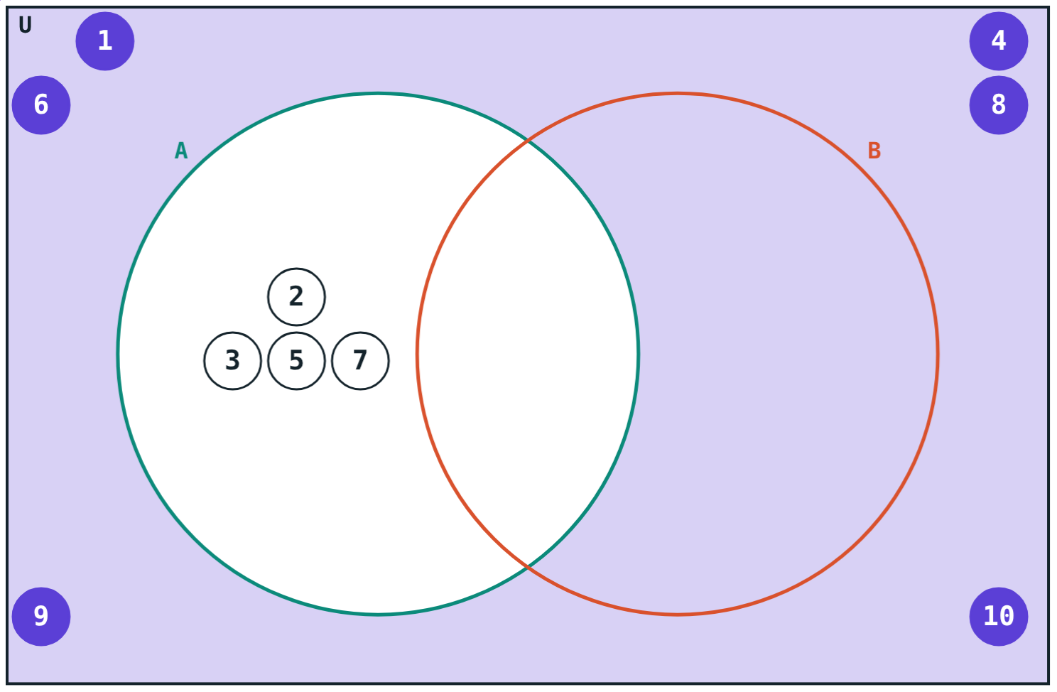
Complement
A′ = {x | x ∈ U, x ∉ A}
The part of U outside A
(A′)′ = A
U′ = ∅ and ∅′ = U
n(A) + n(A′) = n(U)
U = {1, …, 10}, A = primes: A′ shaded
Notes:
The complement always depends on the chosen universal set.

Slide 7
Worked examples
Complement
Subset?
U = {1, …, 10}, A = odd numbers in U. Find A′.
P = multiples of 4 up to 20, Q = even numbers up to 20.
A = {1, 3, 5, 7, 9}
A′ = {2, 4, 6, 8, 10}
Check: 5 + 5 = 10 = n(U)
Every multiple of 4 is even: P ⊆ Q
2 ∈ Q, 2 ∉ P: Q ⊄ P
Notes:
Write out both sets in full before deciding.

Slide 8
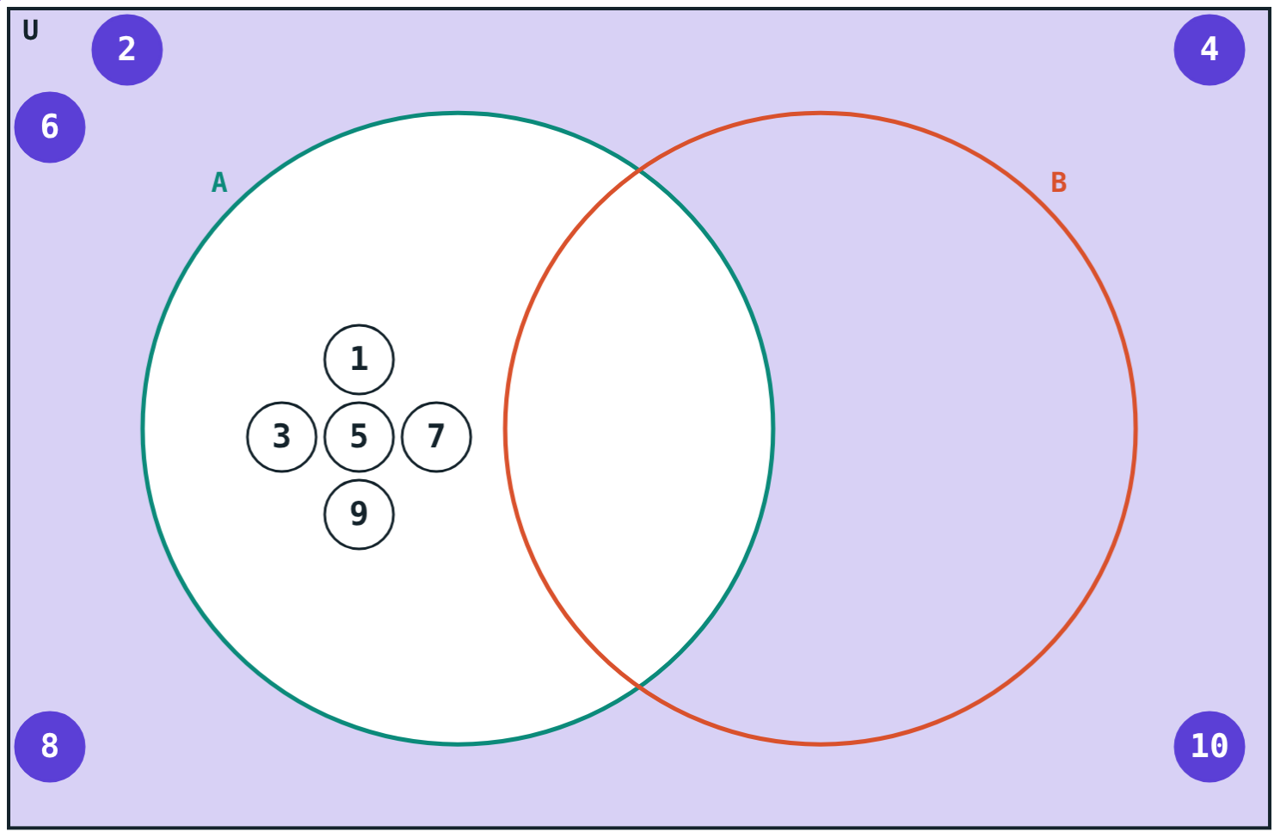
Worked example: all subsets
Write all the subsets of M = {p, q}.
No element: ∅
One element: {p}, {q}
Both: {p, q}
4 subsets in all
A′ for A = odd numbers
Notes:
Students often forget ∅ and the set itself.

Slide 9
Complement check
A and A′ share nothing and together fill U.
n(A) = 4
primes
n(A′) = 6
the rest
4 + 6 = 10 = n(U).
U = {1, …, 10}, A = {2, 3, 5, 7}
Notes:
A′ = {1, 4, 6, 8, 9, 10}. Note that 1 is not prime.

Slide 10

Common mistakes
Writing 2 ⊆ A
B ⊆ A backwards
2 ∈ A, but {2} ⊆ A.
B is the one drawn inside.
Forgetting U
Missing subsets
A′ changes if U changes.
∅ and the set itself count.
Notes:
Ask students to correct a wrong statement for each card.

Slide 11
Quick check
1
U = {1, …, 8}, A = {2, 4, 6, 8}. Find A′.
2
True or false: {1, 2} ⊆ {1, 2, 3}.
3
How many subsets does {x, y} have?
4
n(U) = 9 and n(A) = 4. Find n(A′).
Notes:
Answers: 1) {1, 3, 5, 7}. 2) True. 3) 4: ∅, {x}, {y}, {x, y}. 4) 5.

Slide 12
Drag elements between circles
Open the Venn diagrams lesson on the Visual Science & Maths website. Move numbers and watch the subset test change.
Next lesson: Union, intersection and counting
Notes:
Homework: draw Venn diagrams for N, W and I using a few elements of each.

