Slide 1
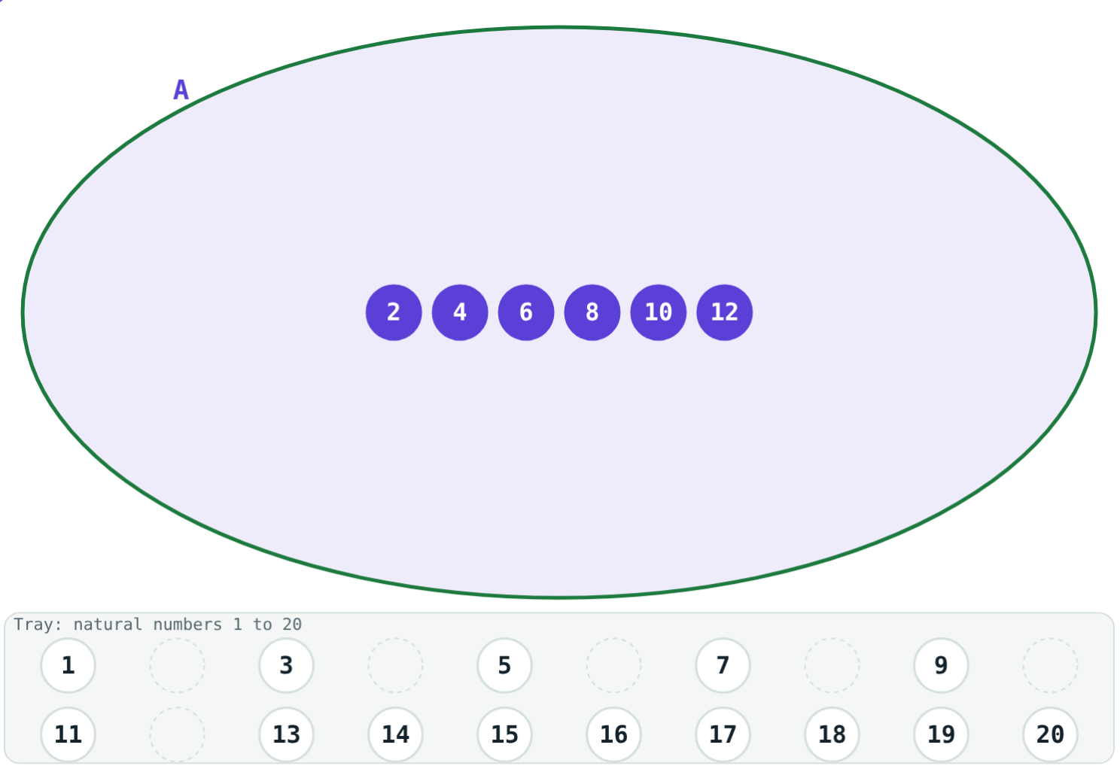
Sets and How to Write Them
STD 9 MATHEMATICS PART I · CH. 1 SETS
Lesson 1 · Visual Science & Maths
Notes:
Goal: students can decide whether a collection is a set, use ∈ and ∉, write a set by listing and by rule, and name finite, infinite, empty, singleton and equal sets.

Slide 2
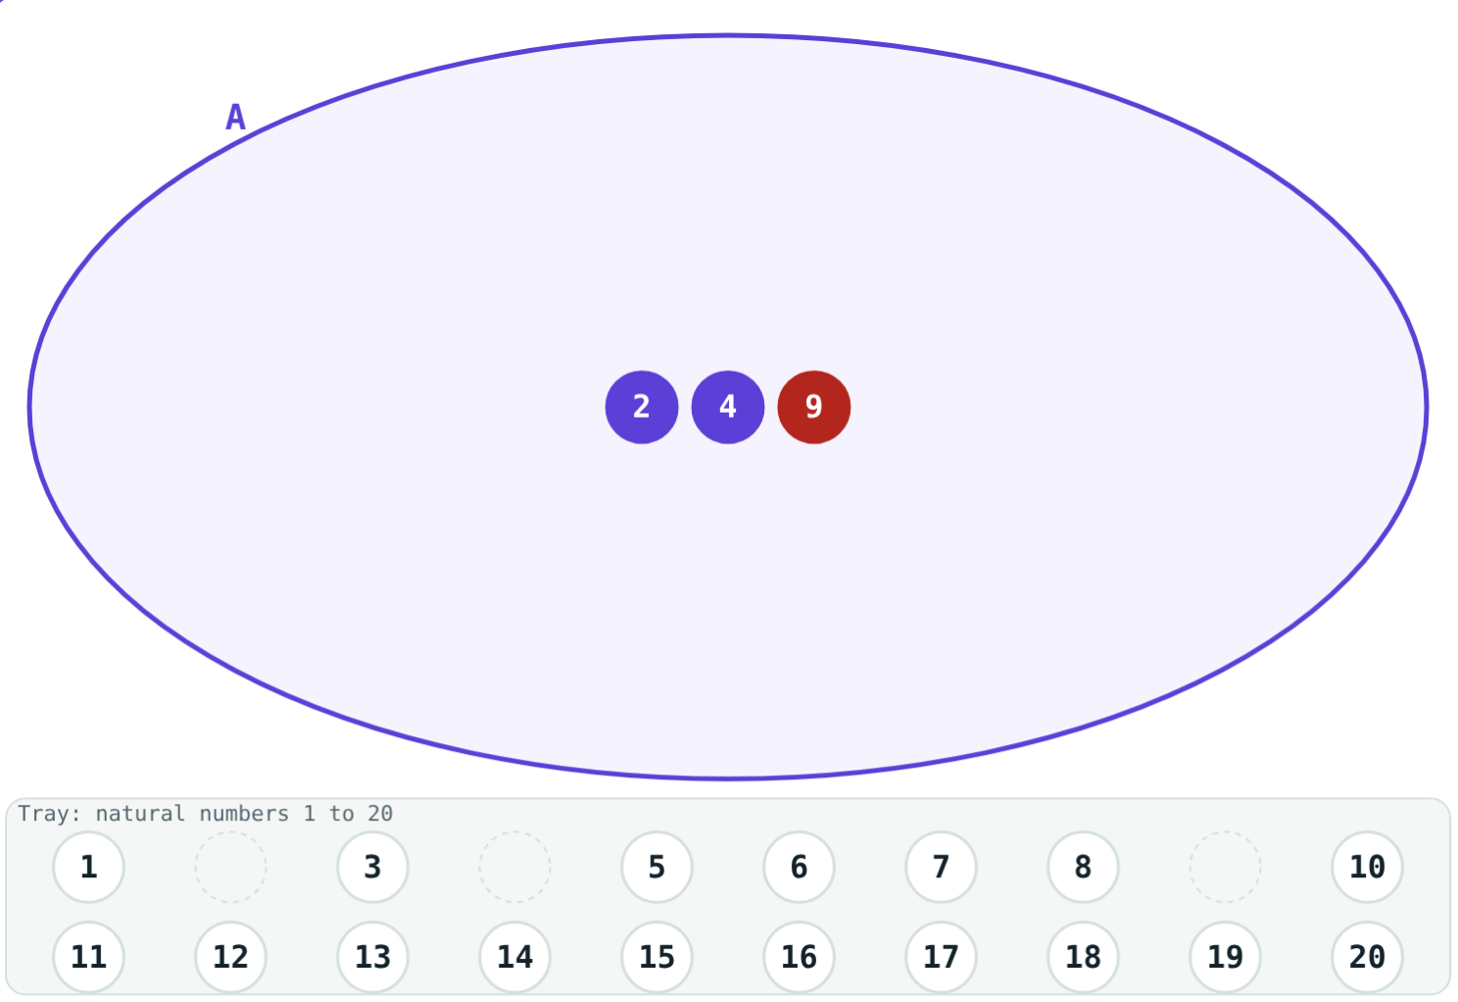
Who belongs?
“Even numbers less than 13” — you can test any number and say yes or no. “Tall students” — people will argue.
Which of the two is a set?
9 does not fit the rule: 9 ∉ A
Notes:
Let students suggest collections and vote: can everyone agree who belongs? Only well-defined collections are sets.

Slide 3
A set and its elements
2 ∈ A, 9 ∉ A
A set is a well-defined collection
Each object in it is an element
Capital letters name sets
∈ “belongs to”, ∉ “does not belong to”
A = even natural numbers less than 13
Notes:
Read the symbols aloud every time: “2 belongs to A”.

Slide 4
Two ways to write a set
Method | How | Example
Listing (roster) | Elements in { }, separated by commas, each once | {1, 2, 3, 6, 9, 18}
Rule (set-builder) | {x | property of x}; “|” is read “such that” | {x | x is a factor of 18}
Notes:
Both lines describe the same set. Practise converting in both directions.

Slide 5
Types of sets
{7}
∅
n(A)
…
Singleton
Empty
Finite
Infinite
Exactly one element: {x | x ∈ N, x² = 49}.
No element: even primes greater than 2.
Elements can be counted: n({1, 2, 3, 6, 9, 18}) = 6.
Never ends: {5, 10, 15, 20, …}.
Notes:
Stress that {0} is a singleton, not the empty set.

Slide 6
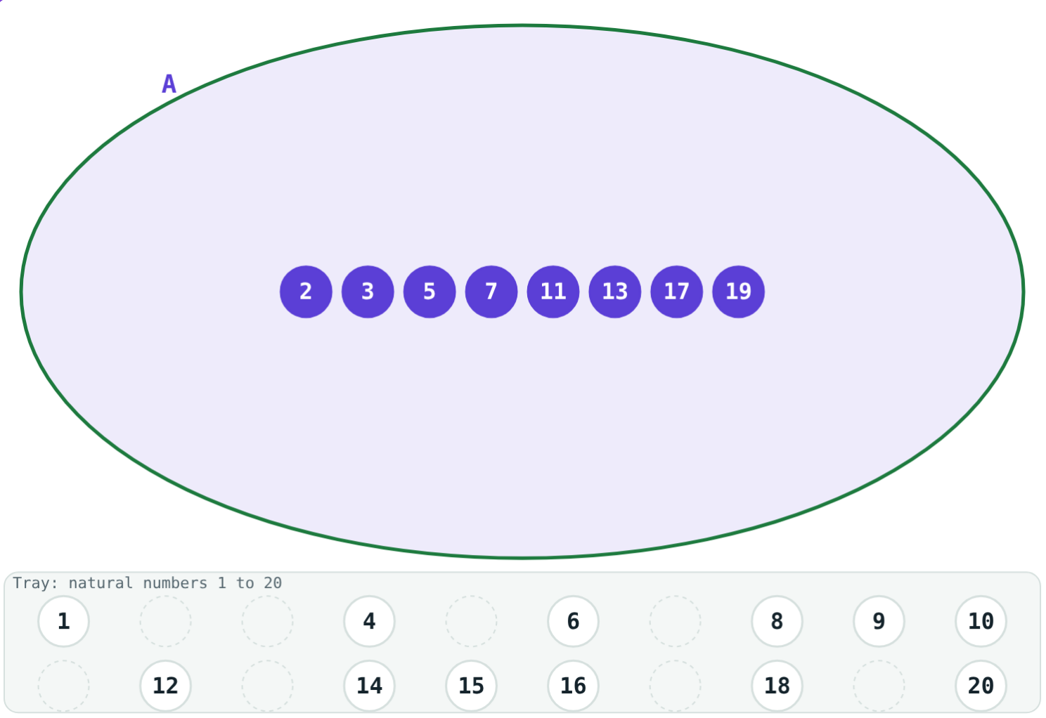
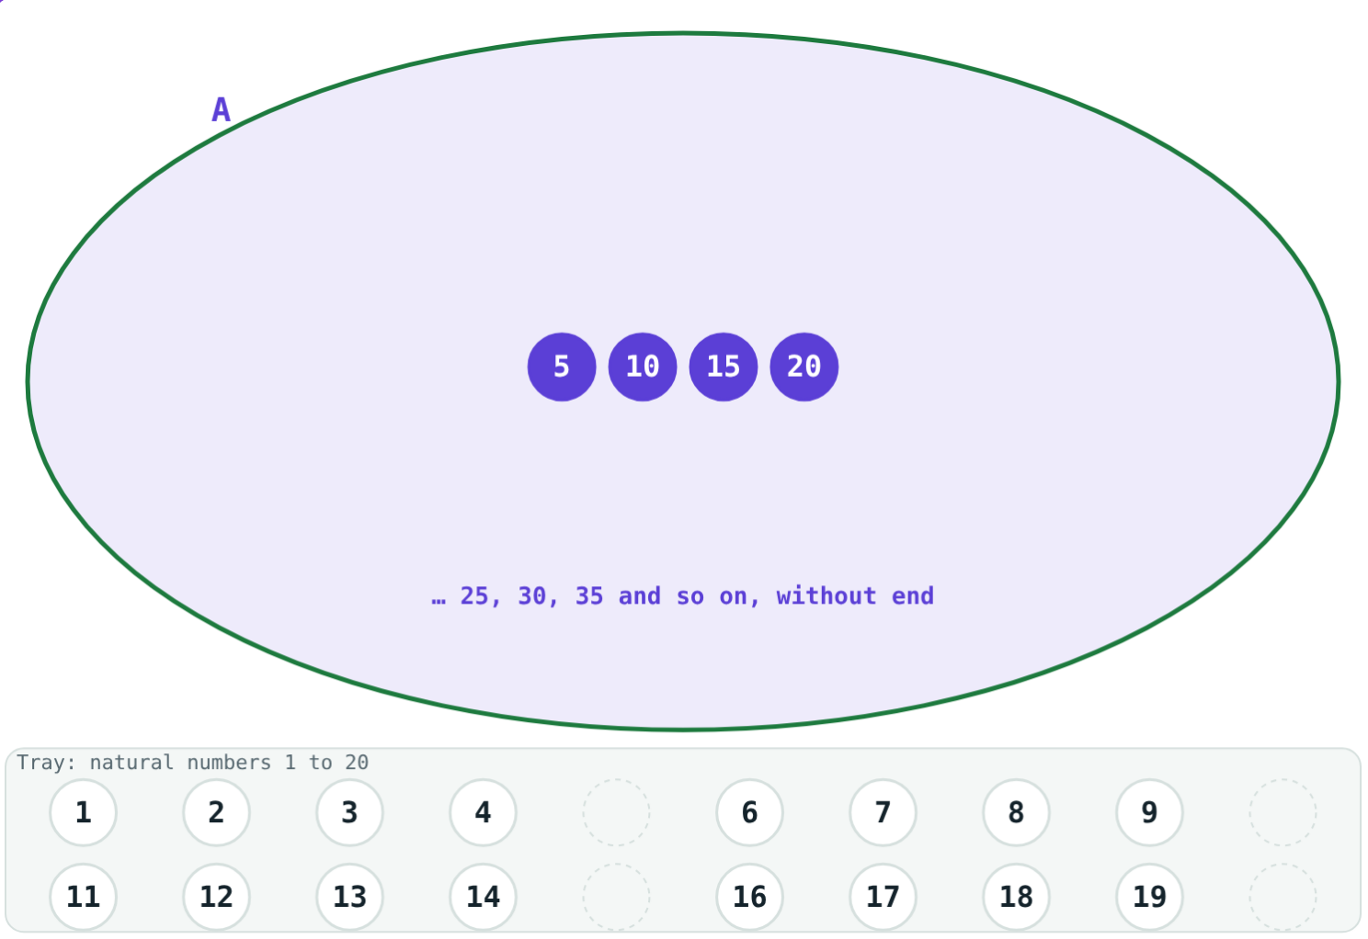
Finite or infinite?
8 elements: a finite set.
{5, 10, 15, 20, …}: infinite.
Equal sets have exactly the same elements: {s, t, o, p} = {p, o, s, t}.
Notes:
The tray stops at 20 but the multiples of 5 do not: that is why we write the dots.

Slide 7
Worked examples
Rule to list
List to rule
A = {x | x is a factor of 18}. List A and find n(A).
Write B = {1, 4, 9, 16, 25} by the rule method.
Pairs: 1 × 18, 2 × 9, 3 × 6
A = {1, 2, 3, 6, 9, 18}, n(A) = 6
1², 2², 3², 4², 5²
B = {x | x = n², n ∈ N, n ≤ 5}
Notes:
Look for a pattern before writing the rule.

Slide 8
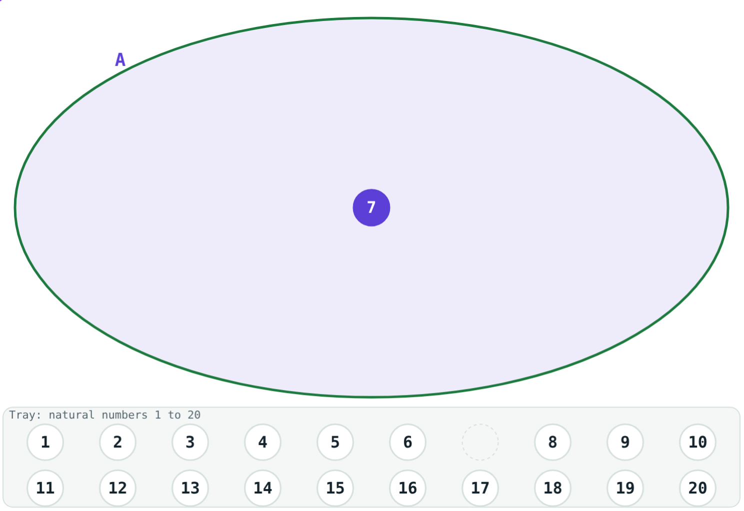
Worked example: which type?
Classify P = {x | x ∈ N, x + 4 = 4}, Q = {0} and S = the letters of “MISSISSIPPI”.
x = 0 ∉ N, so P = ∅: empty
Q has one element: singleton
S = {M, I, S, P}: finite, n(S) = 4
{x | x ∈ N, x² = 49} = {7}
Notes:
Each letter is written only once in S.

Slide 9
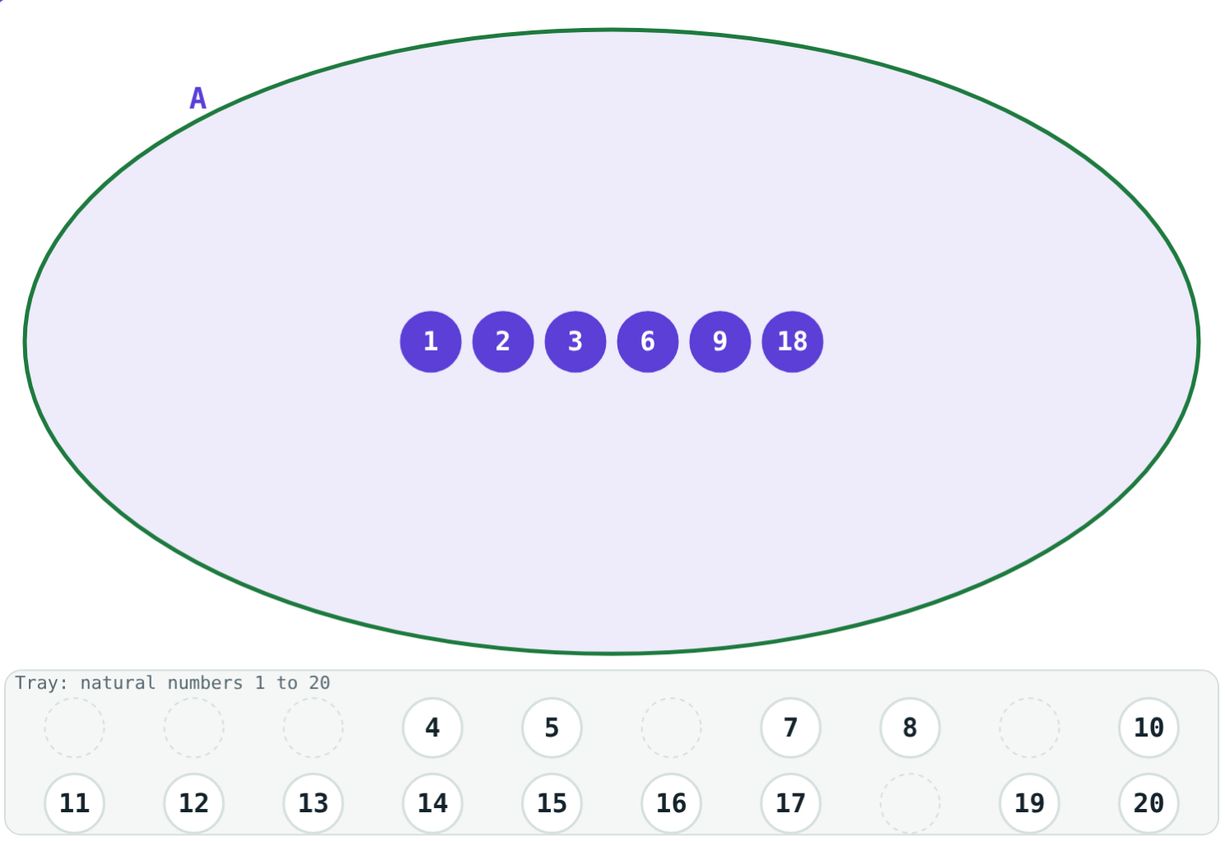
Count the elements
n(A) is the number of elements of a finite set A.
n(A) = 6
factors of 18
n(∅) = 0
the empty set
An infinite set has no n( ): it never ends.
A = {x | x is a factor of 18}
Notes:
Ask: what is n of the letters of BANANA? (3)

Slide 10

Common mistakes
Repeating elements
{0} is not empty
“banana” gives {b, a, n}.
It has one element, 0.
Order does not matter
Vague collections
{1, 2, 3} = {3, 1, 2}.
“Good singers” is not a set.
Notes:
Ask students to give their own example of each slip.

Slide 11
Quick check
1
Which is a set: good books, months with 31 days, tall trees or clever students?
2
A = {x | x is a prime number, 10 < x < 20}. Find n(A).
3
Is {x | x ∈ N, x + 3 = 3} empty, singleton or infinite?
4
Are the letters of “stop” and of “post” equal sets?
Notes:
Answers: 1) Months with 31 days. 2) n(A) = 4: {11, 13, 17, 19}. 3) Empty: x = 0 is not a natural number. 4) Yes, both are {s, t, o, p}.

Slide 12
Sort the numbers yourself
Open the Sets lesson on the Visual Science & Maths website. Pick a rule and drag the tokens into set A.
Next lesson: Venn diagrams, subsets and complements
Notes:
Homework: write five sets of your own, two by listing and three by rule, and name each type.

