Slide 1
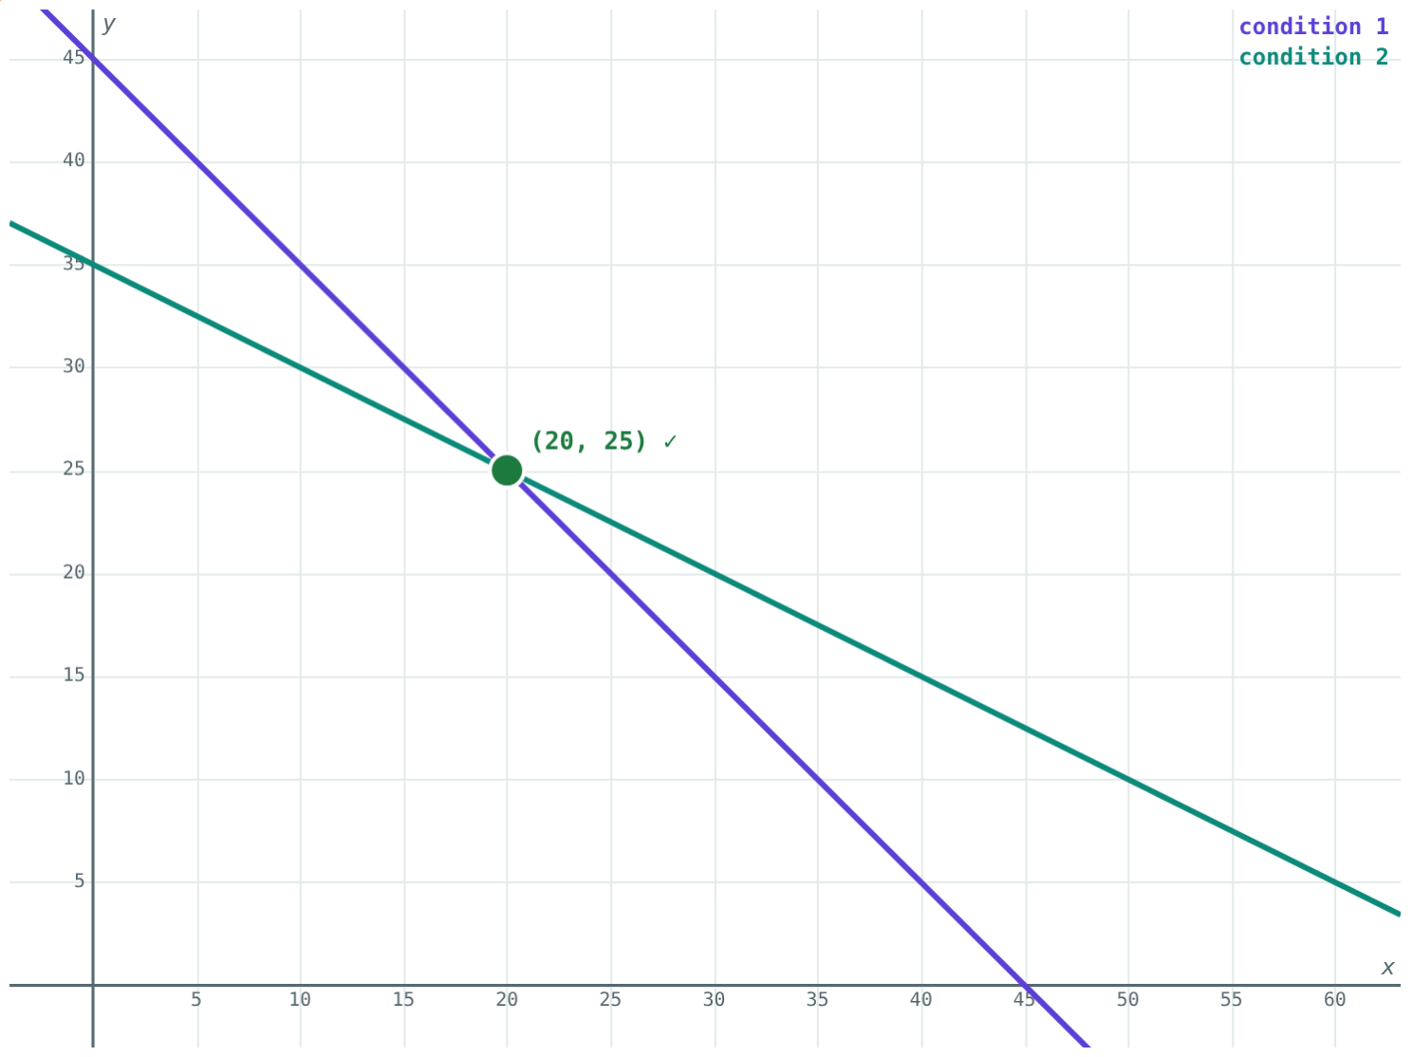
Word Problems with Two Unknowns
STD 9 MATHEMATICS PART I · CH. 5 LINEAR EQUATIONS IN TWO VARIABLES
Lesson 3 · Visual Science & Maths
Notes:
Goal: students can turn a word problem into two linear equations, solve them and answer in words.

Slide 2
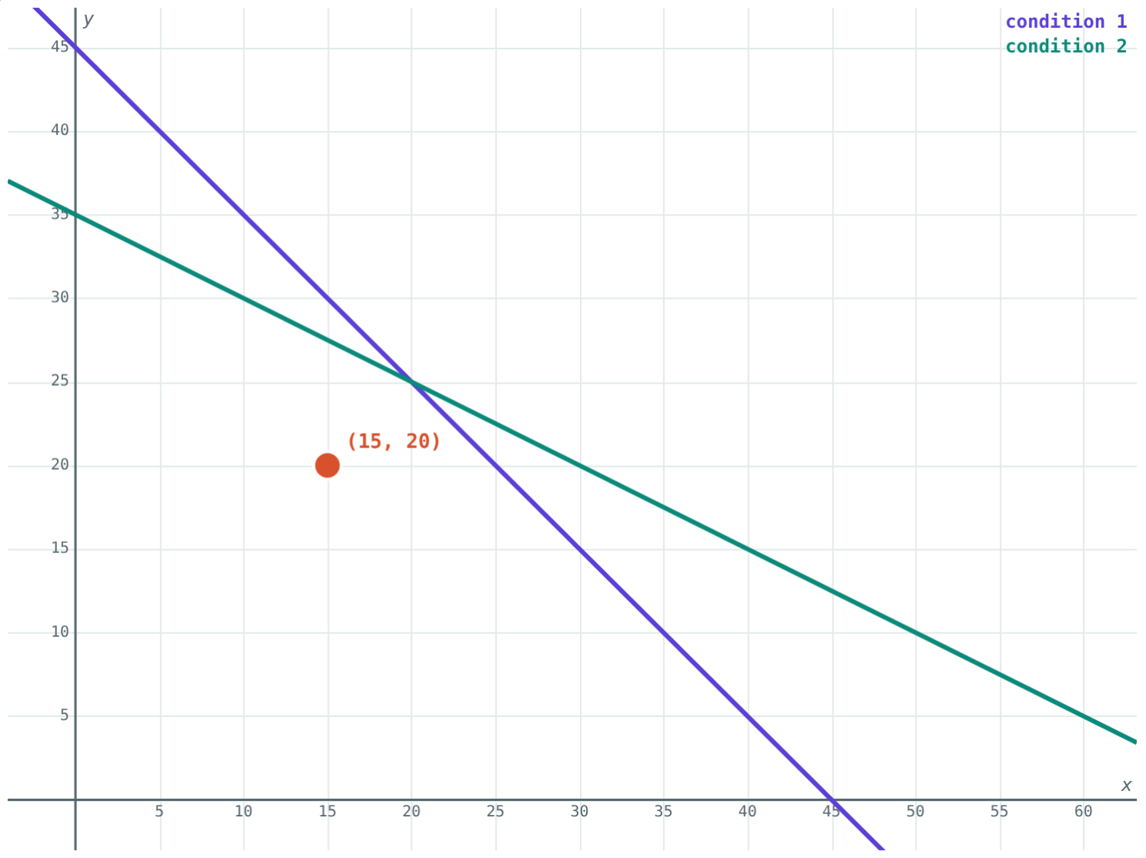
A wallet puzzle
Meena has 45 notes of ₹5 and ₹10, worth ₹350 in all.
How many of each note does she have?
A guess: 15 and 20. Not quite.
Notes:
Let students guess first; most guesses satisfy one clue but not the other.

Slide 3
Four steps
1
2
3
4
Name
Translate
Solve
Answer
Say what x and y stand for, with units.
Turn each clue into an equation.
Elimination or substitution.
Reply in words and check it in the story.
Notes:
Step 1 is the one students skip, and it causes most errors.

Slide 4
Words into equations
Words | Equation
45 notes in all | x + y = 45
₹5 and ₹10 notes worth ₹350 | 5x + 10y = 350
Five years ago, mother 7 times as old | x − 5 = 7(y − 5)
Two-digit number, digits x and y | 10x + y
Length 4 more than breadth | x = y + 4
Notes:
Build this table with the class before solving anything.

Slide 5
Both conditions at once
(15, 20) fits neither clue.
(20, 25) sits on both lines.
Notes:
Each condition is a line; the answer is where they cross.

Slide 6
Worked example: bank notes
45 notes of ₹5 and ₹10 worth ₹350. How many of each?
x + 2y = 70 (divide by 5)
Subtract x + y = 45: y = 25
20 notes of ₹5, 25 of ₹10
x + y = 45, 5x + 10y = 350
Notes:
Check: 100 + 250 = 350.

Slide 7
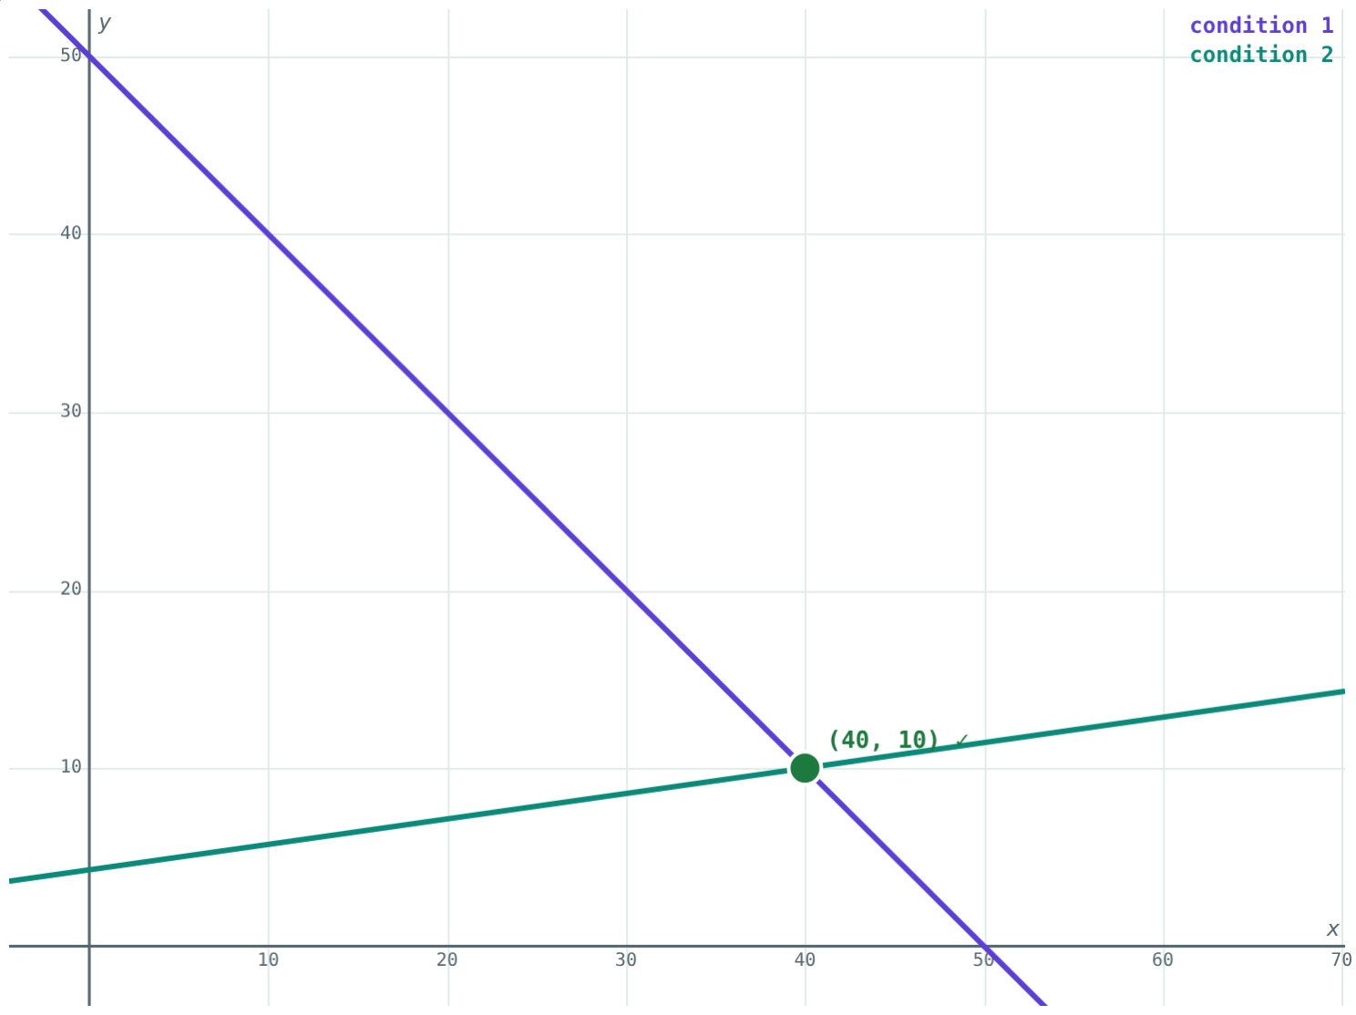
Worked example: ages
Mother and daughter total 50 years. Five years ago the mother was 7 times as old. Find their ages.
x + y = 50; x − 7y = −30
8y = 80, y = 10, x = 40
Mother 40, daughter 10
Mother 40, daughter 10
Notes:
Five years ago applies to both ages.

Slide 8
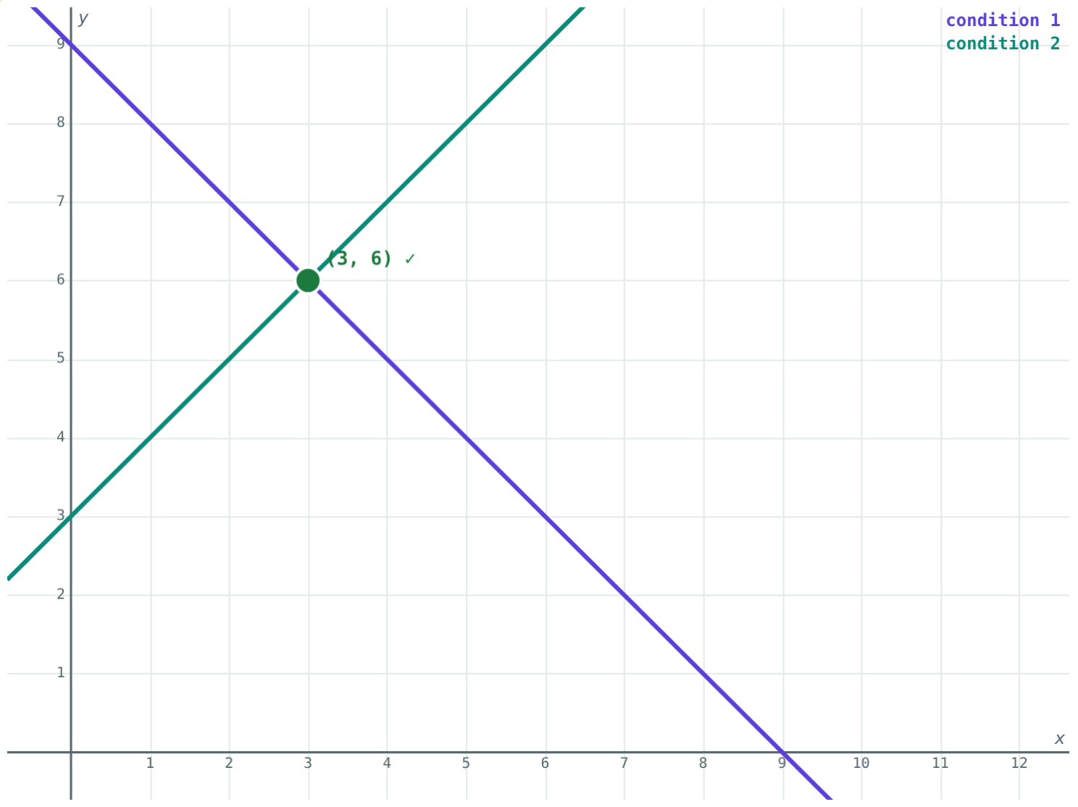
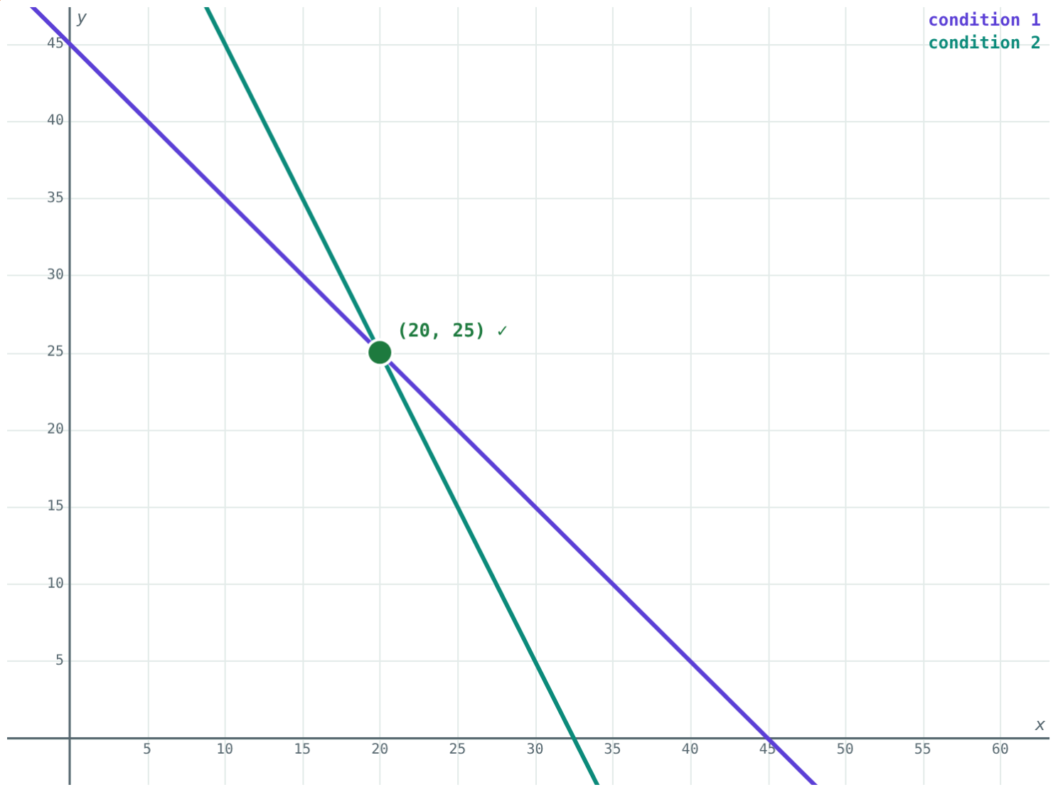
Digits and heads
x + y = 9 and y − x = 3: the number is 36.
x + y = 45, 4x + 2y = 130: 20 lions, 25 peacocks.
Notes:
For digits, reversed 36 is 63, which is 27 more. ✓

Slide 9
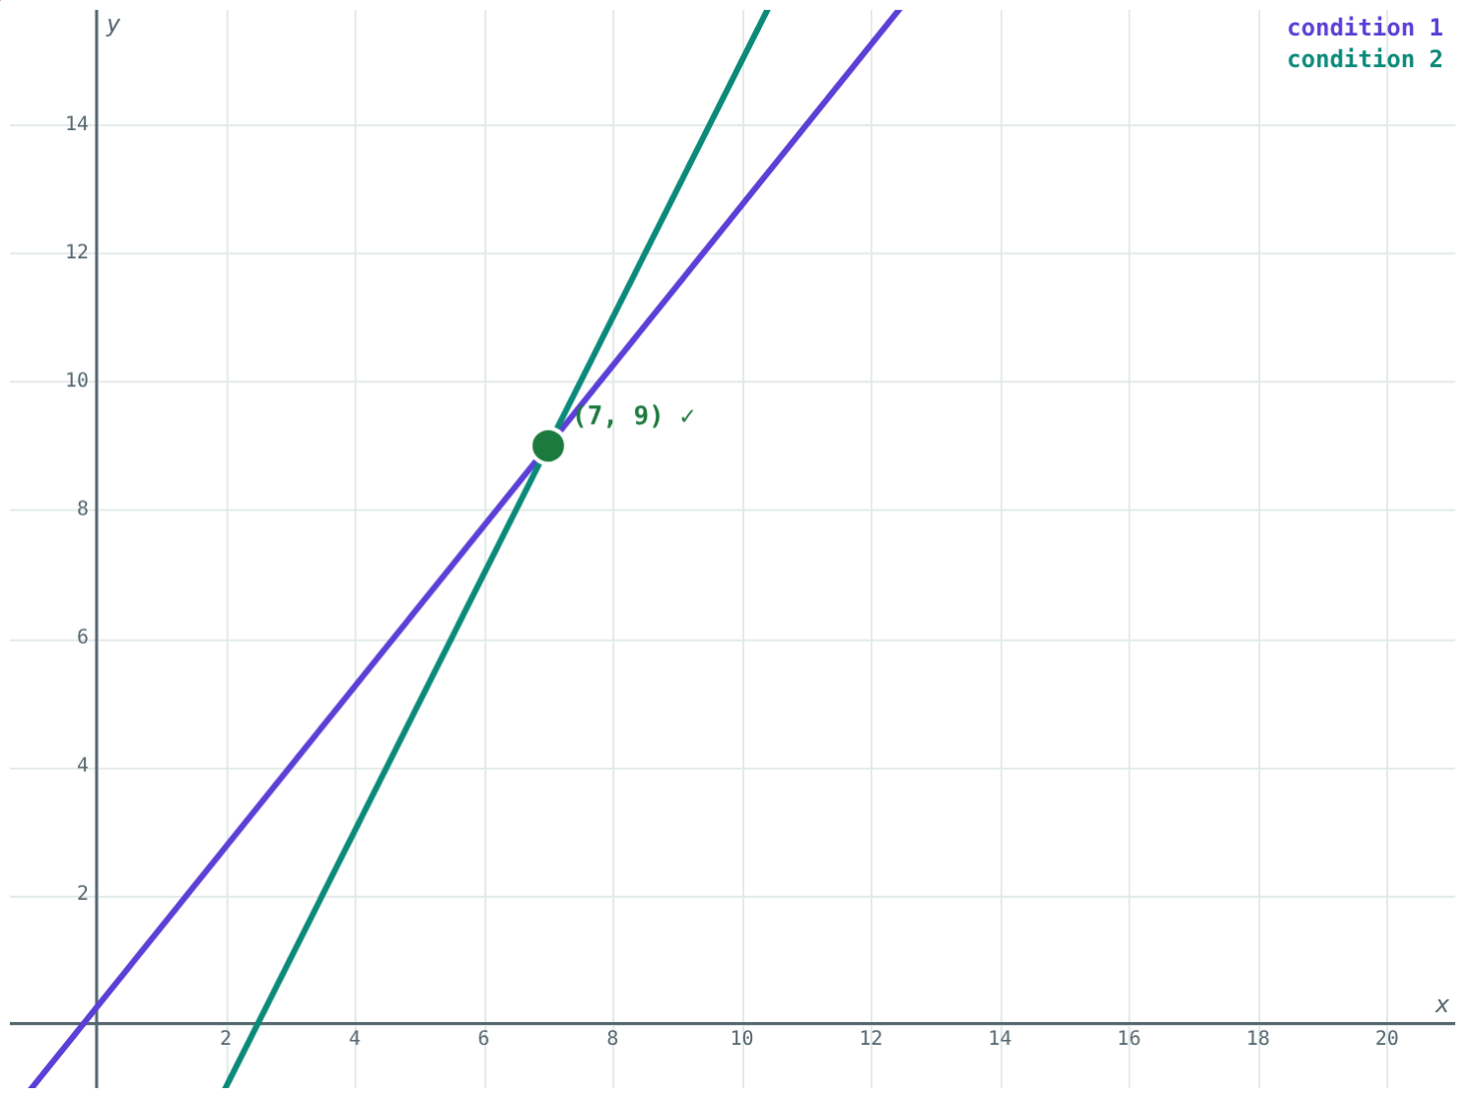
A fraction puzzle
+1 to both gives 4/5; −5 from both gives 1/2:
5x − 4y = −1
first clue
7/9
the fraction
Second clue: 2x − y = 5. Solve to get x = 7, y = 9.
Two clues, two equations
Notes:
Cross-multiply each clue before solving.

Slide 10

Common mistakes
Unnamed unknowns
xy for a number
Write “let x be …” first.
Tens x, units y: 10x + y.
“Years ago” on one age only
Bare numbers
Both ages go back: x − 5, y − 5.
Answer in words, with units.
Notes:
Each mistake comes from rushing step 1 or step 4.

Slide 11
Quick check
1
Two numbers add to 20 and differ by 4. Find them.
2
Write a two-digit number with tens digit x and units digit y.
3
2 pens at ₹x and 3 notebooks at ₹y cost ₹80. Write the equation.
4
50 heads and 140 legs, hens and goats. How many goats?
Notes:
Answers: 1) 12 and 8. 2) 10x + y. 3) 2x + 3y = 80. 4) 20.

Slide 12
Solve the puzzles yourself
Open the Word Problems lesson on the Visual Science & Maths website. Move x and y until both conditions turn green.
Next chapter: Financial Planning
Notes:
Homework: write your own word problem for a classmate to solve.

