Slide 1
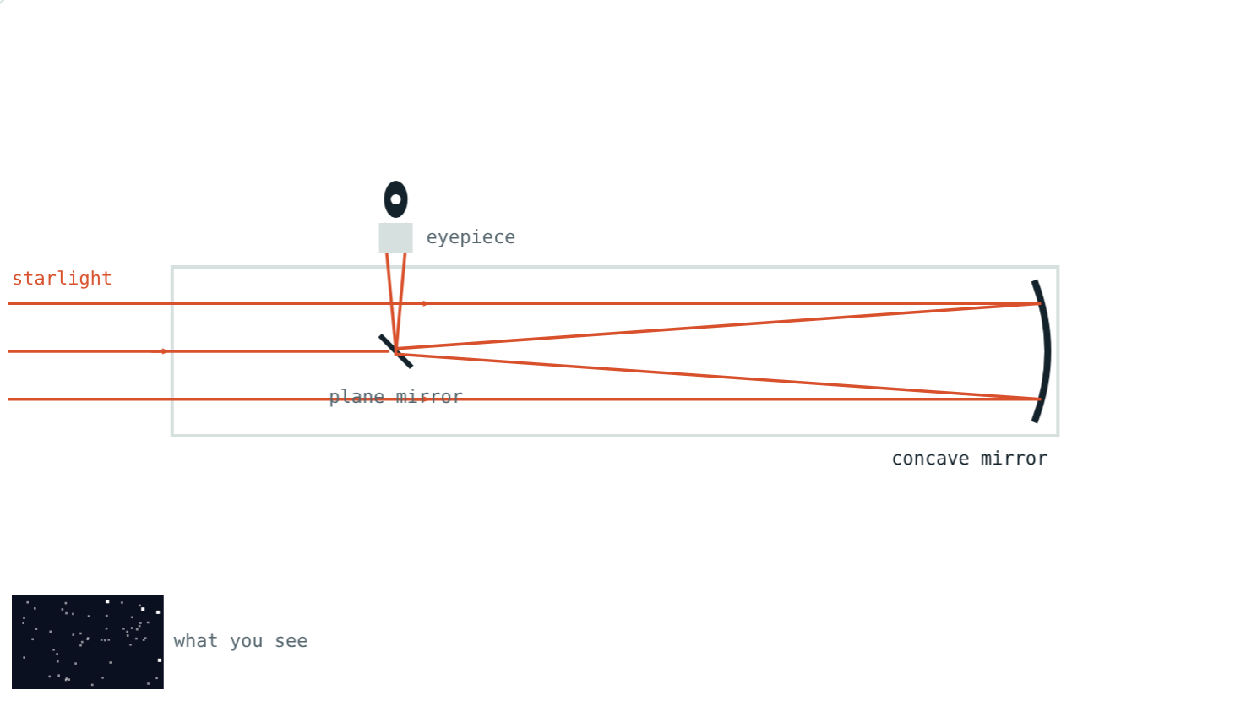
Optical and Radio Telescopes
STD 9 SCIENCE · CH. 18 OBSERVING SPACE: TELESCOPES
Lesson 2 · Visual Physics
Notes:
Goal: students can describe refracting, Newtonian, Cassegrain and radio telescopes and explain why aperture matters.

Slide 2
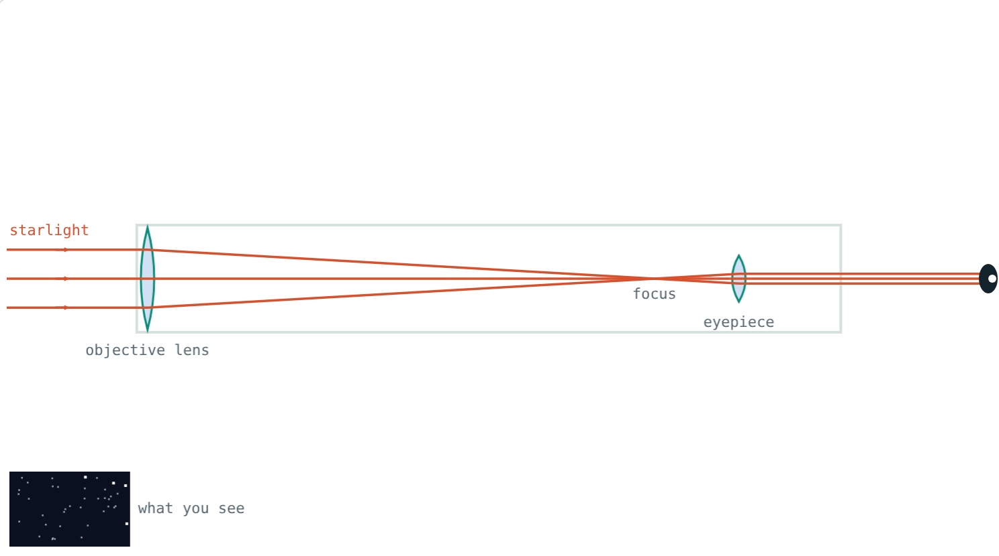
Galileo's first look
In 1609 Galileo turned a small telescope to the sky and saw craters on the Moon and four moons circling Jupiter.
What does a telescope do that the eye cannot?
A refracting telescope like Galileo's
Notes:
Two jobs: gather more light, and show finer detail.

Slide 3

Gathering light
light gathered ∝ D²
D is the aperture: width of the main lens or mirror
Your pupil is about 7 mm wide at night
Twice the width collects four times the light
14 cm: about 400 times your eye
Notes:
Light collected depends on area, and area goes as the square of the width.

Slide 4
Refracting telescope
Convex objective lens focuses the light
Eyepiece lens magnifies the image
Big lenses sag and give coloured fringes
Largest ever: about 1 m wide
Objective, focus, eyepiece
Notes:
Coloured fringes happen because different colours focus at slightly different points.

Slide 5
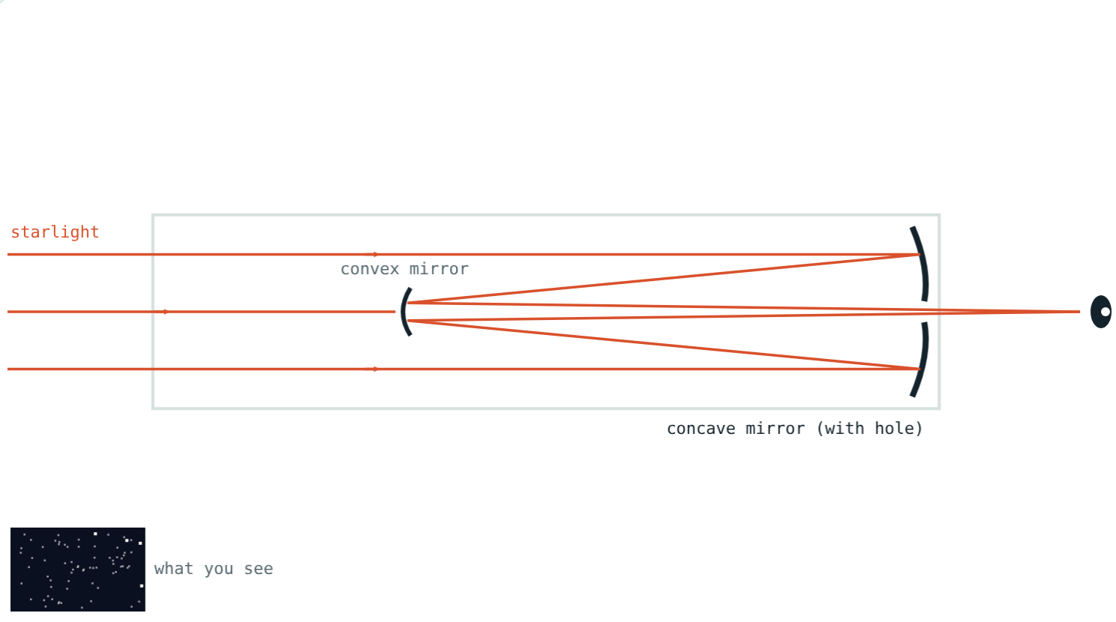
Two kinds of reflector
Concave mirror + plane mirror at 45°; eyepiece at the side.
Concave mirror with a hole + convex mirror; eyepiece at the back.
Notes:
Newton built the first reflecting telescope in 1668.

Slide 6



Why mirrors win
Support
No colour fringes
Huge sizes
A mirror can be held up from behind; a lens only at its edge.
All colours reflect to the same focus.
Mirrors can be 10 m wide, even made of segments.
Notes:
Every large modern telescope is a reflector.

Slide 7
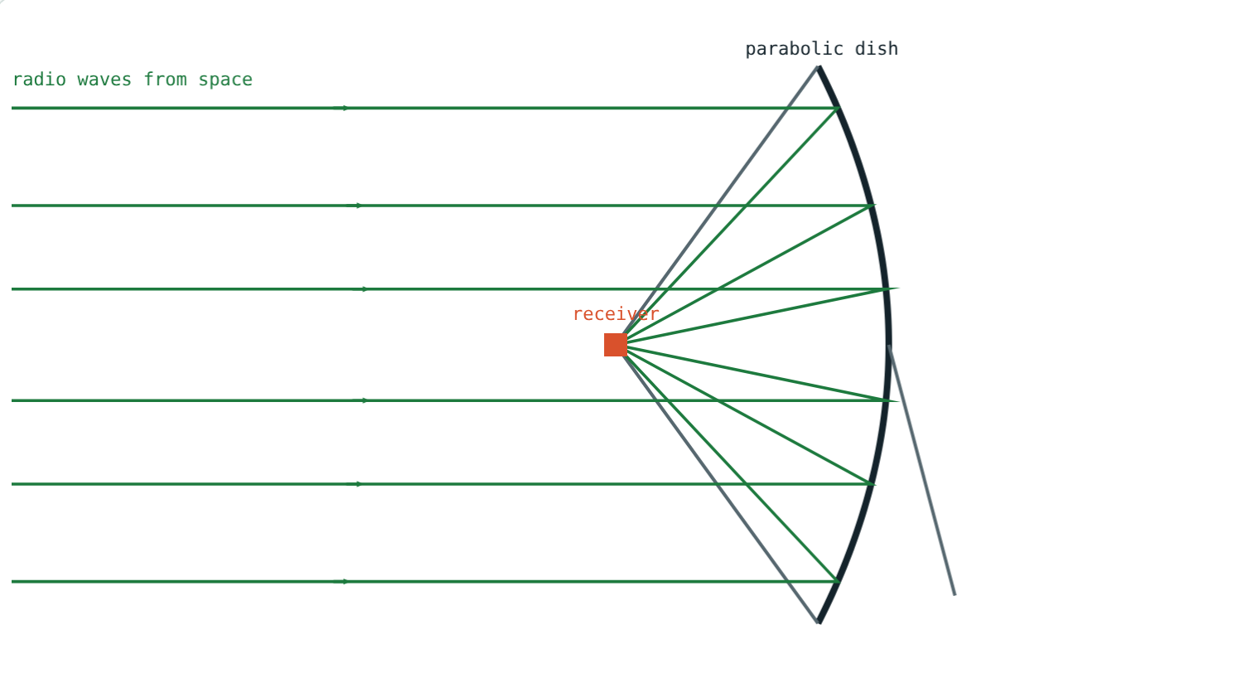
Radio telescopes
A parabolic metal dish reflects radio waves
The receiver sits at the focus
Radio waves are long, so dishes are huge
GMRT near Pune: 30 dishes, each 45 m wide
Parallel waves meet at the receiver
Notes:
GMRT is run by NCRA-TIFR; its dishes are spread over about 25 km near Narayangaon.

Slide 8
Worked examples
A small telescope
Doubling
D = 14 cm, pupil = 0.7 cm. How much more light?
A 50 cm mirror is replaced by a 100 cm one. How much more light?
14 ÷ 0.7 = 20
20² = 400 times
2² = 4 times
Notes:
Square the ratio of widths.

Slide 9
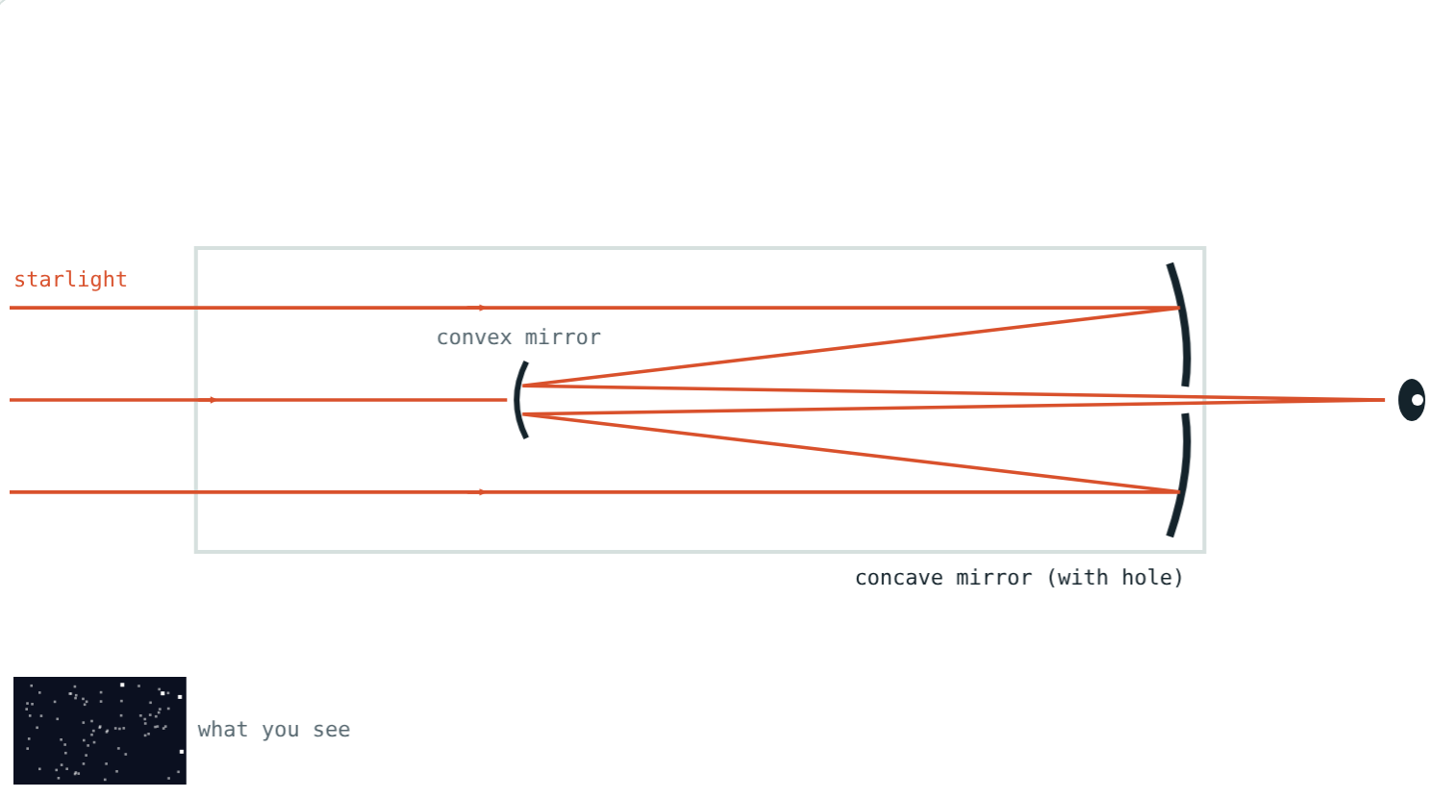
The Hubble Space Telescope
240 cm ÷ 0.7 cm ≈ 343, and 343² ≈
1.2 lakh
times your eye
2.4 m
mirror width
A 2.4 m Cassegrain-type mirror
It can see objects billions of times fainter than the eye can.
Notes:
Hubble's design is a Cassegrain variant called Ritchey–Chrétien.

Slide 10

Common mistakes
“Just a magnifier”
“Twice as wide, twice the light”
First, it collects light.
Four times: area goes as D².
Mixing up reflectors
“Radio telescopes hear sounds”
Newtonian: plane mirror. Cassegrain: convex mirror.
They detect radio waves.
Notes:
Ask students to correct each statement in their own words.

Slide 11
Quick check
1
Which telescope uses a concave mirror and a plane mirror?
2
Why are all very large telescopes reflectors?
3
A telescope's aperture is tripled. How much more light does it gather?
4
Where is the GMRT?
Notes:
Answers: 1) Newtonian. 2) Big lenses sag and give coloured fringes; mirrors can be supported from behind. 3) 9 times. 4) Near Narayangaon, about 80 km from Pune.

Slide 12
Trace the light yourself
Open the Optical and Radio Telescopes lesson on the Visual Physics website. Switch designs and change the aperture.
Next lesson: Telescopes in space
Notes:
Activity: make a simple refractor from two magnifying lenses and a paper tube.

