Slide 1
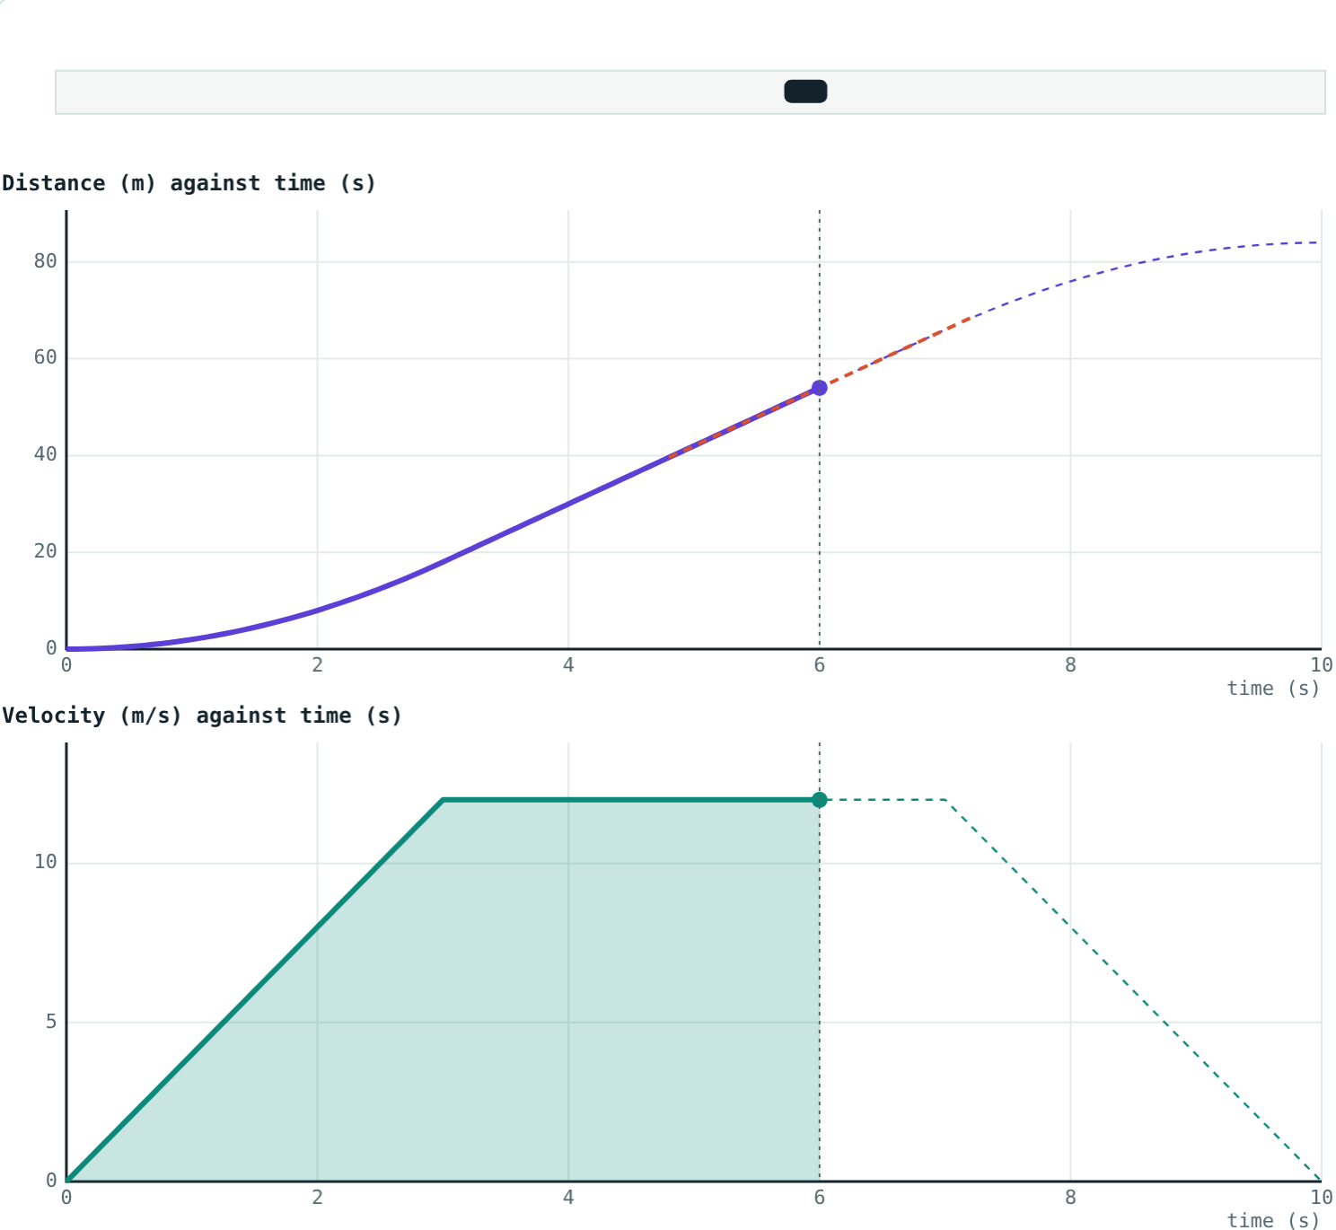
Motion Graphs
STD 9 SCIENCE · CH. 1 LAWS OF MOTION
Lesson 5 · Visual Physics
Notes:
Goal: students can read speed from the slope of a distance–time graph, acceleration from the slope of a velocity–time graph, and distance from the area under a velocity–time graph.

Slide 2
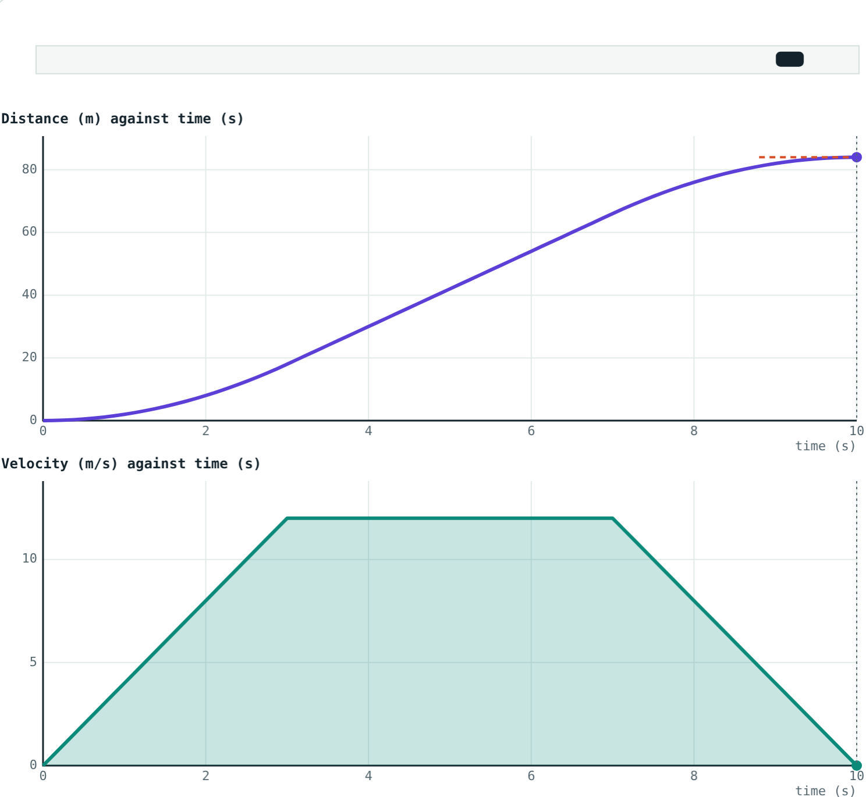
A journey in one picture
A train leaves a station, runs at a steady speed, then brakes into the next station.
Can you see all three parts in the graphs?
Top: distance against time. Bottom: velocity against time
Notes:
Ask students to point to where the train speeds up, cruises and brakes on each graph.

Slide 3
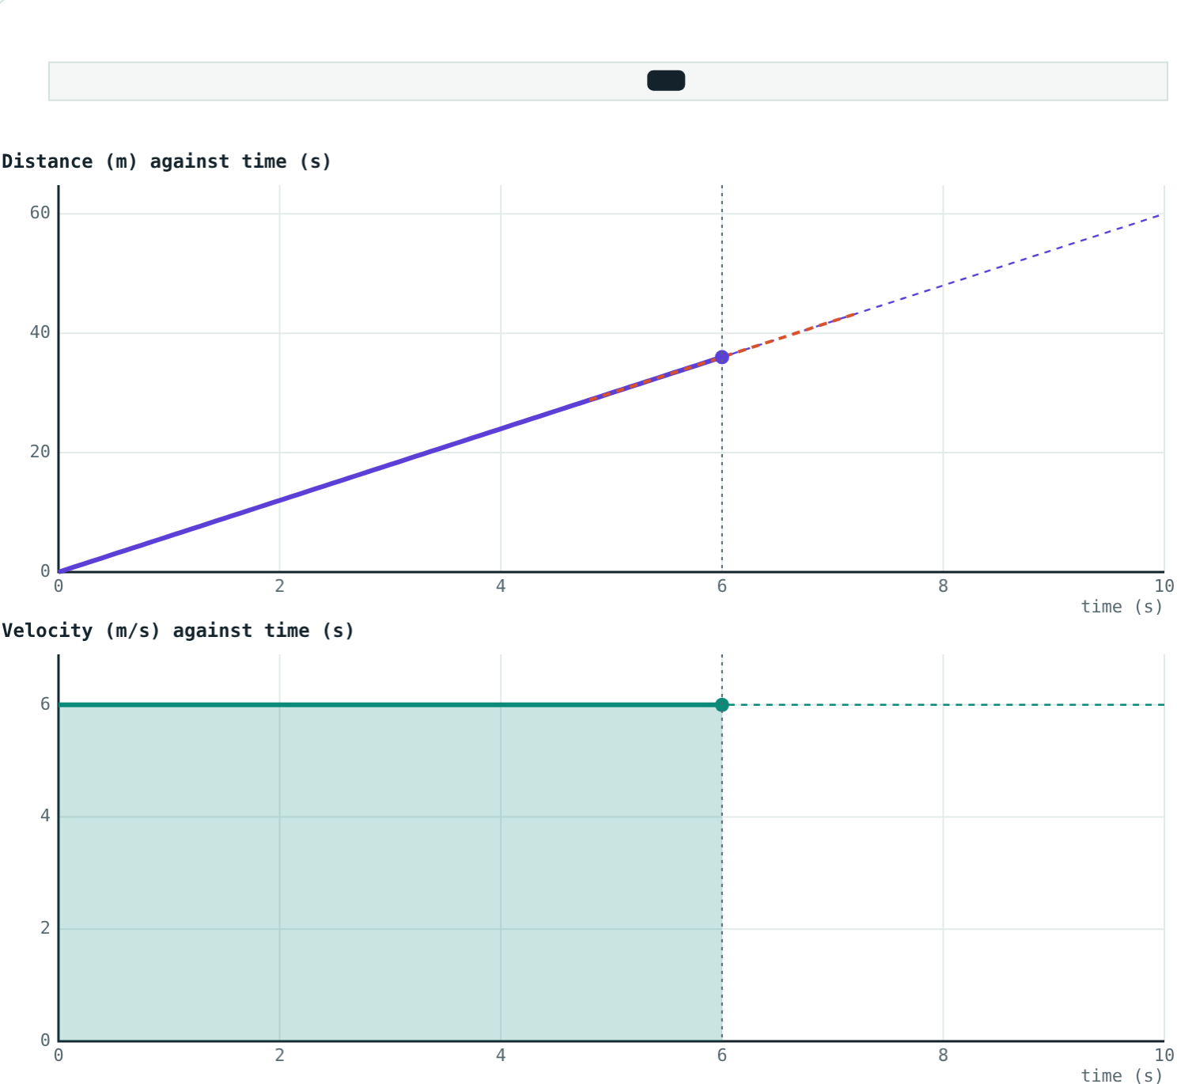
Distance–time graphs
slope = speed
Straight sloping line: uniform motion
Steeper line: higher speed
Flat line: at rest
Curve getting steeper: speeding up
Steady speed: a straight distance line, a flat velocity line
Notes:
Slope = rise ÷ run = distance ÷ time = speed.

Slide 4
Velocity–time graphs
slope = acceleration
Flat line above zero: uniform velocity
Straight line sloping up: uniform acceleration
Sloping down: deceleration
Area under the graph = distance travelled
The shaded area equals the distance so far
Notes:
For a flat line the area is a rectangle, velocity × time, which is exactly distance. That makes the area rule easy to believe.

Slide 5
Shapes at a glance
Motion | Distance–time | Velocity–time
At rest | Flat line | Flat line on zero
Uniform speed | Straight sloping line | Flat line above zero
Speeding up uniformly | Curve getting steeper | Straight line sloping up
Slowing down uniformly | Curve getting flatter | Straight line sloping down
Notes:
Students can copy this table. Cover a column and quiz them.

Slide 6
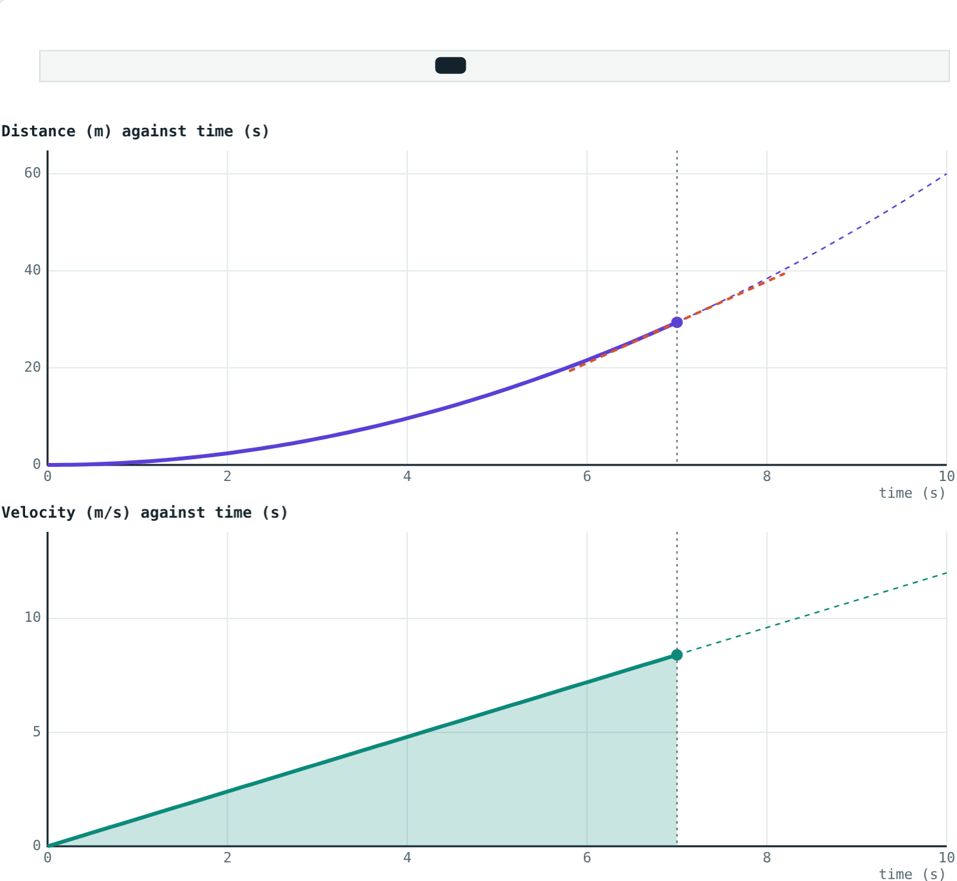
Steady speed or speeding up?
Distance: straight line. Velocity: flat line.
Distance: curve getting steeper. Velocity: straight line rising.
Notes:
The same motion looks different on the two graphs. A curve on one can be a straight line on the other.

Slide 7
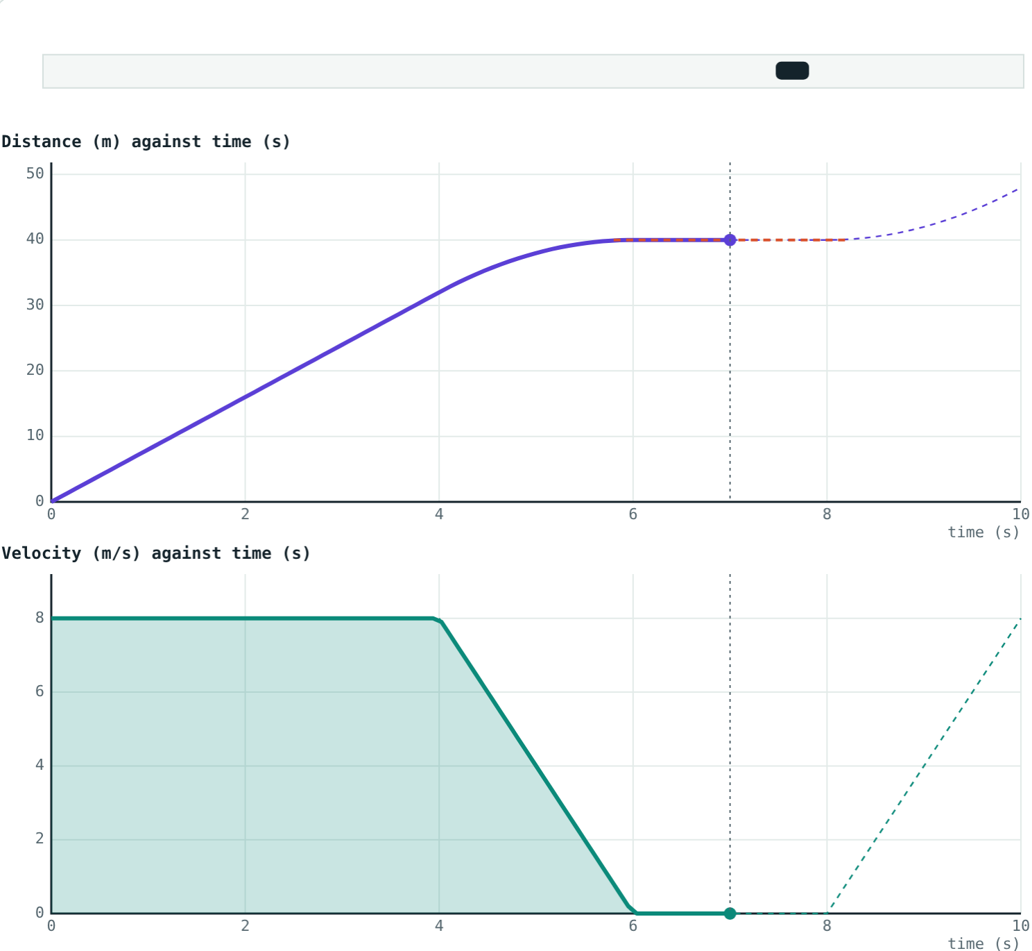
Stopping at a signal
Find the stop on both graphs:
Flat
distance line while waiting
0 m/s
velocity while waiting
Total distance: 48 m, the area under the velocity graph.
8 m/s, brake, wait 2 s, set off again
Notes:
Area: 8 × 4 = 32, then ½ × 2 × 8 = 8 while braking, 0 while waiting, ½ × 2 × 8 = 8 while setting off. 32 + 8 + 8 = 48 m.

Slide 8
Reading a distance–time graph
A cyclist's distance–time graph is a straight line from (0 s, 0 m) to (5 s, 30 m). Describe her motion and find her speed.
Straight sloping line: uniform motion
Speed = slope = 30 ÷ 5 = 6 m/s
A straight distance line: uniform motion
Notes:
Remind students to read the axes and units before calculating the slope.

Slide 9
Reading a velocity–time graph
A train speeds up from rest to 12 m/s in 3 s, runs at 12 m/s for 4 s, then stops in 3 s. Find each acceleration and the total distance.
Speeding up: 12 ÷ 3 = 4 m/s²
Steady part: 0
Slowing down: −12 ÷ 3 = −4 m/s²
Area = 18 + 48 + 18 = 84 m
Area under the velocity graph = 84 m
Notes:
Split the area into a triangle, a rectangle and a triangle.

Slide 10

Common mistakes
Reading the graph as a map
Mixing up flat lines
A curved distance–time graph does not mean the road bends.
Flat on distance–time: at rest. Flat on velocity–time: steady speed.
Wrong slope
Forgetting triangles
Slope of velocity–time is acceleration, not velocity.
Use ½ × base × height for the sloping parts of the area.
Notes:
The flat-line confusion is the most common exam error on this topic.

Slide 11
Quick check
1
A distance–time graph is flat. What is the object doing?
2
What does the slope of a velocity–time graph tell you?
3
A velocity–time graph is flat at 5 m/s from 0 to 4 s. How far does the object go?
4
A distance–time graph curves and gets steeper. What is happening?
Notes:
Answers: 1) At rest. 2) Acceleration. 3) 20 m (area 5 × 4). 4) Speeding up.

Slide 12
Draw journeys yourself
Open the Motion Graphs lesson on the Visual Physics website. Play a journey or drag across the graphs to move through time.
Next lesson: Equations of motion
Notes:
Homework idea: sketch both graphs for your journey to school, with labels for each part.

