Slide 1

Securing and Attacking the HTML5 Landscape
Blake Hitchcock – Cisco Systems, Inc
Notes:
Let’s get into it man

Slide 2
What is HTML5?
Standardizes technology for building Rich Web Applications
New attributes/events
New ways to communicate
New ways to store and process information
New ways to secure your application
Notes:
Umbrella term
We won’t get to all of it today
We’ll see how your XSS filter is in trouble
Strategic relaxation of SOP
More storage and logic in the client
HTTP headers and sandboxing

Slide 3
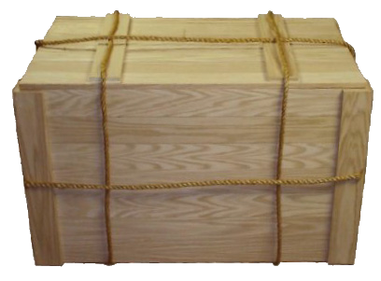







A more open Web
Image by Brad Hill, PayPal
Notes:
Fundamental shift in building rich applications
No more scary plugins
Standardized, built-in support for audio, video
Good for application developers and users

Slide 4
What we’ll cover today
Some new attack vectors
Implications of some new technologies
Some new defensive techniques…
…and ways to bypass those techniques

Slide 5
Let’s start with the basics
Notes:
* First, let’s discuss implications of new tags and events

Slide 6
HTML5 Elements and Attributes
~50 new event attributes
~30 new elements
Numerous new attributes

Slide 7
HTML5 Elements and Attributes
<input onfocus=alert(1) autofocus>

Slide 8
HTML5 Elements and Attributes
<input onblur=alert(1) autofocus>
<input autofocus>

Slide 9
HTML5 Elements and Attributes
<body onscroll=alert(1)>
<br><br><br><br><br><br>...<br><br><br><br><input autofocus>
Notes:
* So what does all this mean??

Slide 10
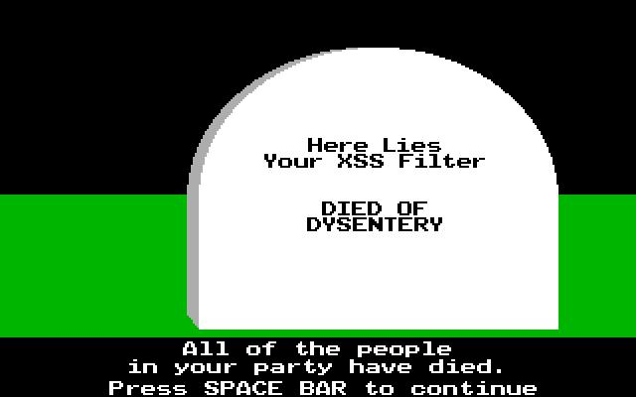
HTML5 Elements and Attributes
Notes:
RIP
You XSS filter is in even worse shape than it already was

Slide 11
HTML5 Elements and Attributes
Nothing really “new” here
Your filter was already broken
Difficult for server script to emulate how browser will parse a document
Browser differences in parsing
Designed to accept bad input
Notes:
Same rules of not trusting user input apply
Set of potential inputs is too complex to filter
Obfuscation

Slide 12
HTML5 Elements and Attributes
First HTML specification to specify complete algorithm for parsing HTML
Better interoperability between browsers
Better compatibility with web pages
Standard for parsing invalid HTML
Notes:
* HTML5 will help, in general

Slide 13
Complex apps need to communicate
Notes:
Let’s shift gears
Look at how HTML5 changes cross domain communication
How it affects mashups

Slide 14
Same-origin Policy
Fundamental basis of web security
Original implementation is too restrictive which leads to dangerous workarounds
protocol://host:port
https://google.com
http://google.com
http://google.com:8080
Notes:
Important to have an understanding of this moving forward
Controls what elements of DOM JavaScript has access to
A script included on 3rd party server executes in context of includer
HTML5 allows developers to strategically loosen this restriction

Slide 15
Communication APIs
New techniques for communicating between origins
Web Messaging, CORS, WebSockets, Server-Sent Events
Notes:
No more JSON-P
No more complicated proxies
WebSockets provide 2 way communication between client/server
Server-Sent Events provide 1-way
We won’t talk about those
We will talk about Web Messaging, CORS

Slide 16
Communication APIs – Web Messaging
Preferred method of cross-document messaging
Allows documents at different origins to communicate
Communication happens in the browser
Used by “mashups”
Notes:
A mashup is a web application that contains elements from other origins
They are everywhere. Think Facebook and Twitter
Sometimes an app will include a component on another subdomain
Web Messaging lets the container communicate to the framed applications via JavaScript

Slide 17
Communication APIs – Web Messaging
framedWindow.postMessage(message, targetOrigin)
framedWindow is listening for messages
Sender should explicitly state targetOrigin
Receiver gets a message object, m
m.data (object passed in message param)
m.origin (origin of window that sent message)
m.source (reference to window object of sender)
Notes:
Parent page includes an iframe
References it via framedWindow variable
State targetOrigin because location may change
Origin is a string containing scheme, domain, and port

Slide 18
Communication APIs – Web Messaging
Simple to secure
If you don’t expect to receive messages from other windows, don’t listen for them!
If you do, always be sure to:
Validate the origin before taking action
Make sure the data is the proper type
Handle data with care
Notes:
SHOW DEMO!
http://localhost:9999/example/messenger.html
<img src=a onerror="alert('I am the iframe. My origin is '+location.protocol+'://'+location.host+'.\nMy name is '+document.getElementsByTagName('h2')[0].innerHTML)">

Slide 19
Communication APIs - CORS
Allows JavaScript to make cross-domain requests
Safer than JSONP
Response is data rather than JavaScript
Notes:
JavaScript allows us to make XMLHttpRequests to other domains now
Response from server determines if JS can access the returned data

Slide 20
Communication APIs - CORS
Response headers
Access-Control-Allow-Origin
source or *
Access-Control-Allow-Credentials
Access-Control-Allow-Methods
Access-Control-Allow-Headers
Request headers
Origin
Access-Control-Request-Method
Notes:
If “*” is specified, no credentials can be sent

Slide 21
Communication APIs - CORS
Two types of requests
Simple
GET, POST, and HEAD
application/x-www-form-urlencoded, multipart/form-data, or text/plain
Preflighted
Other verbs
Custom headers
Notes:
Simple requests are essentially the same ones the browser could already send
Preflighted requests send an OPTION request first

Slide 22
Communication APIs - CORS
Remember that not all requests are preflighted
Usual authn/authz and CSRF rules apply
Only use the header where needed
Notes:
Non preflighted requests will hit the application at the requested URL
So be sure you have proper access control and authentication protections
Either set the header globally to something like “deny”, or just don’t use it

Slide 23
Quickly, on Local Storage…
Notes:
Briefly talk about local storage

Slide 24
Storage APIs
More storage in browsers to be leveraged
Client side databases
No significantly different attack vectors
But, much more likely interesting data will be in the DOM
All content visible to JS in same origin
Don’t store sensitive data!
Interesting potential for persistent attacks
Notes:
5mb localstorage vs 2kb cookie
Things like IndexedDB

Slide 25
Storage APIs – Local Storage
sessionStorage vs localStorage
sessionStorage is cleared when tab closed
Not a good place for session IDs
Use httpOnly cookies instead
Retrieval and storage via JavaScript

Slide 26
Storage APIs – Browser Botnets
Sean Malone’s “HiveMind”
Enrolled clients via anonymous proxy
Designed for distributed file storage

Slide 27
Now, let’s talk defense
Notes:
* HTML5 gives developers new ways to keep their application and users safe

Slide 28
HTTP Response Headers
New headers recognized by browsers to enhance security
Provide defense-in-depth
Some require little to no changes to web apps
It’s possible they can all be turned on without any code changes

Slide 29
HTTP Response Headers
X-Frame-Options
Controls which origins can load your application in an iframe
X-XSS-Protection
Prevents reflected XSS
Strict-Transport-Security
Enforces HTTPS connections
Defends against MITM
User can’t ignore SSL warnings in browser

Slide 30
HTTP Response Headers
Content-Security-Policy
Potential to “eliminate” XSS vulnerabilities
Separates JavaScript from HTML
Disables inline JavaScript and dangerous JavaScript functions, e.g. eval()
Only loads content from trusted origins
Often requires code refactoring
Open source tools can be used to evaluate application’s compliance
e.g. default-src ‘none’; script-src ‘self’
Notes:
Describe what types of elements can be controlled
Different policies for different portions of your app

Slide 31
Sandboxing
sandbox is a new attribute for iframes
Each sandboxed iframe has its own unique origin
Applies principal of least privilege to embedded content
Useful for including 3rd party content
Useful for breaking an application into components to reduce the TCB
Be sure to serve these components as text or from a different origin than the parent
Notes:
Unique origin means iframe is isolated… same origin policy dictates it will never match anything else!
Disables plugins, javascript, window/dialog creation, forms, top level navigation
You can enable this stuff granularly
If you don’t serve the segmented portions as text or form a different origin, attacker can just trick user to going there directly

Slide 32
Sandboxing
allow-forms
Allows form submission
allow-pointer-lock
Allows interaction with pointer lock API
allow-popups
Allows popups
allow-same-origin
Framed document maintains origin
allow-scripts
Allows JavaScript execution
allow-top-navigation
Framed document can navigate the top-level window
Notes:
DEMO AFTER THIS SLIDE
top.location.href = “http://google.com”

Slide 33
Wrap it up
New mind blowing attack vectors?
Not really, but stakes are higher than ever
HTML5 is “more complex” than HTML4
But the two aren’t really comparable
Say goodbye to Flash, Java, ActiveX, etc
HTML5 will fundamentally alter web security
For the better
Notes:
Things are getting better
As we’ve seen with previous presos, web apps are a way in
HTML5 gets me excited. As much as I love finding bugs in web apps, nothing would make me happier than educating developers and pushing out solutions so that I never find another meaningful bug in a web app
HTML5 provides many tools to help make this possible

Slide 34
Further reading
http://www.cs.berkeley.edu/~devdatta/papers/LeastPrivileges.pdf
http://www.html5rocks.com
https://www.owasp.org/index.php/HTML5_Security_Cheat_Sheet
https://html5sec.org/#html5
https://github.com/seantmalone/HiveMind
https://en.wikipedia.org/wiki/List_of_HTTP_header_fields
http://www.webrtc.org/

