Slide 1
EDA Results
What Good Notes users discuss on Reddit

Slide 2
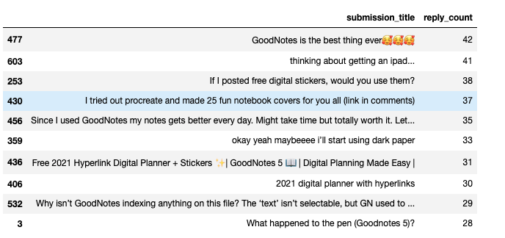
Quick Overview
Performing the initial quick overview of the dataset, we started from eyeballing the top 10 submissions with the highest number of replies.
Noticing that Reddit users:
Share how awesome GoodNotes is for them “GoodNotes is the best thing ever…”, “Since I used GoodNotes my notes gets better every day…”.
share useful techniques and tools: “… I posted free digital stickers…”, “… made 25 fun notebook covers for you all…”
Raise issues: “Why isn’t GoodNotes indexing anything on this file?”, “What happened to the pen…”
Exploring the “Flair” we could clearly distinguish high level categories for 35% of the data samples (2175 out of 6149):
Questions (Ipad/iPhone/Mac/Other)
Reviews
Problems
Templates
So that gives us some understanding of what brings GoodNote users to Reddit! Or at least for 35% of the data samples.

Slide 3
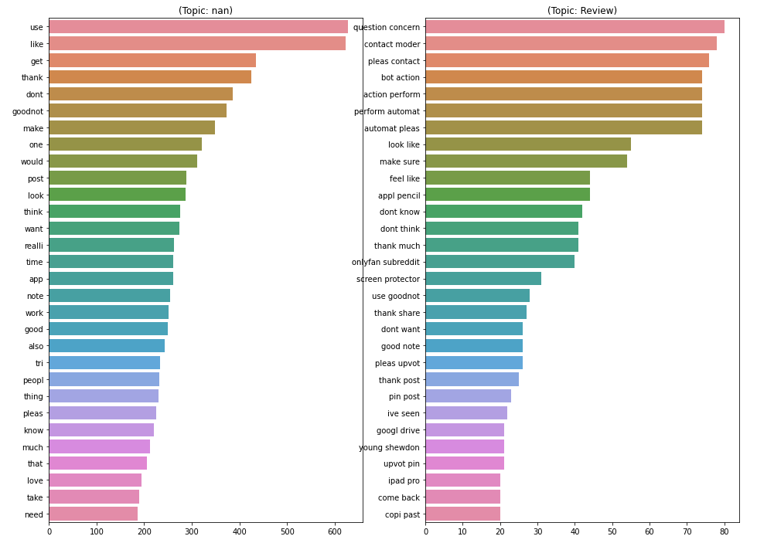
Exploring uncategorized replies
Initial analysis of the remaining 65% of the data samples highlights the following ”Bag of words” and “Bigrams”
Words like: “Use”, “get”, “don’t”, “make” – might indicate that the remaining samples include suggestions and recommendations on how to use GoodNotes application.
Bigrams: “question concern”, ”contact moderator”, “make sure” – might mean that users are bringing various concerns about the app or are getting help from the community.

Slide 4
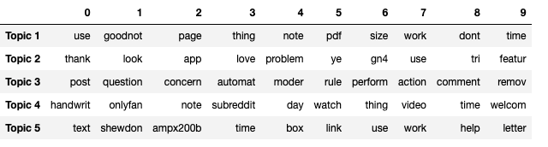
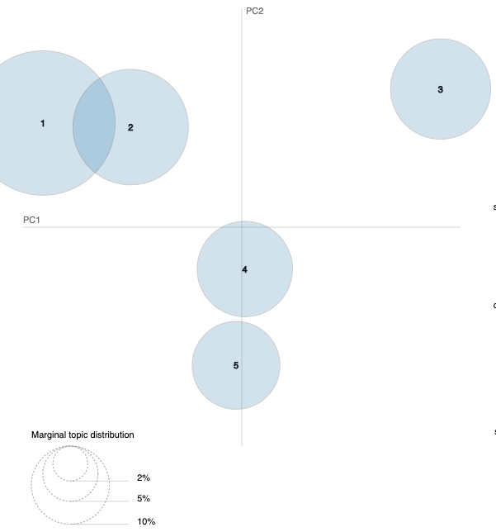
Dipper dive
After performing a dipper LDA analysis of the topics extracted from uncategorized posts:
Perhaps we can draw the conclusion that the remaining comments are also covering similar subjects as the ones that were categorized by users.
Topic1 and Topic2: Perhaps covers Reviews where people share their experience and help each other how to use this product better!
Topic3: Might reveal that about 16 % of posts are about questions, problems and ways to overcome them

Slide 5
Summary:
We performed EDA for provided data samples trying to explore if we can get some insights of what subjects Good Notes users discuss on Reddit.
After performing the quick overview we were able to distinguish the main 4 categories:
Questions,
Reviews,
Problems,
Templates
and categorize 35% of replies among them.
Then we tried exploring the remaining 65% of the data, and highly likely majority of them were also covering Questions, Issues and Reviews that GoodNotes users share with the community.
Possible future enhancements:
Run LDA topic extraction for each of the 4 categories: this way we could try to detect subcategories and more fine-grained subject lines users discuss on Reddit?
Run Sentiment Analysis to get an idea how GoodNotes users feel about good note software and whether their comments are positive, neutral or negative.

