Slide 1

Questions & Knowledge Checks
AWS

Slide 2
What is Completeness of vision
In the Gartner Magic Quadrant, "Completeness of Vision" refers to a company's ability to convincingly articulate its current and future market direction, innovation, and strategies for growth. This metric evaluates whether the company understands market trends, customer needs, and competitive dynamics, and whether it has a robust and coherent strategy to address them.

Slide 3
Edge Location vs POP

Slide 4
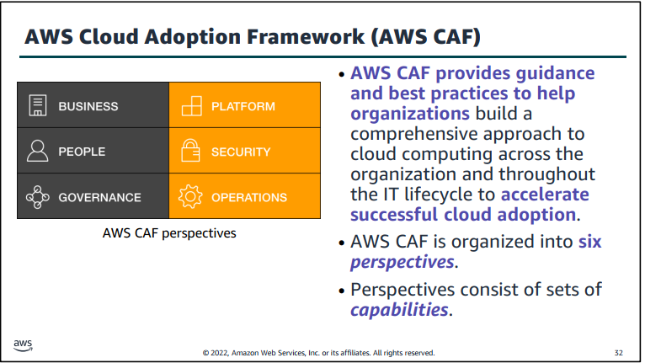
AWS CAF
As you learned so far in this module, cloud computing offers many advantages over the traditional model. However, for most organizations, cloud adoption does not happen instantly. Technology is one thing, but an organization also consists of people and processes, and these three elements must all be in alignment for successful cloud adoption. Cloud computing introduces a significant shift in how technology is obtained, used, and managed. It also shifts how organizations budget and pay for technology services. Cloud adoption requires that fundamental changes are discussed and considered across an entire organization. It also requires that stakeholders across all organizational units—both within and outside IT—support these new changes. In this last section, you learn about the AWS CAF, which was created to help organizations design and travel an accelerated path to successful cloud adoption.
Notes:
Each organization’s cloud adoption journey is unique. However, in order for any organization to successfully migrate its IT portfolio to the cloud, three elements (that is, people, process, and technology) must be in alignment. Business and technology leaders in an organization must understand the organization’s current state, target state, and the transition that is needed to achieve the target state so they can set goals and create processes for staff

Slide 5
AWS CAF
Each organization’s cloud adoption journey is unique. However, in order for any organization to successfully migrate its IT portfolio to the cloud, three elements (that is, people, process, and technology) must be in alignment. Business and technology leaders in an organization must understand the organization’s current state, target state, and the transition that is needed to achieve the target state so they can set goals and create processes for staff The AWS Cloud Adoption Framework (AWS CAF) provides guidance and best practices to help organizations identify gaps in skills and processes. It also helps organizations build a comprehensive approach to cloud computing—both across the organization and throughout the IT lifecycle—to accelerate successful cloud adoption.

Slide 6
AWS CAF
At the highest level, the AWS CAF organizes guidance into six areas of focus, called perspectives. Perspectives span people, processes, and technology. Each perspective consists of a set of capabilities, which covers distinct responsibilities that are owned or managed by functionally related stakeholders.
Capabilities within each perspective are used to identify which areas of an organization require attention. By identifying gaps, prescriptive work streams can be created that support a successful cloud journey.

Slide 7
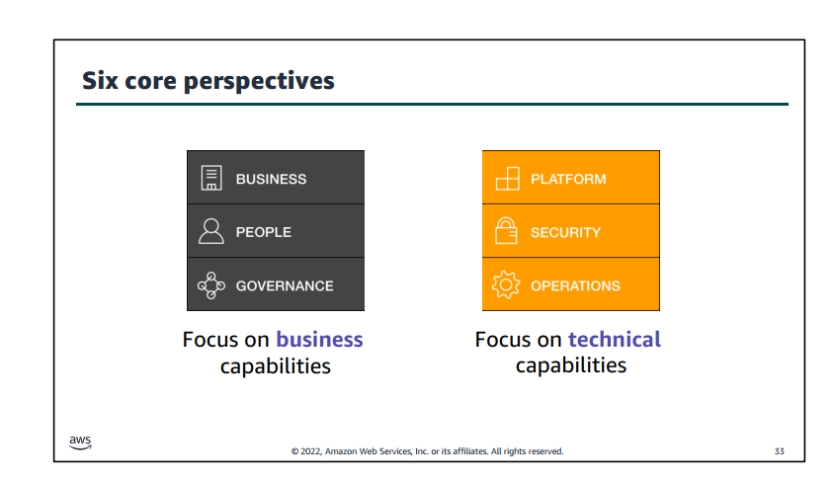

Slide 8
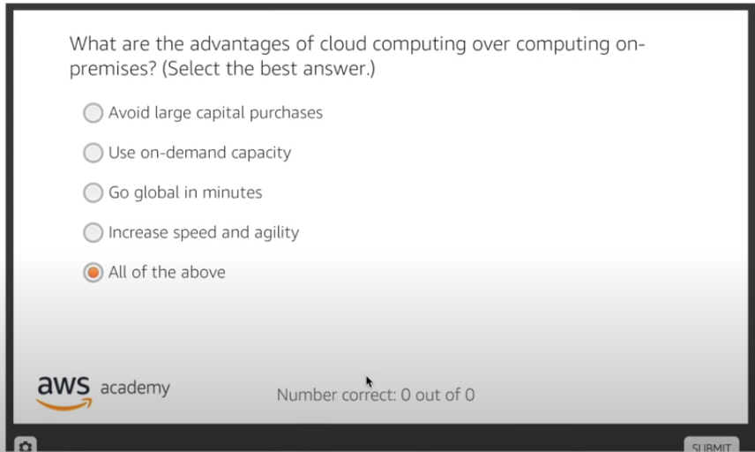
AWS Knowledge Checks

Slide 9
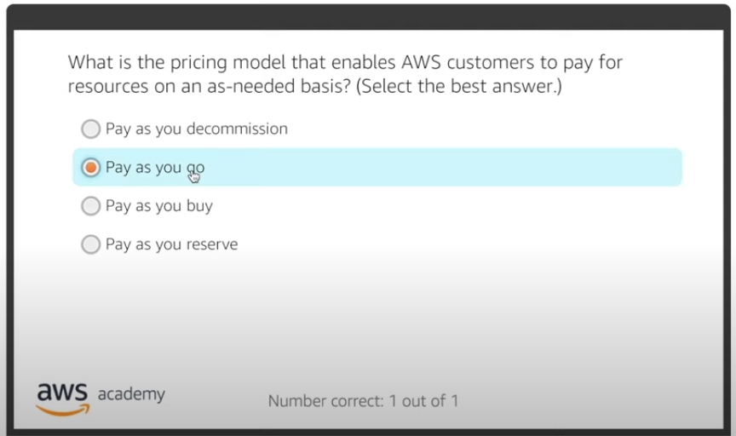

Slide 10
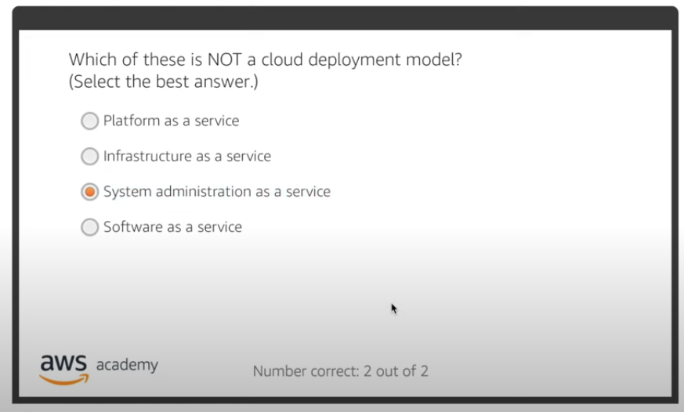

Slide 11
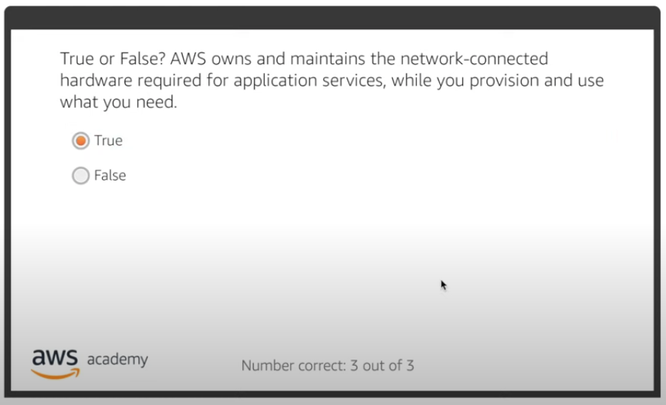

Slide 12
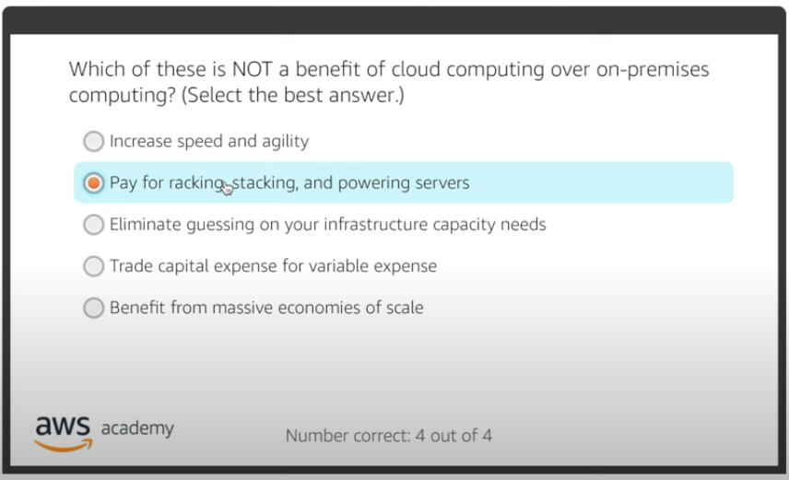

Slide 13
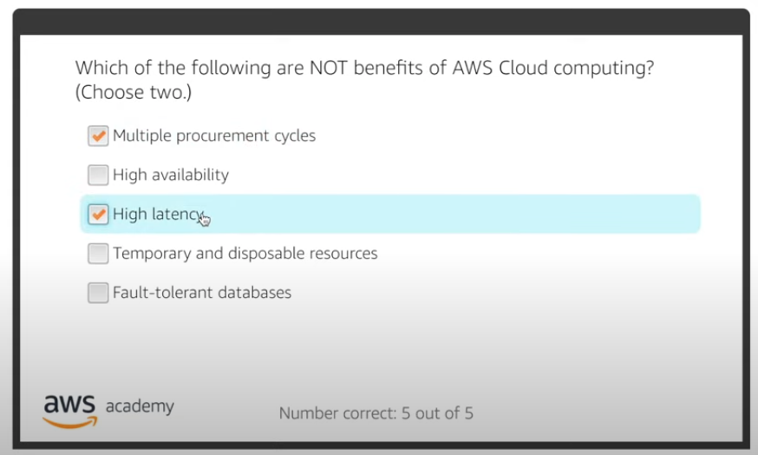

Slide 14
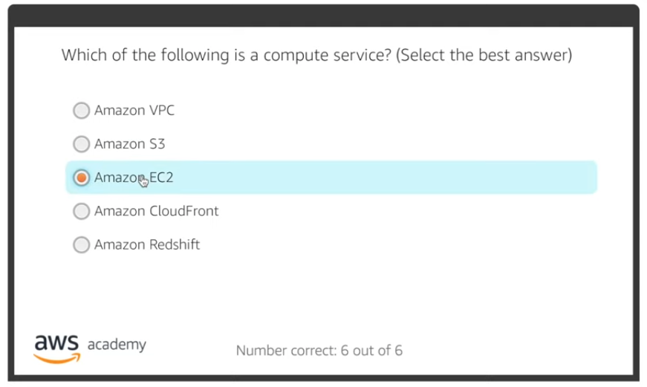

Slide 15
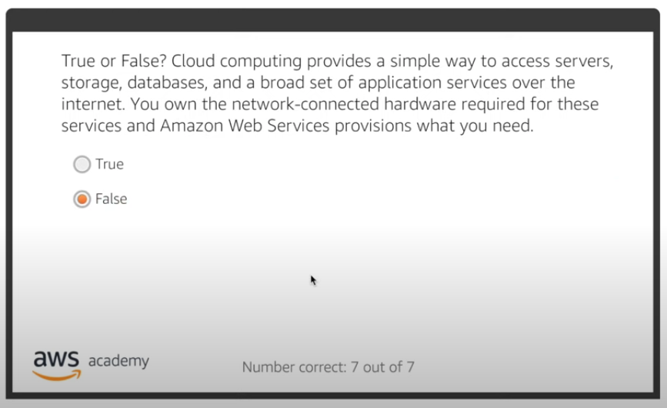

Slide 16
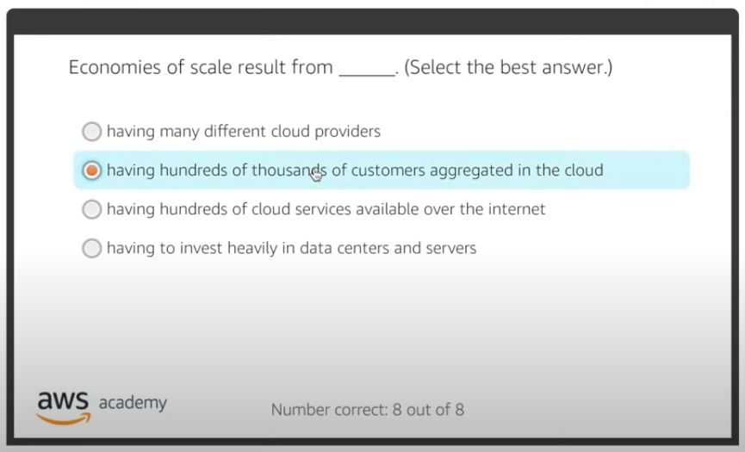

Slide 17
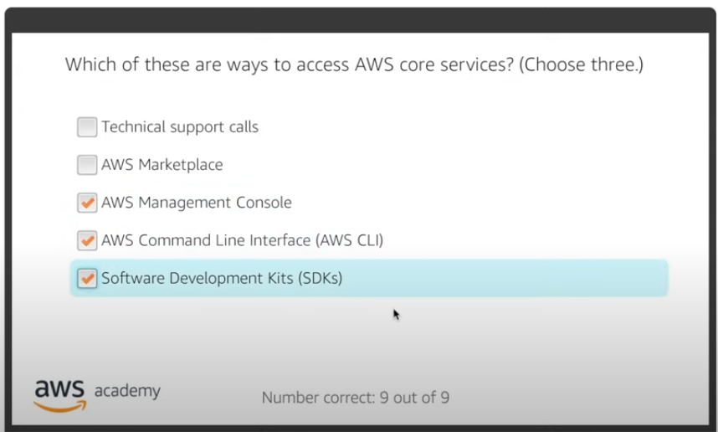

Slide 18
Rest is here
https://www.youtube.com/playlist?list=PLAMhkzmvYCLMDZVFXJKheoeyKgIeKd4j5

Slide 19
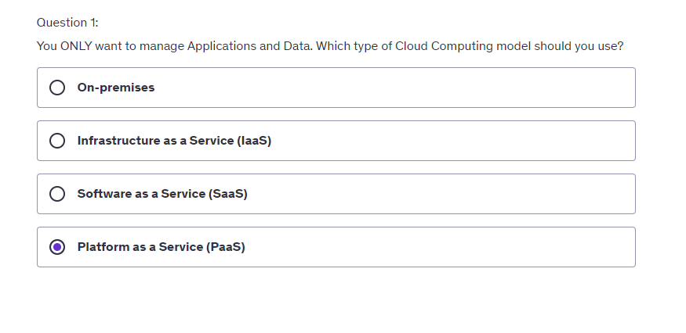
Udemy intro part

Slide 20
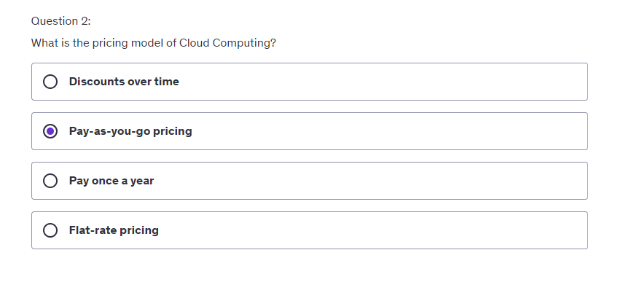

Slide 21
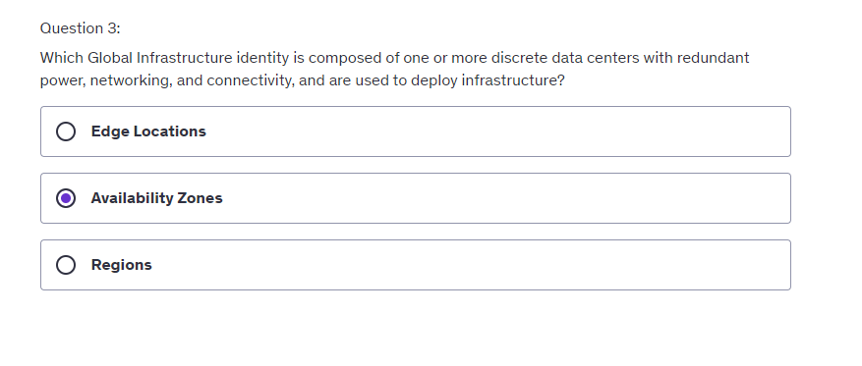

Slide 22
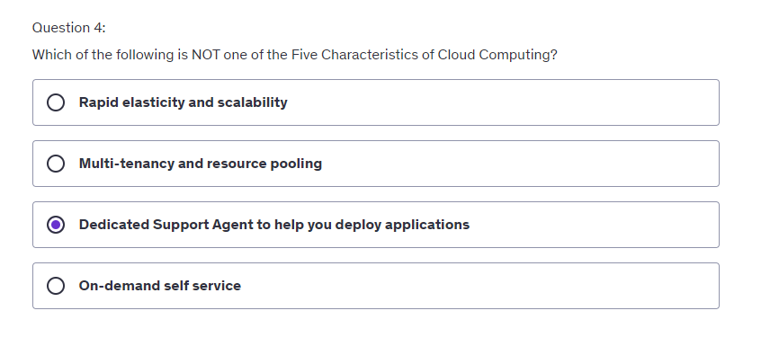
This is not one of the Five Characteristics of Cloud Computing. In the cloud, everything is self-service.

Slide 23
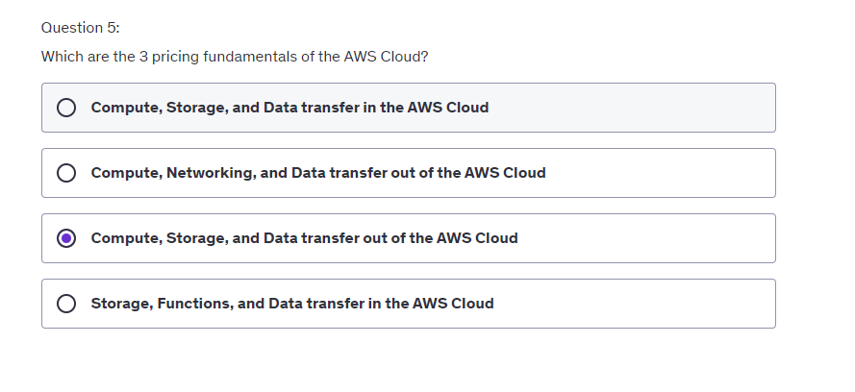

Slide 24
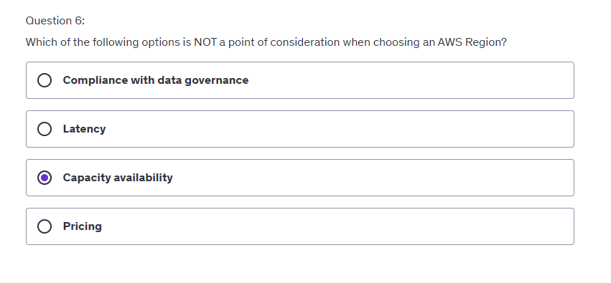

Slide 25
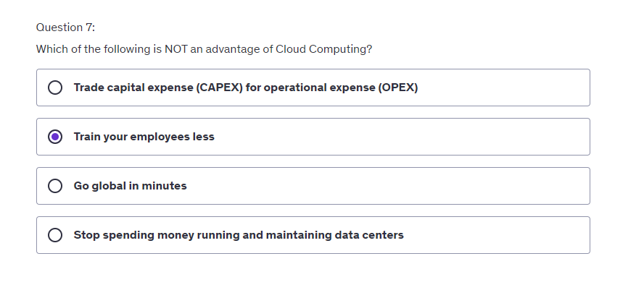

Slide 26
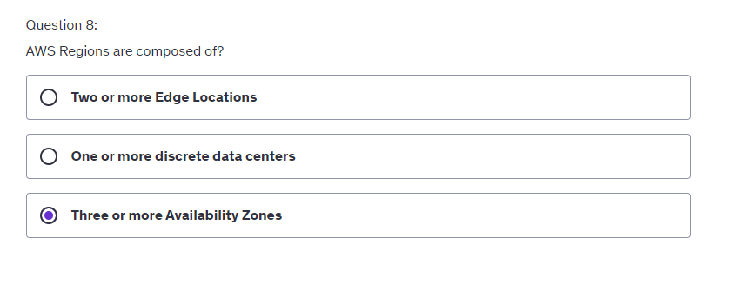
AWS Regions consist of multiple, isolated, and physically separate Availability Zones within a geographic area.

Slide 27
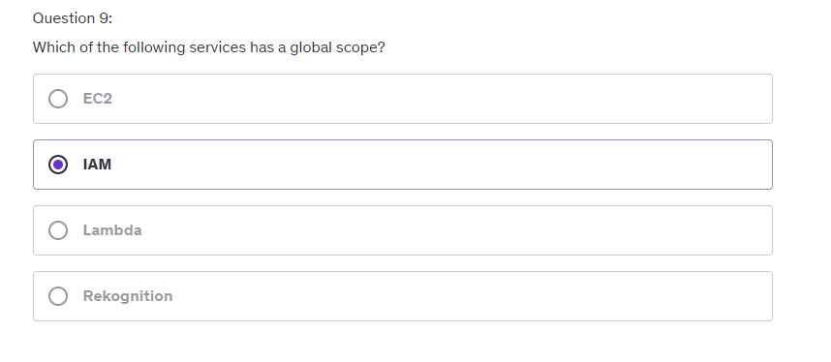

Slide 28
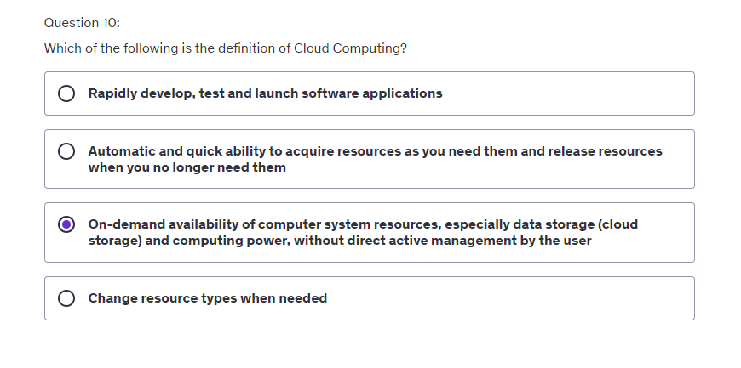

Slide 29
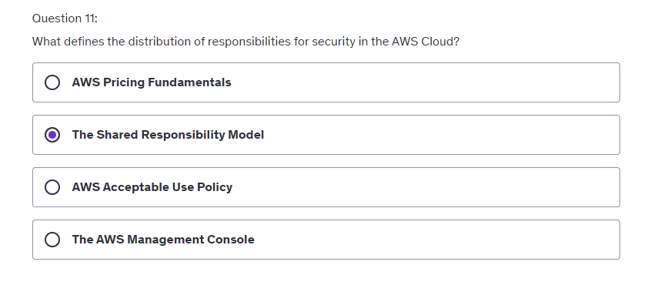

Slide 30
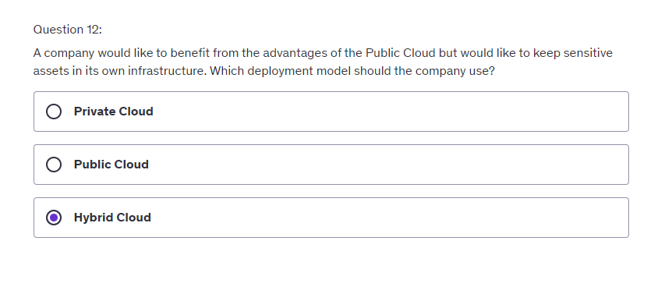

Slide 31
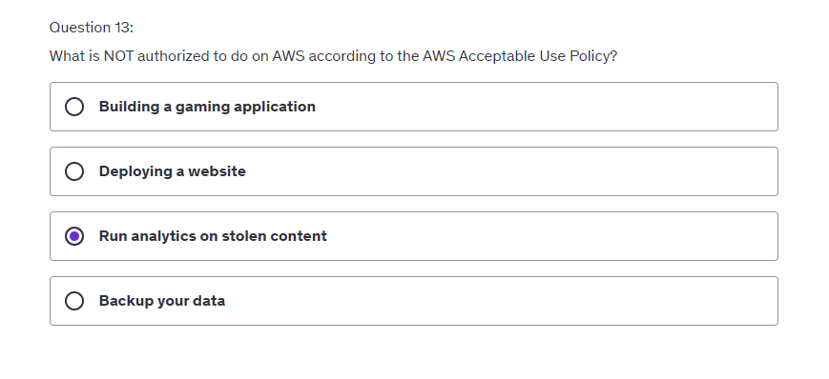
You can run analytics on AWS, but you cannot run analytics on fraudulent content. Refer to the AWS Acceptable Use Policy to see what is not authorized to do on AWS.

Slide 32
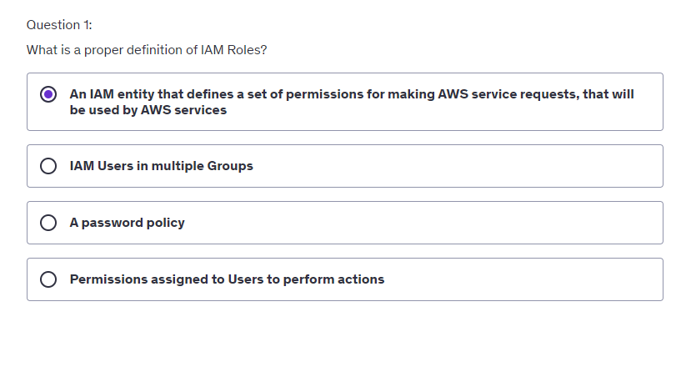
Udemy Iam part
Some AWS service will need to perform actions on your behalf. To do so, you assign permissions to AWS services with IAM Roles.

Slide 33
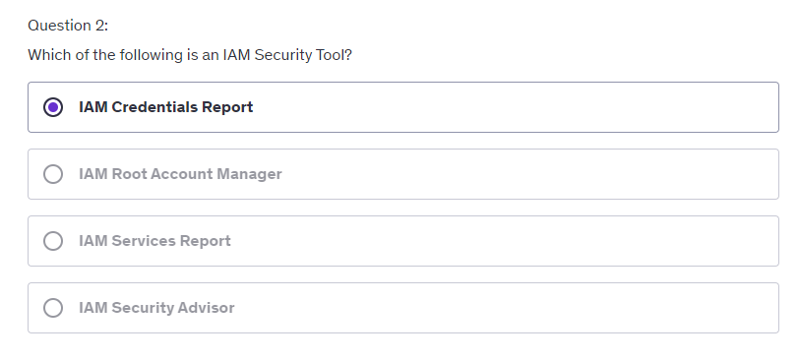
IAM Credentials report lists all your account's users and the status of their various credentials. The other IAM Security Tool is IAM Access Advisor. It shows the service permissions granted to a user and when those services were last accessed.

Slide 34
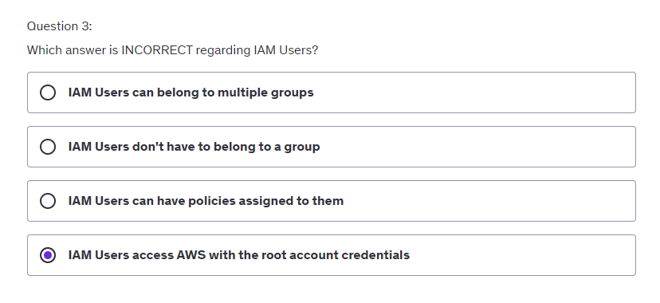

Slide 35
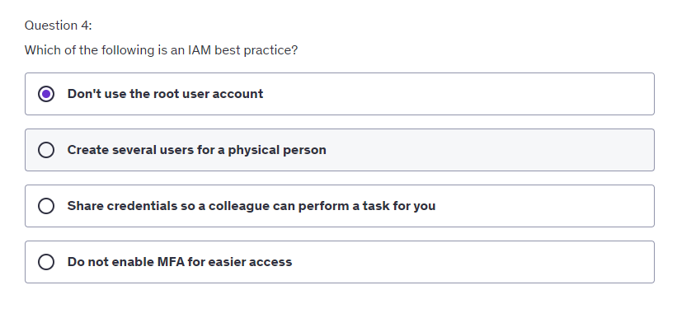

Slide 36
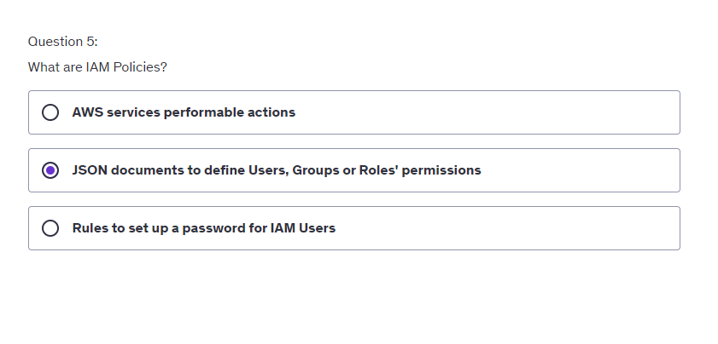
An IAM policy is an entity that, when attached to an identity or resource, defines their permissions.

Slide 37
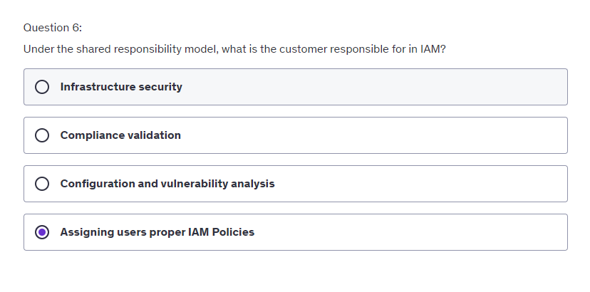

Slide 38
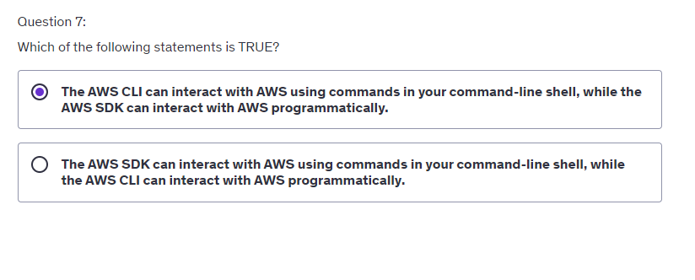

Slide 39
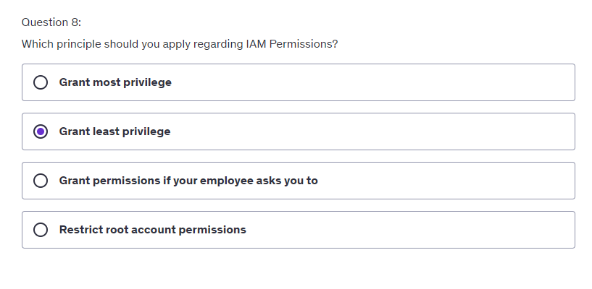

Slide 40
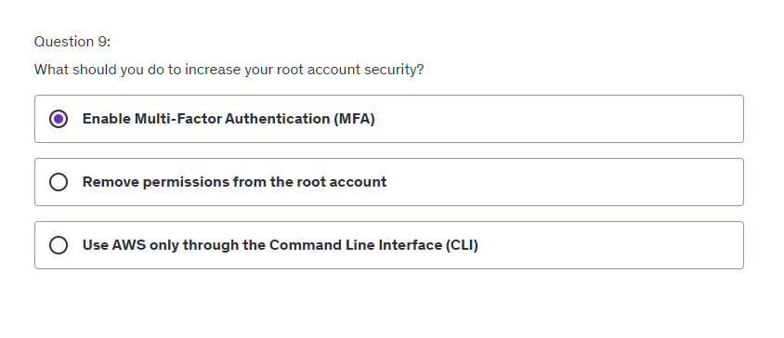

Slide 42
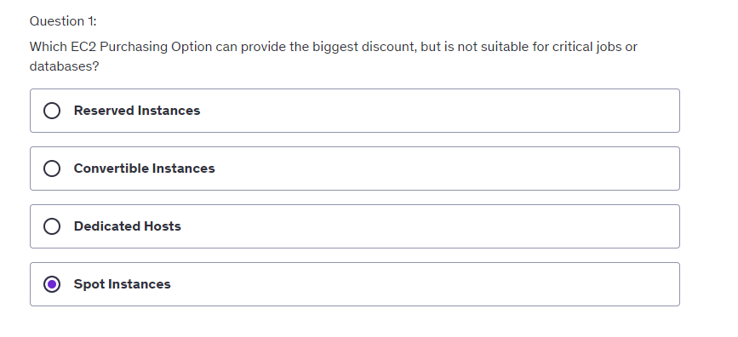
EC2 Udemy Questions
Spot Instances are good for short workloads, but are less reliable.

Slide 43
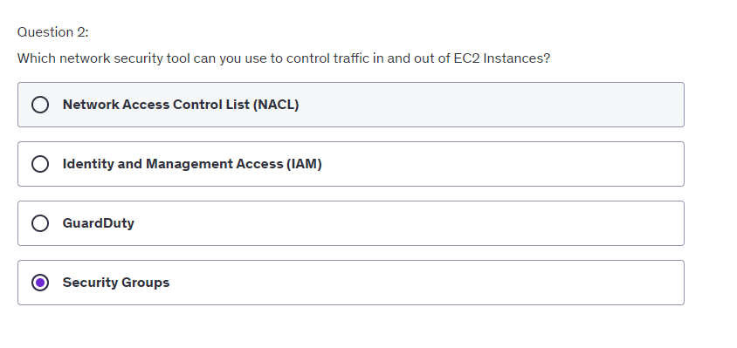

Slide 44
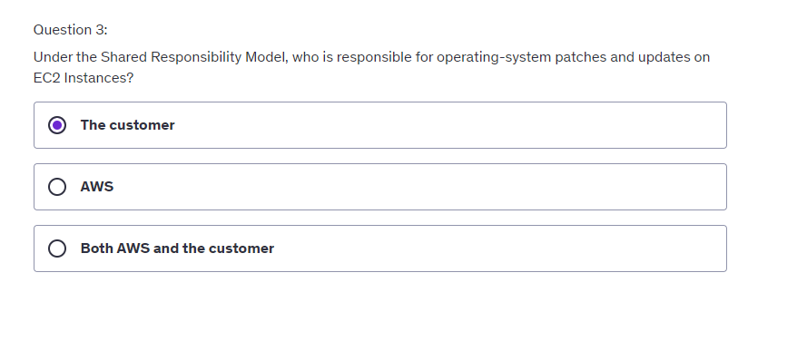
The customer is responsible for operating-system patches and updates on EC2 Instances, as well as data security on the instances, Security Groups rules, etc.

Slide 45
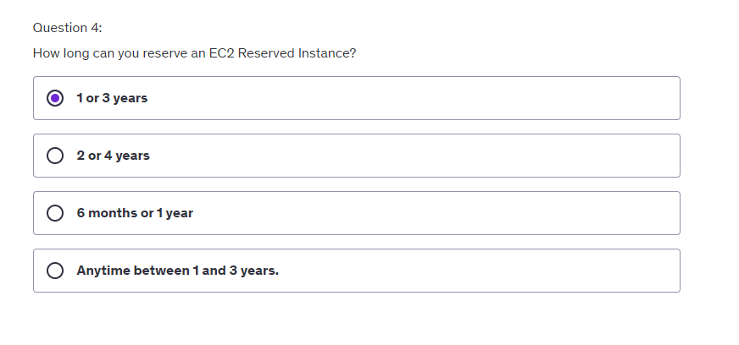
1 year or 3 years terms are available for EC2 Reserved Instances.

Slide 46
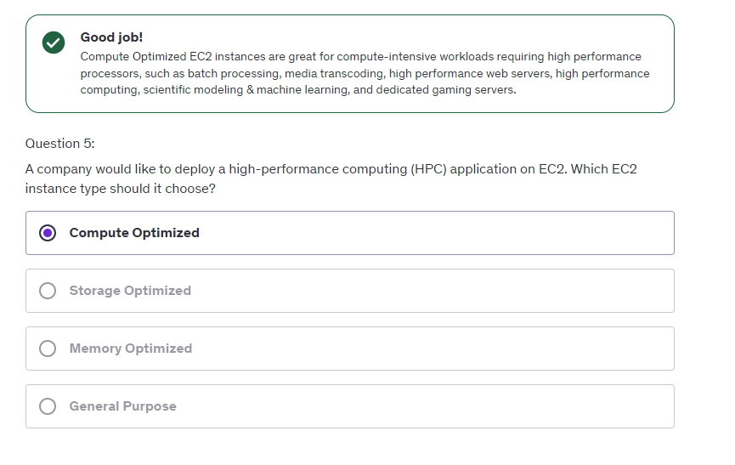

Slide 47
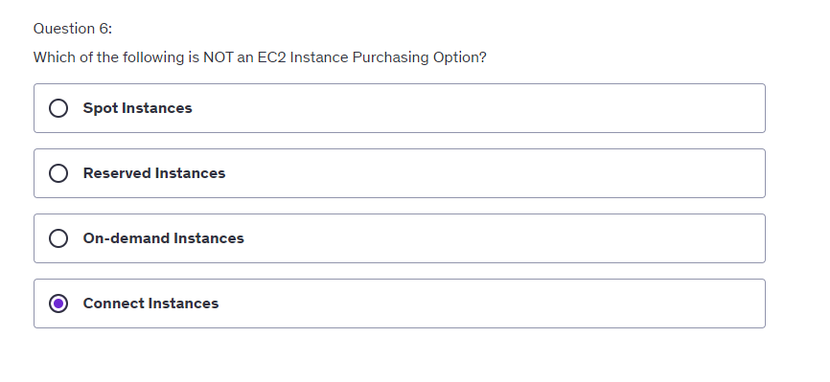

Slide 48
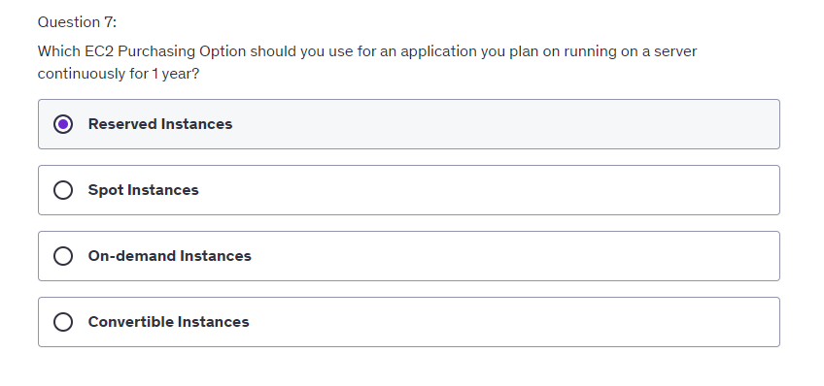
Reserved Instances are good for long workloads. You can reserve instances for 1 or 3 years.

Slide 50
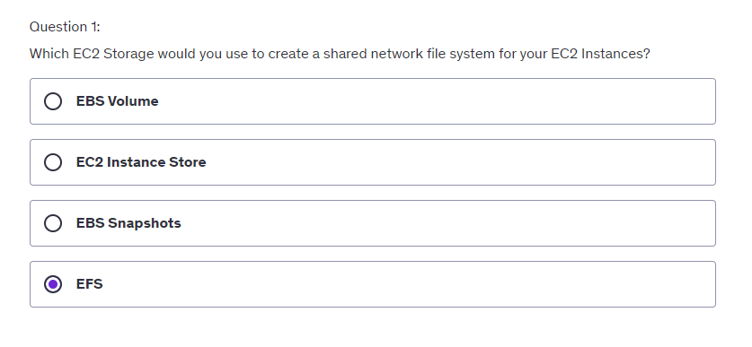
Udemy Ec2 isnatance
Amazon EFS is a fully managed service that makes it easy to set up, scale, and cost-optimize file storage in the Amazon Cloud.

Slide 51
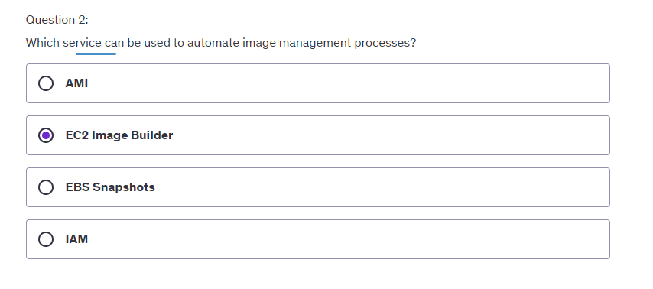

Slide 52
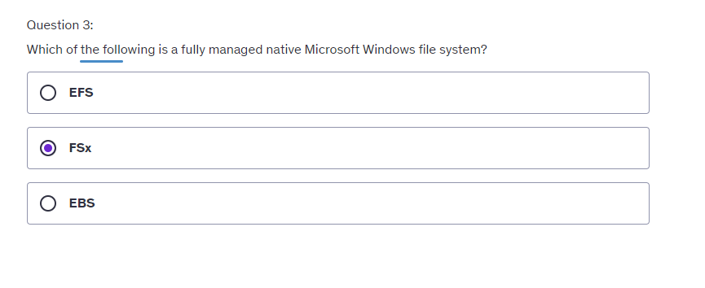
Amazon FSx makes it easy and cost effective to launch and run popular file systems that are fully managed by AWS. It comes in two offerings: FSx for Windows File Server (used for business applications), and FSx for Lustre (used for high-performance computing).

Slide 53
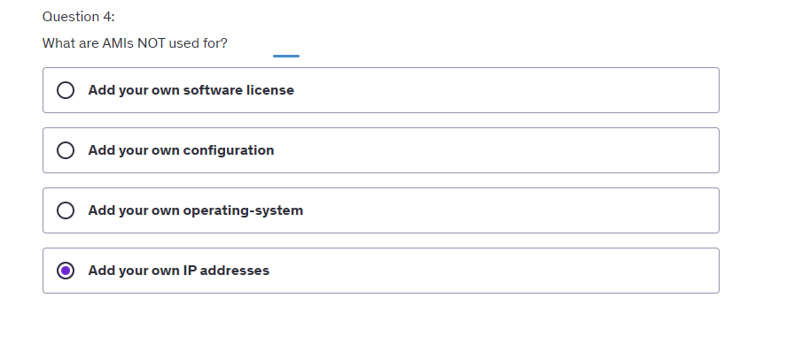

Slide 54
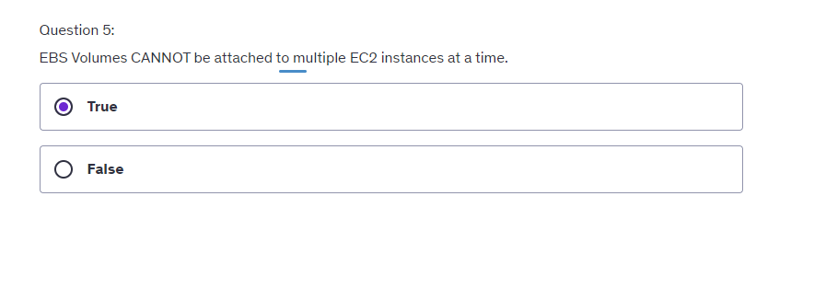

Slide 55
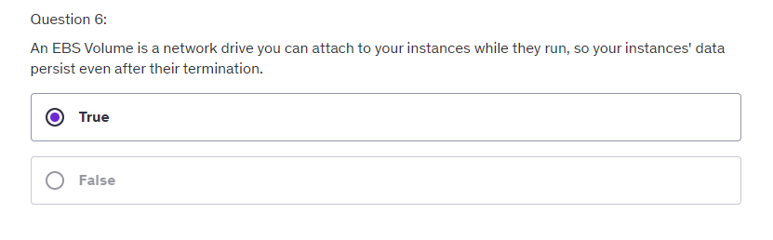

Slide 56
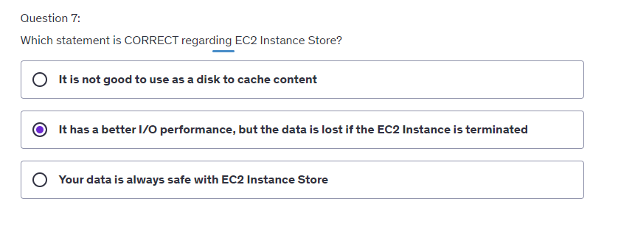

Slide 57
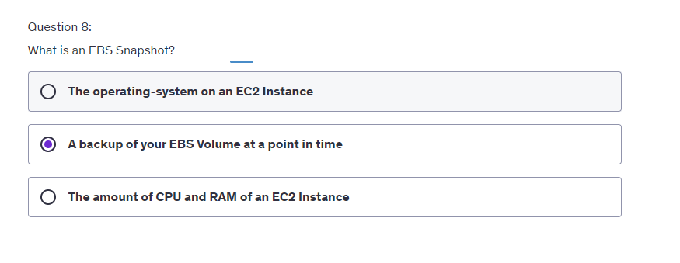

Slide 58
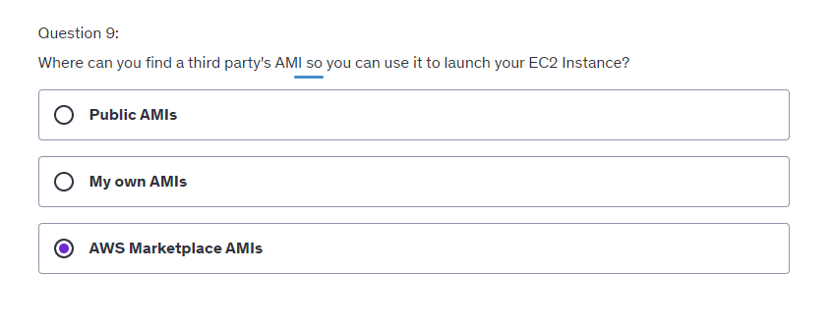

Slide 59


Slide 61

Udemy elb & asp questions
High Availability means applications running at least in two AZs to survive a data center loss.

Slide 62


Slide 63


Slide 64


Slide 65


Slide 66


Slide 67


Slide 68


Slide 69


Slide 71

Udemy Amazon s3 questions

Slide 72


Slide 73


Slide 74


Slide 75


Slide 76


Slide 77


Slide 78

Notes:
Amazon S3 Standard-Infrequent Access allow you to store infrequently accessed data, with rapid access when needed, has a high durability, and is stored in several Availability Zones to avoid data loss in case of a disaster. It can be used to store data for disaster recovery, backups, etc.

Slide 79


Slide 81

Udemy databases & analyses Summary

Slide 82


Slide 83


Slide 84


Slide 85


Slide 86


Slide 87


Slide 88


Slide 89


Slide 90


Slide 91


Slide 92


Slide 93


Slide 94


Slide 95


Slide 96


Slide 97

Udemy – Other compute services

Slide 98


Slide 99


Slide 100


Slide 101

"Event-driven" in Lambda means that functions are invoked when needed. They are triggered.

Slide 102


Slide 103


Slide 104


Slide 105

Notes:
AWS Batch enables developers, scientists, and engineers to easily and efficiently run hundreds of thousands of batch computing jobs on AWS. AWS Batch dynamically provisions the optimal quantity and type of compute resources (e.g., CPU or memory-optimized instances) based on the volume and specific resource requirements of the batch jobs submitted.

Slide 106


Slide 107


Slide 109

Udemy ECS, Lamda , ..Questions

Slide 110


Slide 111


Slide 112


Slide 113


Slide 114


Slide 115


Slide 116


Slide 117


Slide 118


Slide 119


Slide 121

Udemy global infrastructure questions

Slide 122


Slide 123


Slide 124


Slide 125


Slide 126


Slide 127


Slide 128

You can use AWS WAF web access control lists (web ACLs) to help minimize the effects of a distributed denial of service (DDoS) attack. For additional protection against DDoS attacks, AWS also provides AWS Shield Standard and AWS Shield Advanced.

Slide 130

Udemy cloud integration questions

Slide 131

Amazon Simple Notification Service (SNS) is a highly available, durable, secure, fully managed pub/sub messaging service that enables you to decouple microservices, distributed systems, and serverless applications. It uses a push-based system.

Slide 132


Slide 133

When using SQS or SNS, you apply the "decouple your applications” principle. This means that IT systems should be designed in a way that reduces interdependencies—a change or a failure in one component should not cascade to other components.

Slide 134

Amazon Simple Queue Service (SQS) is a fully managed message queuing service that enables you to decouple and scale microservices, distributed systems, and serverless applications. It uses a pull-based system.

Slide 136

Udemy cloud monitoring questions

Slide 137


Slide 138


Slide 139


Slide 140


Slide 141


Slide 142


Slide 143


Slide 144

Udemy VPC & Networking Quiz

Slide 145


Slide 146


Slide 147


Slide 148


Slide 149



Slide 150


Slide 151


Slide 152

Udemy Security & Compliance Questions

Slide 153



Slide 154


Slide 155


Slide 156


Slide 157


Slide 158



Slide 159


Slide 160


Slide 161


Slide 162


Slide 163


Slide 164


Slide 165


Slide 166


Slide 167


Slide 168


Slide 169


Slide 170

Udemy Account Management, Billing & Support Quiz
Service control policies (SCPs) are a type of organization policy that you can use to manage permissions in your organization. An SCP spans all IAM users, groups, and roles, including the AWS account root user. This was discussed in Lecture 215: Organizations Overview

Slide 171


Slide 172


Slide 173


Slide 174


Slide 175


Slide 176


Slide 177


Slide 178


Slide 179


Slide 180


Slide 181


Slide 182


Slide 183


Slide 184


Slide 185


Slide 186


Slide 187


Slide 188


Slide 190

Udemy Advanced Identity Quiz

Slide 191


Slide 192


Slide 193


Slide 194

Udemy Machine Learning Quiz

Slide 196


Slide 197


Slide 198


Slide 199


Slide 200


Slide 201


Slide 202


Slide 203


Slide 204


Slide 205

Udemy other services qiuz

Slide 206


Slide 207


Slide 208


Slide 209


Slide 210

Udemy AWS Architecting & Ecosystem Quiz

Slide 211


Slide 212


Slide 213


Slide 214


Slide 215


Slide 216


Slide 217


