Slide 1
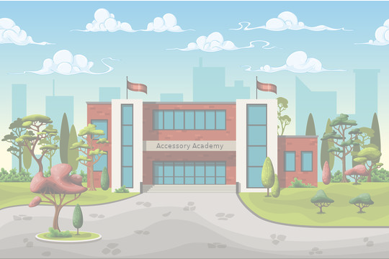

Lights 01-Tuff-Daze

Slide 2




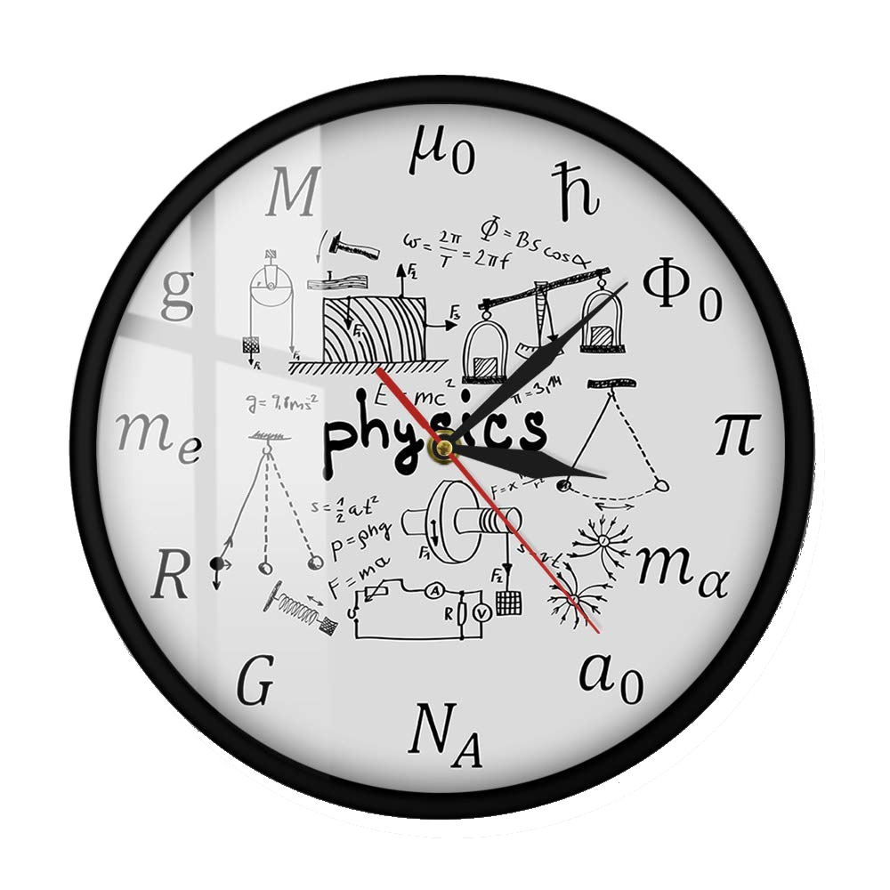

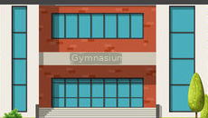
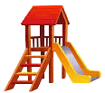
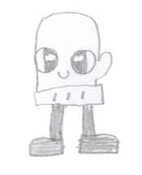
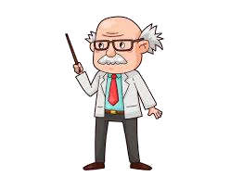
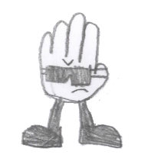


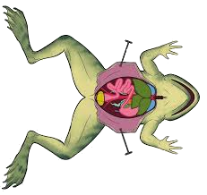
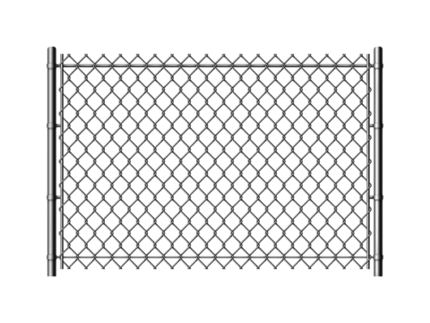

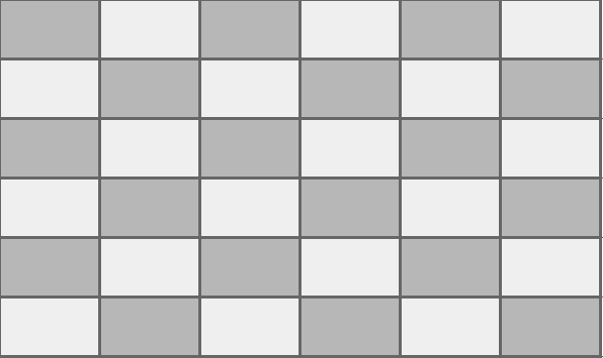

On the playground Glove searches for the final item…
…while in science, Mitten seizes an opportunity
Class & Homework
1. Frog dissections must be completed today
2. Read pages 112 - 118
Hmph! All clues led me here, where is it?
This is
gonna go viral!
Mitten, you know the rules, no selfies with the frog, to the office!
Notes:
Split screen left side for Glove,right for Mitten
Use something like a lightning bolt to split the screen
Glove
Playground scene
Should look like there is an active investigation for clues
Not happy, no luck finding clues
Should say something like “hmmph”
Mitten
Science room backdrop
Selfie with dissected frog
Teacher in the back ground pointing to the door, “To the office”.
Should have thought bubble, my social is going to buzz

Slide 3




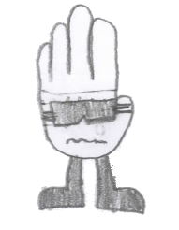

Later…
EDUCATION IS FUNDAMENTAL
WELCOME TO ACCESSORY ACADEMY
Mitten, again?
Yep, again!
Ugh! Mitten, not again…
OFFICE
School Dance
Tonight
Notes:
Split screen -
Mitten in the office (selfie with the principal)
Glove waiting outside for Mitten?

Slide 5
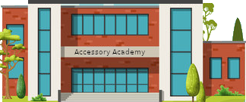

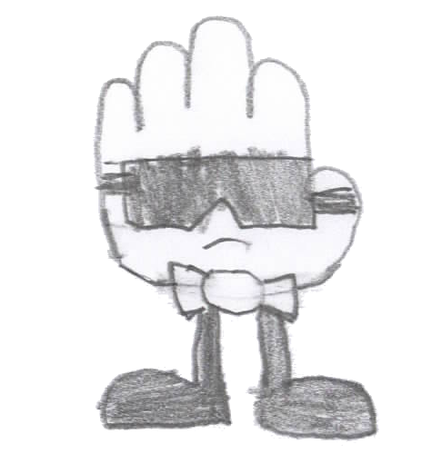
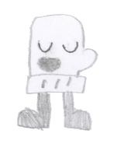
See you tonight at the dance?
Of course, when the “Mittenites” call, I must perform!
Notes:
Glove and Mitten outside the school discussing when and where to meet for the school dance

