Slide 1
Introduction to Databases

Slide 2
Topics List
Database overview
Relational database concepts
Non-relational database concepts

Slide 3
Database Overview
Database is a large collection of related data.
Classically, a database models a real-world organisation (e.g. enterprise, university).
Entities/objects of interest (e.g. students, courses).
Relationships (e.g. “Martin is taking IDS in 2024/25”).
Changes in the organisation results in changes in the database.

Slide 4
Database Overview
A Database Management System (DBMS) is software that enables efficient storage, organisation, and retrieval of data.
Collection of interrelated data (database).
Set of programs to access the data.
An environment that is both convenient and efficient to use.

Slide 5
Database Overview
Database Applications:
Banking: transactions.
Airlines: reservations, schedules.
Universities: registration, grades.
Sales: customers, products, purchases.
Online retailers: order tracking, customized recommendations.
Manufacturing: production, inventory, orders, supply chain.
Human resources: employee records, salaries, tax deductions.

Slide 6
Database Overview
Database Application examples:
Add new students, instructors, and courses.
Register students for courses and generate class rosters.
Assign grades to students, compute grade point averages (GPA) and generate transcripts.

Slide 7
Operations with Databases
Design
Define structure and types of data.
Construction
Create data structures for the database, populate database with data.
Manipulation of Data
Insert, delete, update.
Query: “Which department pays the highest salary?”
Create reports:
“List monthly salaries of employees, organised by department, with average salary and total sum of salaries for each department”.

Slide 8
Evolution from File-Based Systems
File-based system:
Collection of application programs that perform services for the end users (e.g. reports).
Each program defines and manages its own data.

Slide 9
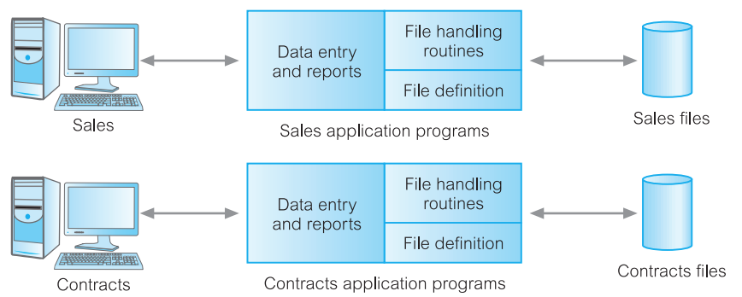
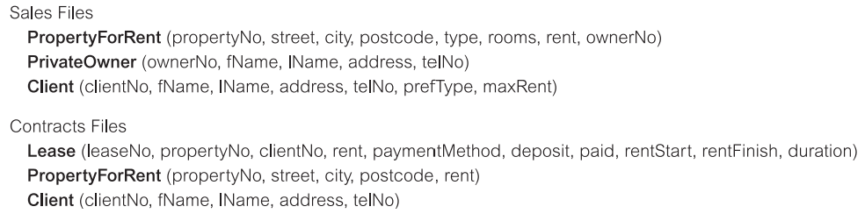
File-Based Processing

Slide 10
Limitations of File-Based Approach
Separation and isolation of data
Each program maintains its own set of data.
Users of one program may be unaware of potentially useful data held by other programs.
Duplication of data
Same data is held by different programs.
Wasted space and potentially different values and/or different formats for the same item.

Slide 11
Limitations of File-Based Approach
Data dependence
File structure is defined in the program code.
Incompatible file formats
Programs are written in different languages, and so cannot easily access each other’s files.
Fixed Queries/Proliferation of application programs
Programs are written to satisfy particular functions.
Any new requirement needs a new program.

Slide 12
Database: definition
Shared collection of logically related data (and a description of this data), designed to meet the information needs of an organisation.
System catalog (metadata) provides description of data to enable program–data independence.
Logically related data comprises entities, attributes, and relationships of an organisation’s information.

Slide 13
Database Approach
Arose because:
Definition of data was embedded in application programs, rather than being stored separately and independently.
No control over access and manipulation of data beyond that imposed by application programs.
Result:
the Database and Database Management System (DBMS).

Slide 14
Database Management System (DBMS)
A software system that enables users to define, create, maintain, and control access to the database.
(Database) application program: a computer program that interacts with database by issuing an appropriate request (e.g. SQL statement) to the DBMS.

Slide 15
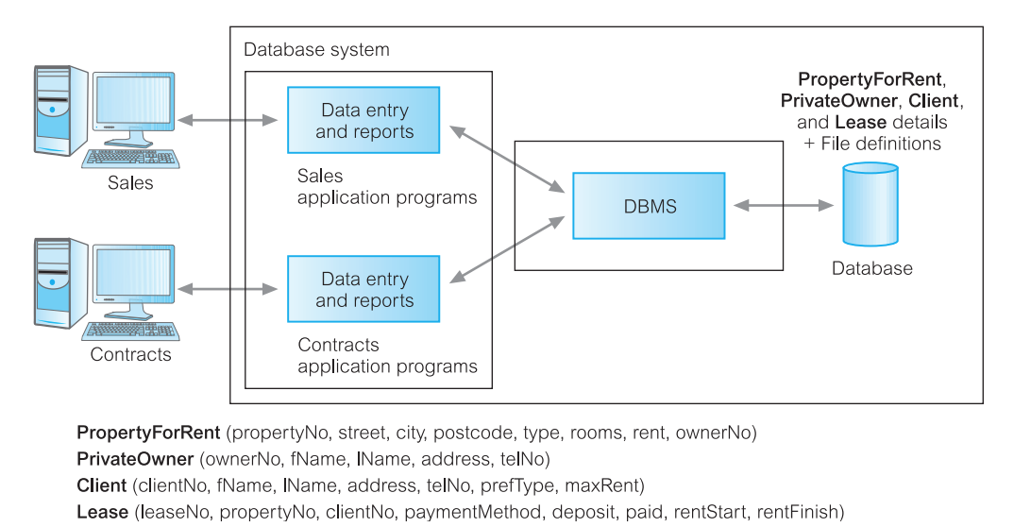
Database Management System (DBMS)

Slide 16
Topics List
Database overview
Relational database concepts
Non-relational database concepts

Slide 17
Relational database concepts
Conceptual design.
Logical design.
Physical design.
Normalisation.
Database administration.

Slide 18
Relational database terminology
DBMS.
Database.
Table (aka Entity or Relation).
Attribute (aka Field or Column).
Record (aka Tuple or Row).
Key (can be primary key or foreign key).
Relationship.

Slide 19
Conceptual design
The process of constructing a model of the data used in an enterprise, independent of all physical considerations.
The goal of this phase is to produce a conceptual schema (which includes identification of the important entity types, relationship types, and attributes) for the database that is independent of a specific DBMS.

Slide 20
Logical design
The purpose of logical design is to translate the conceptual representation to the logical structure of the database, which includes designing the relations.
Logical design is a semi-physical realisation of the concepts. We say semi-physical because we are really not concerned with the actual physical file that is stored in memory; rather, we are concerned with placing data into relational tables that we will visualise as a physical organisation of data.

Slide 21
Physical design
Logical database design is concerned with the what, physical database design is concerned with the how.
Process of producing a description of the implementation of the database on secondary storage.
It describes the base relations, file organisations, and indexes used to achieve efficient access to the data, and any associated integrity constraints and security measures.

Slide 22
Normalisation
Database normalisation is another technique used when organising the data in the database.
Normalisation is a systematic approach of decomposing tables to eliminate data redundancy(unnecessary repetition).

Slide 23
Database Administration
Topics include:
Security measures.
Database backup and recovery.
Managing concurrent users.
Distributed systems.

Slide 24
Topics List
Database overview
Relational database concepts
Non-relational database concepts

Slide 25
Relational vs. non-relational
Relational databases have a clearly defined structure (schema); when creating a relational database you create the structures for entities, attributes, relationships, etc before ever storing a piece of data.
Non-relational databases are schemaless, meaning you don’t have to define any structures in advance; just start storing data.
This works well for applications that run on clusters, for storing large amounts of data, or anywhere that more flexibility is required.

Slide 26
NoSQL database concepts
Types of NoSQL (non-relational) databases.
CAP theorem (Consistency, Availability, and Partition Tolerance).
Non-relational modelling.

