Slide 1
The Relational Model

Slide 2
Topics List
Relational Model Terminology
Properties of Relations
Keys
Integrity Constraints

Slide 3
Relational Model Terminology
A relation is a table with columns and rows.
Only applies to logical structure of the database, not the physical structure.
Attribute is a named column of a relation.
Domain is the set of allowable values for one or more attributes.

Slide 4
Relational Model Terminology
Tuple is a row of a relation.
Degree is the number of attributes in a relation.
Cardinality is the number of tuples in a relation.
Relational Database is a collection of normalised relations with distinct relation names.

Slide 5
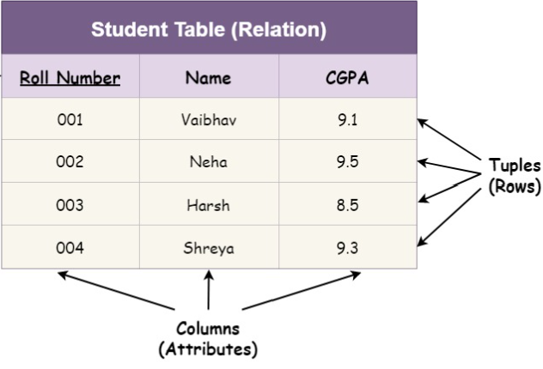
Relational Model Terminology

Slide 6
Topics List
Relational Model Terminology
Properties of Relations
Keys
Integrity Constraints

Slide 7
Properties of Relations
Relation name is distinct from all other relation names in relational schema.
Each cell of relation contains exactly one atomic (single) value.
Each attribute has a distinct name.
Values of an attribute are all from the same domain.

Slide 8
Properties of Relations
Each tuple is distinct; there are no duplicate tuples.
Order of attributes has no significance.
Order of tuples has no significance, theoretically.

Slide 9
Topics List
Relational Model Terminology
Properties of Relations
Keys
Integrity Constraints

Slide 10
Keys
A database is used to store data for retrieval. An attribute that may be used to find a particular entity occurrence is called a key.
A key is an attribute or collection of attributes that uniquely identifies an entity occurrence.
For example, the staffNo value for each staff member makes him/her identifiable among staff.

Slide 11
Relational Keys
Candidate Key
Candidate keys are defined as the minimal set of fields which can uniquely identify each record/tuple in a table. There can be more than one candidate key.
Primary Key
Candidate key selected to identify records uniquely within a relation.
Alternate Keys
Candidate keys that are not selected to be primary key.
Foreign Key
Attribute, or set of attributes, within one relation that matches the primary key of another relation.

Slide 12
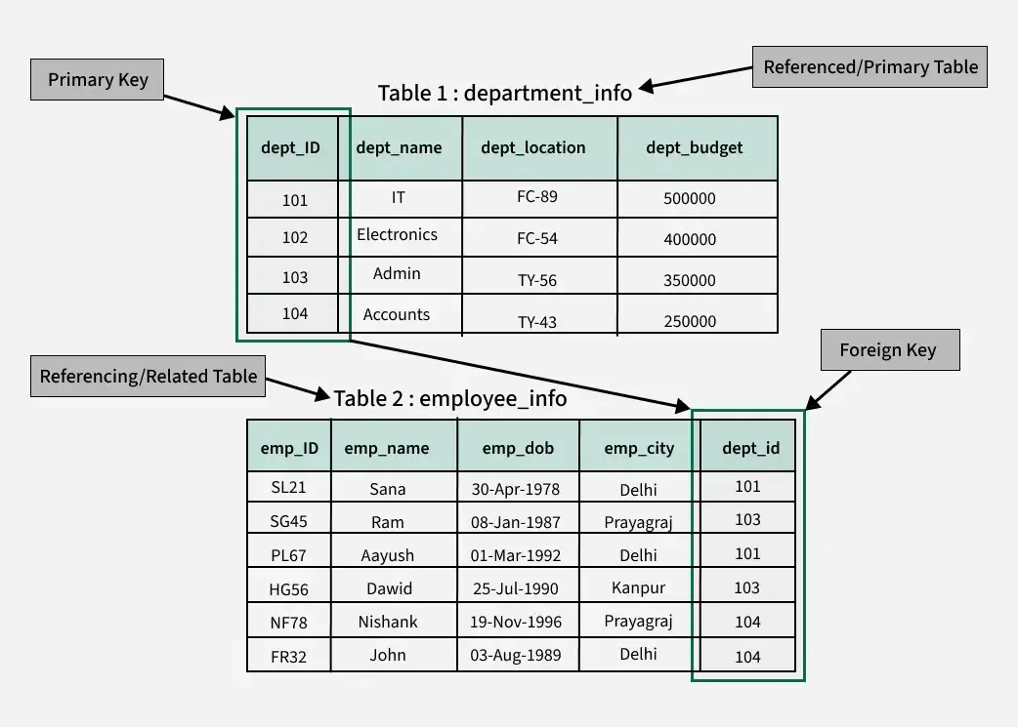
Relational Keys

Slide 13
Topics List
Relational Model Terminology
Properties of Relations
Relational Keys
Integrity Constraints

Slide 14
Integrity Constraints
Null
Represents value for an attribute that is currently unknown or not applicable for this tuple.
Deals with incomplete or exceptional data.
Represents the absence of a value and is not the same as zero or spaces, which are values.

Slide 15
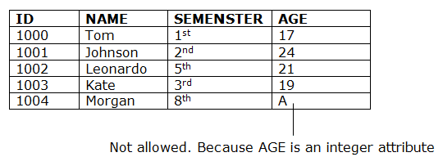
Integrity Constraints
Domain constraints
Domain constraints can be defined as the definition of a valid set of values for an attribute.
The data type of domain includes string, character, integer, time, date, currency, etc. The value of the attribute must be available in the corresponding domain

Slide 16
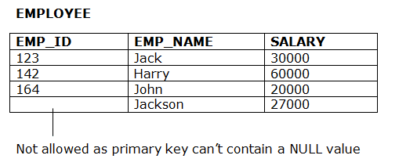
Integrity Constraints
Entity Integrity constraint
In a base relation, no attribute of a primary key can be null.
Primary key must also be unique.

Slide 17
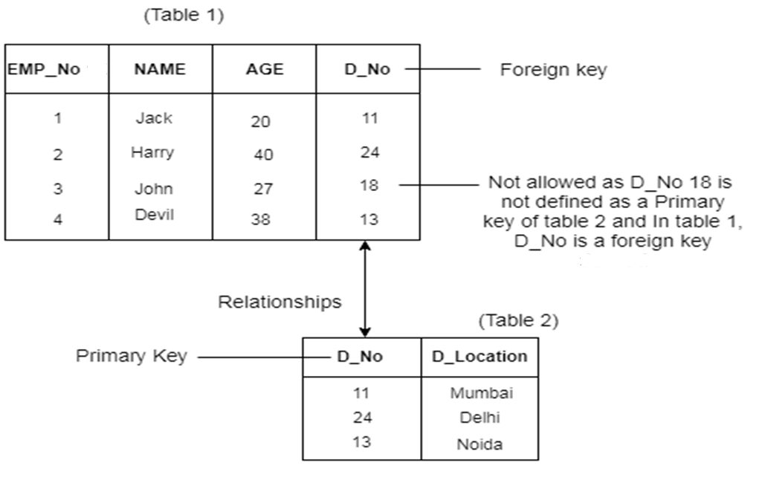
Integrity Constraints
Referential Integrity
If foreign key exists in a relation (Table 1), either the foreign key value must match the primary (or alternate) key value of some tuple in its home relation (Table 2) or the foreign key value must be wholly null.

Slide 18
Integrity Constraints
General Constraints
Additional rules specified by users or database administrators that define or constrain some aspect of the enterprise.
For Example: In the PropertyForRent table, type must be House, Flat or Apartment.

Slide 19
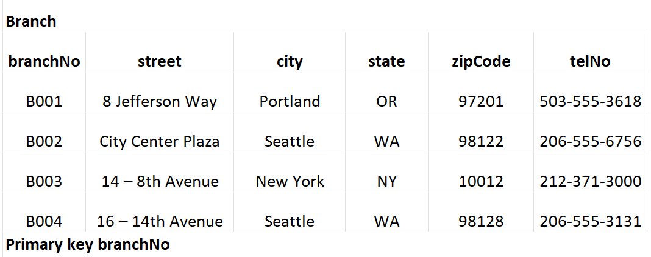
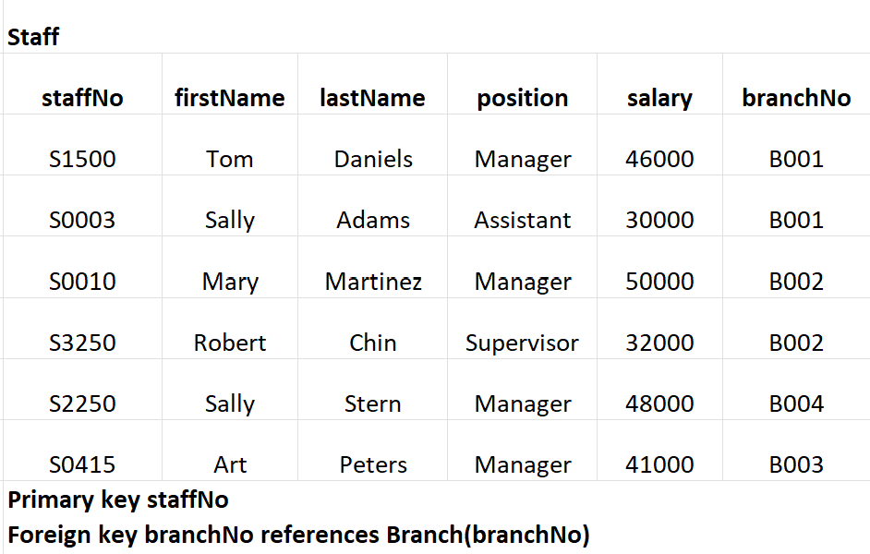
Sample Relations
These 2 relations adhere to the properties of a relation:
Relation names are distinct.
Each cell of each relation contains one value.
Each attribute has a distinct name.
Values of an attribute are all from the same domain (e.g. city column, position column).
Each tuple is distinct; there are no duplicate tuples because of the primary key.
These relations also adhere to the Entity and Referential Integrity constraints.

