Slide 1
Good and Bad Relations

Slide 2
Topics List
Good Relations versus Bad Relations
What’s so Bad about a Bad Relation?
How do we get a Good Relation?

Slide 3
Good Relations versus Bad Relations
A relation is good if it records data about one object of interest. A relation that is not good is bad.
In relational database design, we can attempt to build good relations. And, we can convert bad relations into good relations.
What is a relation “about”? The key to the answer is usually the Primary key.

Slide 4
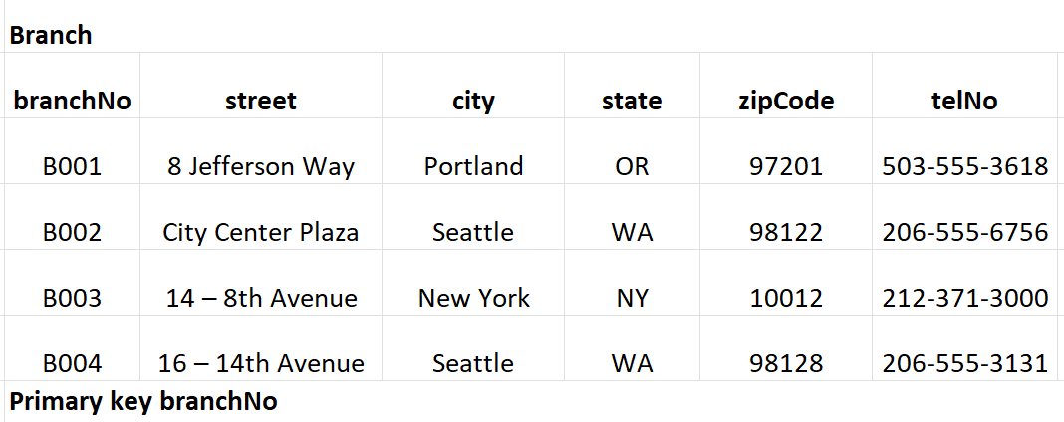
Good Relation Examples
The Branch relation is good because the key is branchNo, which identifies different branches, and each attribute (street, city, state, zipCode, and telNo) is a piece of information about each Branch.
From the relation, we can see that for each branch there is one branchNo value, one street value, one city value, one state value, one zipCode value, and one telNo value.

Slide 5
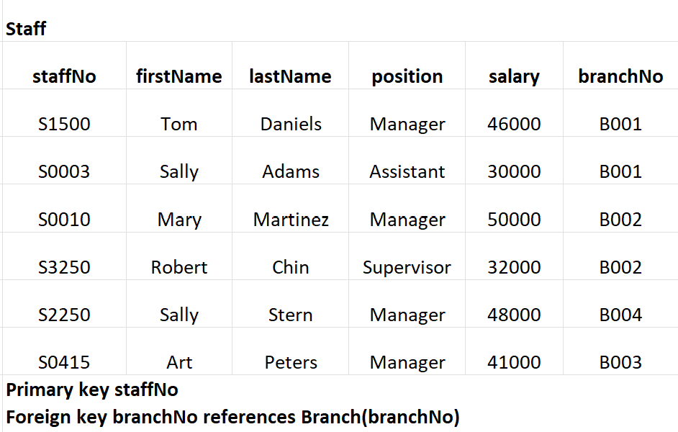
Good Relation Examples
Likewise, the Staff relation is good because the key is StaffNo, which identifies different Staff members, and each attribute (firstName, lastName, position, salary, and branchNo) is a piece of information about each Staff member.
We can see that for each staff member there is one staffNo value, one firstName value, one lastName value, one position value, one salary value, and one branchNo value.
The branchNo identifies the branch where each staff members works, and it is a branch from the Branch relation.

Slide 6
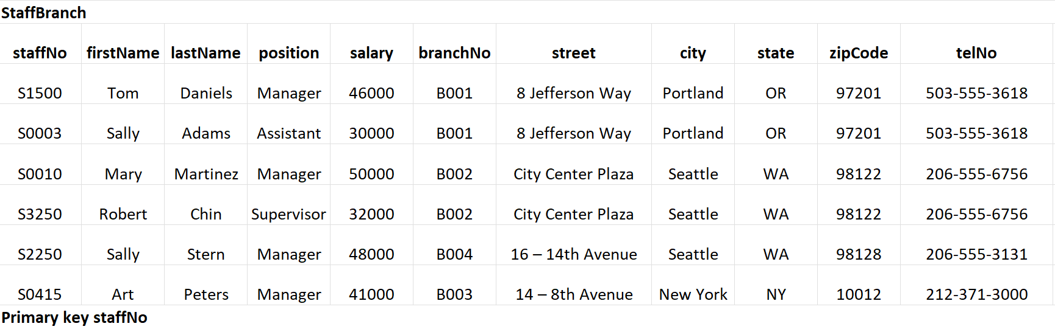
Bad Relation Examples
The key for this relation is staffNo, which infers that the relation is about staff members – which it is.
But the relation also contains attributes – branchAddress (street, city, state, zipCode) and telNo – that are not about Staff but about the branch where the staff is located!
So, this relation is bad and it needs to be converted into 2 relations as in the previous 2 slides.

Slide 7
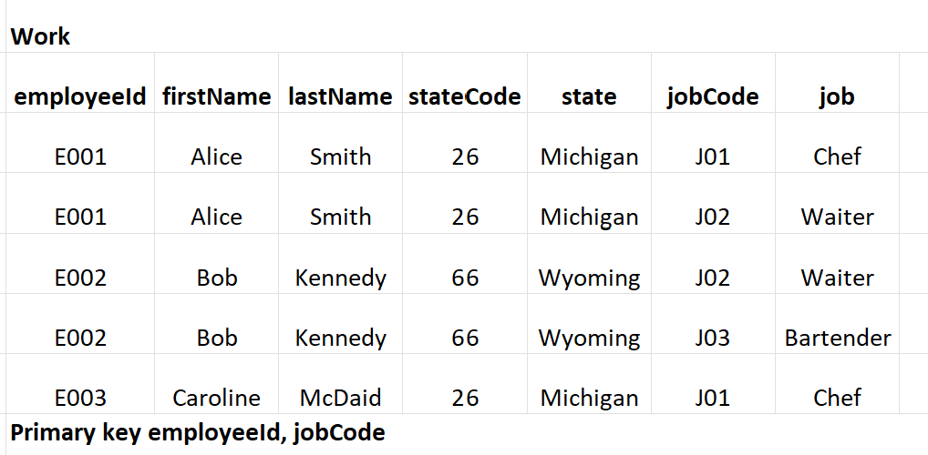
Bad Relation Examples
The key for this relation is employeeId, jobCode, which infers that the relation is about employees and the work they do – which it is.
But the relation also contains attributes – firstName, lastName, stateCode, and state, which are about employees only and each time an employee is assigned a job, those values are replicated!
Likewise, the relation also contains an attribute – job, which is about job assigned only and each time a job is assigned to an employee, this value is replicated also!
So, this relation is bad and it needs to be transformed.

Slide 8
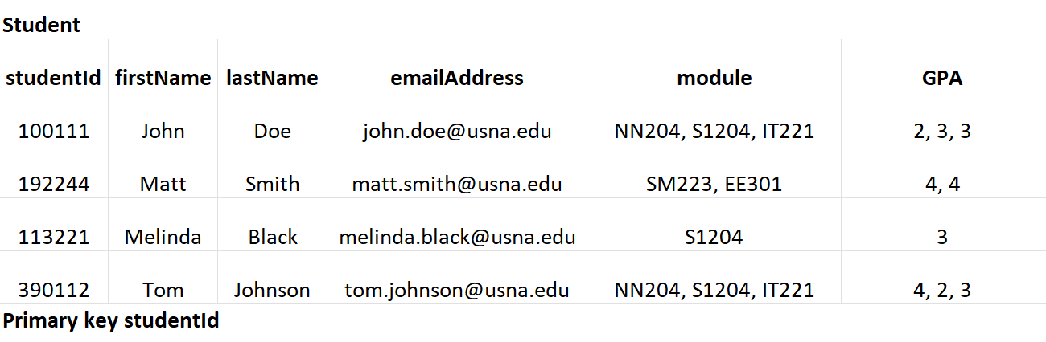
Bad Relation Examples
The key for this relation is StudentId, which infers that the relation is about Students – which it is.
But the relation does not conform to one of the rules for relations (Each cell of relation contains exactly one atomic (single) value) as the module and GPA columns hold multiple values instead of one single value.
So, this relation is bad and it needs to be transformed.
Note: If we design our relations properly, they are normally pretty good.

Slide 9
Topics List
Good Relations versus Bad Relations
What’s so Bad about a Bad Relation?
How do we get a Good Relation?

Slide 10
What’s so Bad about a Bad Relation?
We have already established that this relation is bad. So, what is so bad about a bad relation?
We will examine the reasons under the following three anomalies:
Insert
Update
Delete

Slide 11
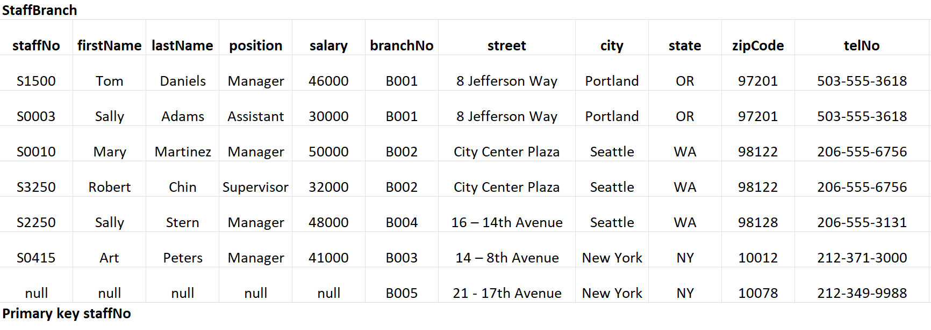
What’s so Bad about a Bad Relation?
Insert Anomaly:
We want to add a new branch B005 in New York but for now there are no employees working at the branch.
Since the primary key for the relation is staffNo, we cannot add a record until we have an employee working at the new branch (Entity Integrity)!
Not permitted

Slide 12
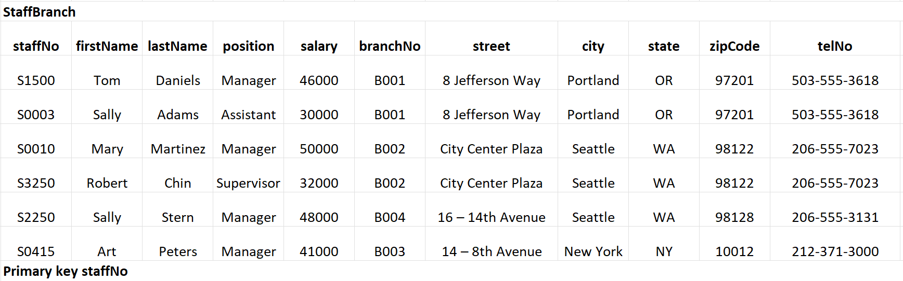
What’s so Bad about a Bad Relation?
Update Anomaly:
What happens if branch B002 changes its telNo from 206-555-6756 to 206-555-7023?
We must search every record/row and change every instance of 206-555-6756 to 206-555-7023 in records involving branch B002.
Multiple changes

Slide 13

What’s so Bad about a Bad Relation?
Update Anomaly:
This one change in the real world may make for many changes in the database.
What if we mess up and end up not making all changes?
Now, what is the telephone number for branch B002?
Two different telNo values

Slide 14
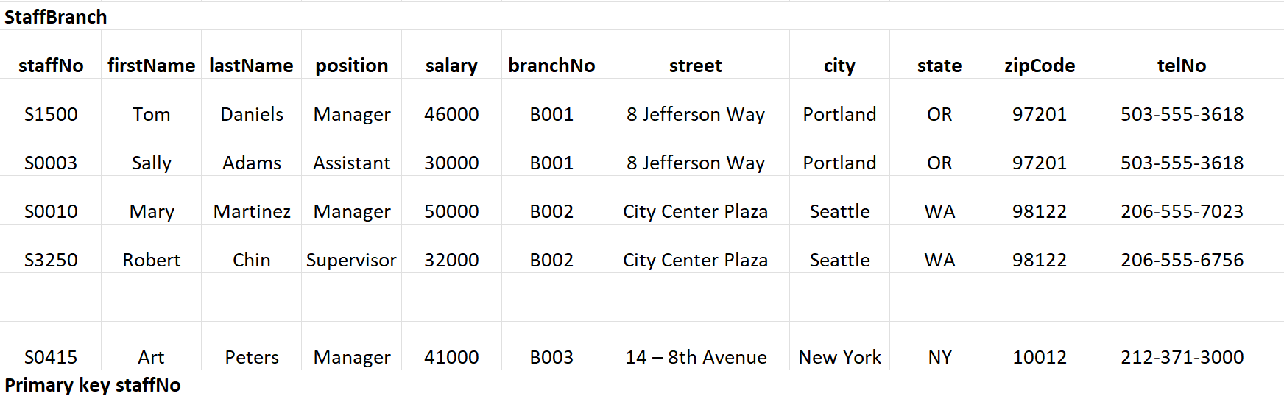
What’s so Bad about a Bad Relation?
Delete Anomaly:
What if staff member Sally Stern leaves the company and her record is deleted?
A consequence is that we lose all information about branch B004 also.

Slide 15
Topics List
Good Relations versus Bad Relations
What’s so Bad about a Bad Relation?
How do we get a Good Relation?

Slide 16
How do we get a Good Relation?
As previously stated in relational database design, we can attempt to build good relations and that is where we will go from here…
We also previously stated that we can convert bad relations into good relations and we will look at this later.

