Slide 1
Entities, Entity Types, and Attributes

Slide 2
Topics List
Concepts of the ER Model
Entities and Entity types
Attributes
Types of Attributes
Keys

Slide 3
Concepts of the ER Model
Entities and Entity types
Attributes
Relationships and Relationship types

Slide 4
Topics List
Concepts of the ER Model
Entities and Entity types
Attributes
Types of Attributes
Keys

Slide 5
Entities and Entity types
Entities are instances of people, places, things, or events that are of interest to us. For example, a customer who has placed an order.
An Entity type defines a collection or set of entities that have the same properties (attributes). For example, Customer entity type.
Entity types are named after the entities that belong to the set of interest. It is a common convention that the names of Entity types are singular and that, at least, the first letter is capitalised.

Slide 6
Entities and Entity types
Examples,
An entity type named Student defines a collection of student entities.
An entity type named Invoice defines a collection of invoice entities.
An entity type named Product defines a collection of product entities.
We represent an entity type by drawing a rectangular shaped box with the name of the entity type at the top (with a line underneath).

Slide 7
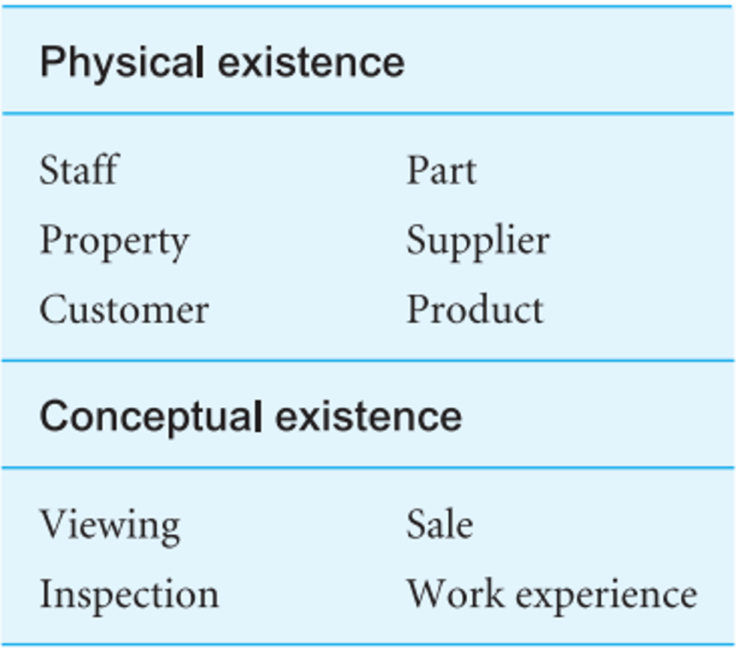
Entities and Entity types
Some entity types are physical while others are conceptual.

Slide 8
Entities and Entity types
What Should an Entity Type Be?
Should be:
An object that will have many instances in the database.
An object that will be composed of multiple properties/attributes.
An object that we are trying to model.
Should not be:
A user of the database.
An output of the database system (e.g. a report).

Slide 9
Topics List
Concepts of the ER Model
Entities and Entity types
Attributes
Types of Attributes
Keys

Slide 10
Attributes
Attributes are the properties or characteristics that describe entity and relationship types.
For example, a Student entity may be described by attributes including student number, name, address, date of birth, course, year, etc...
Whereas an Invoice entity may be described by attributes including invoice number, invoice date, etc…

Slide 11
Attributes Attribute Domain
An Attribute Domain is used to define the range of values allowed in any particular attribute.
Examples:
A student's name cannot be a numeric value. It must be alphabetic.
A student's age cannot be negative and must be 4 or greater (for primary school children).
An exam mark must be numeric and in the range 0 – 100 (assuming no negative marking).

Slide 12
Attributes Naming Convention
A common convention for naming attributes is to use singular nouns. A naming convention may require one of the following:
All characters are in upper case.
All characters are in lower case.
Only the first character is in upper case.
Each part of a multipart name has the first character capitalised (camelCase).

Slide 13
Attributes Naming Convention
Another convention is for attribute names to have a prefix that indicates the entity the attribute describes. Subsequent characters are sufficiently descriptive to identify the attribute. Some examples of attribute names:
empLastName = employee last name.
stuGPA = student grade point average.
prodCode = product code.
invNum = invoice number.

Slide 14
Attributes Naming Convention and Representation
In practice a naming convention is important, and you should expect the organisation you are working for to have a standard approach for naming things appearing in a model.
We represent attributes by placing them with the entity type underneath the name (of the entity type).

Slide 15
Topics List
Concepts of the ER Model
Entities and Entity types
Attributes
Types of Attributes
Keys

Slide 16
Attributes Types of Attributes
Simple or Atomic Attribute: An attribute composed of a single component with an independent existence. Simple or atomic attributes cannot be broken down further or subdivided.
For Example: PPS Number of an employee is a simple attribute as it cannot be subdivided.

Slide 17
Attributes Types of Attributes
Composite Attribute: An attribute is considered composite if it comprises two or more other attributes.
For Example: Name which can be divided into first name, last name and/or middle initial/name.

Slide 18
Attributes Types of Attributes
Single-valued Attribute: An attribute is considered to be single-valued if there is at most one value associated with it at any one point in time.
For Example: Date of Birth as each person has one Date of Birth.
Multi-valued Attribute: An attribute is considered to be multi-valued if there can be many values associated with it at any one point in time.
For Example: Phone Number where a person might have more than one occurrence.

Slide 19
Attributes Types of Attributes
Derived Attribute: An attribute that represents a value that is derivable from the value of a related attribute, or set of attributes, not necessarily in the same entity type.
For Example: Age can be derived from the attribute Date of Birth.

Slide 20
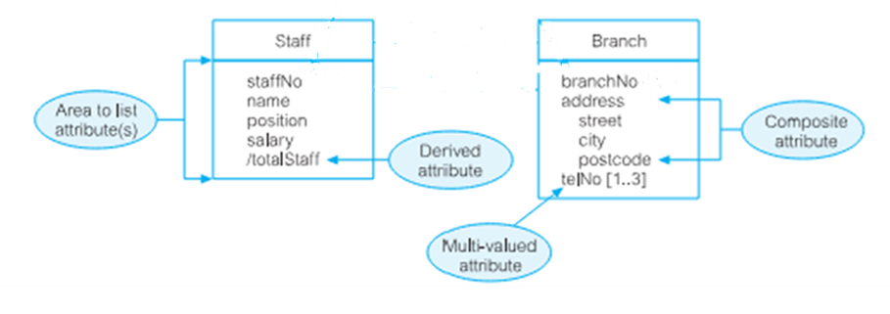
Attributes Types of Attributes

Slide 21
Topics List
Concepts of the ER Model
Entities and Entity types
Attributes
Types of Attributes
Keys

Slide 22
Keys
Recall, a key is an attribute or collection of attributes that uniquely identifies an entity occurrence.
For example, the staffNo value for each staff member makes him/her identifiable among staff.

Slide 23
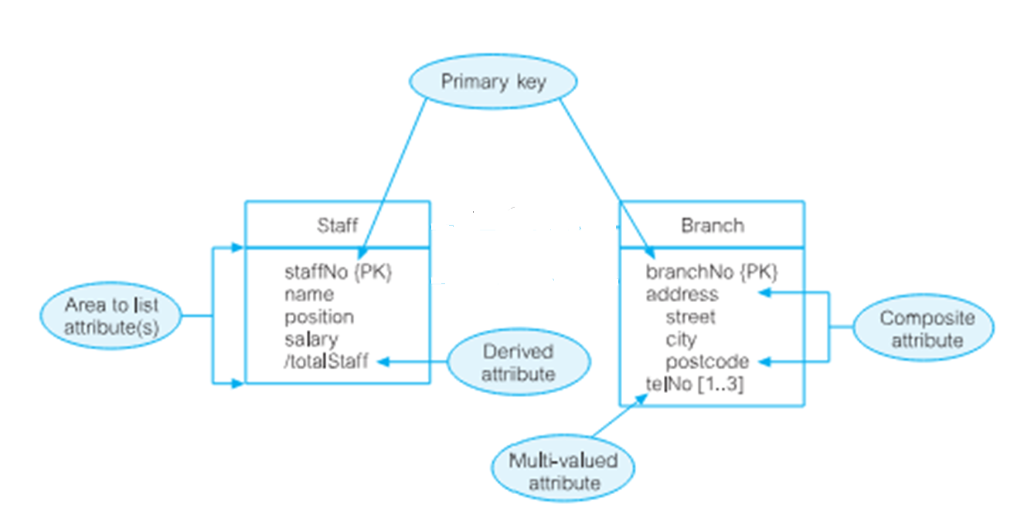
Keys
To denote the primary key value, add {PK} beside the chosen attribute(s).

