Slide 1
Relationships and Relationship Types

Slide 2
Concepts of the ER Model (Recap)
Entities and Entity types
Attributes
Relationships and Relationship types

Slide 3
Topics List
Relationships and Relationship types
Degree of a Relationship
Structural Constraints
Relationship Type Attributes

Slide 4
Relationships
Relationship: The association among entities is called a relationship.
For example: one particular Student identified by 20081285 enrolls_on one particular Course identified by wd155.

Slide 5
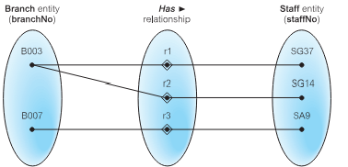
Relationships
In the example, we can see from the occurrence diagram that Branch (identified by branchNo) B003 has 2 Staff members (identified by staffNo) SG37 and SG14.
We can also see that Staff member (identified by staffNo) SG37 works at Branch (identified by branchNo) B003.

Slide 6
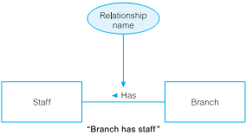
Relationship Type
Relationship type: Defines a relationship set among entities of certain entity types. We assign a name to a relationship type (usually) using a verb.
Examples:
Student registers on Course
Passenger reserves Flight
Branch has Staff
We represent a relationship type by drawing a line between the entity types involved in the relationship.

Slide 7
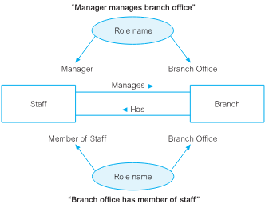
Relationship Type
An entity type can have more than one relationship with another entity type. Relationship types may be given role names to indicate purpose that each participating entity type plays in a relationship.

Slide 8
Topics List
Relationship types and Relationships
Degree of a Relationship
Structural Constraints
Relationship Type Attributes

Slide 9
Degree of a Relationship
Degree of a Relationship: The degree of a relationship is the number of entity types participating in the relationship. When we speak of a student registered for a course, we are discussing a relationship, register, where two entity types (Student and Course) are involved; the relationship is of degree 2 because each instance of register will always involve one student entity type and one course entity type.
Relationships of degree 2 are called binary relationships; relationships of degree 3 are called ternary relationships. In general, we speak of n-ary relationships where n entities participate in a relationship.

Slide 10
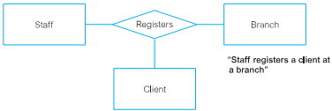
Degree of a Relationship
The following is an example of a ternary relationship.

Slide 11
Degree of a Relationship Recursive Relationship
A Recursive Relationship is one in which a relationship exists between occurrences of the same entity type. These are also called unary relationships.
A typical business example arises when we have a business rule such as "a staff member supervises other staff members".
The role of one staff member may be supervisor whereas the role of another staff member may be supervisee.

Slide 12
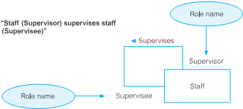
Degree of a Relationship Recursive Relationship

Slide 13
Topics List
Relationship types and Relationships
Degree of a Relationship
Structural Constraints
Relationship Type Attributes

Slide 14
Structural Constraints
As well as assigning a name to a relationship type, we also assign structural constraints. The main type of constraint on relationships is called multiplicity.
Multiplicity is the number (or range) of possible occurrences of an entity type that may relate to a single occurrence of an associated entity type through a particular relationship.
Multiplicity consists of two separate constraints known as cardinality and participation.

Slide 15
Structural Constraints Cardinality
Cardinality: Describes the maximum number of possible relationship occurrences for an entity participating in a given relationship type.
Consider the relationship "works in". When we ask How many employees can work in a single department? or How many departments can an employee work in? we are asking questions regarding the cardinality of the relationship.

Slide 16
Structural Constraints Cardinality
There are three classifications, and these are:
one-to-one (1:1),
one-to-many (1:*), and
many-to-many (*:*).

Slide 17
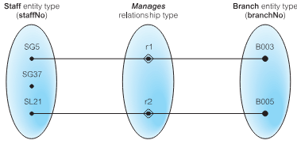
Structural Constraints Cardinality
one-to-one (1:1) Cardinality
One-to-one relationships have 1 specified for both cardinalities, and do not seem to arise very often. In this example, each relationship represents the association between a single Staff entity occurrence and a single Branch entity occurrence. Each Staff member manages zero or one Branch (one) and each Branch is managed by one Staff member (one).

Slide 18
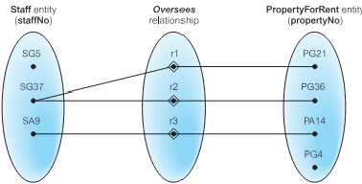
Structural Constraints Cardinality
one-to-many (1:*) Cardinality
One-to-many relationships has 1 specified at one side of the relationship type and many (*) at the other side. In this example, each relationship represents the association between a single Staff entity occurrence and a single PropertyForRent entity occurrence. Each Staff member oversees zero or more (many) properties for rent (PropertyForRent). Each PropertyForRent is overseen by zero or one (one) Staff member.

Slide 19
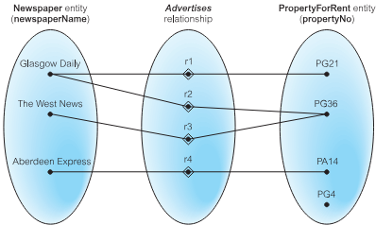
Structural Constraints Cardinality
many-to-many (*:*) Cardinality
Many-to-many relationships have many (*) specified for both cardinalities.In this example, each relationship represents the association between a single newspaper entity occurrence and a single PropertyForRent entity occurrence. Each Newspaper advertises one or more (many) properties for rent (PropertyForRent) and each property for rent is advertised in zero or more (many) Newspapers.

Slide 20
Structural Constraints Participation
Participation: Determines whether all or only some entity occurrences participate in a relationship. There are 2 classifications for participation, these are optional and mandatory.
Optional means that each entity may or may not participate in the relationship. In the example below, Staff has optional participation as not all Staff members participate in the relationship.
Mandatory means that each entity must participate in the relationship. In the example below, Branch has mandatory participation as all Branches participate in the relationship.

Slide 21
Structural Constraints
To represent (record) the cardinality and participation constraints, we will use 2 numbers (min, max) where min represents the minimum participation of an entity in the relationship (participation). Max represents the maximum participation of an entity in the relationship (cardinality).
The min value can be 0 (for optional) or 1 (for mandatory).
The max value can be 1 (for 1) or * (for many).
Note that these values may vary if a specific min and/or max value is given.

Slide 22
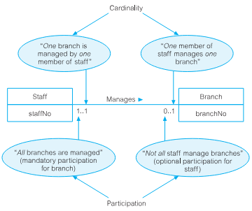
Structural Constraints Example 1 (Staff Manages Branch)

Slide 23
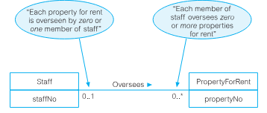
Structural Constraints Example 2 (Staff Oversees PropertyForRent)

Slide 24
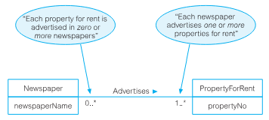
Structural Constraints Example 3 (Newspaper Advertises PropertyForRent)

Slide 25
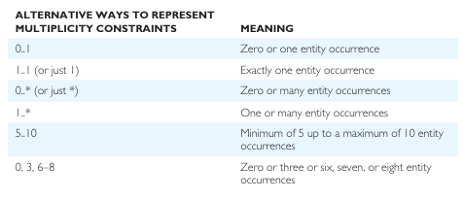
Structural Constraints
Summary of Structural Constraints

Slide 26
Topics List
Relationship types and Relationships
Degree of a Relationship
Structural Constraints
Relationship Type Attributes

Slide 27
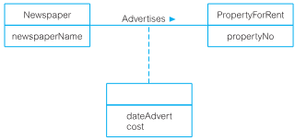
Relationship Type Attributes
Attributes can also be assigned to relationship types. They represent a data item value that needs to be recorded for/about the relationship. In this example, the Advertises relationship between Newspaper and PropertyForRent may wish to record the date of the advertisement (dateAdvert) and the cost of the advertisement (cost).
We represent relationship attributes using the same symbol as an entity type. The rectangle holding the attribute(s) are joined to the relationship using a dashed line.

Slide 28

Exercise
Draw Entity and Relationship types (with structural constraints) for the following:
A department will have a minimum of 4 employees assigned to it. Each employee is assigned to 1 department.
A department is managed by one manager (employee). We keep track of the start date when the employee began managing the department. Not all employees manage a department.
A department may manage a number of projects. Each project is managed by 1 department.
An employee may work on several projects. A project is worked on by many employees. We keep track of the current number of hours that an employee works on each project.

