Slide 1
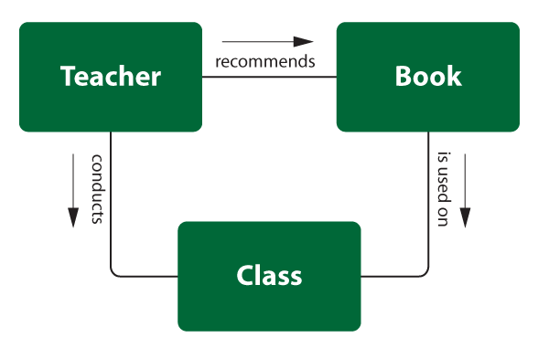
Relationships and Relationship Types

Slide 2
Concepts of the ER Model (Recap)
Entities and Entity types
Relationships and Relationship types
Attributes

Slide 3
Topics List
Relationships and Relationship types
Degree of a Relationship
Structural Constraints
Relationship Type Attributes

Slide 4
Relationships
Relationship: The association among entities is called a relationship.
For example: one particular Student identified by 20081285 enrolls_on one particular Course identified by wd155.

Slide 5
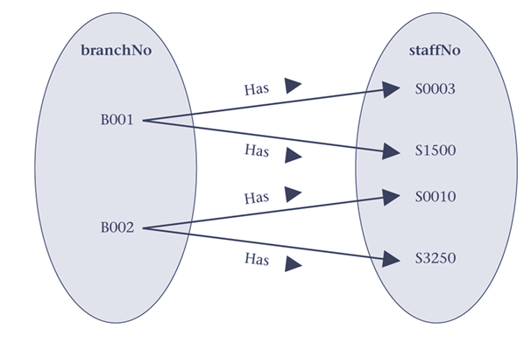
Relationships
In the example, we can see from the occurrence diagram that Branch (identified by branchNo) B001 has 2 Staff members (identified by staffNo) S0003 and S1500.
We can also see that Staff member (identified by staffNo) S0003 works at Branch (identified by branchNo) B001.

Slide 6
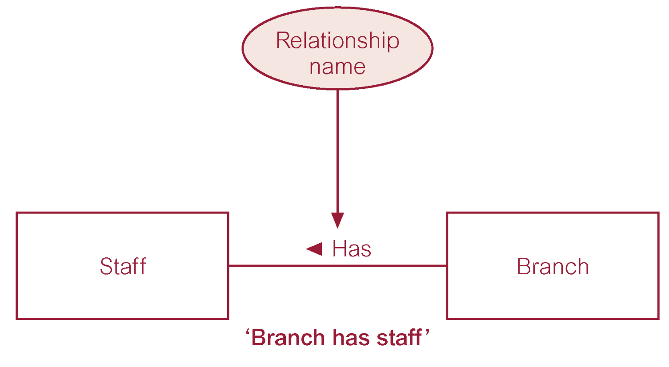
Relationship Type
Relationship type: Defines a relationship set among entities of certain entity types. We assign a name to a relationship type (usually) using a verb.
Examples:
Students register on Courses
Passengers reserve Flights
Branch has Staff

Slide 7
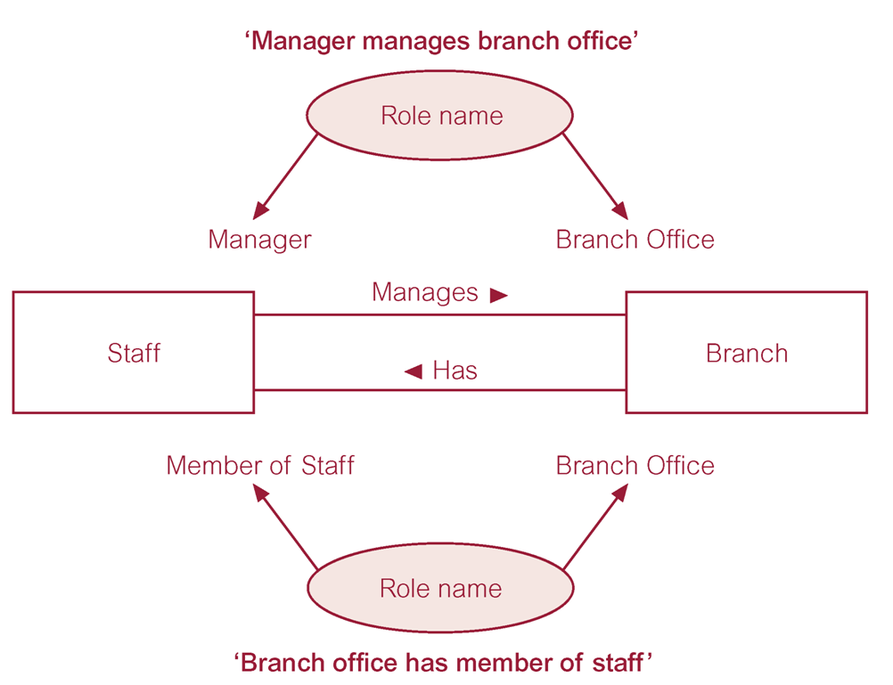
Relationship Type
An entity type can have more than one relationship with another entity type. Relationship types may be given role names to indicate purpose that each participating entity type plays in a relationship.

Slide 8
Topics List
Relationship types and Relationships
Degree of a Relationship
Structural Constraints
Relationship Type Attributes

Slide 9
Degree of a Relationship
Degree of a Relationship: The degree of a relationship is the number of entity sets participating in the relationship. When we speak of a student registered for a course, we are discussing a relationship, register, where two entity sets (Student and Course) are involved; the relationship is of degree 2 because each instance of register will always involve one student entity and one course entity.
Relationships of degree 2 are called binary relationships; relationships of degree 3 are called ternary relationships. In general, we speak of n-ary relationships where n entities participate in a relationship.

Slide 10
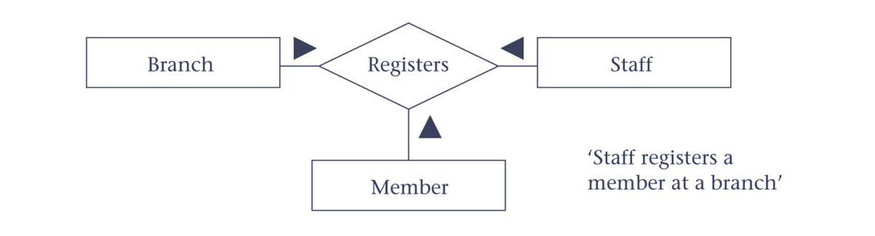
Degree of a Relationship
The following is an example of a ternary relationship.

Slide 11
Degree of a Relationship Recursive Relationship
A Recursive Relationship is one in which a relationship exists between occurrences of the same entity type. These are also called unary relationships.
A typical business example arises when we have a business rule such as "a staff member supervises other staff members".
The role of one staff member may be supervisor whereas the role of another staff member may be supervisee.

Slide 12
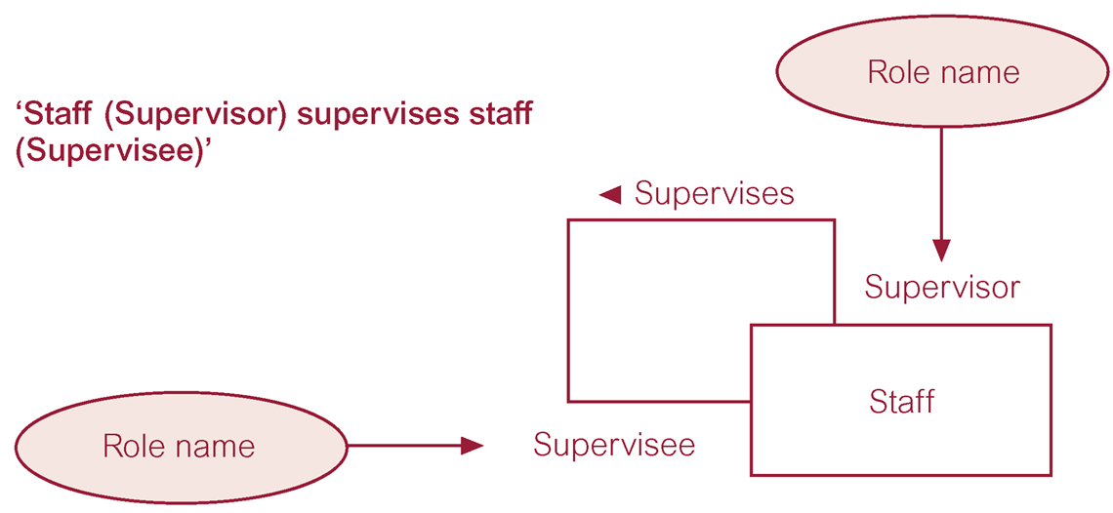
Degree of a Relationship Recursive Relationship

Slide 13
Topics List
Relationship types and Relationships
Degree of a Relationship
Structural Constraints
Relationship Type Attributes

Slide 14
Structural Constraints
As well as assigning a name to a relationship type, we also assign structural constraints (i.e. describe it’s cardinality and participation).

Slide 15
Structural Constraints Cardinality
Cardinality: Cardinality is a constraint on a relationship specifying the number of entity instances that a specific entity may be related to via the relationship.
Consider the relationship "works in". When we ask How many employees can work in a single department? or How many departments can an employee work in? we are asking questions regarding the cardinality of the relationship.

Slide 16
Structural Constraints Cardinality
There are three classifications, and these are:
one-to-one (1:1) ,
one-to-many (1:*) , and
many-to-many (*:*) .

Slide 17
Structural Constraints Cardinality
one-to-one (1:1) Cardinality
One-to-one relationships have 1 specified for both cardinalities, and do not seem to arise very often. To illustrate a one-to-one, we require very specific business rules.

Slide 18

Structural Constraints Cardinality
one-to-one (1:1) Cardinality
Suppose we have Staff and Vehicles. Assume that we are only concerned with the current driver of a vehicle, and that we are only concerned with the current vehicle that a driver is operating. Then, we have a one-to-one relationship between Staff and Vehicle.

Slide 19
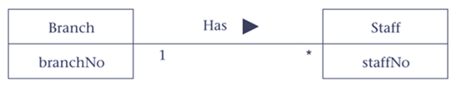
Structural Constraints Cardinality
one-to-many (1:*) Cardinality
One-to-many relationships has 1 specified at one side of the relationship type and many (*) at the other side.
For example, A Branch entity occurrence has many Staff members; and one Staff entity occurrence works in one Branch.

Slide 20
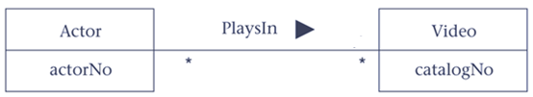
Structural Constraints Cardinality
many-to-many (*:*) Cardinality
Many-to-many relationships have many (*) specified for both cardinalities.
For example, An Actor entity occurrence stars in many Videos; and a Video entity occurrence has many Actors.

Slide 21
Structural Constraints Participation
Participation: Determines whether all or only some entity occurrences participate in a relationship.
There are 2 classifications for participation, these are optional and mandatory.
Optional means that each entity occurrence may or may not participate in the relationship.
Mandatory means that each entity occurrence must participate in the relationship.

Slide 22
Structural Constraints
To represent (record) the cardinality and participation constraints, we will use 2 numbers (min, max) where min represents the minimum participation of an entity occurrence in the relationship (participation). Max represents the maximum participation of an entity occurrence in the relationship (cardinality).
The min value can be 0 (for optional) or 1 (for mandatory).
The max value can be 1 (for 1) or * (for many).
Note that these values may vary if a specific min and/or max value is given.

Slide 23
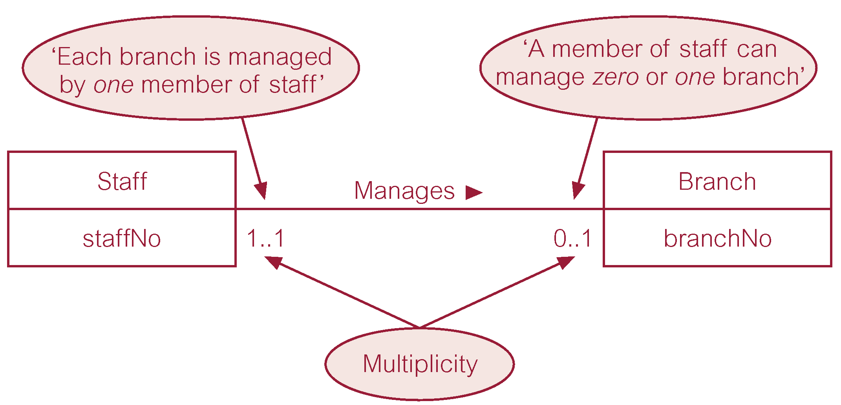
Structural Constraints Example 1

Slide 24
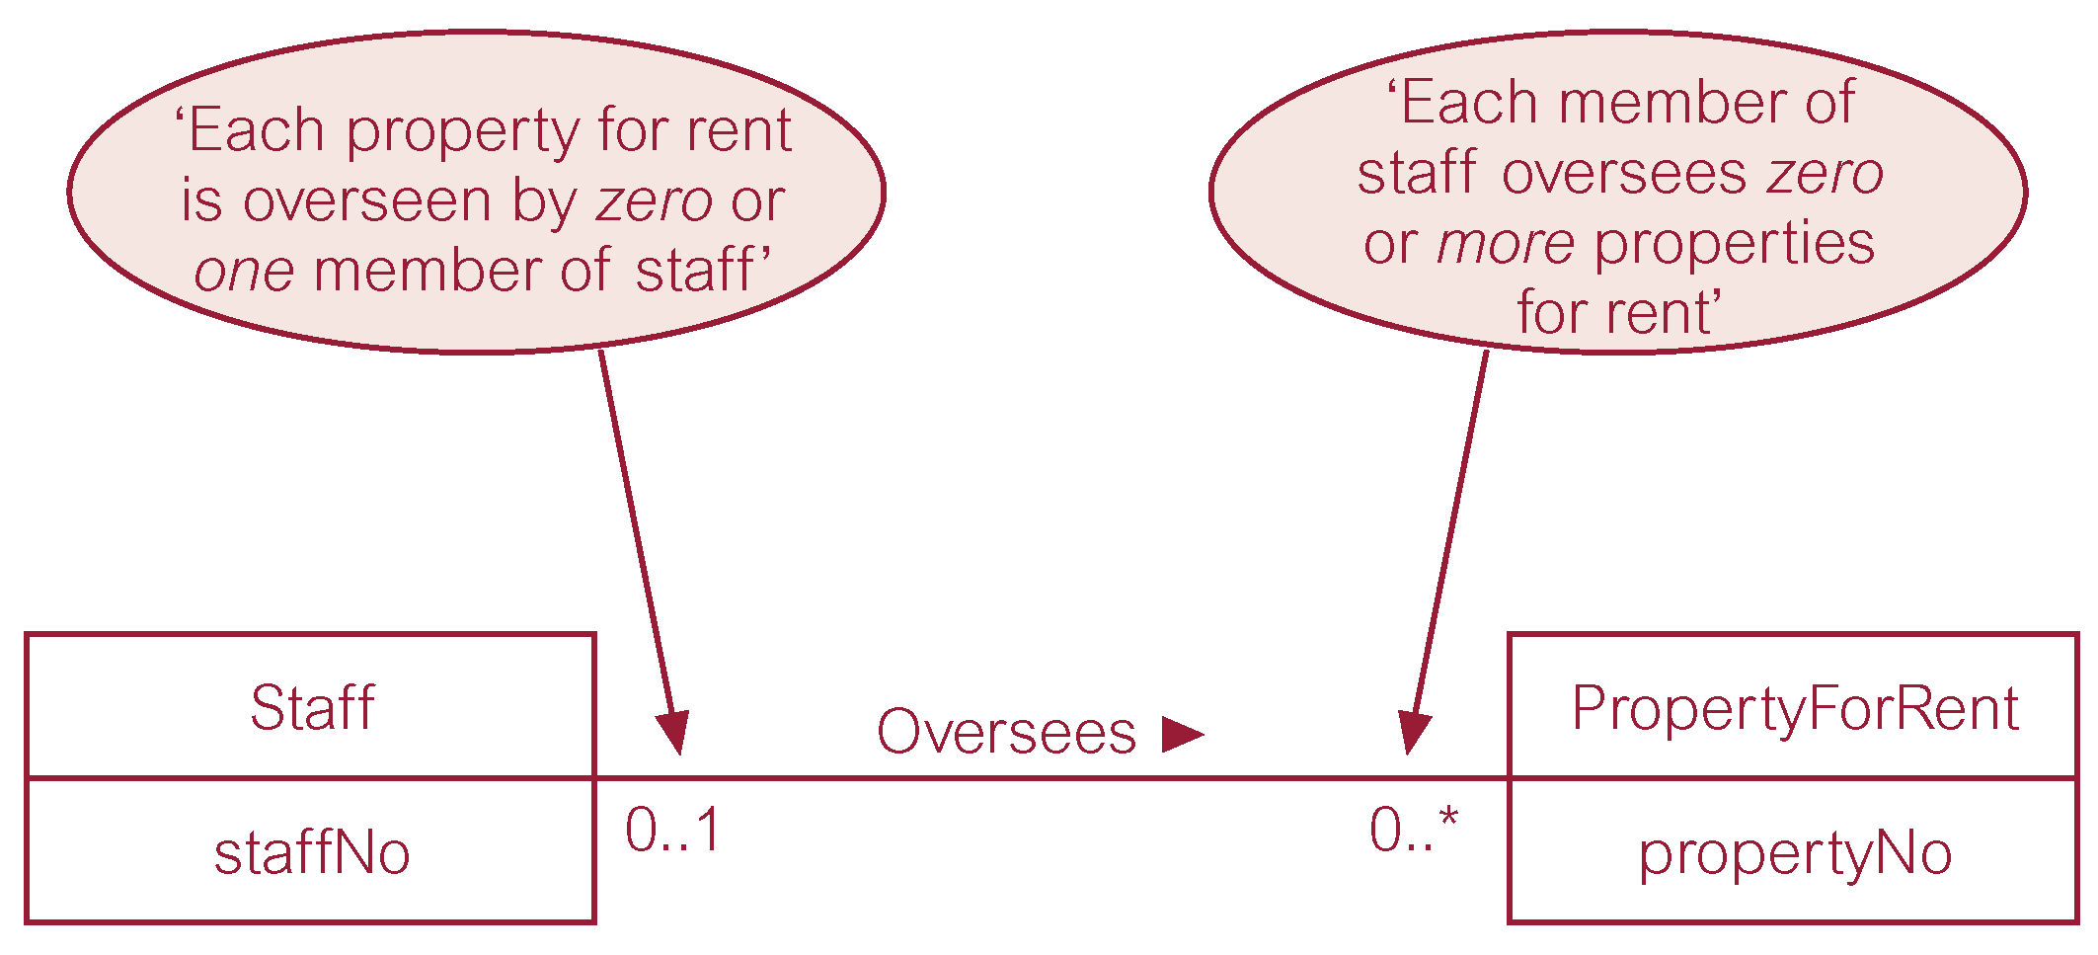
Structural Constraints Example 2

Slide 25
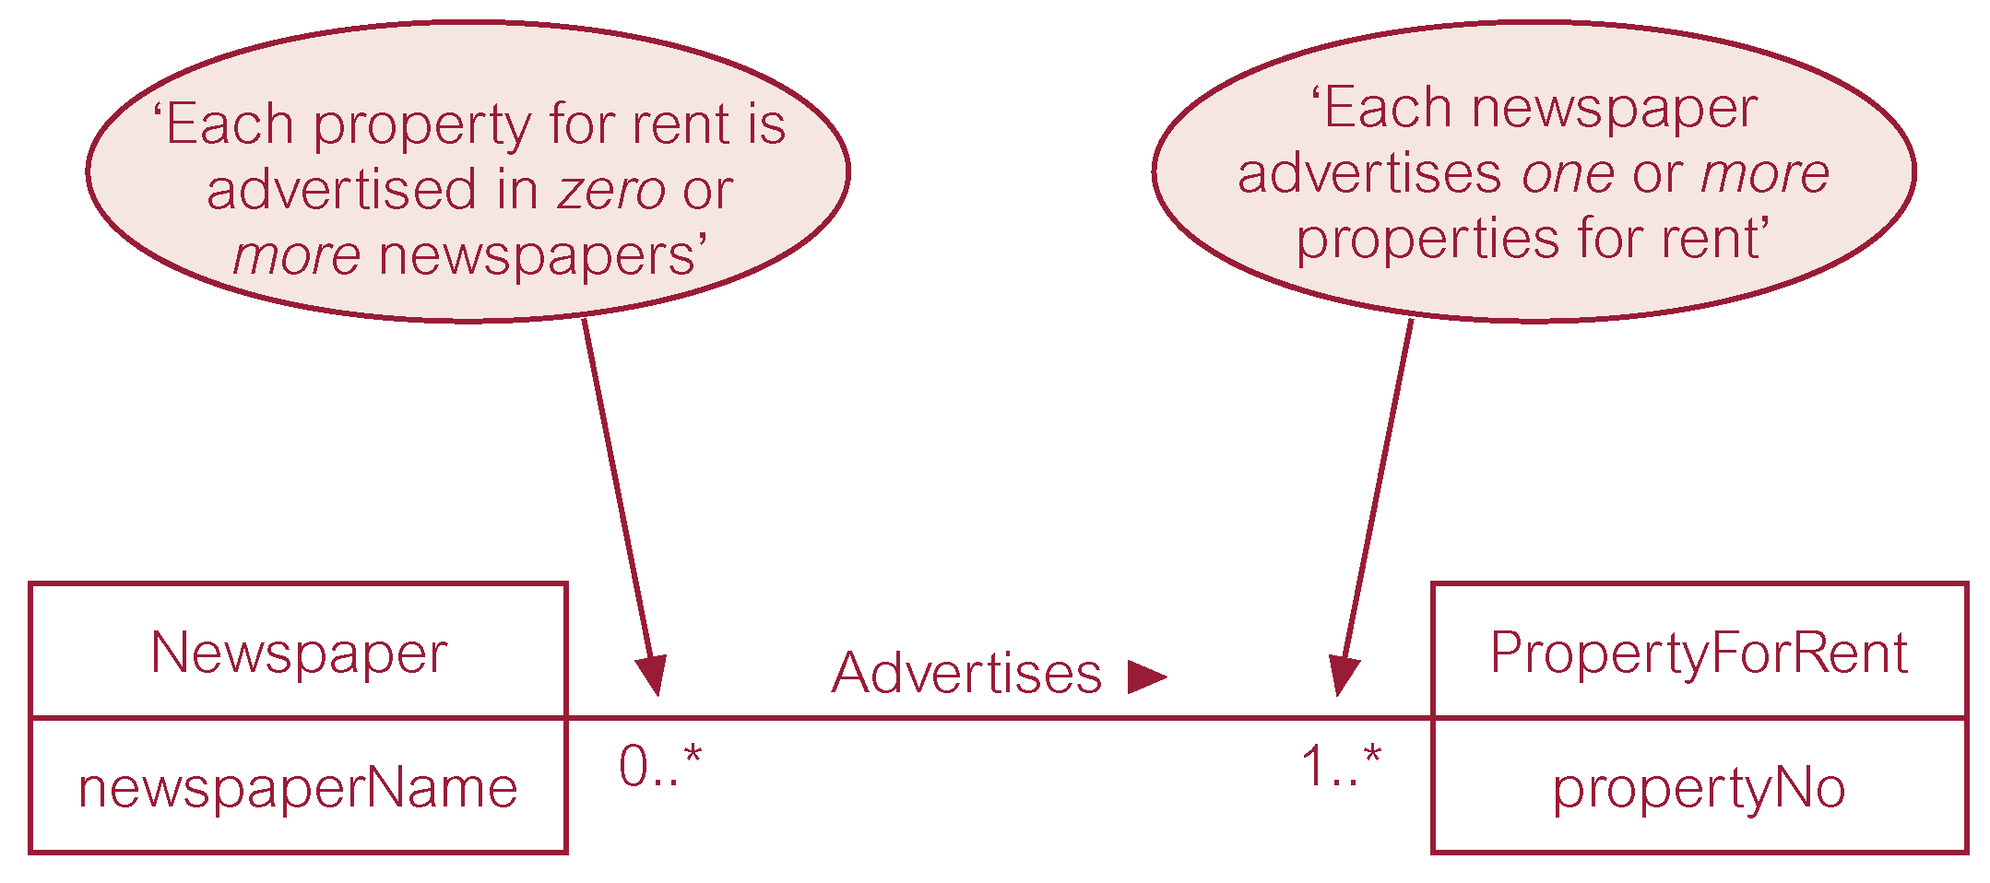
Structural Constraints Example 3

Slide 26
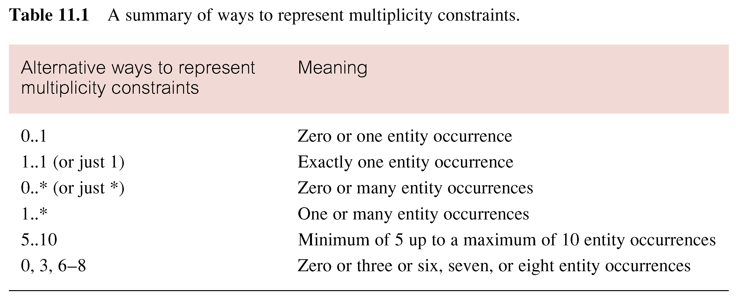
Structural Constraints
Summary of Structural Constraints

Slide 27

Structural Constraints Exercise
Draw Entity and Relationship types (with structural constraints) for the following:
A course offers at least 6 modules and a module may or may not be offered on a few courses. A lecturer is assigned 3 (and only 3) modules and a module may or may not be only assigned to 1 lecturer.

Slide 28
Structural Constraints Exercise

Slide 29
Topics List
Relationship types and Relationships
Degree of a Relationship
Structural Constraints
Relationship Type Attributes

Slide 30
Relationship Type Attributes
Attributes can also be assigned to relationship types. They represent a data item value that needs to be recorded when an entity occurrence on each side of the relationship is associated with one another.
For Example, suppose we have entity types Student and Module that are associated via a studies relationship type. An attribute that helps to describe a Student studying a Module is grade. This will record the grade that each student obtains on each module that they are associated with.

