Slide 1
SELECT statement 2

Slide 2
Topics List
Using LIKE
Using BETWEEN…AND
Using IN
IS NULL
Using ORDER BY
Date Functions
Calculations

Slide 3
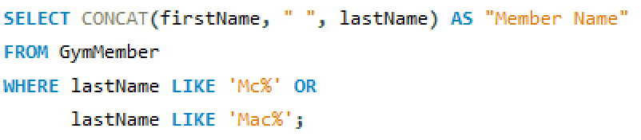
Using LIKE
With strings if you are using equality (=), you cannot always exactly match the data, so nothing will be returned. Pattern Matching through the LIKE clause allows you to enter a string with one or more wildcard characters. The % is a wildcard character meaning 0 or more characters.

Slide 4
Topics List
Using LIKE
Using BETWEEN…AND
Using IN
IS NULL
Using ORDER BY
Date Functions
Calculations

Slide 5
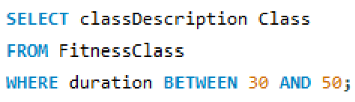
Using BETWEEN…AND
With numeric data, if you want to return records where one data field is in a particular range, then we use the BETWEEN…AND clause.

Slide 6
Topics List
Using LIKE
Using BETWEEN…AND
Using IN
IS NULL
Using ORDER BY
Date Functions
Calculations

Slide 7
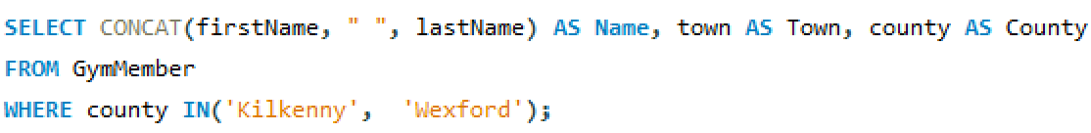
Using IN
The IN clause means one of the following (from a list). It is useful when there are a few alternatives for a data field value.

Slide 8
Topics List
Using LIKE
Using BETWEEN…AND
Using IN
IS NULL
Using ORDER BY
Date Functions
Calculations

Slide 9
IS NULL
A NULL value exists in a database where a piece of data is missing or not filled in. It means the value is unknown or not available.
It is not zero or an empty string.
For example, when entering information into a table not all the information may be to hand at the time of data entry and so may be left NULL.
Sometimes we may want to find out where these NULL values are by using IS NULL. Alternatively ,we can use IS NOT NULL for negation.

Slide 10
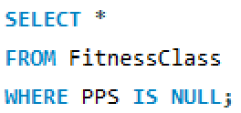
IS NULL
If a Trainer left the GYM, any classes associated with him/her would result in the PPS value being updated to NULL. To check for this, we could use:

Slide 11
Topics List
Using LIKE
Using BETWEEN…AND
Using IN
IS NULL
Using ORDER BY
Date Functions
Calculations

Slide 12
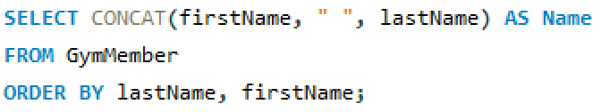
Using ORDER BY
The ORDER BY clause sorts the returned data in the order specified. The default is ASC (ascending), use DESC for descending order.

Slide 13
Topics List
Using LIKE
Using BETWEEN…AND
Using IN
IS NULL
Using ORDER BY
Date Functions
Calculations

Slide 14
Using Date
You can ascertain the current date and/or time from the system in MySQL.
Current date in the format 'yyyy-mm-dd’
Current date and time in the format 'yyyy-mm-dd hh:mm:ss'

Slide 15
Using Date
To display the date in a more readable fashion, we can apply the DATE_FORMAT function, which allows you to display the date in whatever format you want using parameters.
DATE_FORMAT has 2 parameters:
date: The date to be formatted, it is a required value.
format: The format to use, it is also a required value. The format can be one or a combination of values.

Slide 16
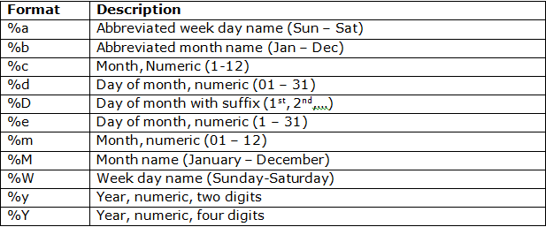
Using Date
Selection of format values:
https://dev.mysql.com/doc/refman/8.4/en/date-and-time-functions.html#function_date-format

Slide 17
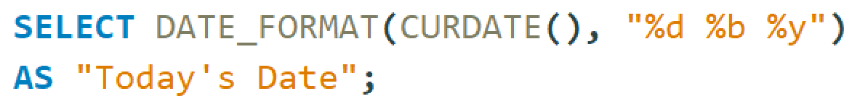
Using Date
For example, to return the current date in the format of
date of month (01 to 31)
abbreviated month name (Jan, Feb, …)
numeric year (2-digit, 23)

Slide 18
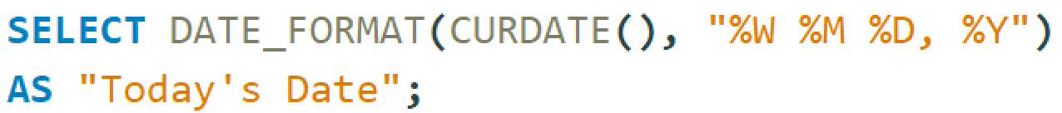
Using Date
For example, to return the current date in the format of
day of week (Sunday, Monday, …)
month name (January, February, …)
date of month (1st, 2nd, …)
numeric year (4-digit, 2026)

Slide 19
Topics List
Using LIKE
Using BETWEEN…AND
Using IN
IS NULL
Using ORDER BY
Date Functions
Calculations

Slide 20
Performing Calculations
DATEDIFF()
DATEDIFF calculates the distance (number of days) between 2 dates.

Slide 21
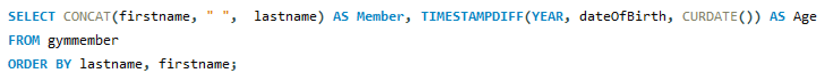
Performing Calculations
TIMESTAMPDIFF()
The MySQL TIMESTAMPDIFF() function is used to calculate the difference between two date (or datetime) expressions.
For example, we can calculate the difference between a given date and today and return the result in YEARs. Obviously, we can return the result in days, months, quarters, hours, etc…
In the following example, we return the age for each gym member based on their date of birth.

Slide 22
Performing Calculations
DATE_ADD()
The MySQL DATE_ADD() function is used to add a specified time or date interval to a specified date and then return the date.
In the following example, we return the next renewal date for all gym members based on their current renewal date.

Slide 23
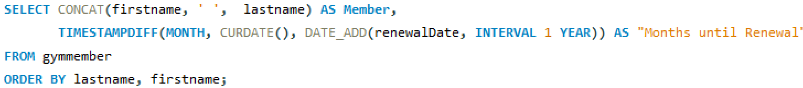
Performing Calculations
And in the following example, we combine the TIMESTAMPDIFF() and DATE_ADD() functions to return the member name and the number of months until their next renewal date.

Slide 24
Performing Calculations
We can use the usual operators to perform calculations:
Operator | Meaning
+ | Addition
- | Subtraction
* | Multiplication
/ | Division
% | Modulus

