Slide 1
Aggregate Functions

Slide 2
Topics List
Aggregate Functions
Rounding and Formatting
Group By clause
Having clause

Slide 3
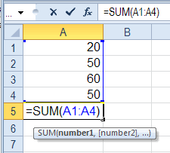
Aggregate Functions
An aggregate function allows you to perform a calculation on a set of values to return a single scalar value.

Slide 4
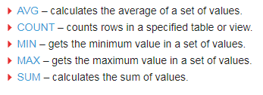
Aggregate Functions

Slide 5
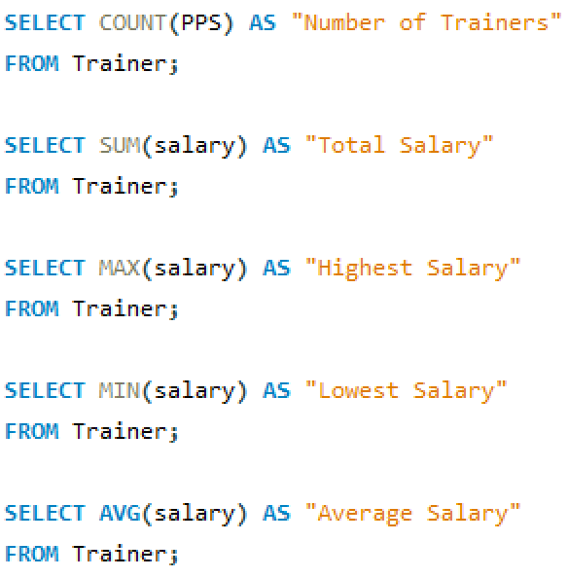
Aggregate Functions

Slide 6
Topics List
Aggregate Functions
Rounding and Formatting
Group By clause
Having clause

Slide 7
Rounding and Formatting
To round a numeric value to a whole number (or to 2 decimal places for example), use ROUND()
ROUND(12.75) returns 13
ROUND(12.751, 2) returns 12.75
ROUND(12.755, 2) returns 12.76

Slide 8
Rounding and Formatting
FORMAT() will format numbers to a specified number of decimal places, adding commas as thousands separators.
FORMAT(8550.579, 2) returns 8,550.58

Slide 9
Topics List
Aggregate Functions
Rounding and Formatting
Group By clause
Having clause

Slide 10


Group By clause
The GROUP BY statement is often used with aggregate functions (COUNT, MAX, MIN, SUM, AVG) to group the result-set by one or more columns.

Slide 11
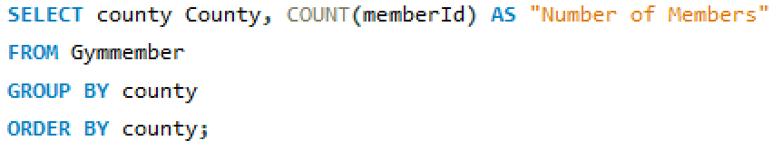
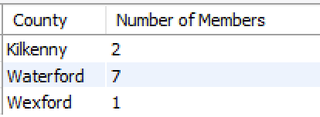
Group By clause
If want to count the number of students per County, we add county as an output AND use the clause GROUP BY with county.

Slide 12
Topics List
Aggregate Functions
Rounding and Formatting
Group By clause
Having clause

Slide 13
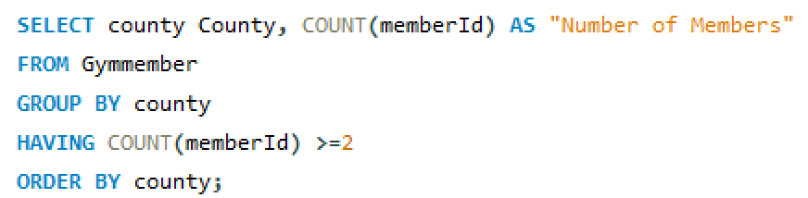
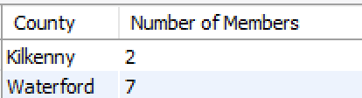
Having clause
To restrict rows returned with aggregate functions, use a HAVING clause.

