Slide 1
Join clause

Slide 2
Topics List
JOIN
Multi-table JOIN
OUTER JOIN

Slide 3
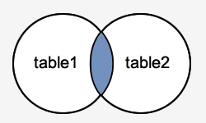
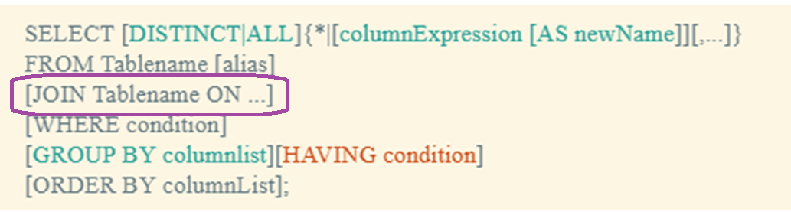
Join
A SQL join is an instruction to combine data from two (or more) sets of data (i.e. two tables) based on a related column between them.
This Join is known as an equijoin or an inner join.

Slide 4

Join
The JOIN keyword selects all rows from both tables if there is a match between the join columns in both tables (i.e. Primary Key - Foreign Key link).

Slide 5
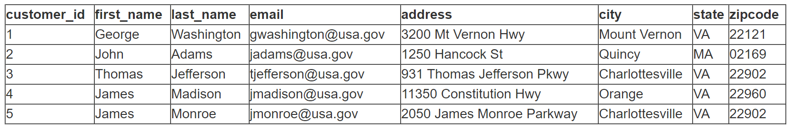
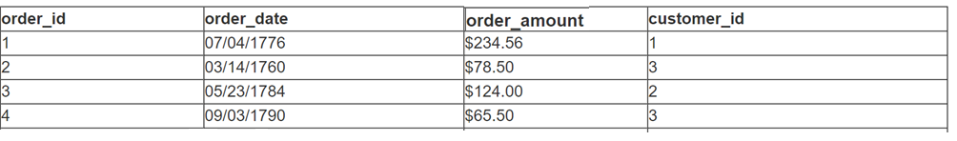
Join
customers
Primary Key - Foreign Key link
orders

Slide 6
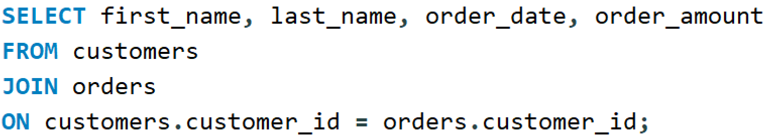
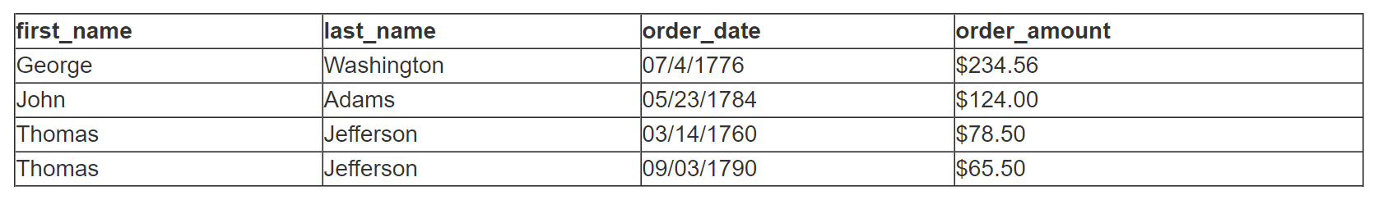
Join

Slide 7
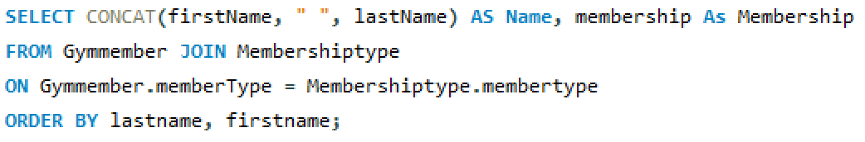
Join
The following example selects each member name from the Gymmember table and corresponding (matching) membership from the Membershiptype table:

Slide 8
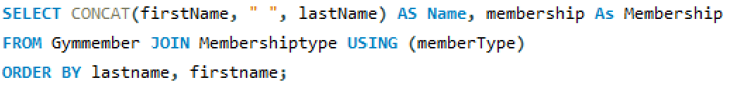
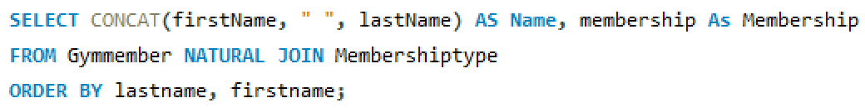
Join
There are 2 variations on the Join statement. Both require that the columns being joined have the same name:
USING clause
NATURAL JOIN

Slide 9
Join
In each SELECT statement that requires a JOIN, there are four things to do:
Identify which tables have the data you are looking for. These table names are used in the JOIN clause.
Identify which columns are the primary and foreign keys in these tables. We use these in the ON clause.
Identify which columns we want the query to output. We put these in the SELECT clause of the statement.
Add any conditions necessary (if there are any).

Slide 10
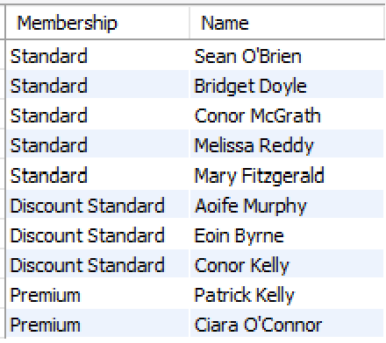
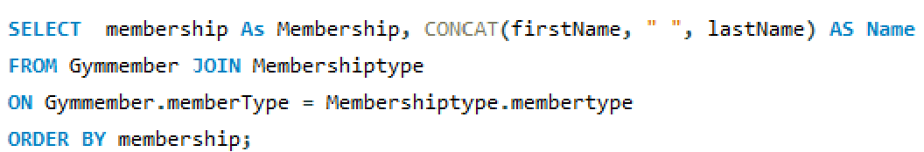
Join
When we join 2 tables one record is returned per match, so for example if we join the Gymmember and Membershiptype tables the result can be seen in the output.

Slide 11
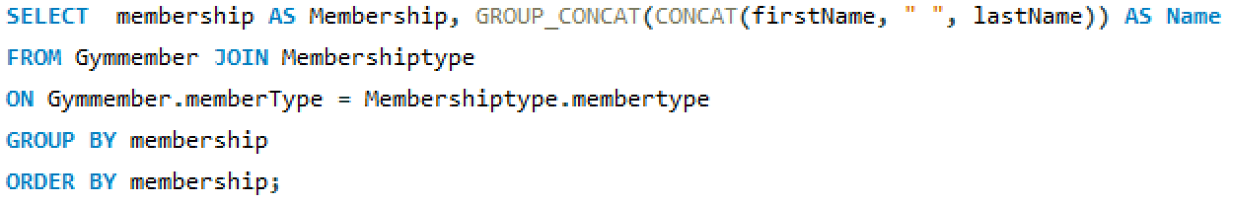
Join
To just return one record per title, we can use GROUP_CONCAT().
The GROUP_CONCAT() function is used to concatenate data from multiple rows into one field. This is an aggregate (GROUP BY) function that returns a string value if the group contains at least one non-NULL value. Otherwise, it returns NULL.

Slide 12
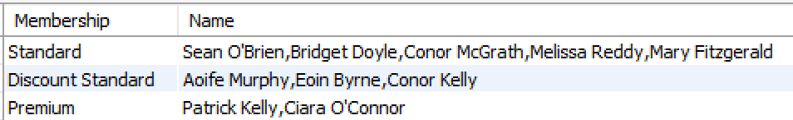
Join

Slide 13
Topics List
JOIN
Multi-table JOIN
OUTER JOIN

Slide 14
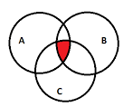
Multi-table Join
A Multi-table SQL join is an instruction to combine data from three or more sets of data (i.e. three or more tables).
Just add another (1 or more) JOIN clause(s) after the first JOIN clause.

Slide 15
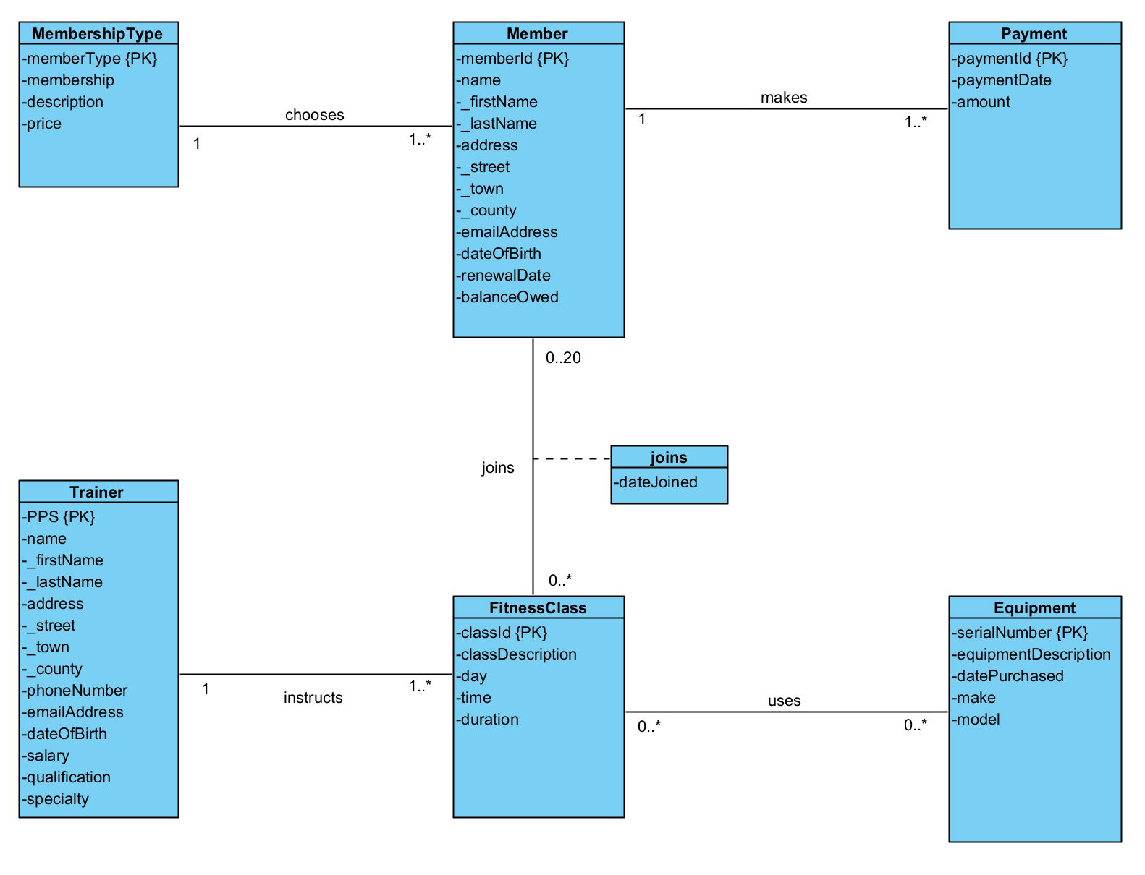
Gym example
Member – FitnessClass
M:N relationship
Created memberclass relation at logical mapping stage

Slide 16
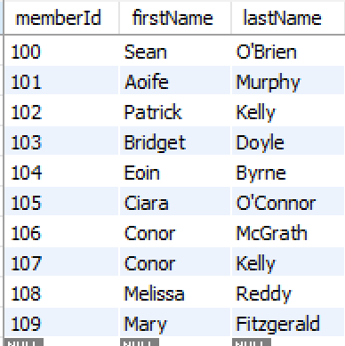
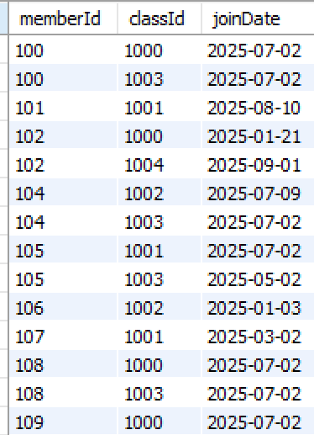
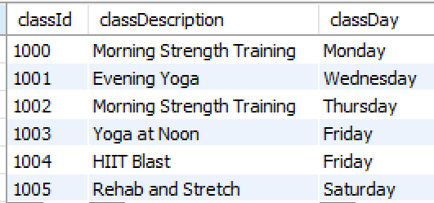
Gym example
GymMember
MemberClass
FitnessClass

Slide 17
Multi-table Join
For example, for each member we want to return the member's name and the description of each fitness class they are taking.
Identify which tables have the data you are looking for. These table names are used in the JOIN clause. These are gymmember, fitnessClass, and memberClass.
Identify which columns are the primary and foreign keys in these tables. We use these in the ON clause. gymmember – memberClass (memberId); fitnessClass – memberClass (classId).
Identify which columns we want the query to output. We put these in the SELECT clause of the statement. firstname, lastname, classDescription
Add any conditions necessary (if there are any).

Slide 18
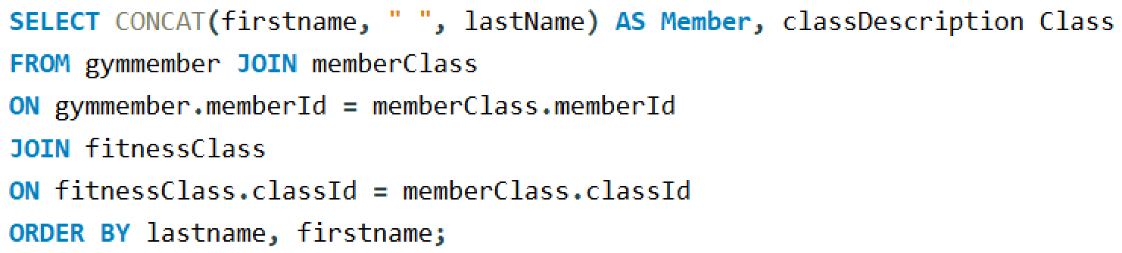
Multi-table Join

Slide 19
Topics List
JOIN
Multi-table JOIN
OUTER JOIN

Slide 20
Outer Join
Outer joins. When performing an inner join, rows/records from either table that are unmatched in the other table are not returned.
In an outer join, unmatched rows in one or both tables can be returned.

Slide 21
Outer Join
To perform an outer join in MySQL, we use either the LEFT JOIN or the RIGHT JOIN.
LEFT JOIN returns only unmatched rows from the left table.
RIGHT JOIN returns only unmatched rows from the right table

Slide 22
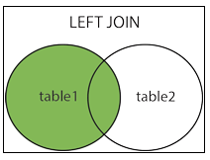
Left Join
The LEFT JOIN keyword returns all rows from the left (first) table (table1), with the matching rows in the right table (table2).
The result is NULL in the right side when there is no match.

Slide 23
Left Join
customers
orders

Slide 24
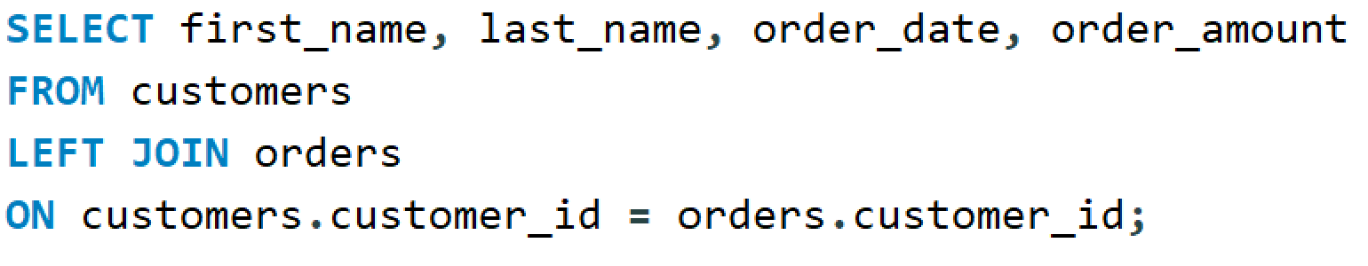
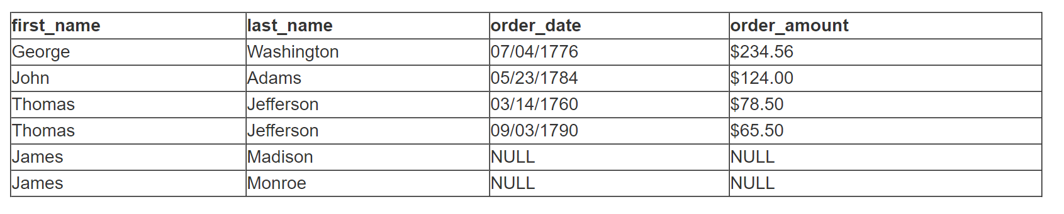
Left Join

Slide 25
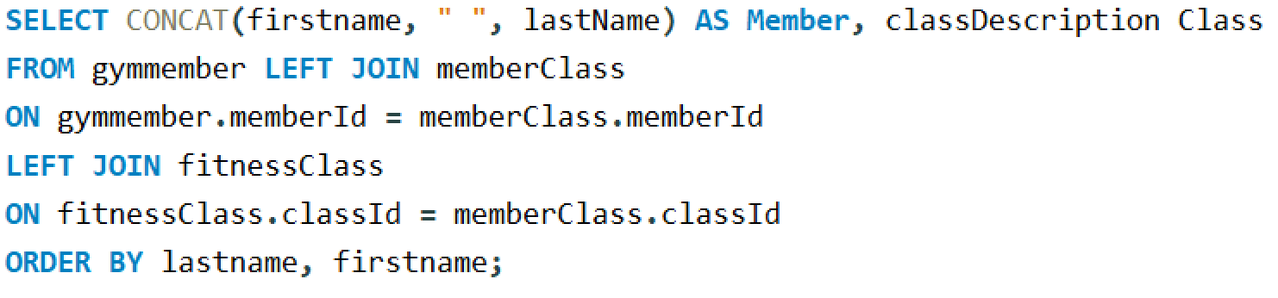
Left Join
In the following example, we select the member's name and the classDescription of the fitness classes they are taking. If the member is taking no classes, their name is returned and the classDescription value will be NULL.

Slide 26
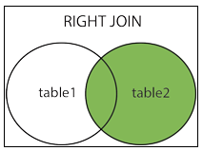
Right Join
The RIGHT JOIN keyword returns all rows from the right (second) table (table2), with the matching rows in the left table (table1).
The result is NULL in the left side when there is no match.

Slide 27
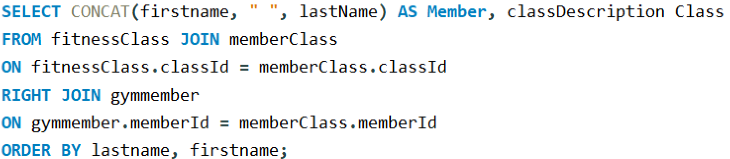
Right Join
Here is the previous example written with the RIGHT OUTER JOIN syntax. This time all the records from the second (right) table are returned.

