Slide 1
Subqueries

Slide 2
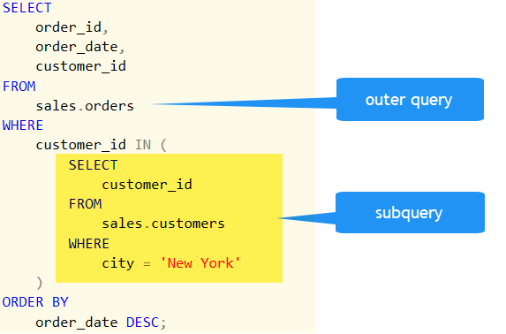
What is a subquery?
A subquery is where we have a complete SELECT statement embedded within another SELECT statement.
The results of this inner SELECT statement (or subselect) are used in the outer statement to help determine the contents of the final result.

Slide 3
Example
Get the list of members signed up for the class “Evening Yoga”
SELECT memberId
FROM memberclass
WHERE classId =
(SELECT classId
FROM fitnessclass
WHERE classDescription ='Evening Yoga');
Outer SELECT
Inner SELECT

Slide 4
Example
The inner select statement returns one value for the classId (1001).
The condition in the outer select is now WHERE classId = 1001.
SELECT memberId
FROM memberclass
WHERE classId =
1001
Outer SELECT
Inner SELECT
(result)

Slide 5
Subqueries with multiple results
If the inner select returns more than one value, then we use IN with our WHERE clause.
SELECT CONCAT(firstName, " ", lastName) AS Name
FROM trainer
WHERE PPS IN (
SELECT PPS
FROM fitnessclass
WHERE duration >= 60
);
Outer SELECT
(find names of trainers with PPS numbers in this list)
Inner SELECT
(find list of trainers who teach longer classes)

Slide 6
ANY and ALL
The keywords ANY and ALL may be used with subqueries that produce a single column of numbers.
SELECT classId, classDescription, classDay, classTime, duration
FROM fitnessclass
WHERE duration >= ALL(
SELECT duration
FROM fitnessclass
);

Slide 7
Subqueries vs. Joins
In many situations, the same result can be achieved by using either a JOIN or a subquery
So when should you use one over the other?

Slide 8
Subqueries vs. Joins
Subqueries are useful when:
You need an intermediate result that is only used once
For example, filtering based on an aggregate result
SELECT name
FROM employees
WHERE salary > (
SELECT AVG(salary)
FROM employees
);

Slide 9
Subqueries vs. Joins
Subqueries are also useful for filtering with IN, as in our previous example
SELECT CONCAT(firstName, " ", lastName) AS Name
FROM trainer
WHERE PPS IN (
SELECT PPS
FROM fitnessclass
WHERE duration >= 60
);

Slide 10
Subqueries vs. Joins
JOIN queries have better performance when combining related rows and getting columns from multiple tables
If you need to get data from multiple tables, a JOIN may be a better choice
If you only need the result from the second table as a filter for the outer query, a subquery might be the right choice

