Slide 1
React Introduction

Slide 2
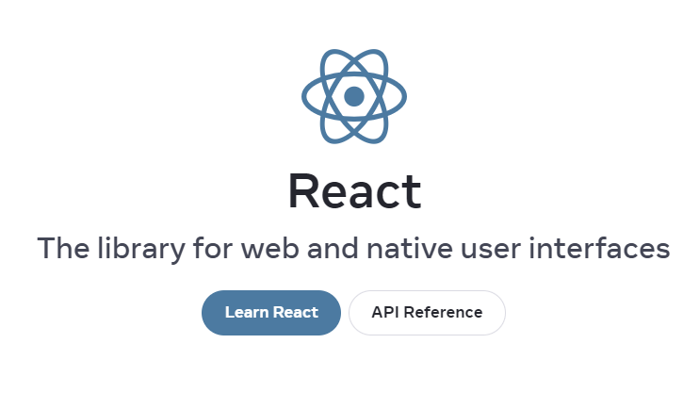
What is React?

Slide 3


React History
Created by a software engineer at Facebook
Later used on Instagram
Open-sourced in 2013

Slide 4
React is a JavaScript library
React uses JavaScript
Code is executed in the user’s own browser
Fast, modern web apps

Slide 5
React History
Challenged established best practice
MVC (Model View Controller)
Templating
React only concerned with ‘V’ (the View)
Focused on the visual components of a UI

Slide 6
Single Page Applications (SPAs)
React allows us to create a single-page application
Page is rendered once and the remainder of the user’s interactions are executed in the browser
React components can also be used in multi-page applications

Slide 7
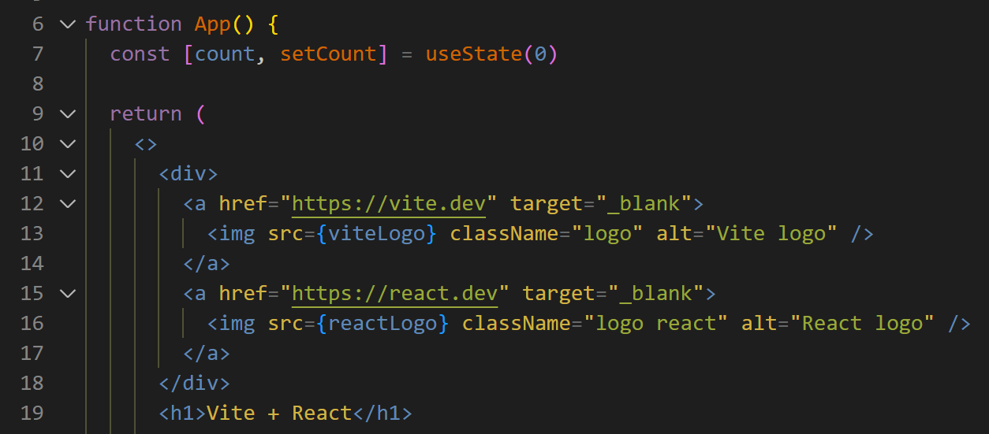
React code
Looks like a mixture of JavaScript and HTML
Is actually “JSX” code (JavaScript XML)

Slide 8
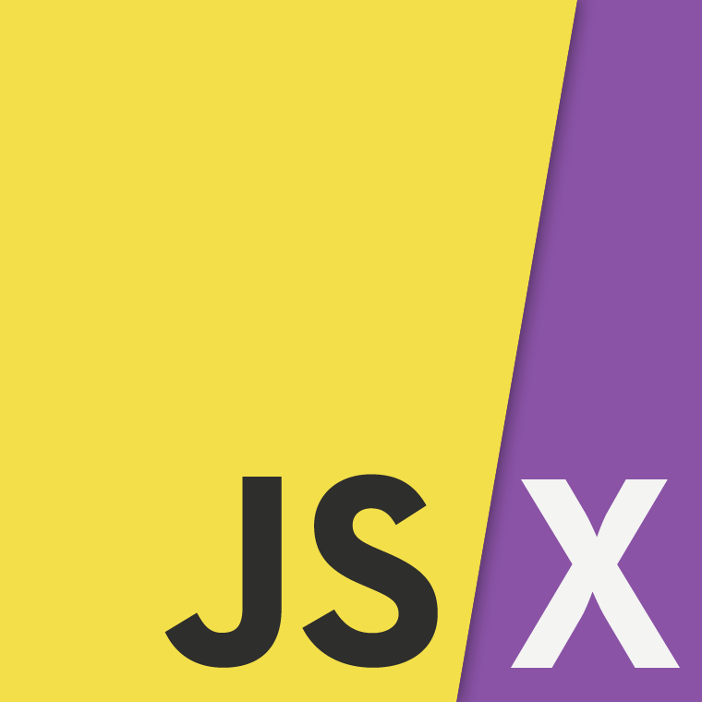
JSX
JSX stands for JavaScript XML
JSX allows us to write HTML-like code inside React components
Needs to be converted to standard JavaScript in order to be rendered by a web browser

Slide 9
Development environment
Node.js
npm (node package manager)
Git / GitHub
Visual Studio Code
Chrome
Vite

Slide 10
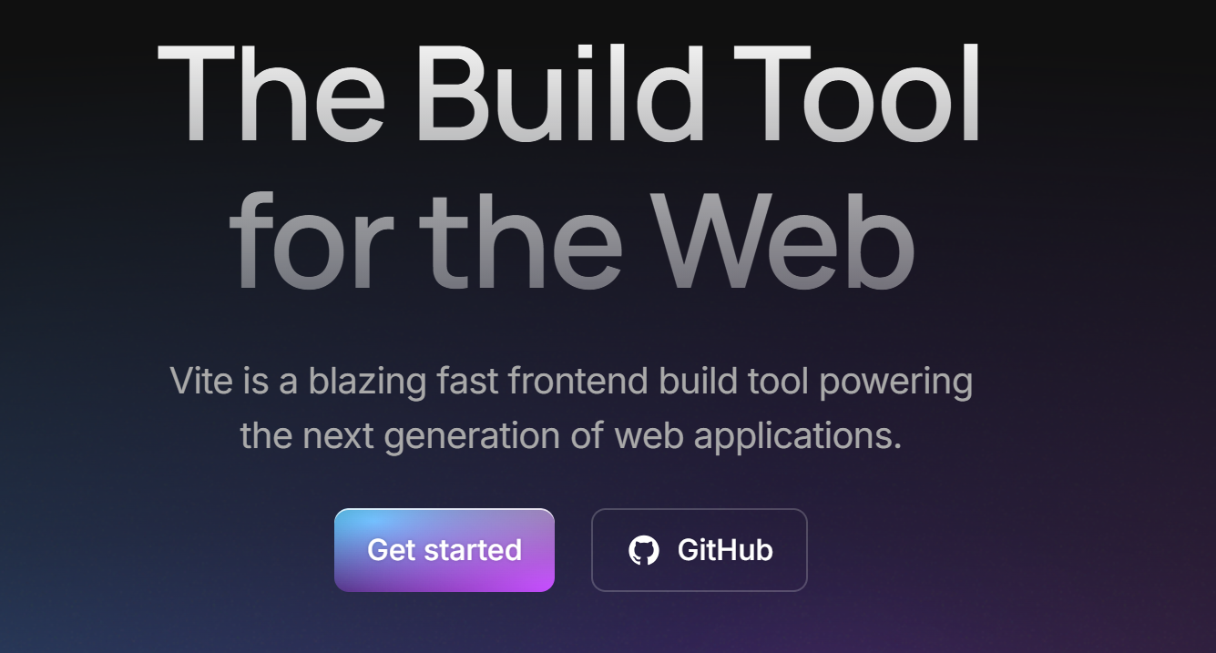
Vite
Vite is a build tool that creates starter apps for front-end frameworks such as React, Vue, Svelte, and others

Slide 11
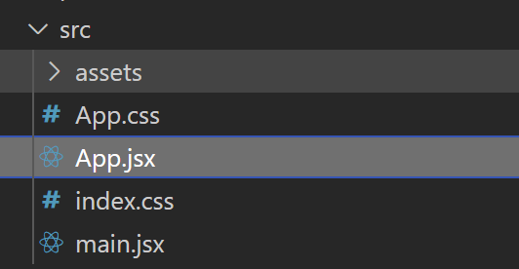
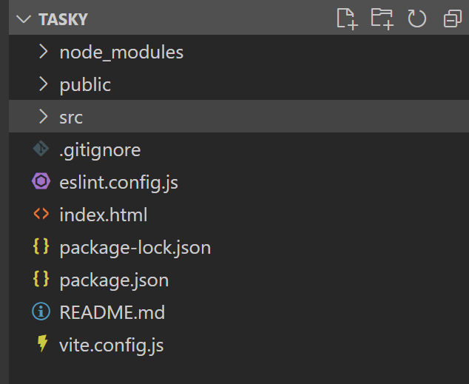
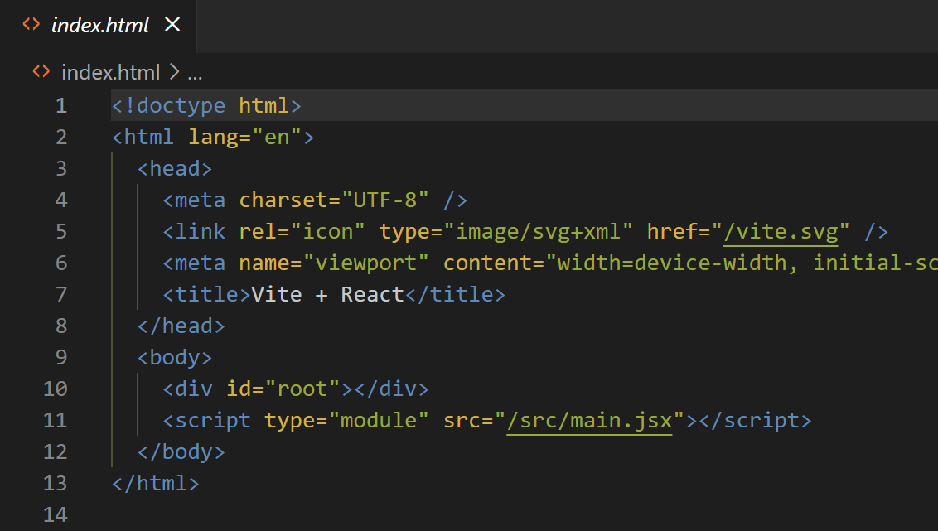
Test app folder structure
Notes:
Demo test app created in Lab 1
Show “root” div in index.html where content is being rendered
Change some content, change names to demo

Slide 12
Vite
When we create a React app with Vite, it installs and configures all the packages needed to:
Use the React library
Use the react-dom library (for interactions with the browser DOM)
Transpile JSX code so that it can be interpreted by any browser
Restart the development server each time you make changes to the code
And lots more!

