Slide 1
Components and Props

Slide 2
Overview
React components
Functional components
Props

Slide 3

React Components
Using React, we aim to split the user interface into reusable components
DRY principle (Don’t Repeat Yourself)

Slide 4
React Components
“Conceptually, components are like JavaScript functions. They accept arbitrary inputs (called ‘props’) and return React elements describing what should appear on the screen.” (reactjs.org)
“Components are independent and reusable bits of code. They serve the same purpose as JavaScript functions, but work in isolation and return HTML.” (W3Schools.com)

Slide 5
React Components
So React components are:
A simple component will look just like a JavaScript function with some HTML inside
JavaScript functions that…
…return React elements
(i.e. JSX/HTML)

Slide 6
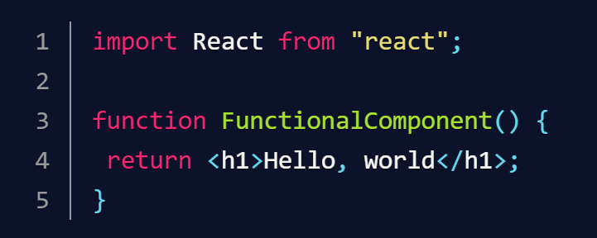
React component
Note the line import React from “react” – this is necessary in order to use JSX within the component

Slide 7
Overview
React components
Functional components
Props

Slide 8
Functional components
A functional component looks just like a JavaScript function
Note the line import React from “react” – this is necessary in order to use JSX within the component

Slide 9
Creating a functional component
import React from 'react';
const Subject = () => {
return (
<p>
This is a subject!
</p>
)
}
export default Subject;
Import React library from React package
Create subject component (using arrow function syntax)
Return a paragraph (using JSX)
Export the subject component
Notes:
Switch to demo of sample app with Subject component

Slide 10
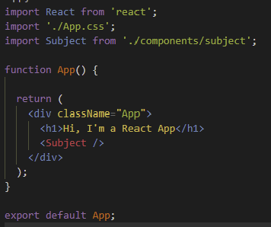
Using the component
Import Subject component from its file
Note the component name: always use an uppercase first letter
Use subject component (with no contents): <Subject />

Slide 11
Overview
React components
Functional components
Props

Slide 12
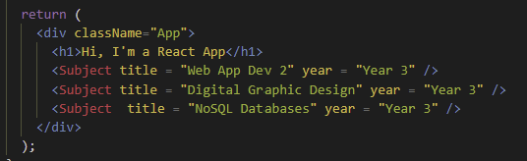
Props
Props are properties that we can pass into our components

Slide 13
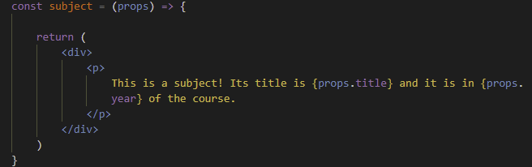
Using props
When our component takes in a props parameter, we can use the properties with the syntax {props.propertyname}

Slide 14
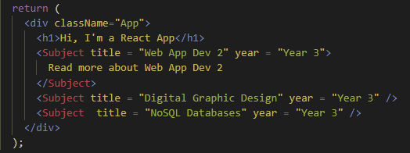
The children prop
The children prop is a special property that holds the contents of any of our component elements

Slide 15
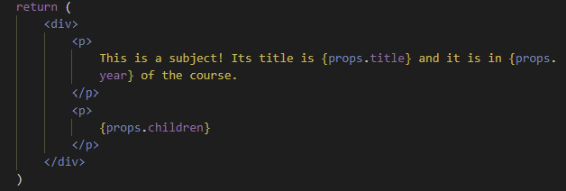
Using the children prop
In our component, we can access the children prop using the syntax {props.children}
Notes:
Switch to demo of sample app with props inc. children prop

Slide 16
Quiz!

